Slide 1
Impact of impulse stops on pedestrian flow
Jaeyoung Kwak,
H. Jo, T. Luttinen and I. Kosonen
Traffic and Granular Flow 15

Slide 2
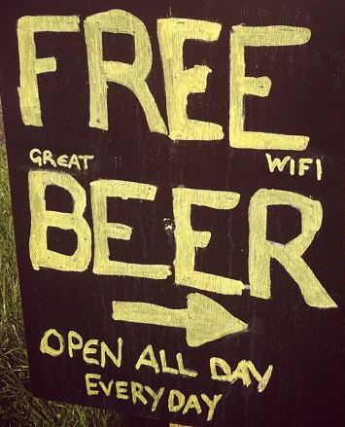
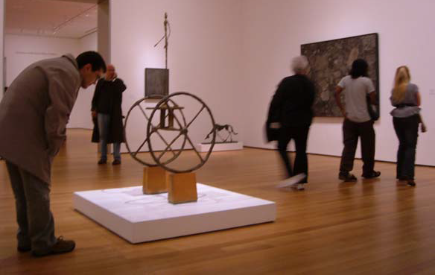
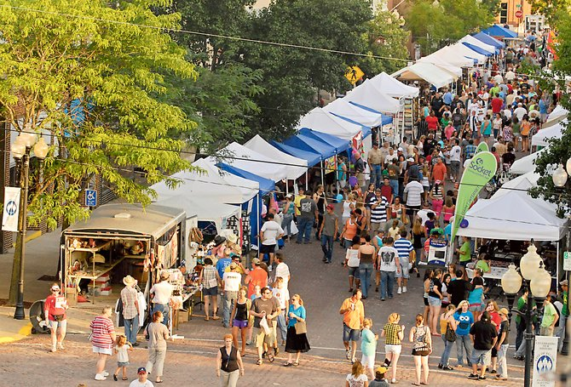
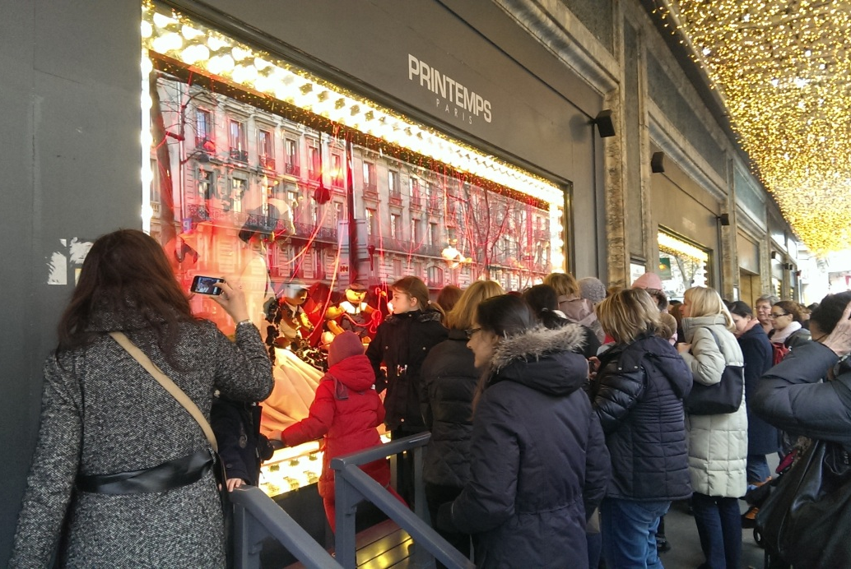
Attractions
Notes:
Hello everyone! I am Jaeyoung, a doctoral student at/from Aalto University. I am working on pedestrian flow simulation, especially on the impact of attractive interactions. Today, I would like to talk about some preliminary results of/from my research (and hope you would find them interesting).
When we are walking on the streets, sometimes we can see attractions such as shop displays and artworks. If such attractions are temping enough, we might change our mind and stop by those attractions.

Slide 3
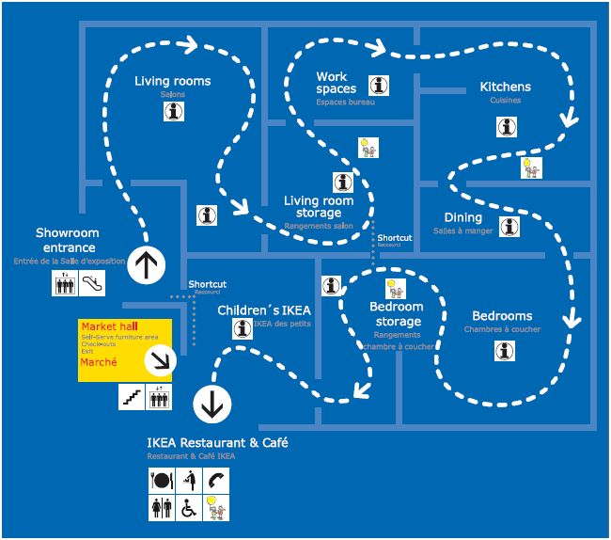
Attractions
Notes:
Attractive interactions in museums can lead visitors to buy items that they did not planned.
For instance, attractive interactions in museums can initiate contacts between visitors and museum displays. So architects have proposed various museum layouts in order to motivate visitors to contact more displays.
In stores, such attractive interactions can lead shoppers to buy items that they did not planned. Therefore, marketing strategies have focused on exposing customers to more merchandise and encouraged them to stop to buy.

Slide 4
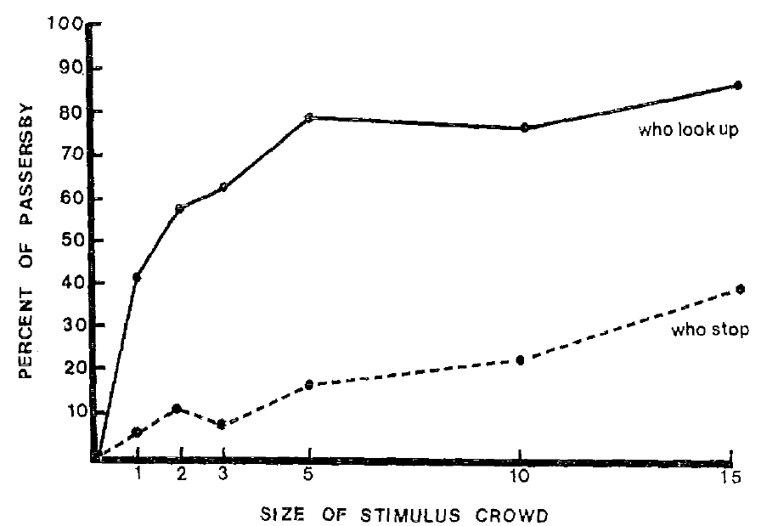
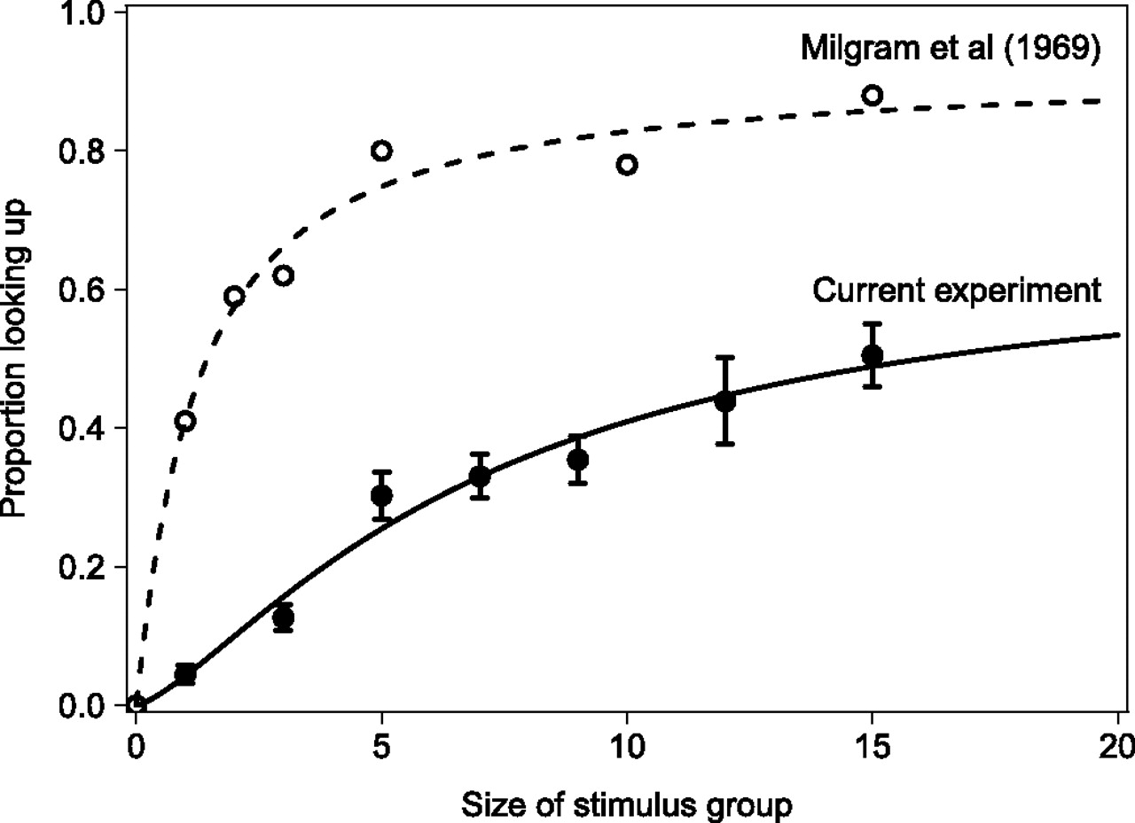
Influence of others
Gallup et al. (2012)
source: Milgram et al. (1969), Gallup et al. PNAS (2012)
Notes:
Milgram and Gallup’s studies have reported that a growing number of attendees around an attraction are likely attract more passersby. That is, impulse stopping pedestrians can be affected by other’s choice.

Slide 5
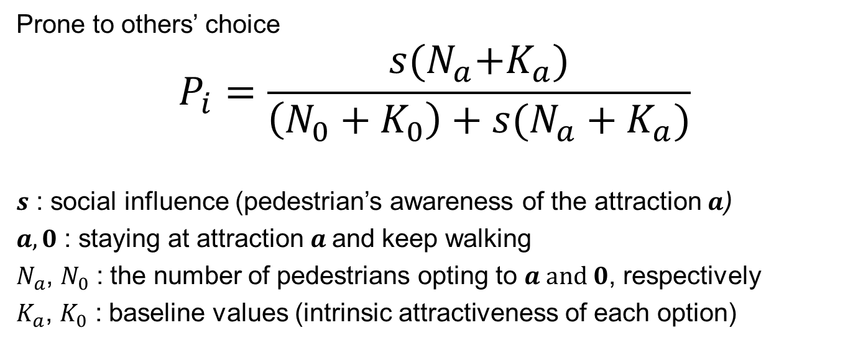
Impulse stops
Prone to others’ choice
$$P_{i}=\frac{s{(N}_{a}+K_{a})}{\left(N_{0}+K_{0}\right)+s(N_{a}+K_{a})}$$
$s$ : social influence (pedestrian’s awareness of the attraction $a$)
$a, 0$ : staying at attraction $a$and keep walking
$N_{a}$, $N_{0}$ : the number of pedestrians opting to $a and 0$, respectively
$K_{a}$, $K_{0}$ : baseline values (intrinsic attractiveness of each option)
source: Kwak et al. PLOS ONE (2015)
Notes:
In order to simulate the impulse stops and its influence on pedestrian flow, first, I

Slide 6
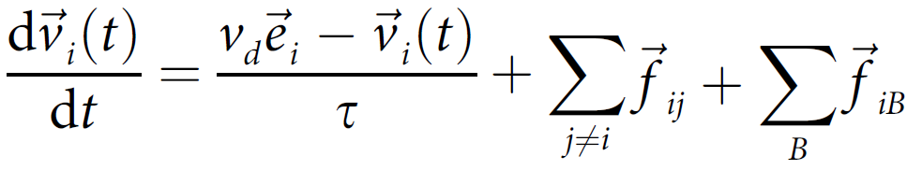
Pedestrian movement
Social Force Model (SFM)
Driving force
Pedestrian-boundary repulsion
Interpersonal
repulsion
source: Helbing and Molnar. PRE (1995),
Johansson et al. Adv. Complex. Syst. (2008).
Notes:
The pedestrian movement was simulated with the social force model. The model represents internal motivation for pursing a goal and response to external stimuli. Here the unit direction vector e_i, which is in the red circle, is coupled with the switching behavior model.

Slide 7
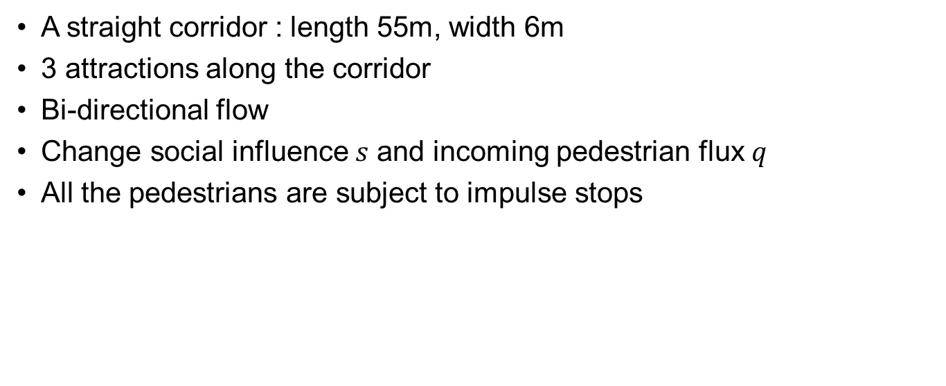
Numerical simulation setup
  A straight corridor : length 55m, width 6m
  3 attractions along the corridor
  Bi-directional flow
  Change social influence $s$ and incoming pedestrian flux $q$
  All the pedestrians are subject to impulse stops
1
2
3
Notes:
We performed numerical simulations for a straight corridor with 3 attractions.

Slide 8

Numerical simulation setup
  Each pedestrian considers others within the area of influence
  Leave the attraction after a certain amount time ($\overline{t_{d}}$ = 30 sec.)

Slide 9
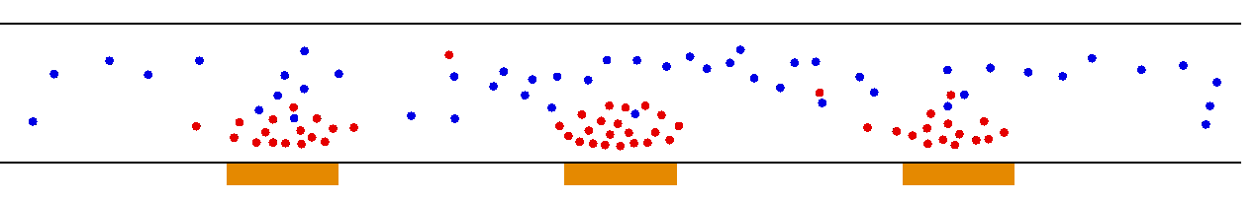
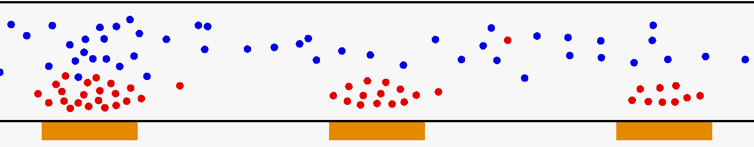
Stable clusters

Slide 10
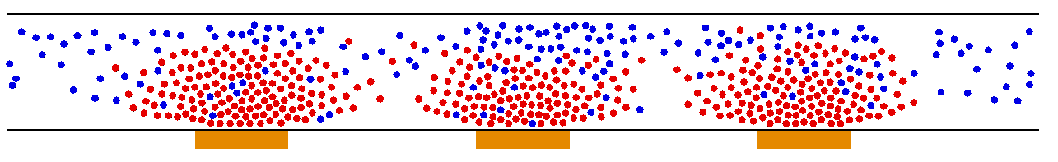
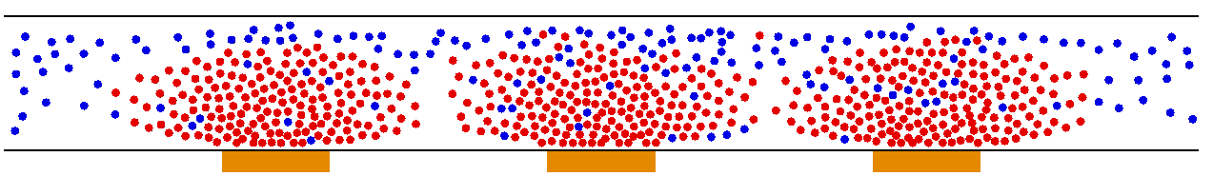
Unstable clusters
Swirling clusters

Slide 11
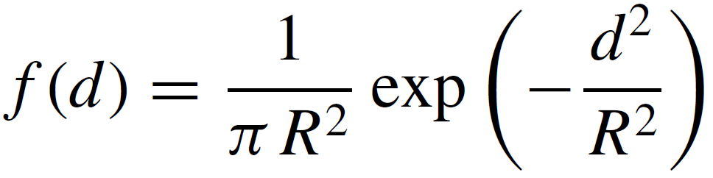
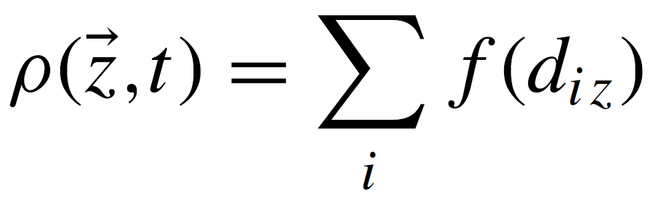
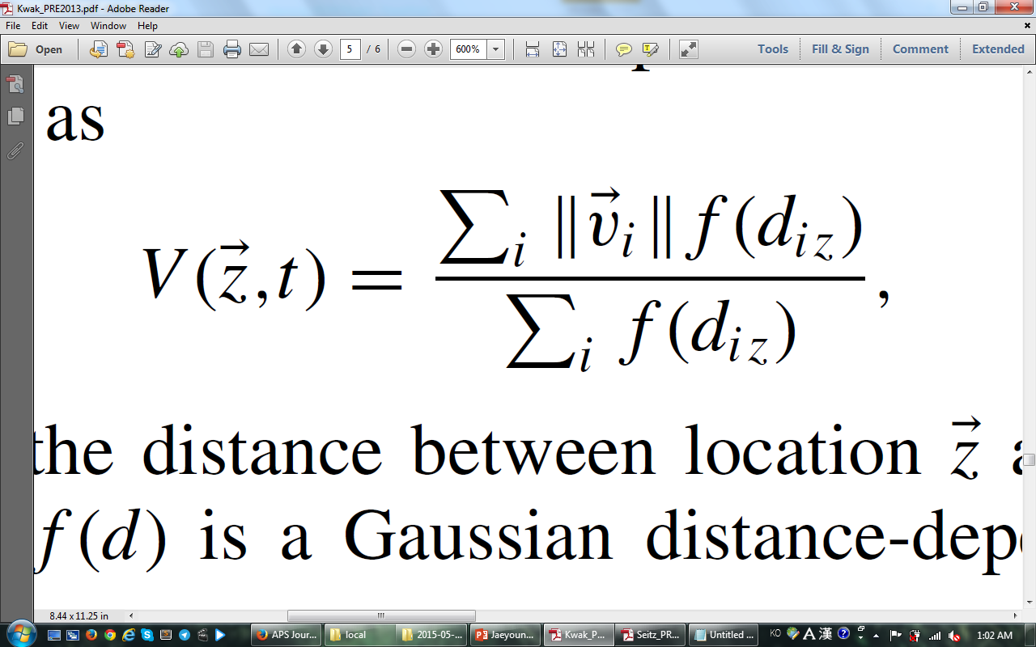
Local measures
Based on Gaussian function:
reflect how crowded an individual feels in the situation
source: Helbing et al. PRE (2007)

Slide 12
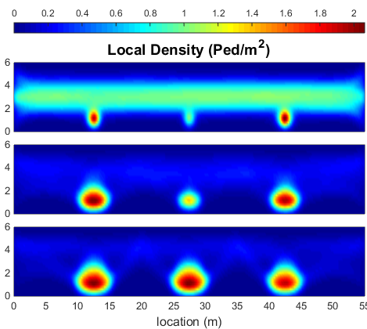
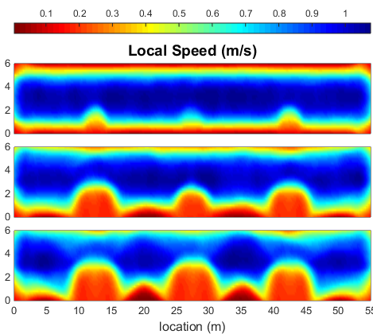
Local measures (q = 0.05)
s = 0.2
s = 0.6
s = 1.2

Slide 13
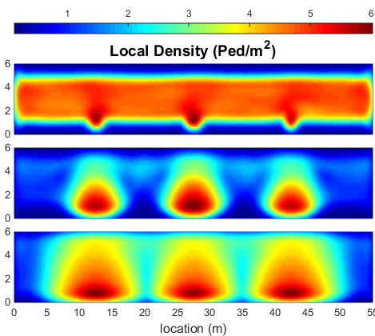
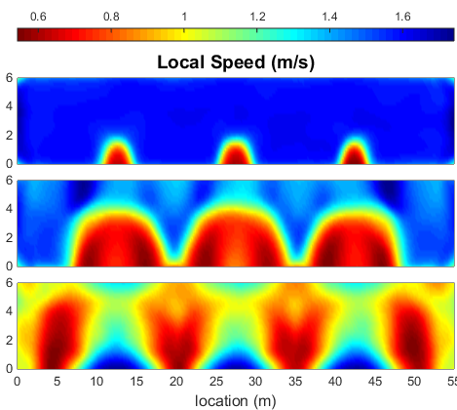
Local measures (q = 0.3)
s = 0.2
s = 0.6
s = 1.2

Slide 14
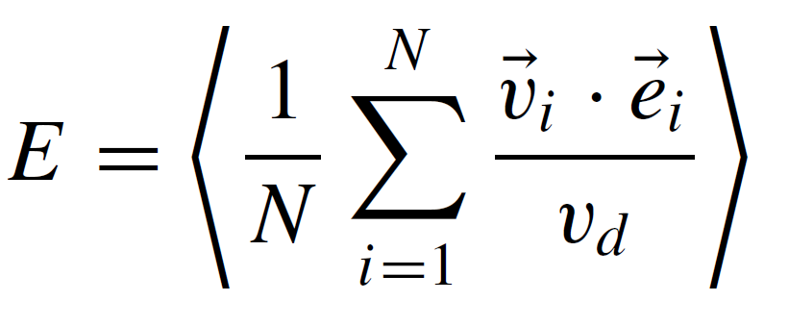
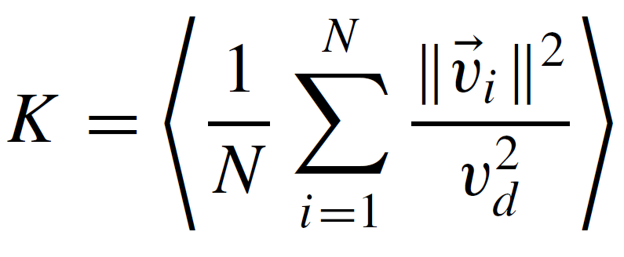
Collective behavior measures
Efficiency of motion
Normalized kinetic energy
Modified from Helbing et al. PRL (2000)

Slide 15
Collective behavior measures

Slide 16


Collective behavior measures
$$\frac{∂K}{∂s}<0$$
$$\frac{∂K}{∂s}>0$$
Stabale cluster
Unstable cluster

Slide 17
Schematic diagram
q
Unstable
Stable
s

Slide 18
Summary
Two patterns: stable and unstable clustering
Local measures: local density and local speed
Collective behavior measures: K and E
  Unstable clustering: swirling

Slide 19
Thank you!
Jaeyoung Kwak jaeyoung.kwak@aalto.fi

Slide 20
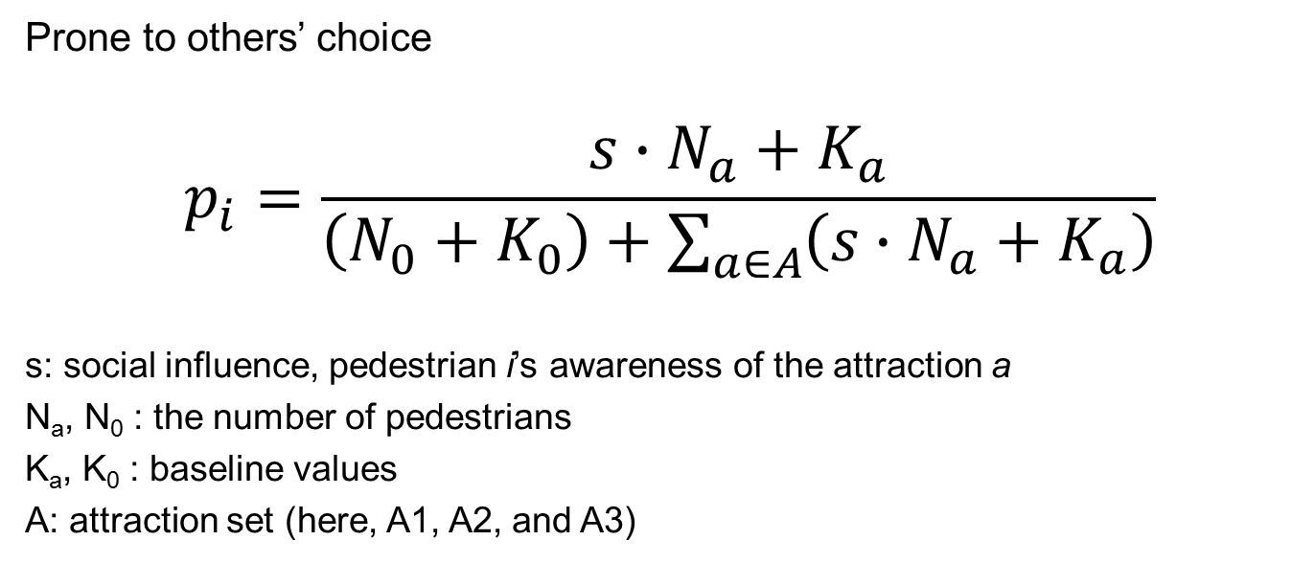
Impulse stops
Prone to others’ choice
$$p_{i}=\frac{s∙N_{a}+K_{a}}{\left(N_{0}+K_{0}\right)+\sum_{a∈A}{\left(s∙N_{a}+K_{a}\right)}}$$
s: social influence, pedestrian i’s awareness of the attraction a
N_{a}, N₀ : the number of pedestrians
K_{a}, K₀ : baseline values
A: attraction set (here, A1, A2, and A3)

Slide 21

Social Force Model (1)
First RHS: driving force
$v_{d}$ : desired speed
$v_{i}(t)$ : velocity at time $t$
$τ$ : relaxation time
${\vec{e}}_{i}$ : unit vector indicating the goal
source: Helbing and Molnar. PRE (1995),
Johansson et al. Adv. Complex. Syst. (2008).

Slide 22
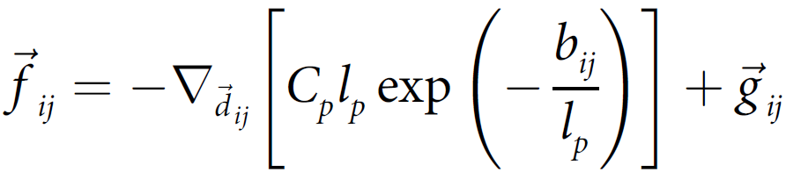
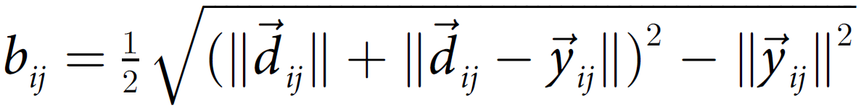
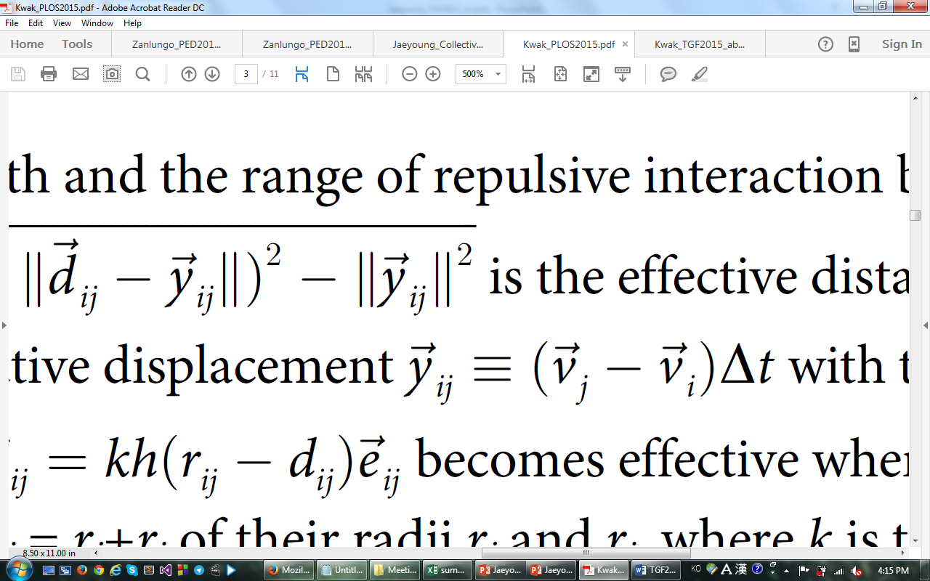
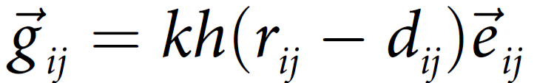
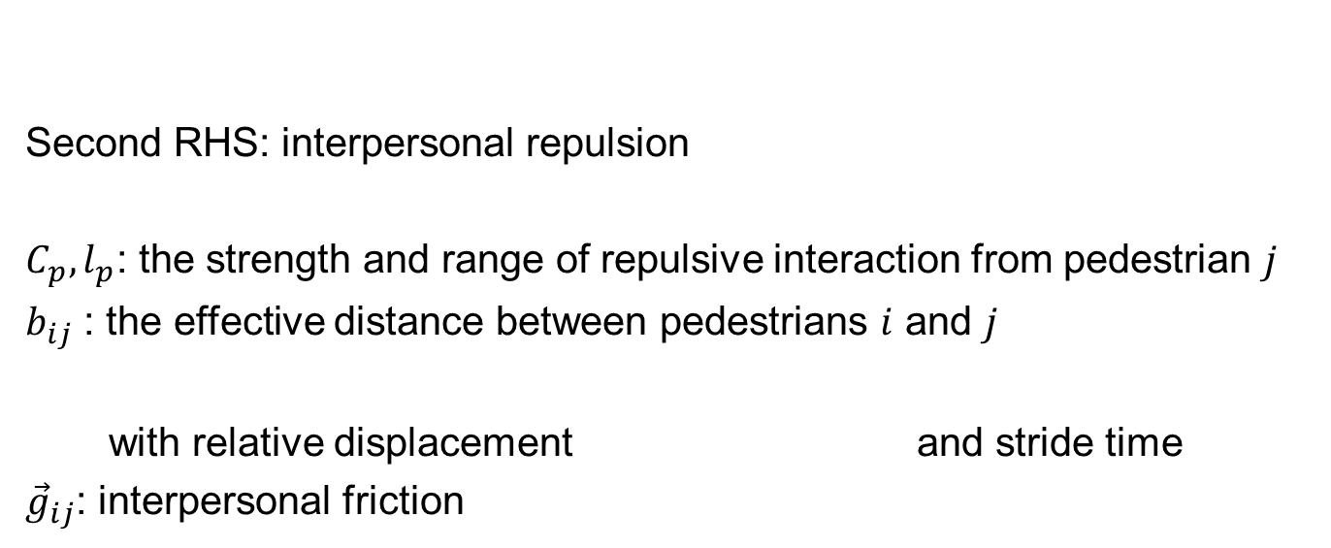
Social Force Model (2)
Second RHS: interpersonal repulsion
$C_{p},l_{p}$: the strength and range of repulsive interaction from pedestrian $j$
$b_{ij}$ : the effective distance between pedestrians $i$ and $j$
with relative displacement and stride time
${\vec{g}}_{ij}$: interpersonal friction
source: Helbing and Molnar. PRE (1995),
Johansson et al. Adv. Complex. Syst. (2008).

Slide 23
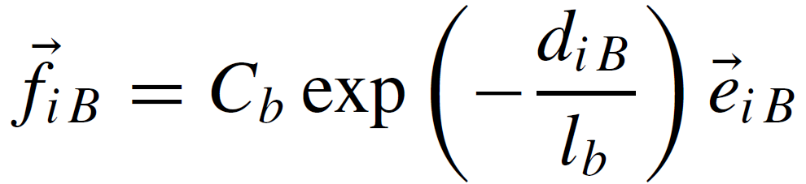
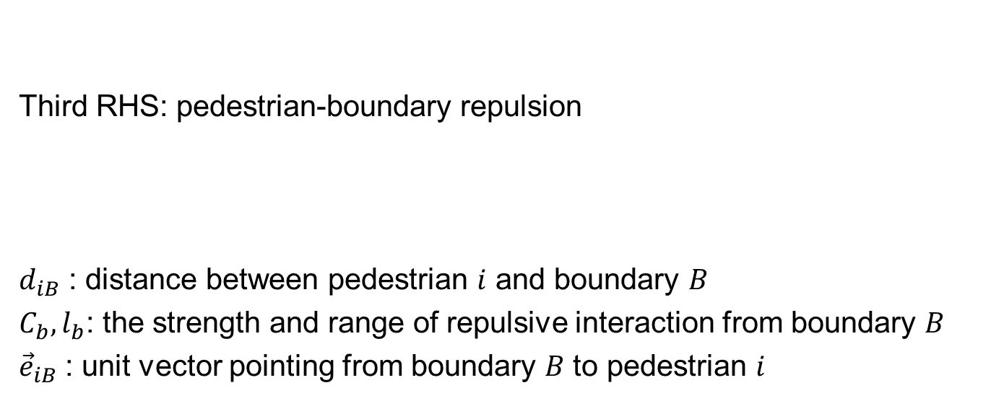
Social Force Model (3)
Third RHS: pedestrian-boundary repulsion
$d_{iB}$ : distance between pedestrian $i$ and boundary $B$
$C_{b},l_{b}$: the strength and range of repulsive interaction from boundary $B$
${\vec{e}}_{iB}$ : unit vector pointing from boundary $B$ to pedestrian $i$
source: Helbing and Molnar. PRE (1995),
Johansson et al. Adv. Complex. Syst. (2008).

