Slide 1
Subjective Expert Judgement:
A retrospective over 4 decades
Simon French
Alliance Manchester Business School
simon.french.50@gmail.com

Slide 2
Agenda
Reflections on Subjective Expert Judgement (SEJ) of uncertainties, particularly the combination of the judgements of several experts.
Beginnings
Lindley, Tversky and Brown → Dependence of Experts and Decision-Makers
Three Problem Types
The Classical Model: the Early Years
Applications
Bayesian Models
SEJ Elicitation and Modelling: a research agenda

Slide 3
The beginnings

Slide 4
The Beginnings
Stone (1961) Linear Opinion Pool
  A statistician’s first thought: take a weighted average!
  See also Kevin McConway (1981)
Howard Raiffa (1968)
  A Bayesian decision analyst’s perspective
  But non-Bayesian thinking on the Independence Preservation Property
Morris (1974)
  An exploration of Bayesian ideas on the problem, though not entirely convincing.
  See discussion of all Morris’s work in Management Science (1986) 32(3) 293-328
References
Morris, P.A., (1974) Decision analysis expert use. Management Science, 20(9), pp.1233-1241.
McConway, K.J., (1981) Marginalization and linear opinion pools. Journal of the American Statistical Association, 76(374), pp.410-414
Raiffa, H., (1968.) Decision analysis: Introductory Lectures on Choices under Uncertainty: Addison-Wesley, Reading, Massachusetts,
Stone, M., (1961) The opinion pool. The Annals of Mathematical Statistics, pp.1339-1342..

Slide 5
Lindley, Tversky and Brown

Slide 6
My first encounter with SEJ …
… and a bus!
Dennis Lindley, Amos Tversky and Rex Brown (1979) used a Bayesian 3-stage model to impose probabilistic coherence on the expert’s judgements.
  Stage 1: DM’s prior for the unknown events
  Stage 2: DM’s assessment of the Experts’ knowledge
  Stage 3: DM’s assessment of Experts’ ability at probability encoding
Examples used normal linear 3-stage model (over log odds)
I heard Dennis’ seminar at UMIST in 1978
It didn’t quite make sense, except for the case of sycophantic yes-men
I realised that as I crossed the road after the seminar …
Fortunately, the bus stopped!
References
Lindley, D.V., Tversky, A. and Brown, R.V. (1979) On the reconciliation of probability assessments. Journal of the Royal Statistical Society: Series A (General), 142(2), pp.146-162.

Slide 7
Dependences are important!
Experts’ judgements are correlated by virtue of their:
  Common science base
  Similar education
  Similar experiences, including recent journals, conferences…
But the expert judgements may also be correlated with the decision -maker’s
  i.e. the person who owns the prior for the decision problem
Led to the development of − conceptual! − models in which a Bayesian decision-maker’s prior is correlated with the experts’ judgements
References
French, S., (1980) Updating of belief in the light of someone else's opinion. Journal of the Royal Statistical Society: Series A (General), 143(1), pp.43-48.
French, S., (1981) Consensus of opinion. European Journal of Operational Research, 7(4), pp.332-340.
French, S., (1982) On the axiomatisation of subjective probabilities. Theory and Decision, 14(1), pp.19-33.

Slide 8
Three Problem Types

Slide 9
Valencia 2
I surveyed the field of combining expert judgement as it stood then (French, 1985)
  For an updated review, see French (2011)
To structure my review, I introduced three problem types:
References
French, S., (1985) Group consensus probability distributions: A critical survey. In Bernardo, J.M., DeGroot M A H, Lindley, D V, Smith, A F M. (eds) Bayesian statistics. Bayesian statistics, 2., 183-201
French, S (2011) Aggregating Expert Judgement. Revista de la Real Academia de Ciencias Exactas, Fisicas y Naturales. Serie A. Matematicas 105(1),181–206

Slide 10
Group Consensus Probability Distributions
Bayesian Statistics 2, Valencia 1983
The Expert Problem | The Group Decision Problem | The Text-Book Problem
Decision Maker
Group of decision makers
Group of experts
Issues and undefined decisions
Experts

Slide 11
The Expert Problem
Probably the most common structure in risk analysis.
Bayesian perspective: experts’ probabilities are data to the decision-maker(s)
It is easy to take an ethical position that is justifiable to calibrate or ignore some or all of the experts
Questions about choosing experts, how to work with them and elicit their judgements.
Perhaps not entirely solved, but we have it under control.
Decision Maker
Experts

Slide 12
The Group Decision Problem
Most auditable decisions made by groups
A group member’s probabilities are her assessment of the uncertainties; but those of others may be data to her.
  Bayesian conversations
Hard to take an ethical position allowing calibration of their probabilities.
Arrow’s Impossibility Theory ⇒ difficulties!
Manipulability and dishonesty ⇒ more difficulties!
Groups are social processes not decision-making entities
  Decision conferencing
Far from solved: and there is much naïve (and wrong) software available!
Reference
French, S. (2007) Web-enabled strategic GDSS, e-democracy and Arrow's theorem: A Bayesian perspective. Decision Support Systems, 43(4), pp.1476-1484.
Group of decision makers

Slide 13
The Textbook Problem
Does it exist?
Reporting issues
Reuse of SEJ studies
  Now facilitated by web and social media
  Updating previous studies in the light of new data ( and alternative facts)?
  ‘Plug-it-in’ computation
Methodology of meta-analyses of SEJ studies
Reference
French, S. (2012) Expert judgment, meta-analysis, and participatory risk analysis. Decision Analysis, 9(2), pp.119-127.
Group of experts
Issues and undefined decisions

Slide 14
The Classical Model: the Early Years

Slide 15
Developments led by TU Delft
TU Delft Project (1986-88)
  Driven by Seveso Directive
  Application led (4 major case studies)
  Developed Classical Model including:
    elicitation processes
    reporting guidelines
ESRRDA Report (1990)
Cooke (1991) Experts in Uncertainty
EU/USNRC (1994?-1998?)
The processes for using SEJ were largely set out by 2000 and there was an emphasis on further validation in future projects.

Slide 16
Applications

Slide 17
Applications
Lots of applications of usually equally weighted linear opinion pools
  Many unacknowledged, simply averaging expert judgements
A (very!) few applications of Bayesian methods
  (Aside) Bayesian statistical practice more concerned with ‘objective’ non-informative priors than drawing in current scientific knowledge.
The Classical Model was motivated by applications
  Now over 200 reported and archived applications
  TU Delft database of applications
    test new methods
    But has it been used for empirical evaluation of the outturn of the risk events?
EFSA has adopted SEJ (EKE in EFSA speak) as a standard procedure
COST project

Slide 18
Bayesian Models

Slide 19
Bayesian Models for the Expert Problem
Bayesian Approach
P_{DM}(θ |Q) ∝ P_{DM}(Q|θ ) × P_{DM}(θ )
P_{DM}(•) Decision maker’s probabilities
θ unknown quantity
Q expert judgements
Expert judgements are data to DM
Calibration of experts; overconfidence, etc.
Expert judgements are correlated
- with each other’s
- with decision maker’s
Social pressures, conflicts of interest, competition between experts
Real difficulty for Bayesian methods is dealing with calibration and dependencies between experts
Decision Maker
Experts

Slide 20
Developments over 40+ years
Raiffa and Morris promoted the Bayesian approach to the Expert Problem
Lindley, Tversky and Brown introduce the use of a normal linear model
French explored variants of the normal linear model to explore conceptual ideas
Winkler and many co-workers have used normal linear models in some illustrative/real applications
Albert et al (2012) developed a more sophisticated Bayesian approach
French and Wiper (1995) and Hartley and French (2021) have explored Bayesian models that work with data in the format for the Classical Model.
References
Wiper, M.P. and French, S. (1995) Combining experts' opinions using a normal‐wishart model. Journal of Forecasting, 14(1), pp.25-34.
Albert, I., Donnet, S., Guihenneuc-Jouyaux, C., Low-Choy, S., Mengersen, K. and Rousseau, J., (2012) Combining expert opinions in prior elicitation. Bayesian Analysis, 7(3), pp.503-532.
Hartley, D. and French, S., 2021. A Bayesian method for calibration and aggregation of expert judgement. International Journal of Approximate Reasoning, 130, pp.192-225.

Slide 21
Hartley and French
Method constructs correlations by clustering experts into groups
Bayesian result is unimodal, with broader support

Slide 22
SEJ Elicitation and Modelling:
A Research Agenda

Slide 23
The wider expert judgement problem
Have we been solving only part of the problem?

Slide 24
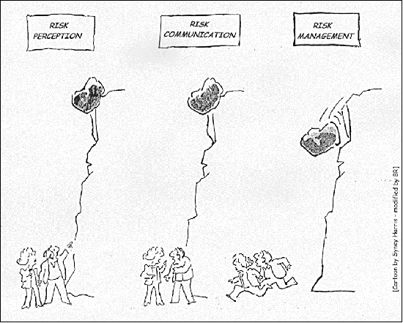


An outline of the analytical process
Problem-owners perceive risk
Analyst builds risk model.
Analyst consults experts for parameters in model (or observables from model)
Analyst uses SEJ data in model to assess risk
Risk Management!

Slide 25

Or more commonly …..
Problem-owners perceive risk
Analyst consults (further?) experts for parameters in model (or observables from model)
Analyst uses SEJ data in model to assess risk
Risk Management!
Working with experts, Analyst builds risk model.

Slide 26
Models and Parameters
Process assumes that the analyst builds the model
but the analyst often/usually consults experts to build it
  Perhaps different experts
  How should their views on modelling be combined?
  What about heuristics, biases and calibration
  New combination problem?
Process distinguishes between
  qualitative (form of models) and quantitative (parameters)
  models and their parameters

Slide 27
Qualitative – Quantitative
A qualitative/quantitative divide? There is no such dichotomy
In a simple model, a parameter may represent, say, the average output of a sub-model in a more complex model
Measurement theory tells us that quantification simply reflects the qualitative relationships of a system but does so more precisely
So we should not see eliciting model structure as different from eliciting numerical quantities
Model building is part of elicitation
β

Slide 28
Elicitation
SOFT Elicitation
HARD Elicitation
Qualitative Quantitative
Understanding Assessments
Entities
Cause and Effect
Uncertainties
Preferences
Model Structure
Physical Parameters
Probabilities
Utilities
Computational Parameters
Reference
French, S. (2021) From soft to hard elicitation. Journal of the Operational Research Society, on web, early view

Slide 29
Elicitation
SOFT Elicitation
HARD Elicitation
Qualitative Quantitative
Understanding Assessments
Less well discussed, often distributed over several literatures without much crossover
Well discussed in risk, decision and structured expert judgement literature
Entities
Cause and Effect
Uncertainties
Preferences
Model Structure
Physical Parameters
Probabilities
Utilities
Computational Parameters
Reference
French, S. (2021) From soft to hard elicitation. Journal of the Operational Research Society, on web, early view

Slide 30
Physical models are seldom unique
The same physical model may be embedded and approximated differently in distinct computer codes
Major consequence codes have many different physical and statistical models chained together in different combinations
Different experts use different (selections of) models
So different experts experience different behaviours and errors in the output of models
Computer codes, parameters and prediction errors depend on each other very closely

Slide 31
Physical models are seldom unique
Even if a physical model is precisely stated, it may be embedded and approximated differently in distinct computer codes
Major consequence codes have many different physical and statistical models chained together in different combinations
Different experts use different models
So different experts experience different behaviours and errors in the output of models
Computer codes, parameters and prediction errors depend on each other very closely
The expertise and knowledge encoded in the model needs to fully compatible with the expertise and knowledge encoded in the parameters

Slide 32
Uncertainty
We ask experts for their knowledge to reduce uncertainty
  but some uncertainty remains
How do we assess that residual uncertainty?
  There are well developed procedures for the assessing the residual uncertainty from the hard elicitation conditional on the model
  But what about the residual uncertainty from the soft elicitation of the model?
  Statistics has long discussed model uncertainty after data analysis
How do we validate – calibrate – elicited models?

Slide 33
Expert judgement of modelling uncertainty
If the process elicits models and parameters, then we have a problem
  Only the judgemental uncertainty on the parameters is assessed
  The uncertainty introduced by the elicitations in modelling is forgotten
If the process elicits models and uncertainty on observables, then
  Backfitting of models to the uncertainty on observables seemingly allows for the errors on the (model⊗parameter)
  But actually it relies on the fitted parameters ‘taking up’ all the variation leaving the structure of the model immutable

Slide 34
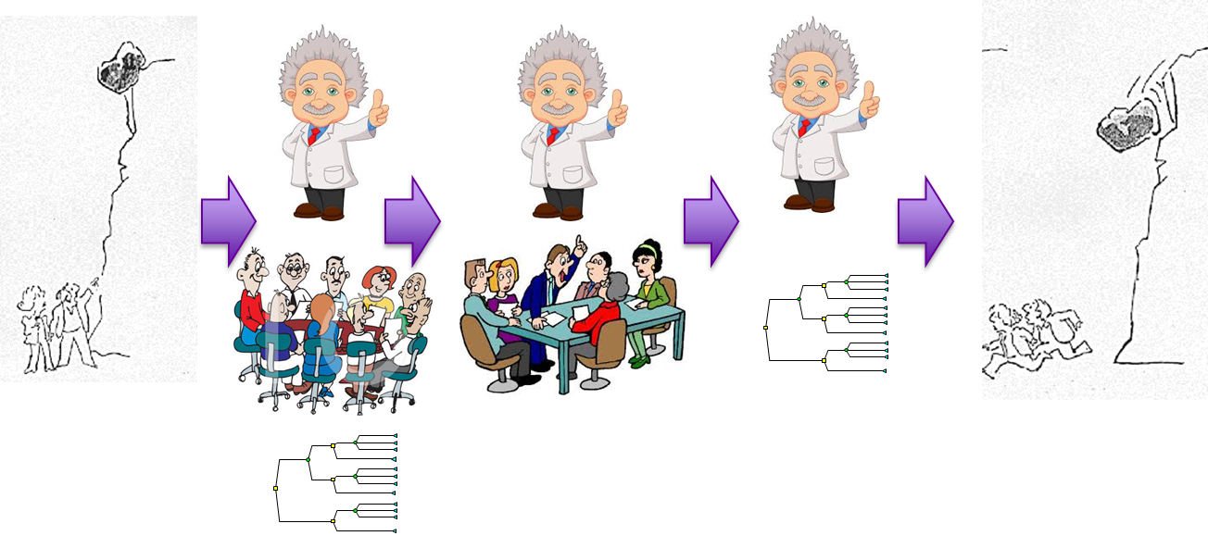
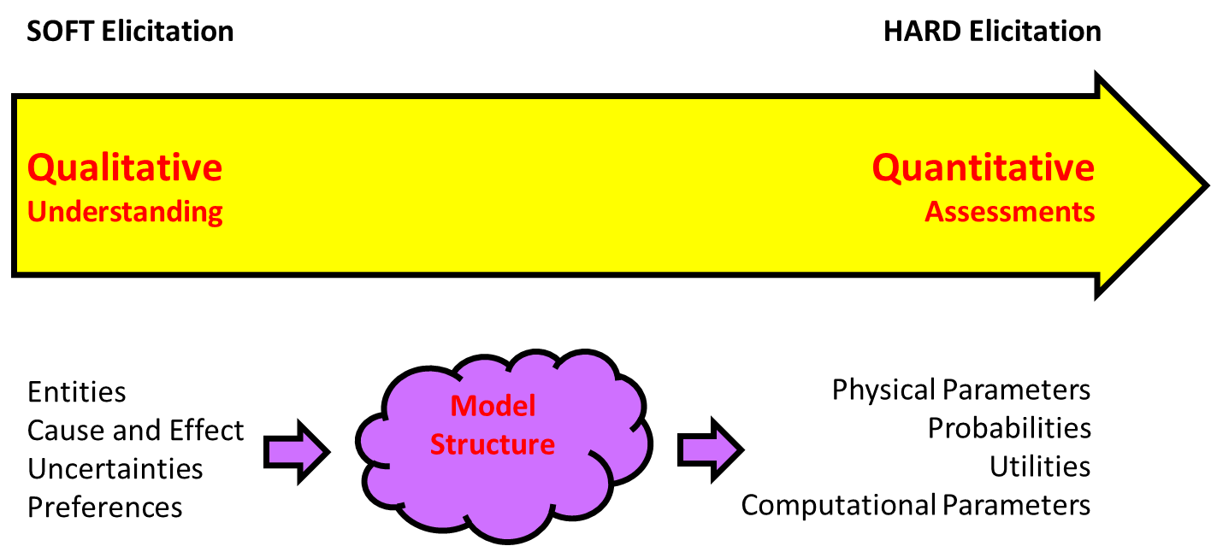
Conclusions
Not my problem: I’m retired!
But if I was starting out I would have two objectives:
Understand where expertise and knowledge enters the full risk analysis process
Understand uncertainty and calibration along entire elicitation process

Slide 35
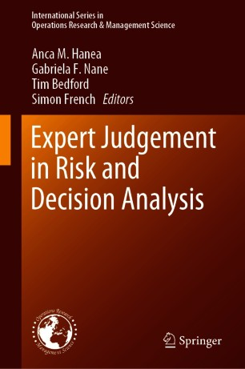
Thank You
Anca, M., Hanea, N., Gabriela, F., Bedford, T. and French, S., (2021) Expert Judgement in Risk and Decision Analysis. Springer.

