Slide 1
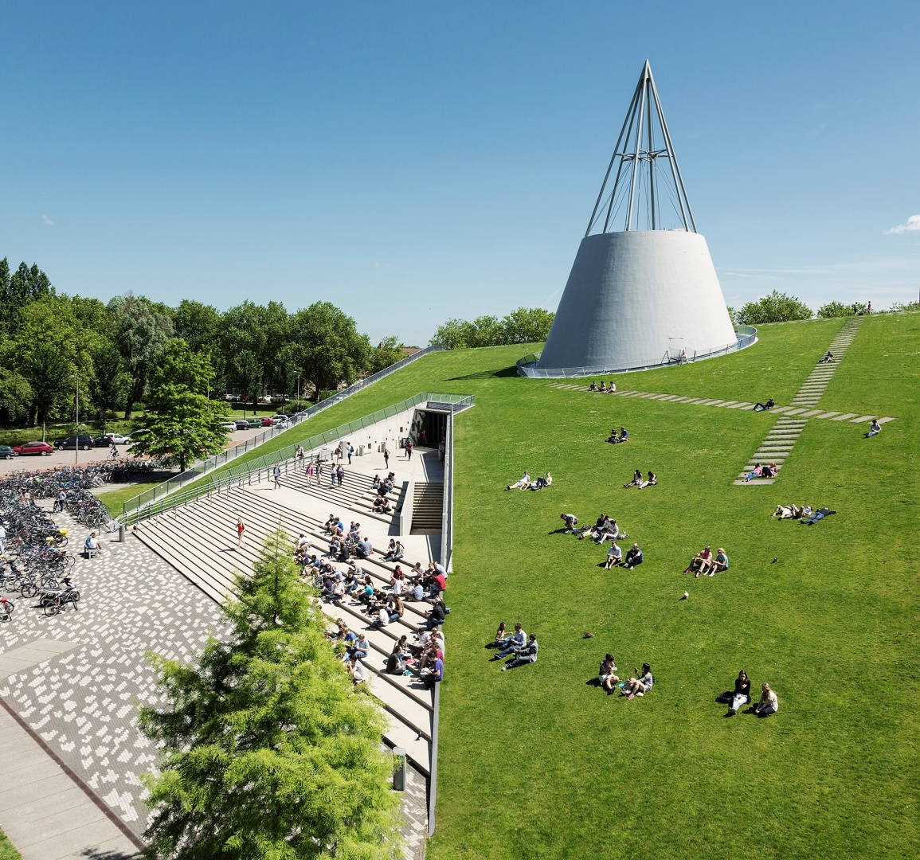
Information meeting
Honours Programme
Bachelor
Faculty of EEMCS

Slide 2
Introduction
Janneke Koorn
Martine van der Laag-Hoogendijk
Andrei Drăgoi
Coordinators Bachelor Honours Programme
Honourscommittee-EEMCS@TUDelft.nl
Responsible for the Faculty component
Sanne Goudriaan (HPD@tudelft.nl)
Honours Programme Delft (HPD)
Responsible for the Interdisciplinary component

Slide 3
Today’s agenda
What is the Honours Programme
Why participate in the Honours Programme
Timeline
Admission requirements
How to apply
Contact information
Questions

Slide 4
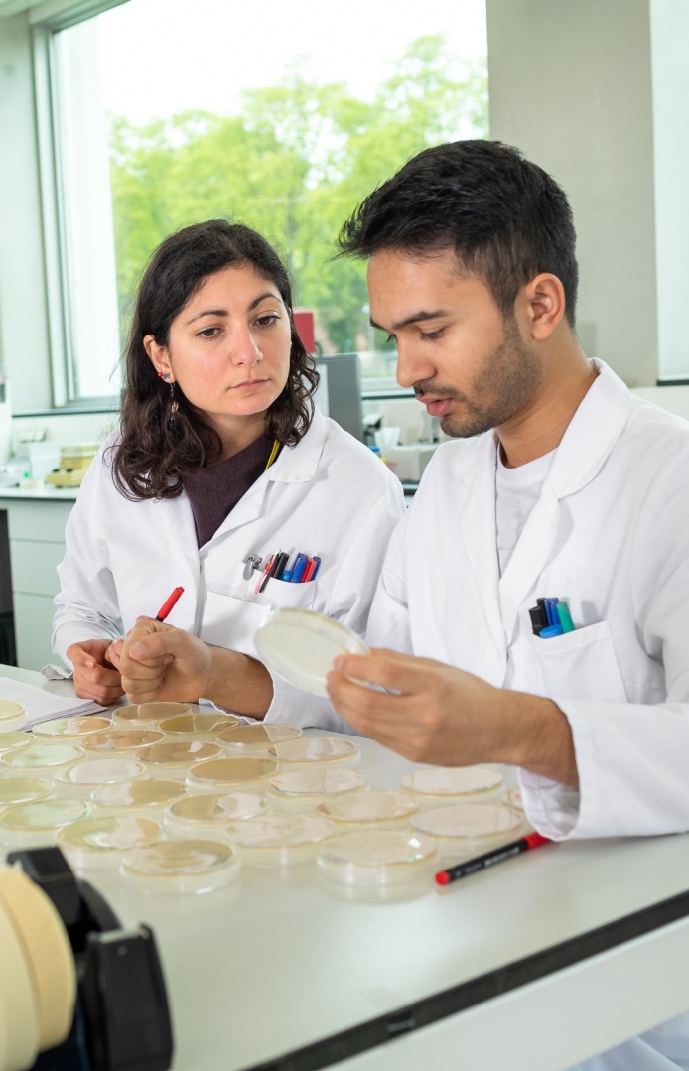
What is the Honours Programme?
20 EC on top of your regular programme
Duration: 2 years
Faculty component (15 EC)
Research Project
Next Generation Robotics (NGR) (EE and CSE)
Awareness & Culture
Sustainability (Leiden, Delft, Rotterdam)
Interdisciplinary component (5 EC)
Courses on Academic and professional development
Together with all Honours students of the TU Delft

Slide 5
Honours Class Next Generation Robotics (NGR)
Next Generation Robotics (tudelft.nl)

Slide 6
Awareness & Culture
Specialization ‘Awareness & Culture’ (tudelft.nl)
You work on your personal development, to focus on self-exploration, and discover how your “self” relates to your study and future career.
The focus is on you, as a person, on your own awareness of the “self” and your understanding of the relations that bind you to others – to social groups, societies & cultures.
There are only 20 places available for this specialization!

Slide 7
LDE Bachelor Honours Programme
Sustainability (Leiden-Delft-Erasmus)
Sustainability (Leiden-Delft-Erasmus) (tudelft.nl)
To develop your fundamental knowledge on sustainability and develop practical skills
by addressing real-world sustainability challenges.
Split in two parts:
Sustainability Fundamentals (5EC)
Designing solutions in a real-world Sustainability Challenge (10EC)

Slide 8
Why join the Honours Programme?
Deepening
Broadening
Challenge
Focused on research
This programme should not impact your regular study!
Are you in doubt? Contact the academic counsellor:
Academic Counsellors (tudelft.nl)

Slide 9
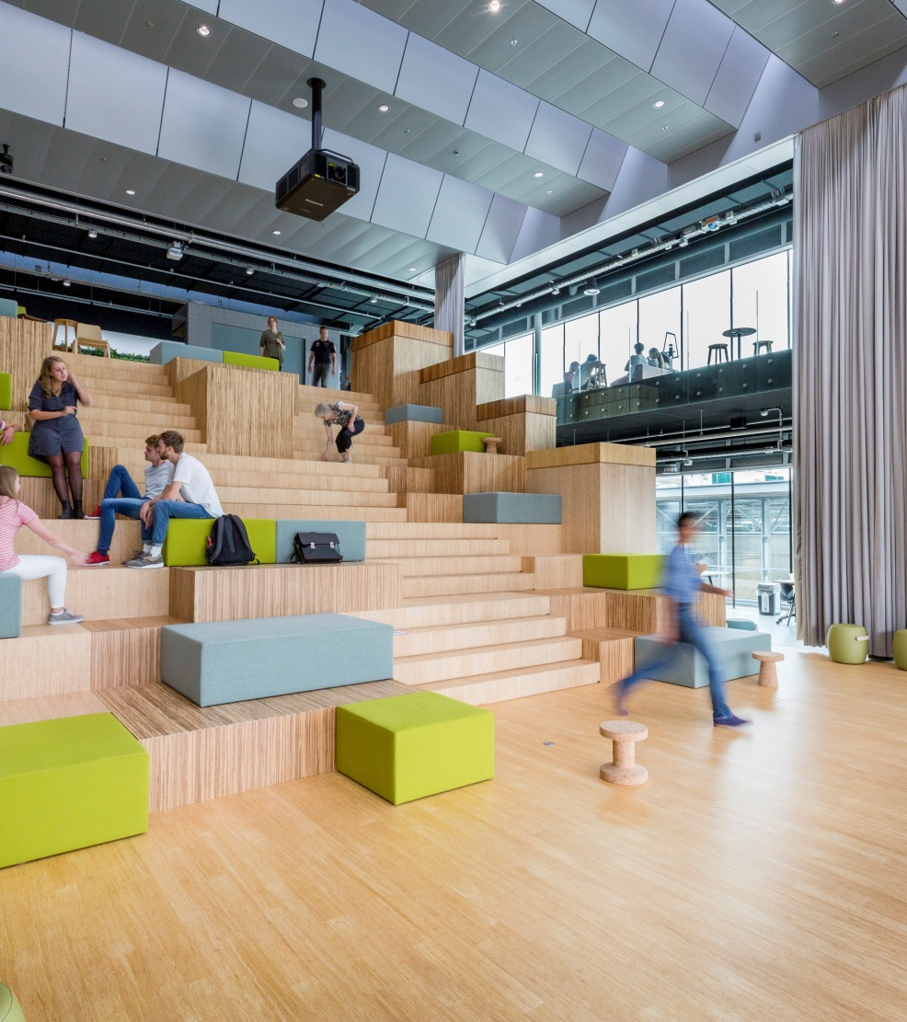
Admission requirements:
You have completed the first academic year in a single year.
You have an average grade of 8.0 or higher for all your year 1 courses.
You hand in a complete application package before the deadline.

Slide 10
How to apply:
Proposal form
Include a list of marks with GPA and CV
Send email to honourscommittee-EEMCS@TUDelft.nl
Application timeframe:
Between August 1st to August 31st 2024
Notes:
Form vervangen voor online zetten.

Slide 11
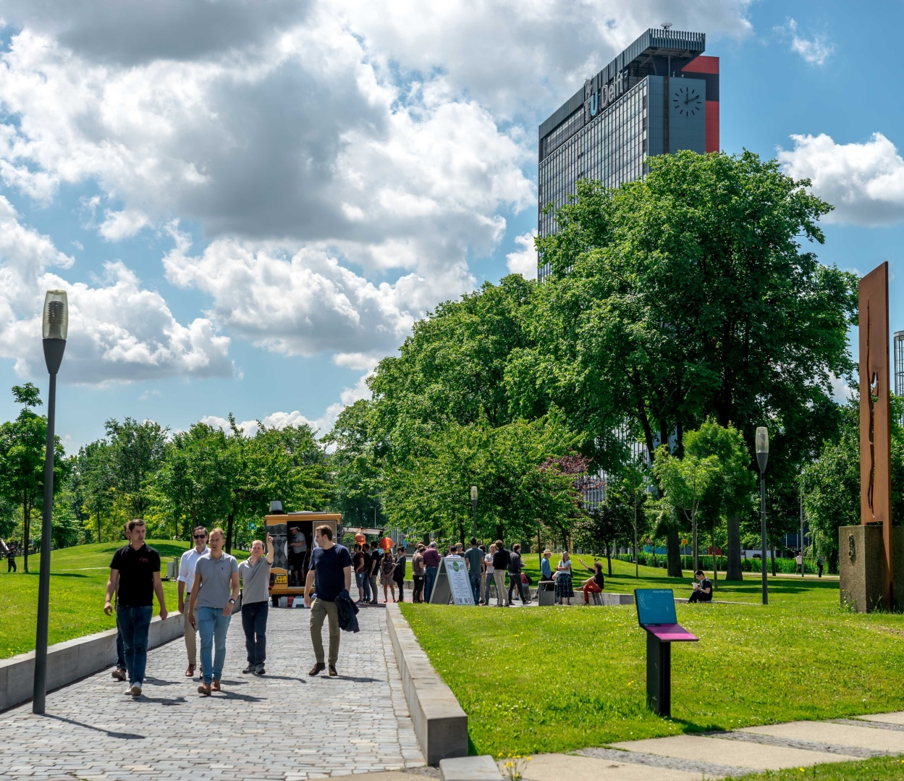
Selected by Honours Committee
What are we looking for in your proposal?
convincing motivation statement
feasible study plan
clear and delineated problem description
problem that is (societally) relevant
confirmed supervisor

Slide 12
The Honours Faculty coordinators:
Wolter Groenevelt
Applied Mathematics
Paddy French
Electrical Engineering
Julian Urbano
Computer Science Engineering
Notes:
Inhoudelijke vragen, problemen tijdens rearch, zij geven beoordeling met supervisor

Slide 13
Timeline Year 1:
Application deadline August 31st
Central kick-off September 15th
Progress meetings During the year
Midterm Report by August 1st
Year 2:
Poster presentation market June
Final paper deadline August 1st
Progress meetings During the year

Slide 14
Research project:
Find your own research topic
Find a supervisor
Group project (max. 3)
All students must write a paper.

Slide 15
Special Programme:
Hand in Proposal, CV and grade list
Deadline for application may be different
(NGR 30 September)

Slide 16
Honours community
Be part of the honours community!
board-hpd@tudelft.nl.
the Honours Board organizes a variety of different events like:
Introduction Day
Excursions
Tours
Lectures
Social Events
End of Year Event
June 3rd 17:00-22:00
ECHO

Slide 17
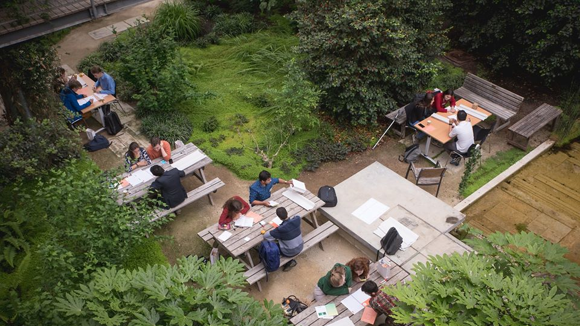
Questions?

Slide 18
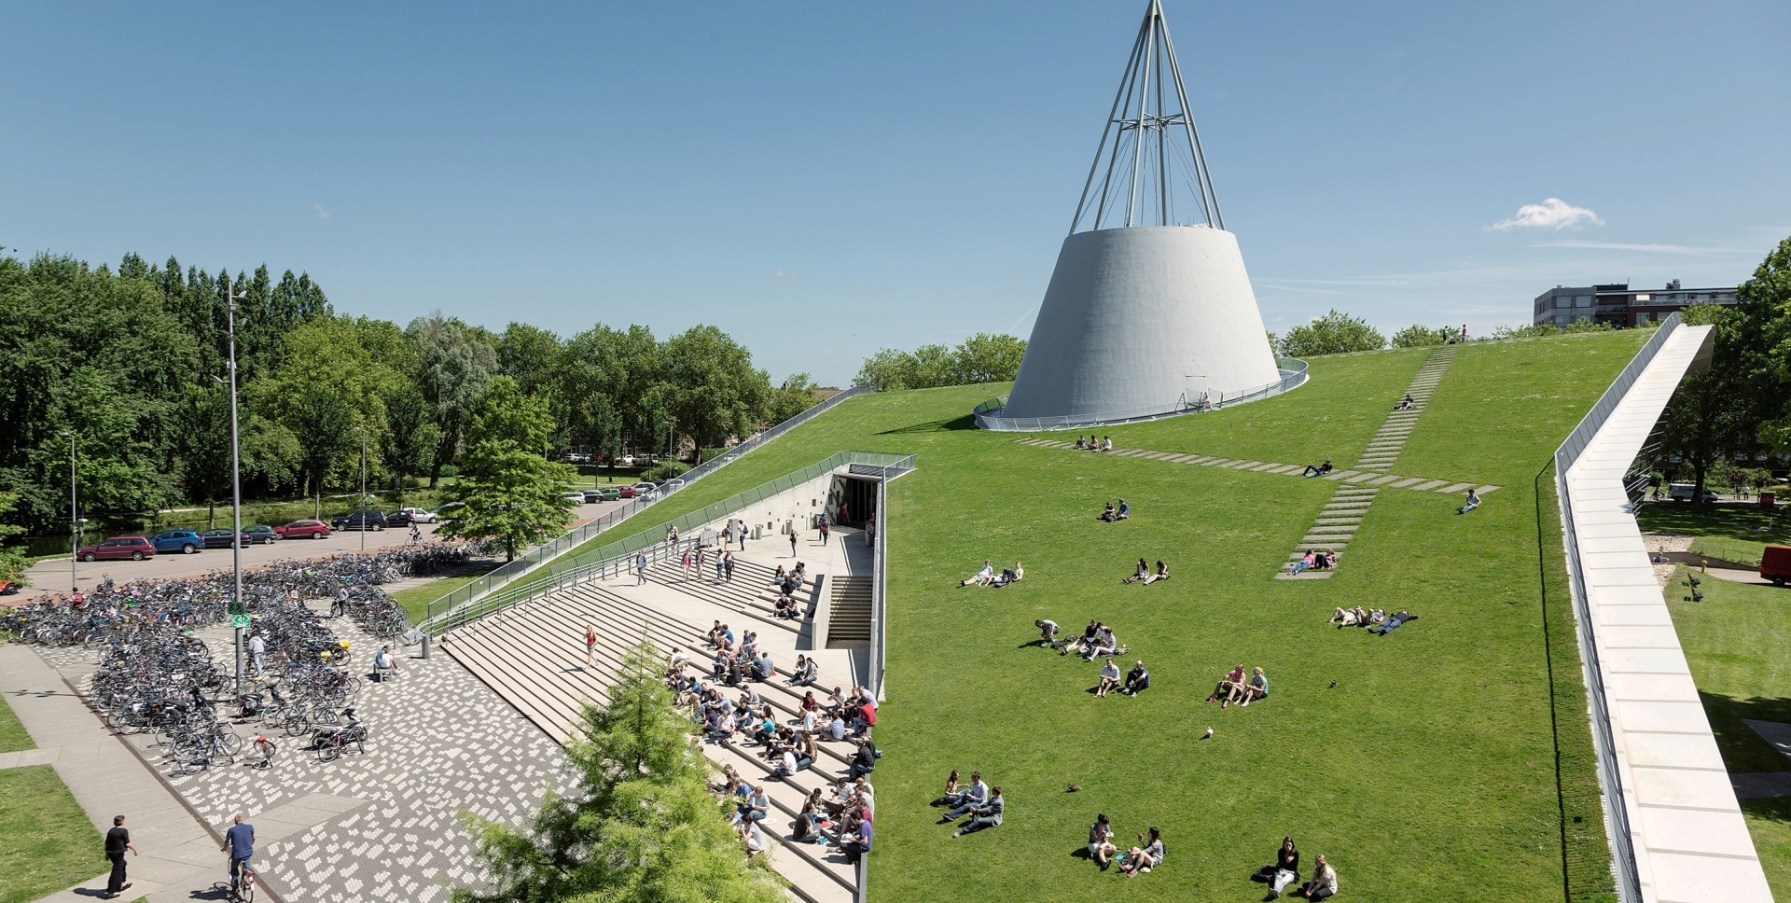
Contact & Information
Contact:
EEMCS honourscommittee-EEMCS@tudelft.nl
Information:
Honours website EEMCS
https://www.tudelft.nl/en/student/eemcs-student-portal/education/honours-programme
Honours website Delft
https://www.tudelft.nl/en/education/programmes/honours-programme-delft-hpd

