Slide 1
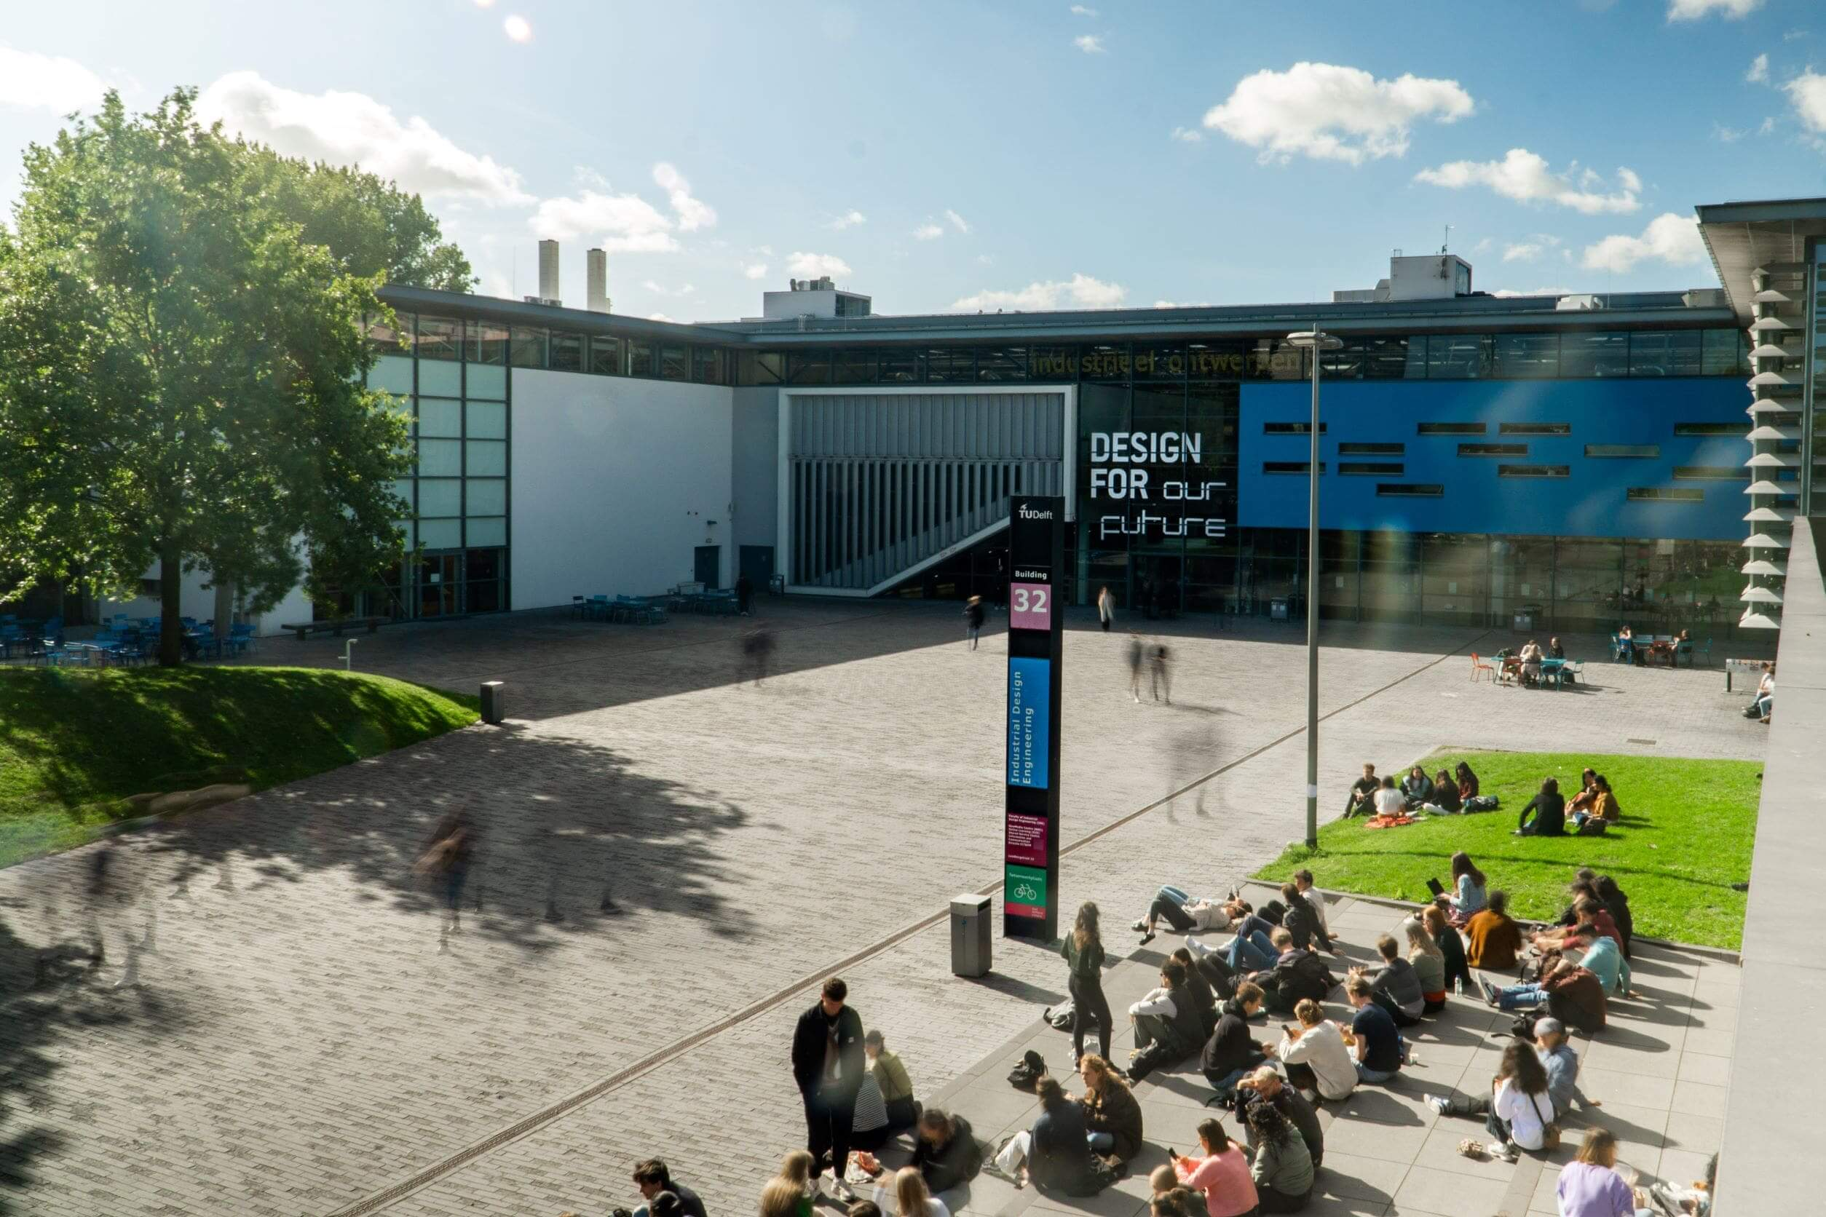
Welcome!
Your Name
Your Title/Position

Slide 3
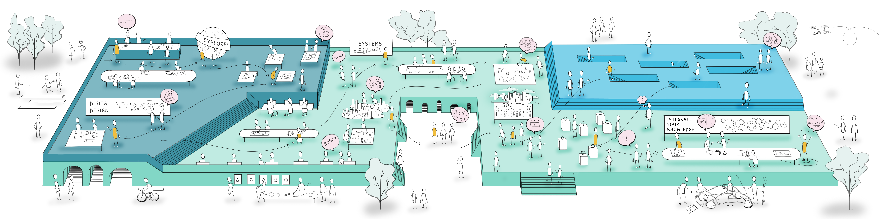
Content
Context
Research strategy
Student Life
Origins
Our departments
Alumni
Redesigning design
Research Themes
Recent developments
Facilities
Education
Get involved

Slide 4
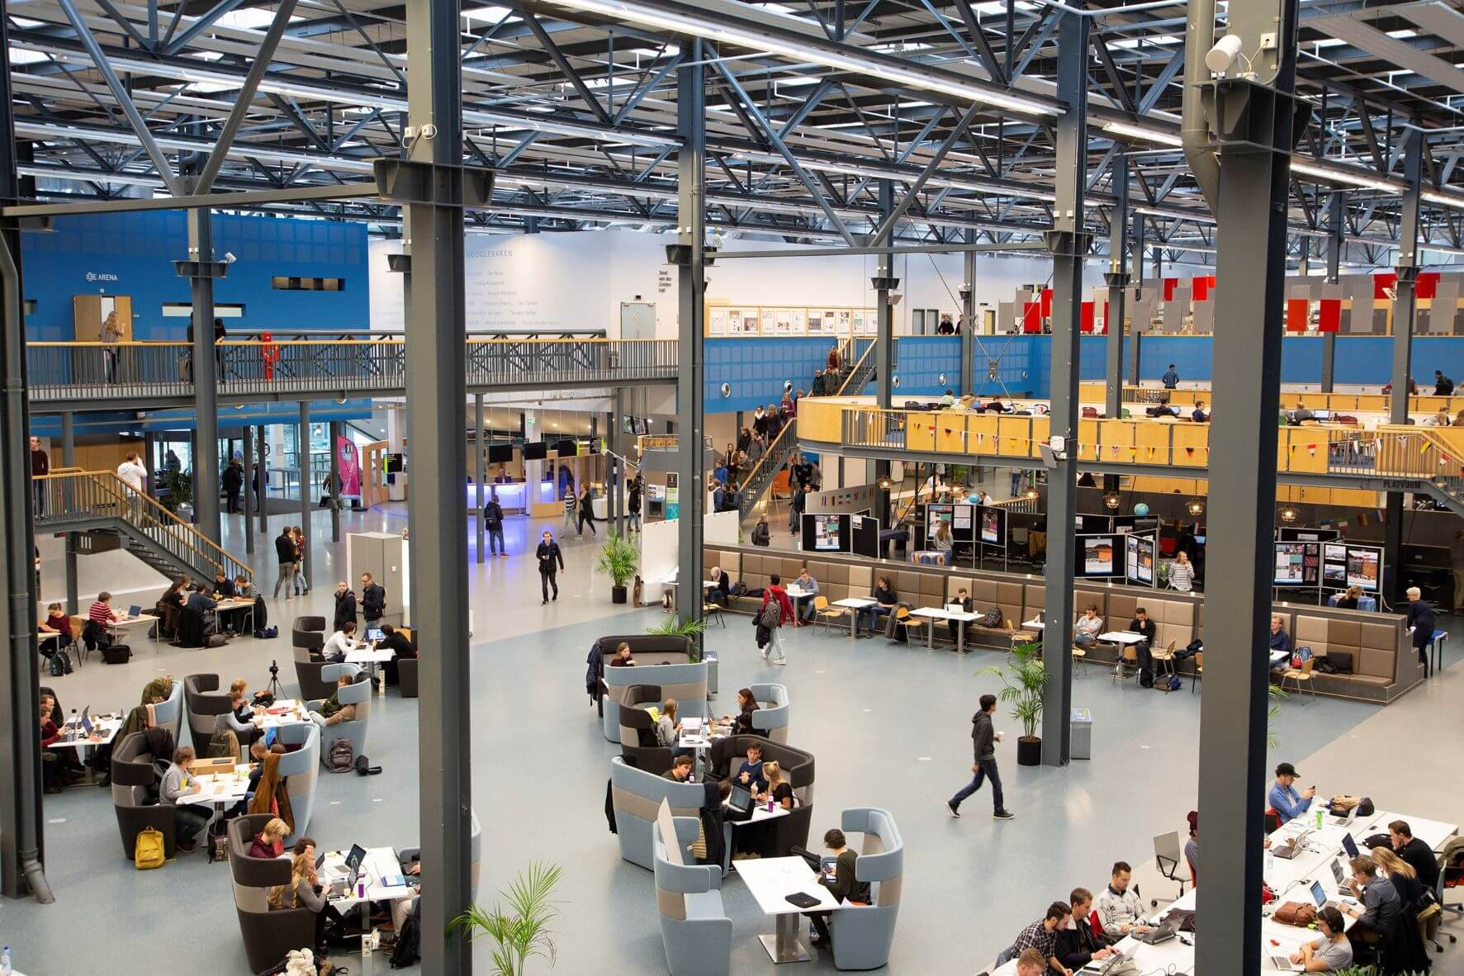


Industrial Design Engineering
1 of 8 faculties at TU Delft
2000+ students (50% female)
350 research staff
7500 + alumni
Methods-based design
Bachelor Industrial Design Engineering (Dutch)
3 Masters programmes
(English)
250,000 students
for online courses
Notes:
Basic IDE Facts:
1 of 8 faculties at Delft University of Technology, in the Netherlands.
One of the top 15 universities in the world for Engineering &Technology and Art & Design (according to the QS subject ranking of 2023)
With over 2000 students and over 350 research staff, we are one of the biggest design schools in the world
We’re not just big in terms of numbers and facilities but also in terms of the range of research interests all brought together in-house. Ranging from designing with novel materials and interaction design to designing with AI and strategic design, and everything in between.
As a University of Technology, we are evidence-based. We teach a methods-based form of design. Many of the tools and methods we and others use are developed here in-house. Many of these are brought together in “The Delft Design Guide”
We offer a Bachelor’s in Industrial Design Engineering delivered in Dutch and three Master’s programmes delivered in English.

Slide 5
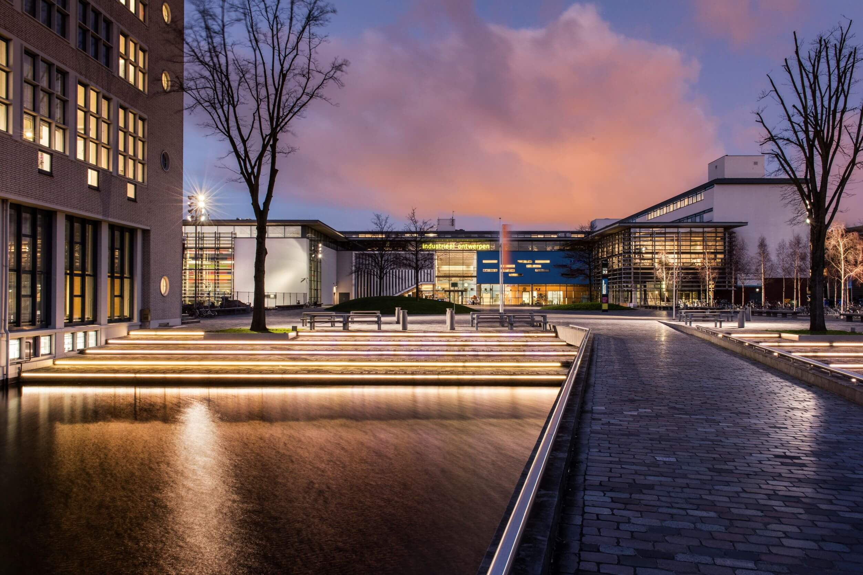
Our Origins
Notes:
IDE Background
In the post war period, the Minister of Education, Science and the Arts and several progressive designers drew up plans to train industrial designers. Those plans were handed to what was then known as the Institute of Technology in Delft. And the rest as we say, is history!
It was the early sixties when the industrial design engineering programme started albeit with rather humble beginnings – in the attic of the Architecture building!
A promising architectural trainee at Philips, Joost van der Grinten would eventually develop the new degree course in Industrial Design.
As the programme developed, in 1969 the Institute of Technology received ministerial approval for the new degree programme in Industrial Design. In the following years, the first graduates came through.
(NOTE: for more detailed information on IDE’s history please visit this page:
https://www.tudelft.nl/en/ide/about-ide/delft-design-history#c405944)

Slide 6
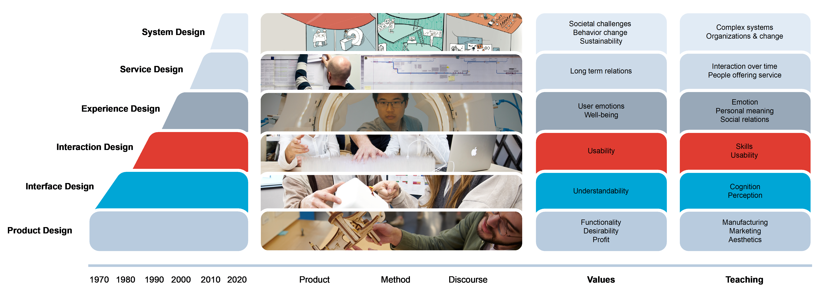
Redesigning Design
Notes:
Design however, like other scientific disciplines is no static thing. Over the last 50+ years, our faculty has responded – and been at the front line - of debates and developments in the field.
Most noteworthy is the move from design of physical products, to products as part of a service and today, products and services as part of a systems. Through design we shape products, (digital) services, systems (interventions), and (triggers for) societal transitions.
So while we are proud to call ourselves the Faculty of Industrial Design Engineering, the Industrial component is today less about perfecting the shape of the products for mass consumption and more about the scale of design impact.

Slide 7
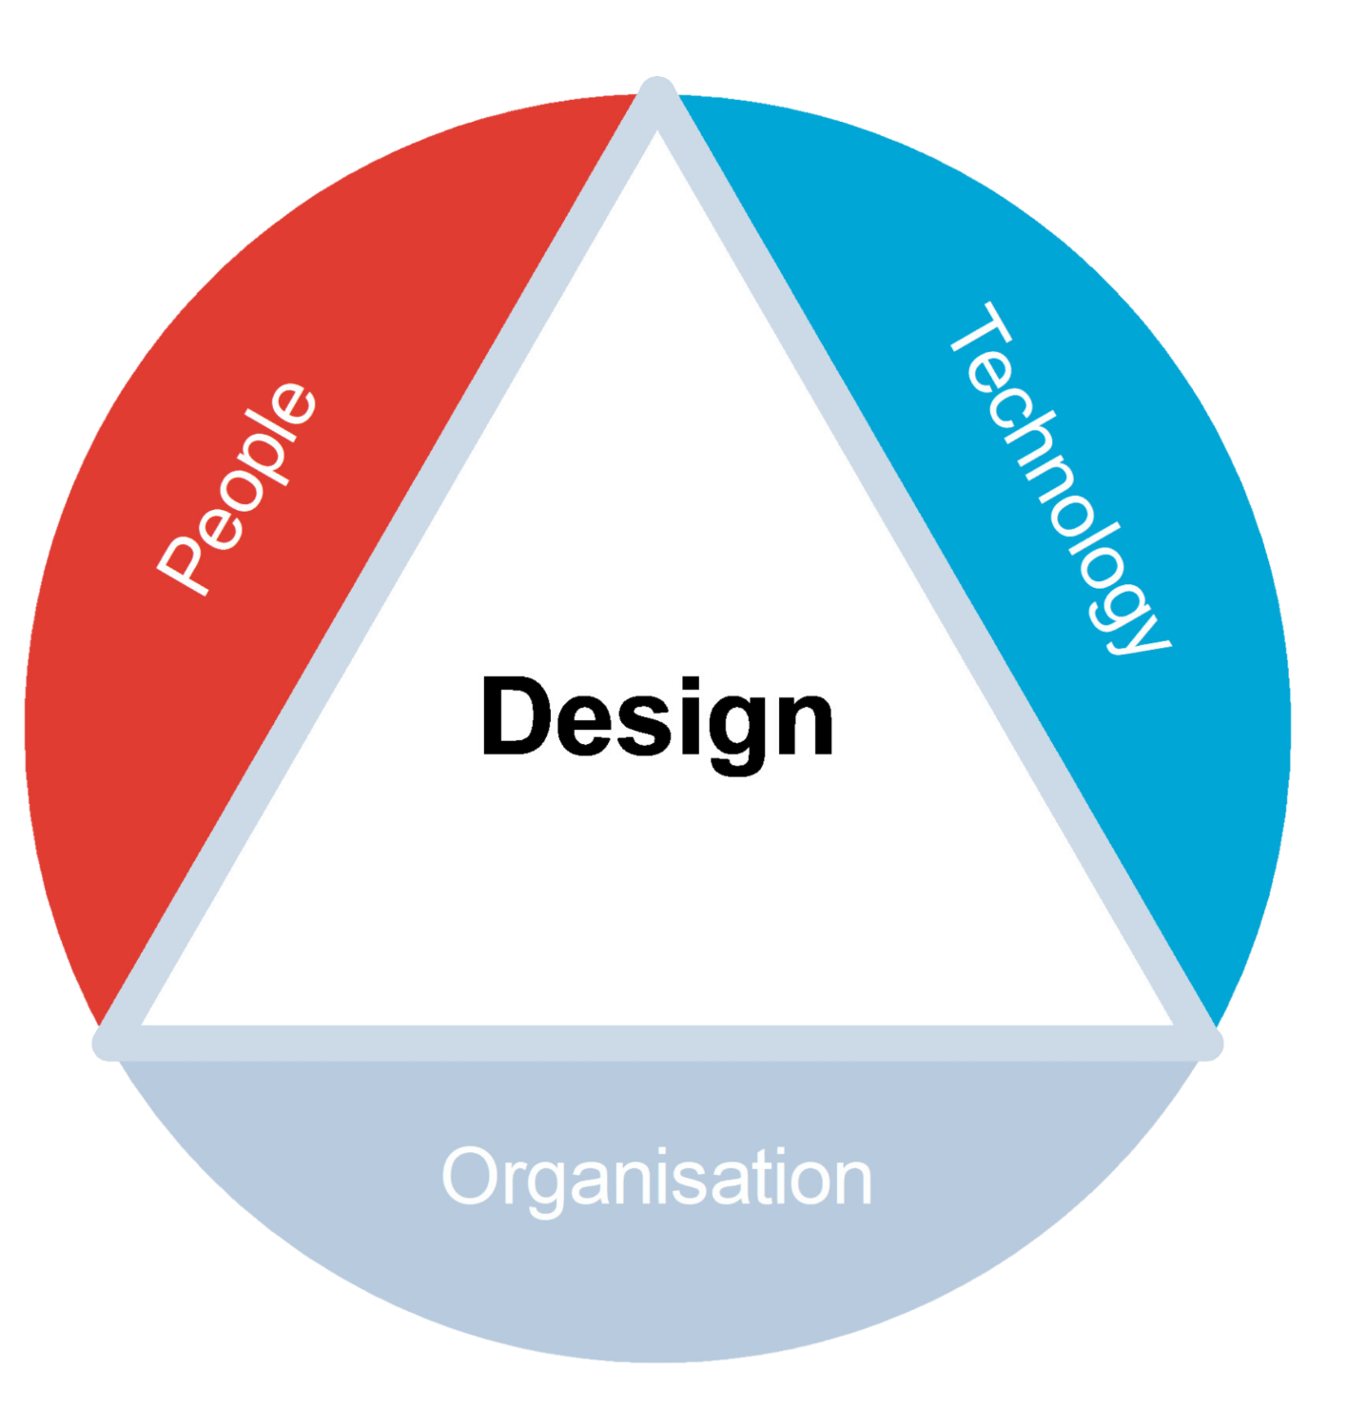
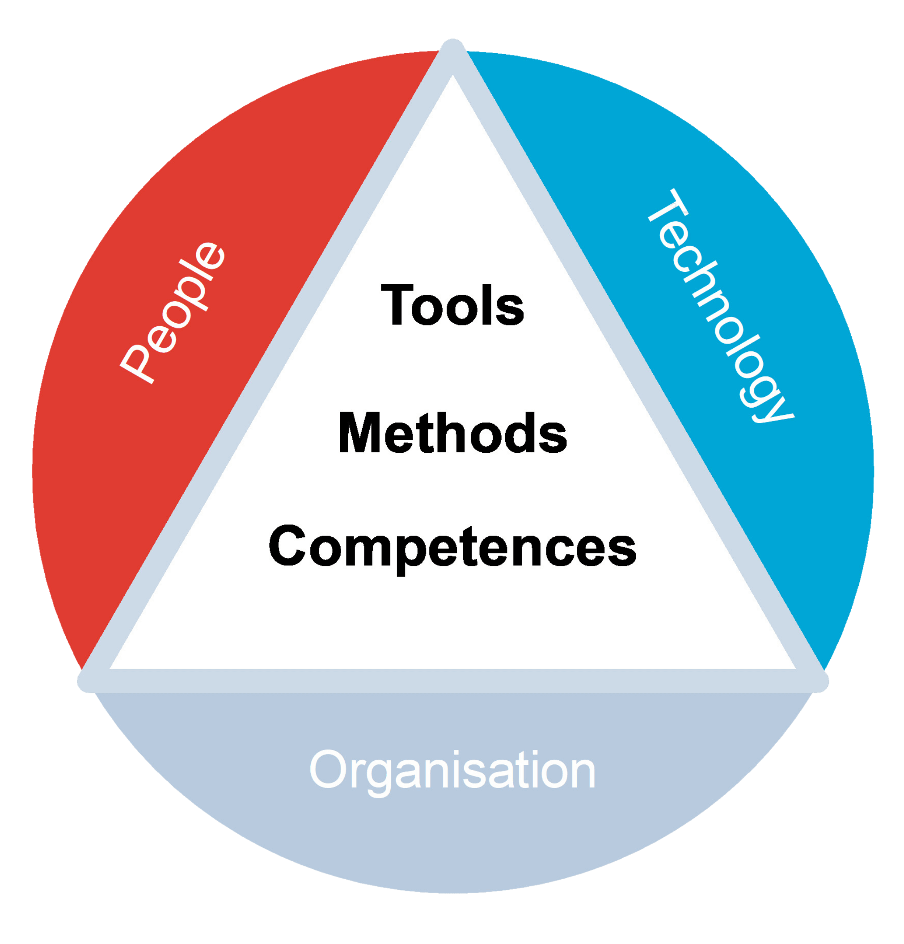
The Pillars
of Design
Notes:
What distinguishes us as a school of design today is the integration of 3 perspectives through design.
People, Technology, and Organisation.
These perspectives are pillars in education and are combined with the tools, methods and competencies to create evidence-based designers who strive for maximum impact.

Slide 8
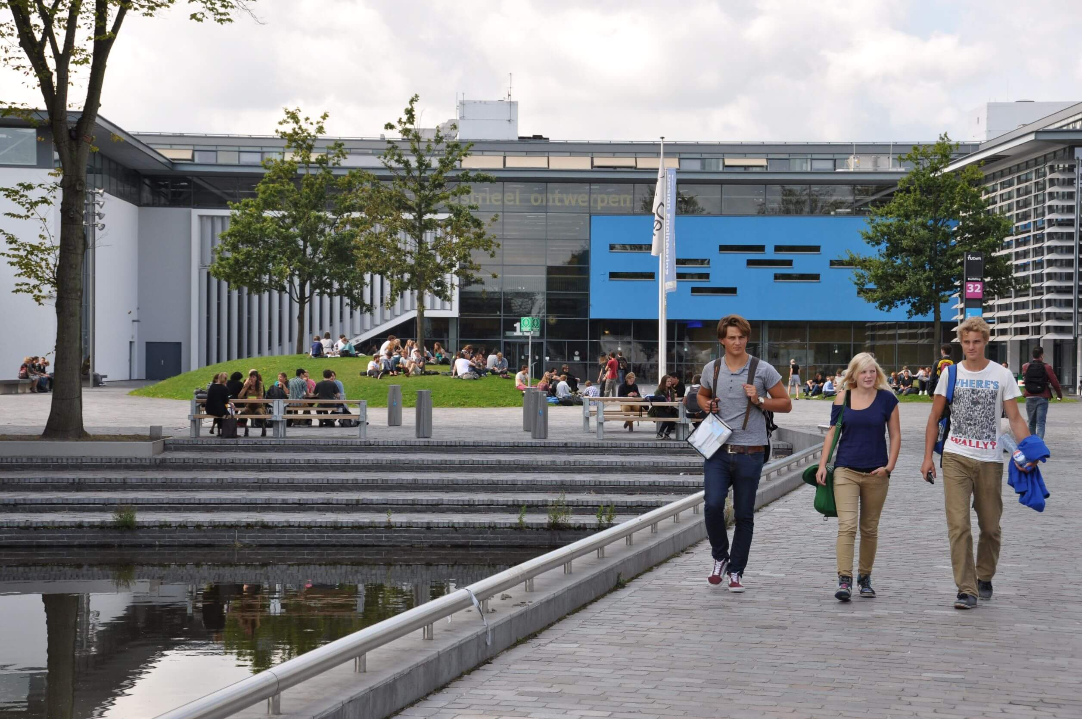

Our home
Notes:
And where does this industrious design activity take place?
We are located on the TU Delft campus in Building 32, which gives an idea of the scale of the TU Delft campus.
Keeping to numbers, the building is big at over 30,000 metres squared (the equivalent of 5 ½ football pitches).
But what’s it like inside?

Slide 9
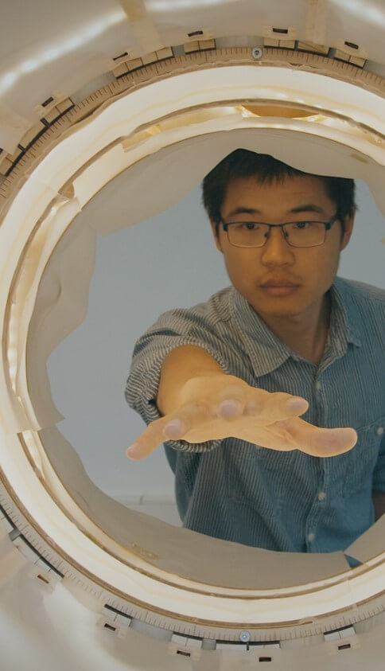
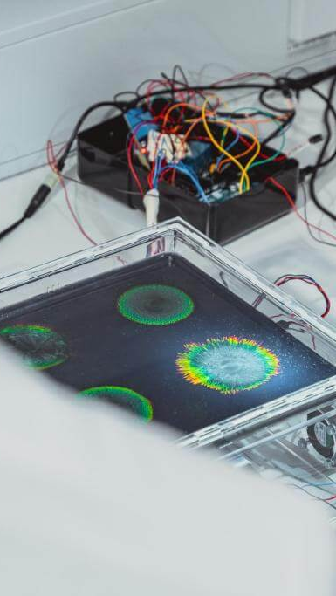
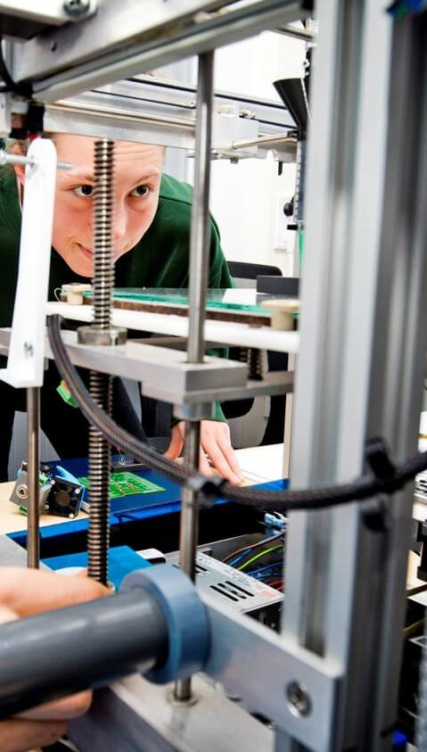
World class facilities
Notes:
We enjoy excellent, indeed world facilities! We have dozens of lab design studios, with state-of-the-art equipment. They are hives of knowledge.
Examples of these include the Applied Labs, where researchers create large-scale prototypes; a brand new BioDesign Lab, where researchers are able to explore new (bio-based) design materials; and the Body Lab, which includes a full-body scanner and 3D printing capabilities.
These facilities, amongst many others, are located throughout IDE and act as hubs where students, staff, and visitors can meet, study, learn, and mingle.
Our facilities are there to support education, research, and impact.

Slide 10
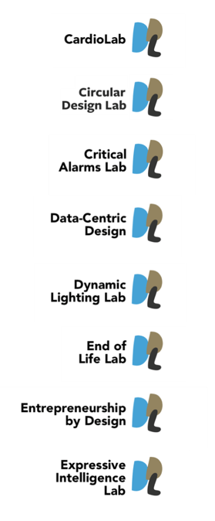
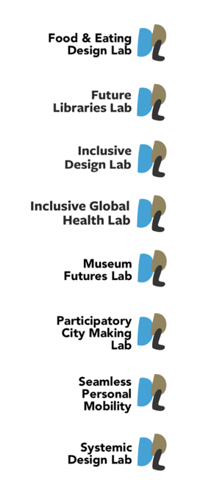
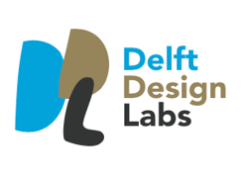
Notes:
Students can also graduate in house for example in our Delft Design Labs which bring together IDE researchers, students and external partners on a range of topics from the future of museums to food and eating. Some of the students that graduate in these labs go on to do PhDs at the faculty.
The Delft Design Labs act as creative hotspots.
They are platforms for design, science, and innovation.
They promote cross-disciplinary teamwork and design explorations.

Slide 11
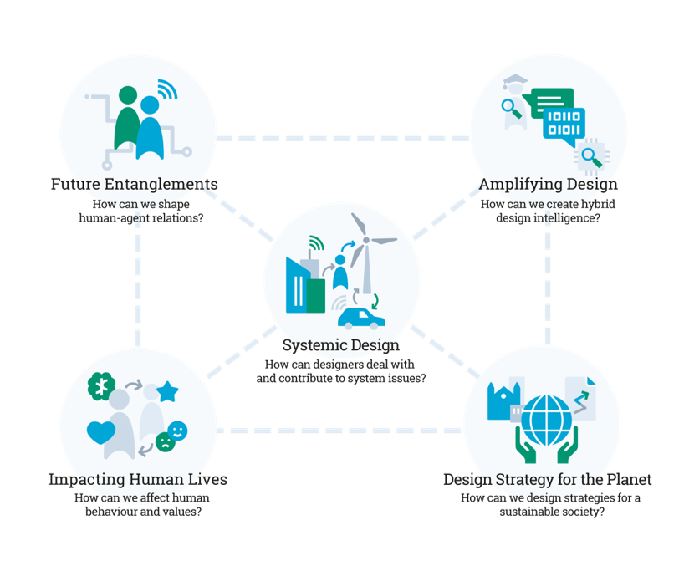
IDE Research Strategy 2022-2029
IDE researchers take leadership in the progression of the knowledge base and methods that enable and foster design practice to play an effective and distinctive role in social and sustainable transitions.
Notes:
TU Delft, as a whole, strives to Impact for a Better Society and we believe that we can contribute to this through design.
We published a research strategy in 2021 that makes our contribution explicit.
By researching and developing the tools and methods that allow designers in practice to tackle the challenges of a complex future (e.g. climate change, creating a better healthcare system) we can have an impact.
In this diagram, you can see the five areas we are focusing on.
Our research strategy is delivered by a vibrant research community, which is organised around three departments.

Slide 12
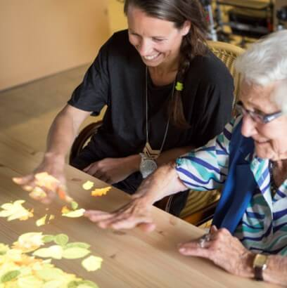
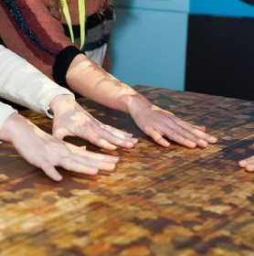
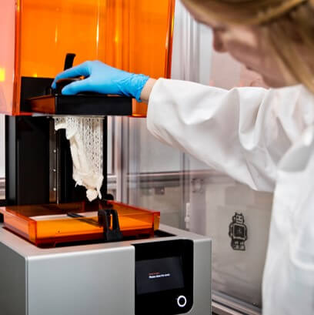
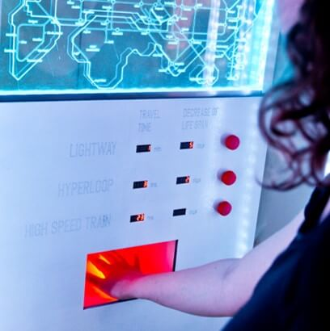
3 departments, 3 perspectives
Department of Human-Centered Design (HCD)
Department of Sustainable Design Engineering (SDE)
Department of Design Organisation and Strategy (DOS)
Notes:
IDE has three departments and they are loosely organised around our three perspectives (people, technology, and organisation).
In addition to the departments, we have cross-departmental communities grouped around four impact areas.

Slide 13
Design at TU Delft
Shaping a better future

Slide 14
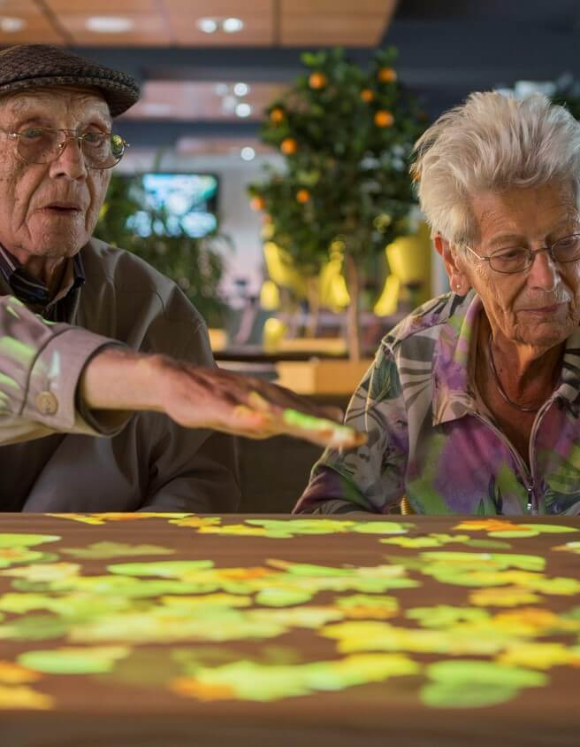



Design
and Health
Our healthcare systems need more funding, staff and technology, but they also need people who look at entire processes differently. Delft Designers pull up a third chair in the consultation room. They investigate the perspectives and patients within the healthcare system to reframe the conversation.
User centered
Holistic approach
Designing solutions human centered with a holistic view enable people and organization to shape the products, services and systems that support thriving global ecosystems and prosperous society.
14

Slide 15
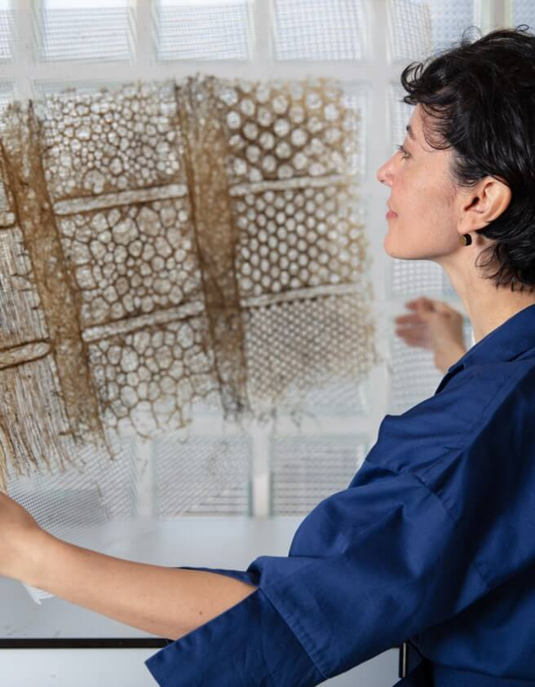



Design
and Sustainability
Sustainability should not be a lifestyle choice but the smart and logical choice, hard-wired into the design.
Our researchers develop tools, strategies, and methods to help design teams, communities and decision makers develop products, services, and systems that consider scarcity, pollution and the environment and that are kinder to our future. want to approach sustainable living not as a lifestyle choice but as the smart and logical choice, hard-wired into the design of products, services and systems. This means clever designs with scarcity, pollution, and reuse in mind to eliminate waste and minimise pressure on the environment.
User centered
Holistic approach
Designing solutions human centered with a holistic view enable people and organization to shape the products, services and systems that support thriving global ecosystems and prosperous society.
15

Slide 16

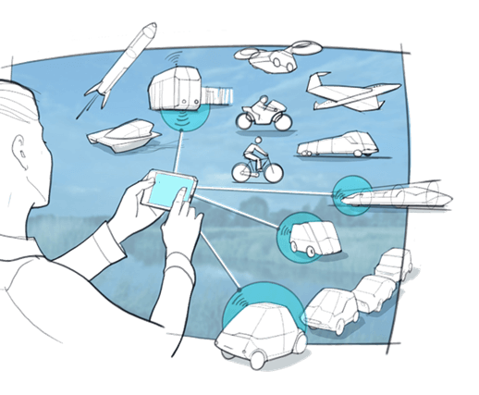

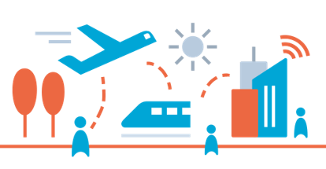
Design
and Mobility
The “Design in Mobility” program enables mobility transformations by providing knowledge and stimulating collaboration to solve the main mobility challenges our society currently faces and will face in the future.
Human-centered
Holistic approach
We envision a future in which meaningful travel is the norm and work to make this a reality via a human-centered research approach in which people’s needs and desires, as well as collective societal concerns are considered throughout the entire design process of innovations in the mobility field.

Slide 17

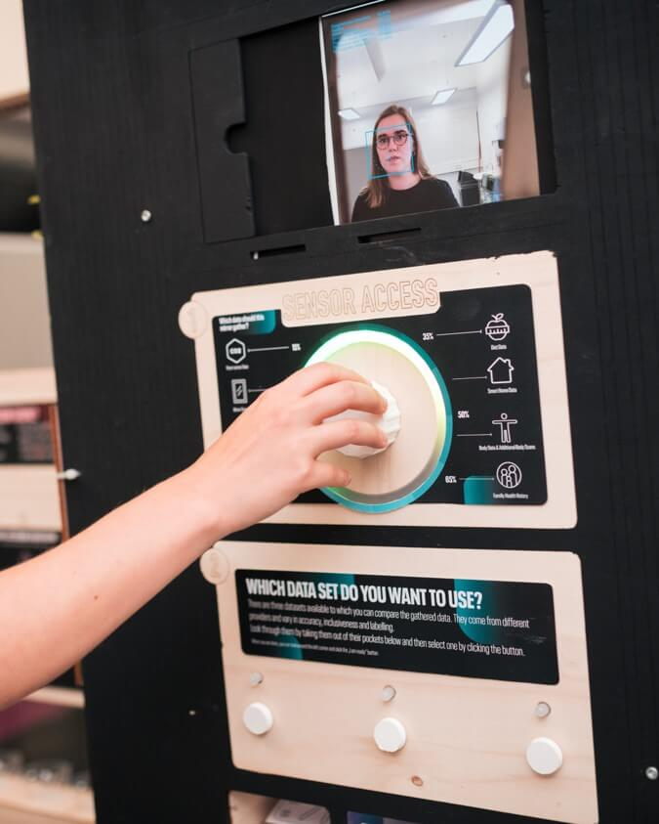


Design
and Artificial Intellegence
AI systems are increasingly applied to decision making across key aspects of everyday life. Our research focuses on developing knowledge and methods for trustworthy AI, partnerships with AI, and the design of AI. In these areas, we work collaboratively with computer scientists and ethics experts concentrating on real world settings for a better society.
User centered
Holisticapproach
We think creatively and critically about how humans and non-humans interact and form new ecosystems.
17

Slide 18
Education
at IDE

Slide 19
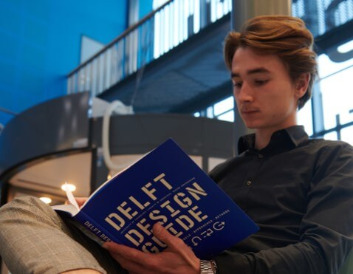
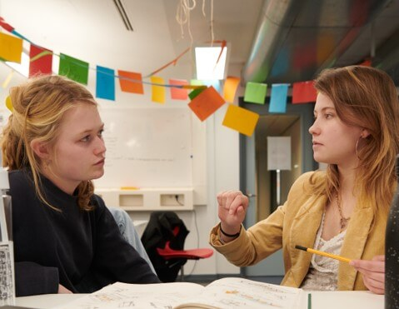
Bachelor’s Education
3 Year Dutch Programme
Pillars of People, Technology, Organisation
Always Designing
Methods-based
Design for Complexity
Notes:
These societal challenges are also very much part of our Bachelor's education. Our students are given the tools, methods and competences needed to tackle complex societal challenges.
Through our programme (which was redesigned in 2021), we ensure students are able to put theory into practice with design projects that run throughout the three-year-long programme.
Our graduates are creative autonomous designers who have the tools to respond to complexity in a concrete way.

Slide 20
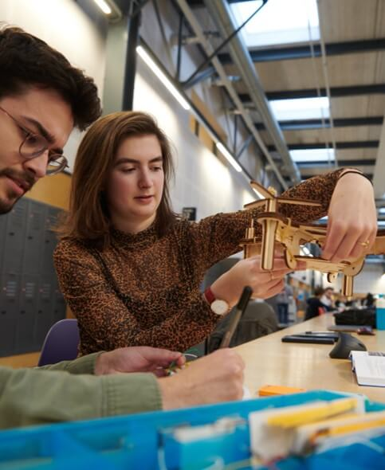
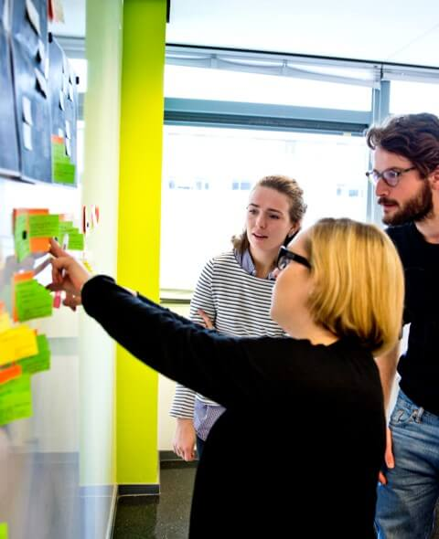
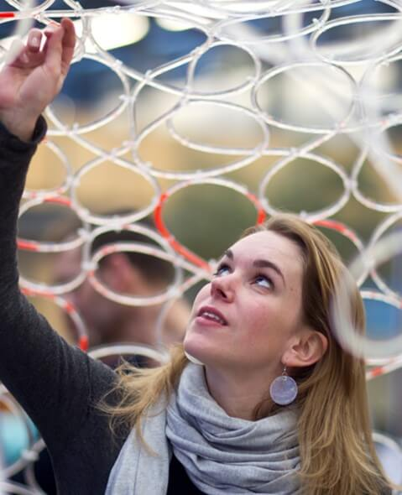
Masters Education
Integrated
Product Design
Strategic
Product Design
Design for Interaction
Notes:
Many bachelor students (STAT needed) continue at the faculty after their bachelors for a master’s degree in one of 3 (English language) programmes currently on offer at the faculty, together with a contingent of international students.
Integrated Product Design
Strategic Product Design
Design for Interaction
During the master’s, students continue to hone their skills in the design process but also develop skills as researchers. All students graduate on a project for stakeholders – whether a company or another organisation. This means that our alumni are well-prepared for the challenges of having real-world impact.
As our Bachelor’s education programme has recently been renewed to better prepare students for design for complexity and impact, our Master’s programme is also undergoing a renewal programme.

Slide 21
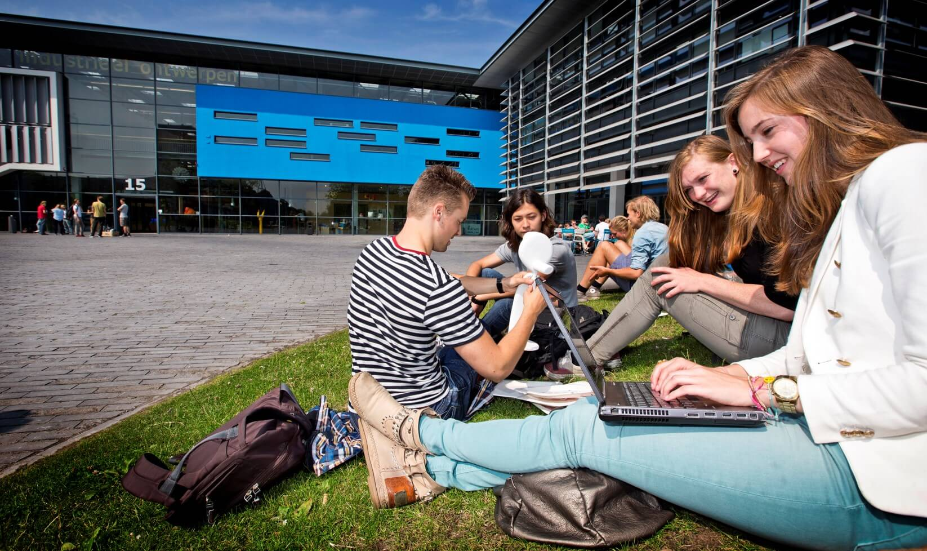
IDE
Students

Slide 22
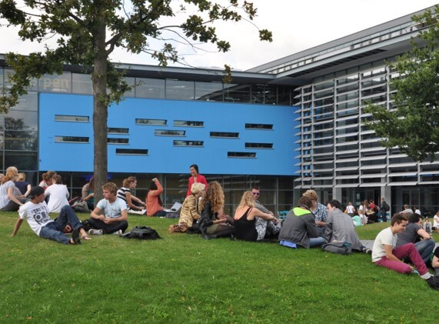
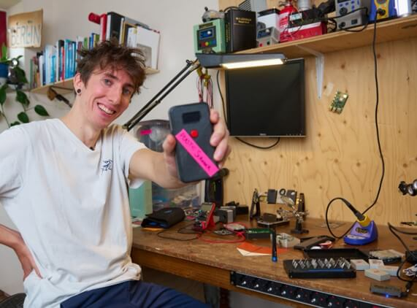

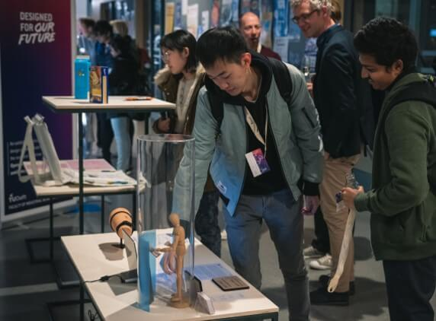
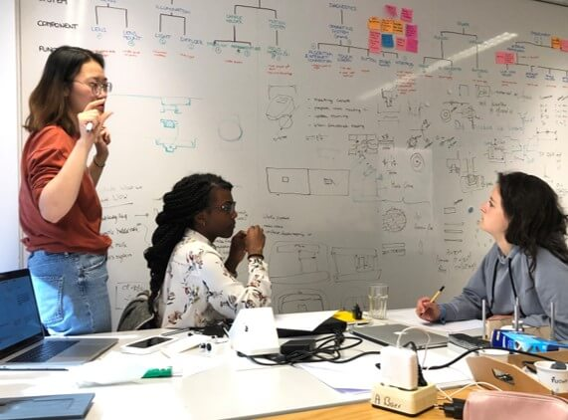
ID study association
Award
winners
Design
Exhibitions
Dream Teams

Slide 23
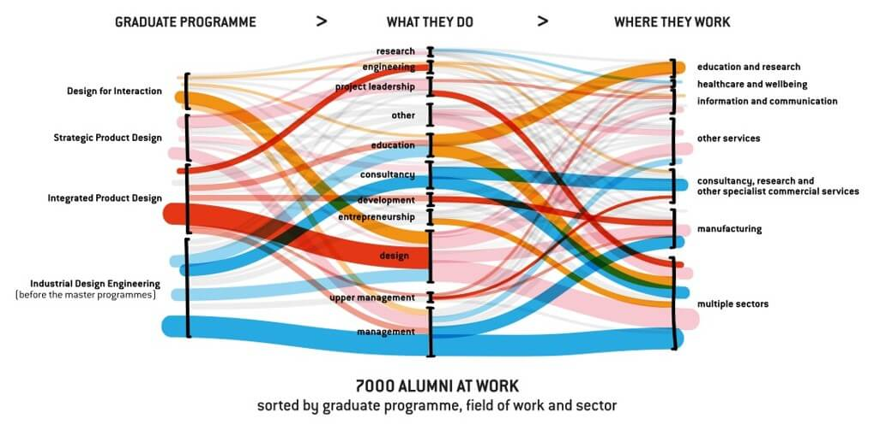
Alumni Impact

Slide 24
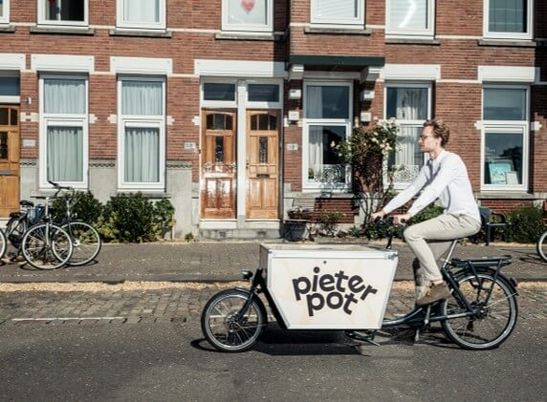
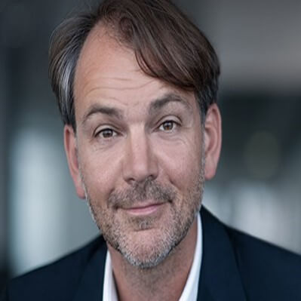
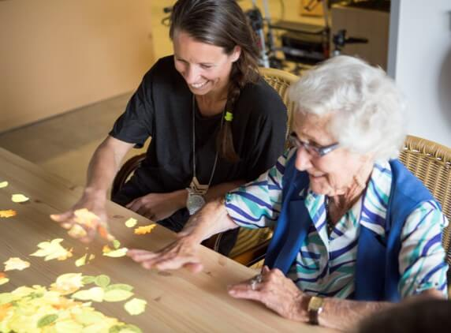
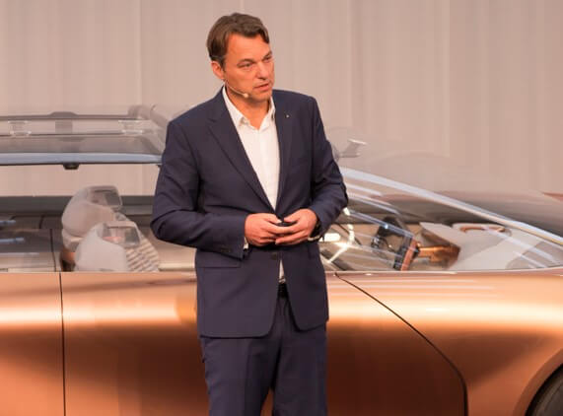
Pieter Pot
Joeri Schoemaker
BMW
Adrian van Hooydonk
Tovertafel
Hester Le Riche
Renault
Laurens van den Acker

Slide 25

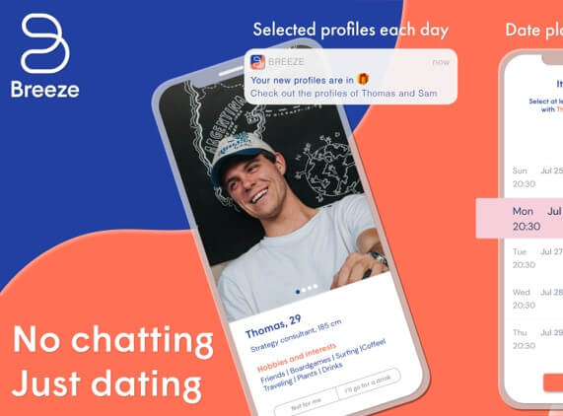
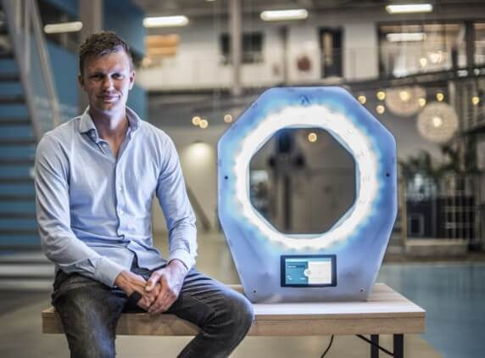
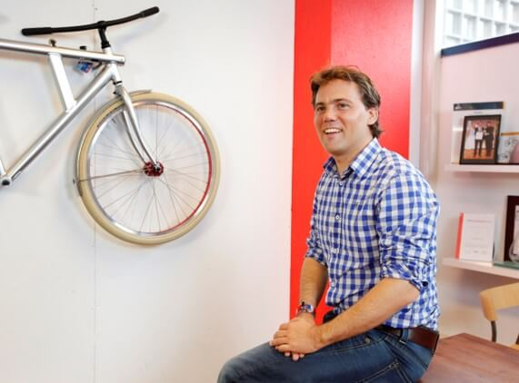
Praxa Sense
Leonard Moonen
Marsha Goei
Breeze
Manometric
Pieter Smakman
VanMoof
Taco Carlier

Slide 26
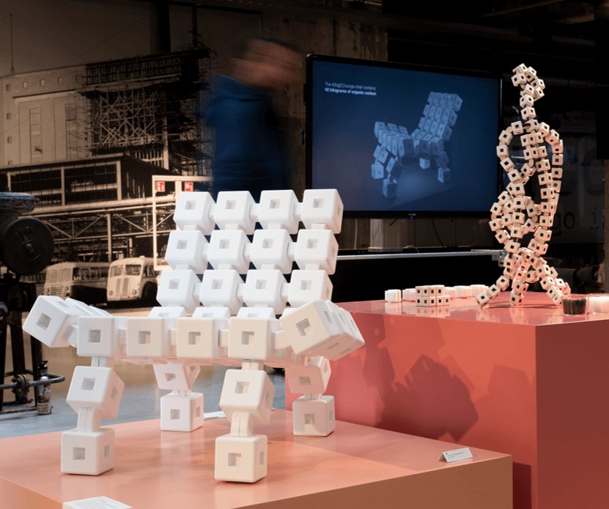
Developments in Design
Riel Bessai
IDE alumnus of the year 2021
Modular chair
CO2 storing blocks
Notes:
Can be used for a project page, example page, etc

Slide 27
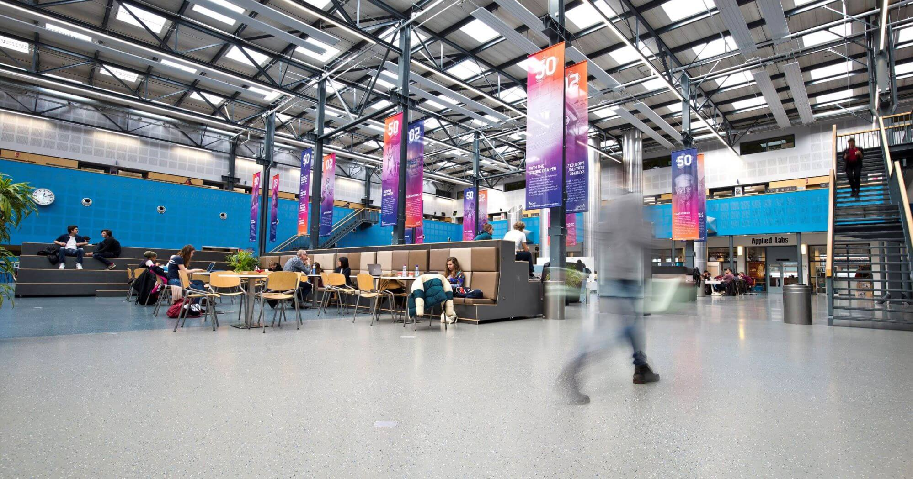




Follow us
@idetudelft
Notes:
Can also be used for a closing message

