Slide 1


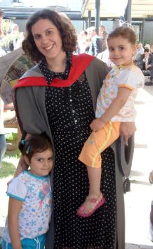
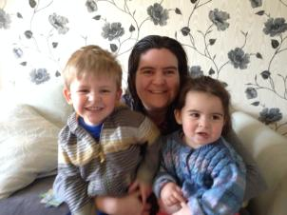
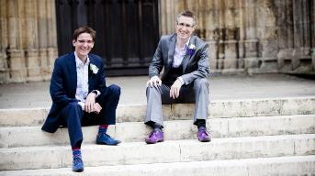
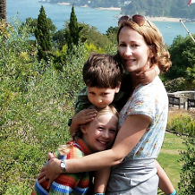
What does it take to become a golden department for gender equality?
Athena SWAN in Chemistry@York
Dr Caroline Dessent
Chair of Equality and Diversity Group
Dewis Symposium
March 4th, 2019

Slide 2
Overview
● Something about me
● Good policies benefit everyone
  Flexible working assurance
  Promotion, quality over quantity
  Recruitment, unconscious bias observer scheme
● The Athena SWAN scheme

Slide 3
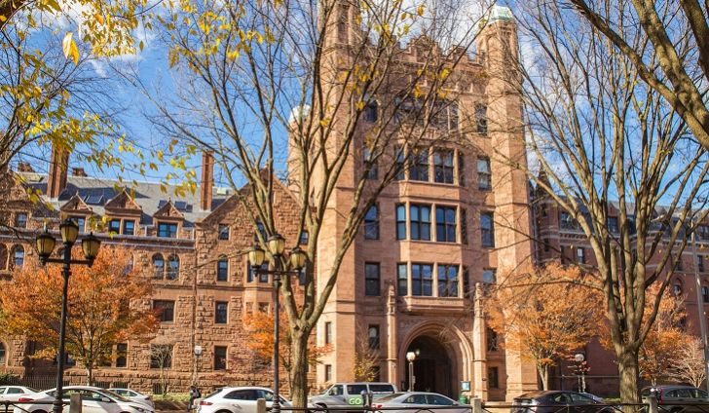
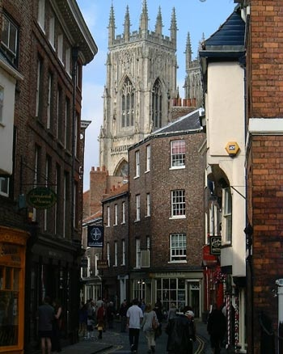




A career snapshot: timeline 1
University of York, 1997:
  Post-doctoral fellow: 1997-1999
  Royal Society University Research Fellow: 1999-2008
  ERC Starting Independent Research Fellow:2008-2015
  Senior Lecturer: 2015-2017
  Reader: 2017-

Slide 4
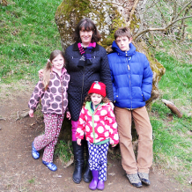
Timeline 2: Family
James 2000
Grace 2005
Kitty 2009

Slide 5
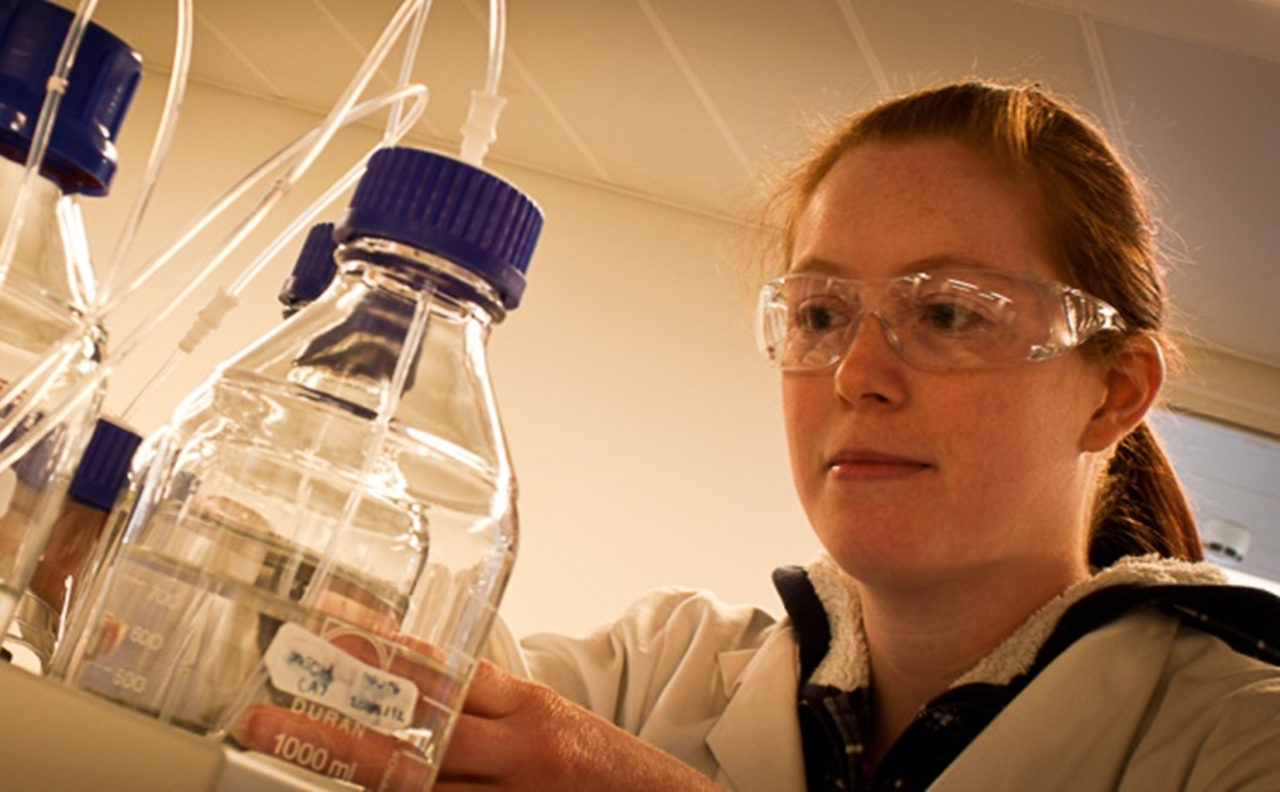
Chemistry at York

Slide 6
UK Universities Chemistry Pipeline
% Male 2004
% Male 2014
% Female 2014
% Female 2004
Notes:
National data
Orange line shows %F at UK universities at each career stage (solid line 2014, dotted line 2004)
Classic scissors shape shows huge drop off from MSc level – we are LOOSING TALENT
Should always plot equality data over time to show progress (some slow progress seen over ten years but %F UG actually getting worse even though 50% A-level chemists are now F)

Slide 7
York Chemistry Pipeline %F
Notes:
Our York chemistry data shows that we have no leaky pipeline up to lecturer.
Then we see drop off but better than national average. 16 % of profs are Female compared to 9% nationally (9% of all F UK chemistry professors are at York).

Slide 8
Chemistry at York
Female senior academic staff (SL, R, Prof)
% Female senior staff
Number of
female senior staff
Notes:
Combination of recruitment and promotion

Slide 9
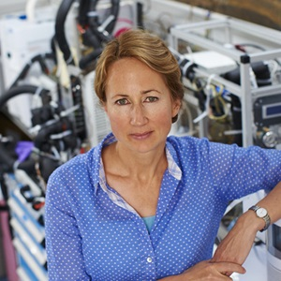
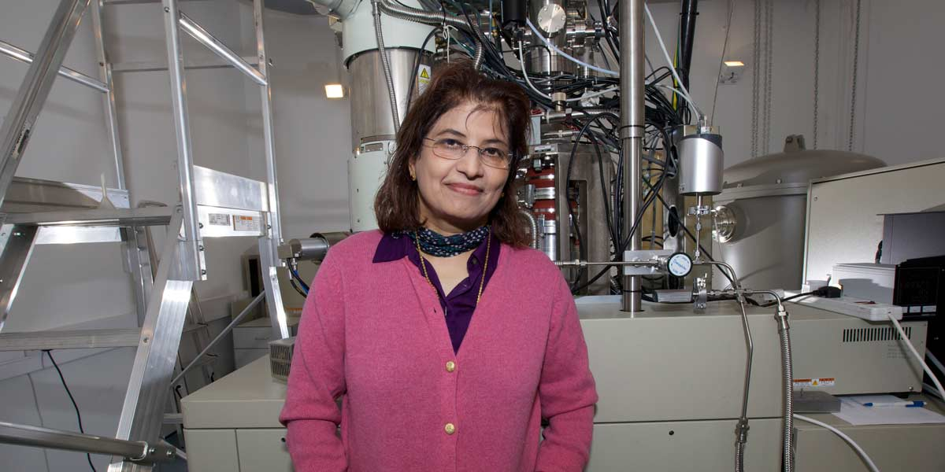
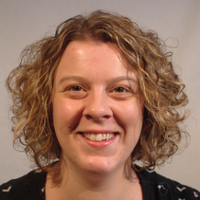
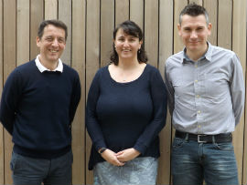
Chemistry at York
“Home-grown” Female Success
Prof. Lucy Carpenter: 2000:
Royal Society Rosalind Franklin Award 2013
RSC Tilden Award 2017
Prof. Pratibha Gai: 2007: L’Oreal-Unesco Women of Science Award 2013
Dr Kirsty Penkmann: 2006:
RSC Joseph Black Award 2016
Dr Jacqui Hamilton: 2009: Desty memorial Award For Innovation in Separation Science
Notes:
Combination of recruitment and promotion

Slide 10
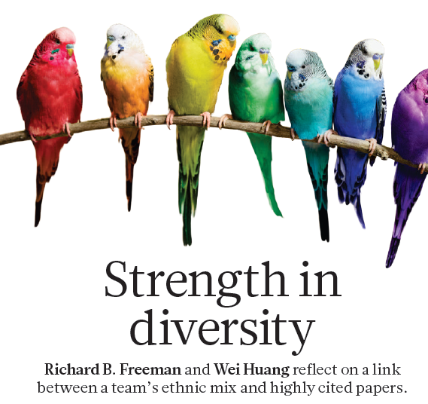
Homophily
Nature, 2014, 513, 305.
Notes:
Combination of recruitment and promotion

Slide 11
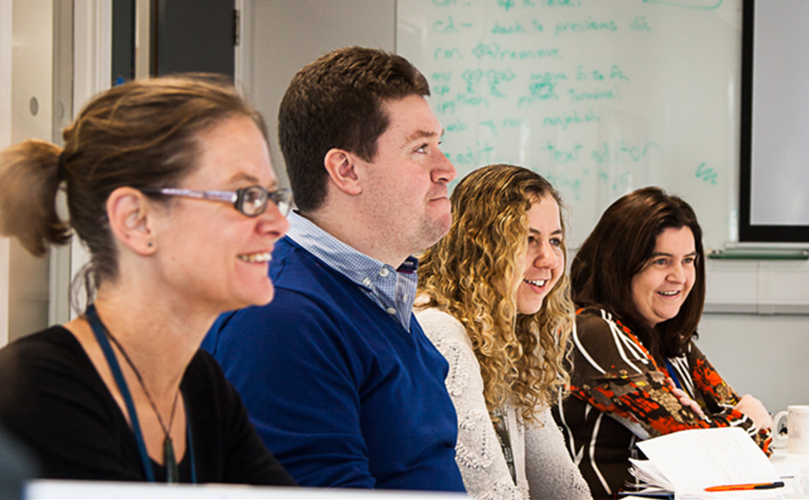
Good policies benefit everyone

Slide 12
Family-friendly Policies
Part-time working, job shares, annualised hours,
flexi-time, meetings in core hours
Part-time working assurance
  increased uptake of part-time working (M+F)
Benefits men and women
Adoption leave policies
Promotion to professor whilst working part time
  Quality over quantity

Slide 13
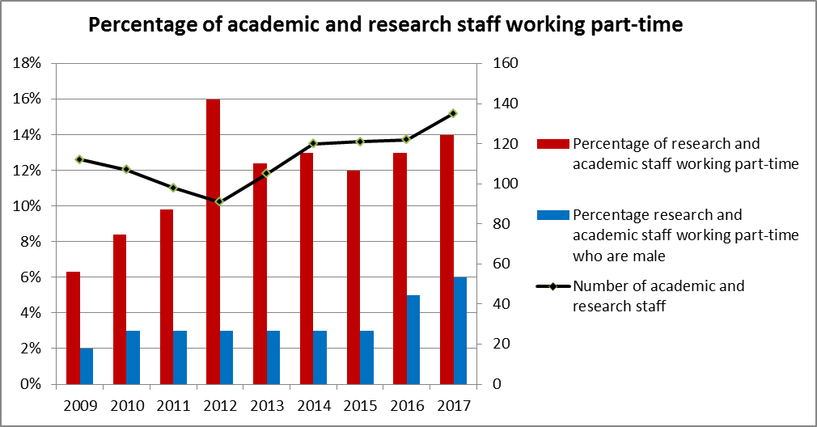
Family-friendly policies:
Part-time working

Slide 14
Promotion
Focus should be on quality not quantity
Value full range of tasks an individual contributes
Workload model
Worked with university to ensure criteria assess
  quality
  academic citizenship/admin activities
  PT working and periods of leave
  taken into account

Slide 15
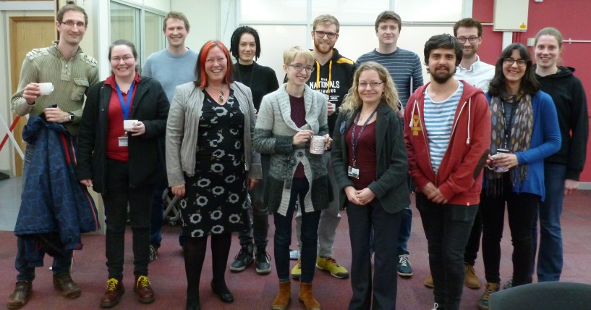
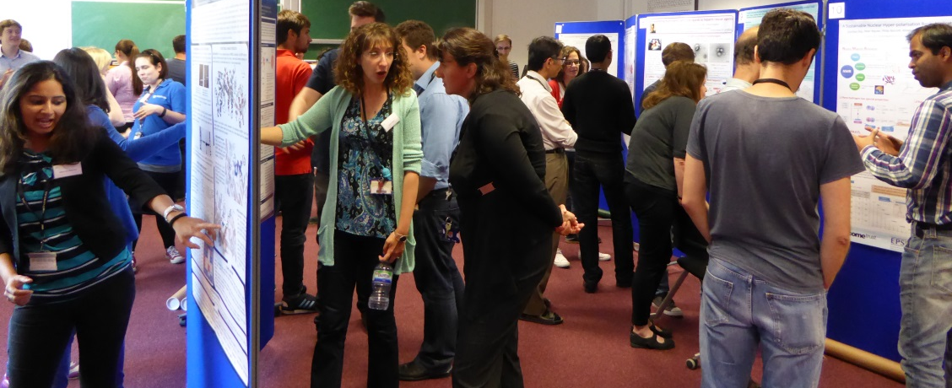
Support for Postdocs
Concordat
Induction and mentoring
Researcher ‘Champion’
Fellowship day
One to one careers and fellowship writing support
Teaching and summer student opportunities
Networking lunches with visiting speakers
Annual postdoc poster prize
Joliot Curie Conference
Confidence

Slide 16
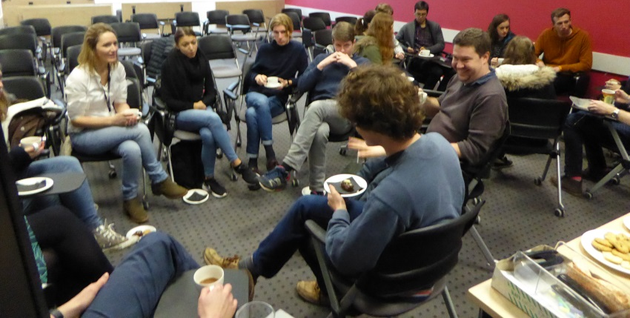
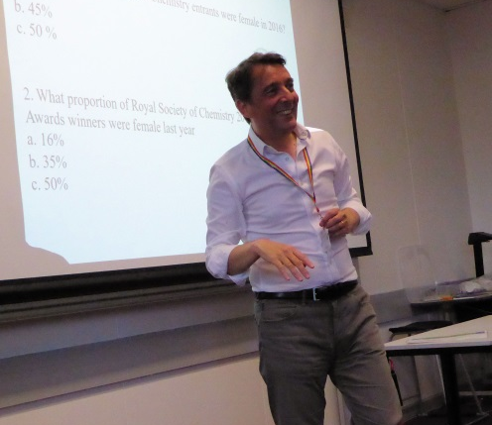
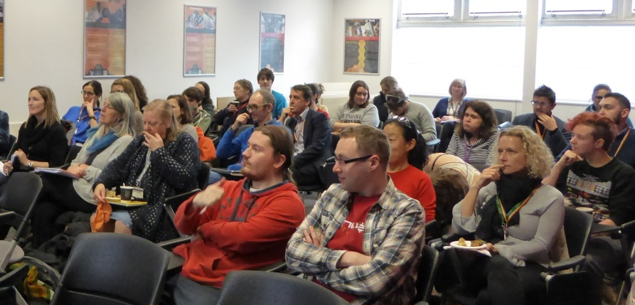
E&D training and culture
Recruitment and UB training for staff
  Online UB training introduced
PGR equality and diversity training introduced 2015
  equality act, gender equality statistics and literature, unconscious bias, being an active bystander, mental health, cultural and disability awareness
UG training introduced 2017
Annual diversity talk and beacon seminars
Lunchtime fora
  Work-life balance, mental health, LGBT+ issues, impostor syndrome

Slide 17
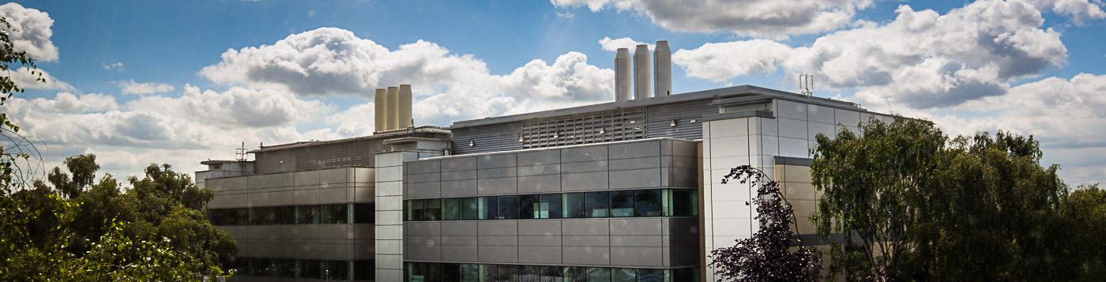
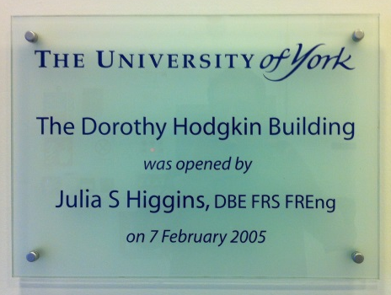
Put equality at the heart
of everything you do
Equality matters standing item at all committees
Academic group leaders have responsibility for E&D
Family friendly social activities
Outreach
Culture survey
Pay gap data published and discussed

Slide 18
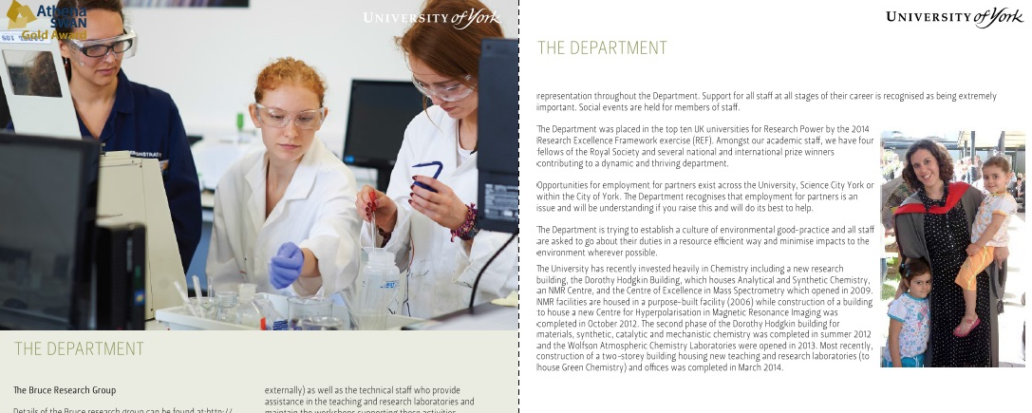
Recruitment
Revised advertising material to encourage F applicants
  Gendered language
  Images
  Flexible working/family friendly info
  Strap-lines
Recruitment training for all panellists
Unconscious bias observer scheme

Slide 19
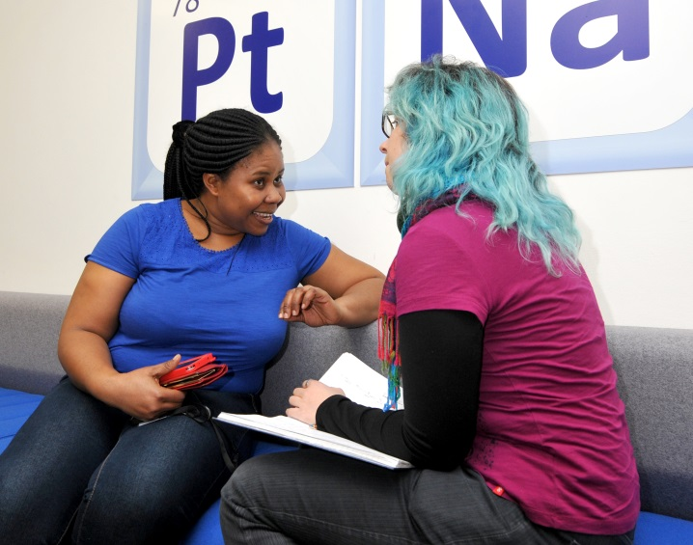
Moving forward
Broadening of equality and diversity group remit to include all protected characteristics
Disability and mental health
LGBT+
BME and internationality
Professional and support staff

Slide 20
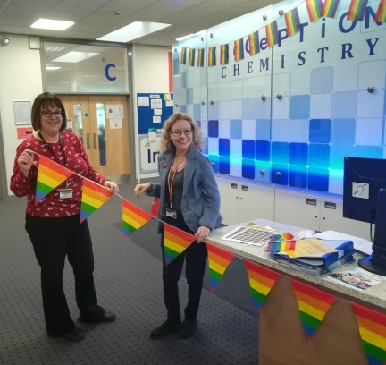
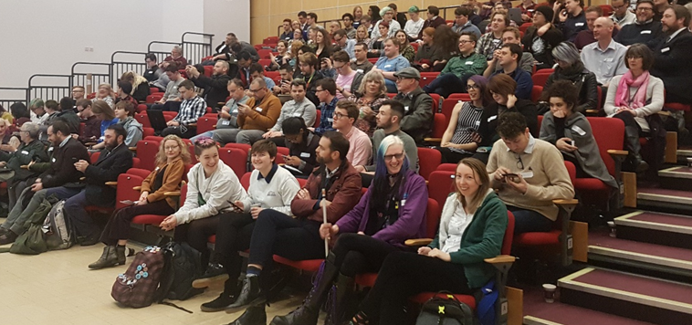
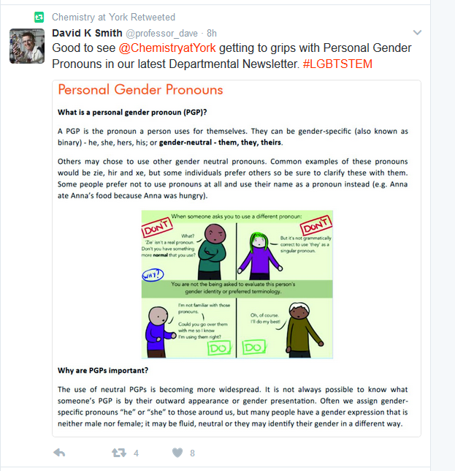
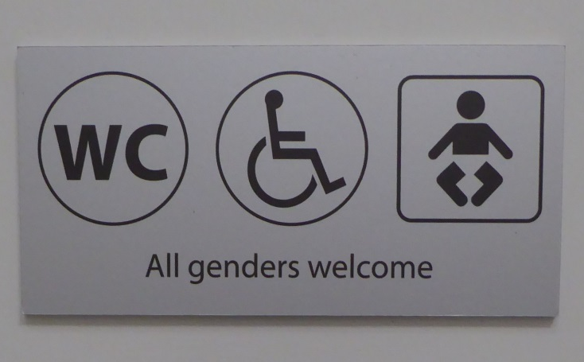
LGBT+ inclusion
Fostering inclusive culture
High profile out staff, social media presence
Invited career talks from LGBT+ scientists
LGBT+ STEMinar 2018
Listen to our students
Gender pronouns guide
Trans* awareness training
First department in York to
introduce all genders toilets

Slide 21
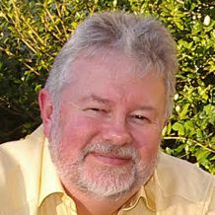
Ingredients for success
Widespread commitment to achieving equality and diversity
Real support from senior
management
Policies that benefit women and men
Money (+ Personnel)
Prof Duncan Bruce
Head of Department

Slide 22

THE DEPARTMENT OF CHEMISTRY
Equality and Diversity
First academic department in the UK to receive the Athena SWAN Gold award.
Awarded in 2007, renewed in 2010 and 2015
Longest held Athena SWAN Gold
10 years this year
Notes:
So what are we doing to support equality in the dept?
Longest held gold award
Gold means a substantial and well-established activity and achievement record in working towards equality in career progression
And beacon activities (dissemination of good practice).

Slide 23
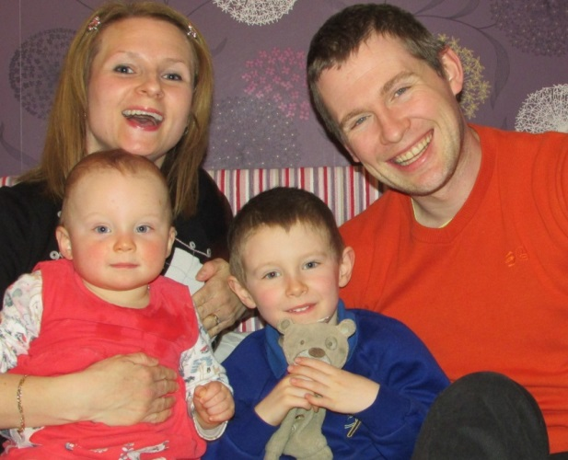
Athena SWAN Charter
‘Recognising advancement of gender equality: representation, progression and success for all’
Established 2005
‘To encourage and recognise commitment to advancing the careers of women in (STEMM) in higher education'
Looks at:
representation
progression of students into academia
journey through career milestones
working environment for all staff
Charter expanded May 2015 to include:
All academic departments
Support staff
Trans* staff and students
Gender equality (not just barriers that affect women)
Notes:
In case you are not familiar with the Athena SWAN scheme

Slide 24

Athena SWAN Principles
Recognise the talents of all
Advance gender equality
Recognise differences across disciplines
Tackle the gender pay gap
Remove obstacles to progression
Address short-term contracts
Tackle discrimination against trans people
Demonstrate senior commitment
Make structural and cultural changes
Consider intersectionality
Notes:
The principles are what the University has signed up to as a member of the Charter = effectively the contract we have with our staff and students
Abbreviated version of:
1. We acknowledge that academia cannot reach its full potential unless it can benefit from the talents of all.
2. We commit to advancing gender equality in academia, in particular, addressing the loss of women across the career pipeline and the absence of women from senior academic, professional and support roles.
3. We commit to addressing unequal gender representation across academic disciplines and professional and support functions. In this we recognise disciplinary differences including:
the relative underrepresentation of women in senior roles in arts, humanities, social sciences, business and law (AHSSBL)
the particularly high loss rate of women in science, technology, engineering, mathematics and medicine (STEMM)
4. We commit to tackling the gender pay gap.
5. We commit to removing the obstacles faced by women, in particular, at major points of career development and progression including the transition from PhD into a sustainable academic career.
6. We commit to addressing the negative consequences of using short-term contracts for the retention and progression of staff in academia, particularly women.
7. We commit to tackling the discriminatory treatment often experienced by trans people.
8. We acknowledge that advancing gender equality demands commitment and action from all levels of the organisation and in particular active leadership from those in senior roles.
9. We commit to making and mainstreaming sustainable structural and cultural changes to advance gender equality, recognising that initiatives and actions that support individuals alone will not sufficiently advance equality.
10. All individuals have identities shaped by several different factors. We commit to considering the intersection of gender and other factors wherever possible.

Slide 25
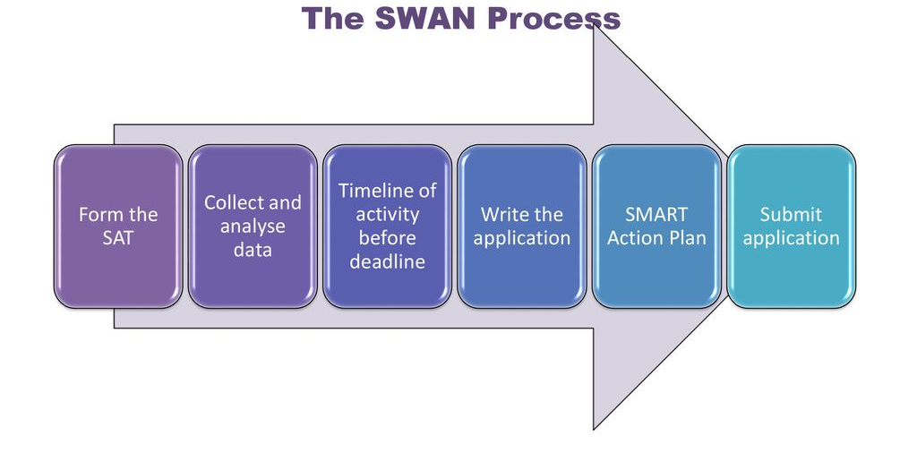

Slide 26
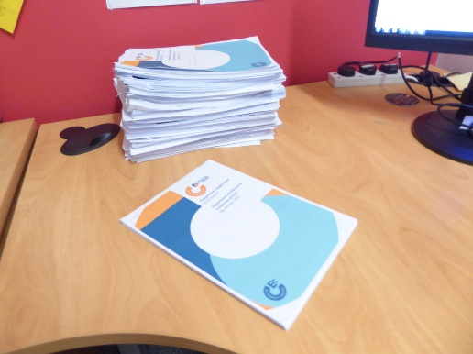
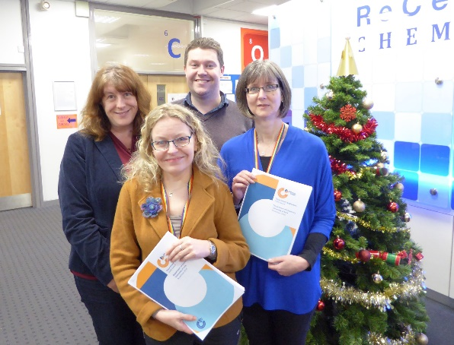
The Application (Department)
Letter of endorsement from the HoD
Description of the department
The self-assessment process
A picture of the department
- (student and staff data)
Supporting and advancing women’s careers
- career transition points
- career development
- flexible working/career breaks
- organisation & culture
Case studies (higher awards only)

Slide 27

Athena SWAN Awards
Bronze = promotion of gender equality; assessment of data; identification of issues; plan of future actions
Silver = actions undertaken to address identified issues; impact of those actions can be demonstrated
Gold = significant, sustained progress and achievement; continued impact; beacons of achievement

Slide 28
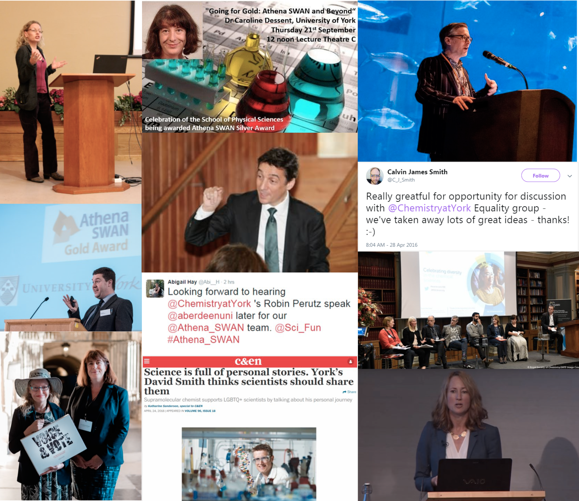
Some Beacon Activities from Chemistry@York

Slide 29

How are Awards Decided?
Assessment panel 5-6 people
Mixture of academics and professional and support staff
All have some experience of equality and diversity work
Panel reaches consensus on whether an award is given

Slide 30
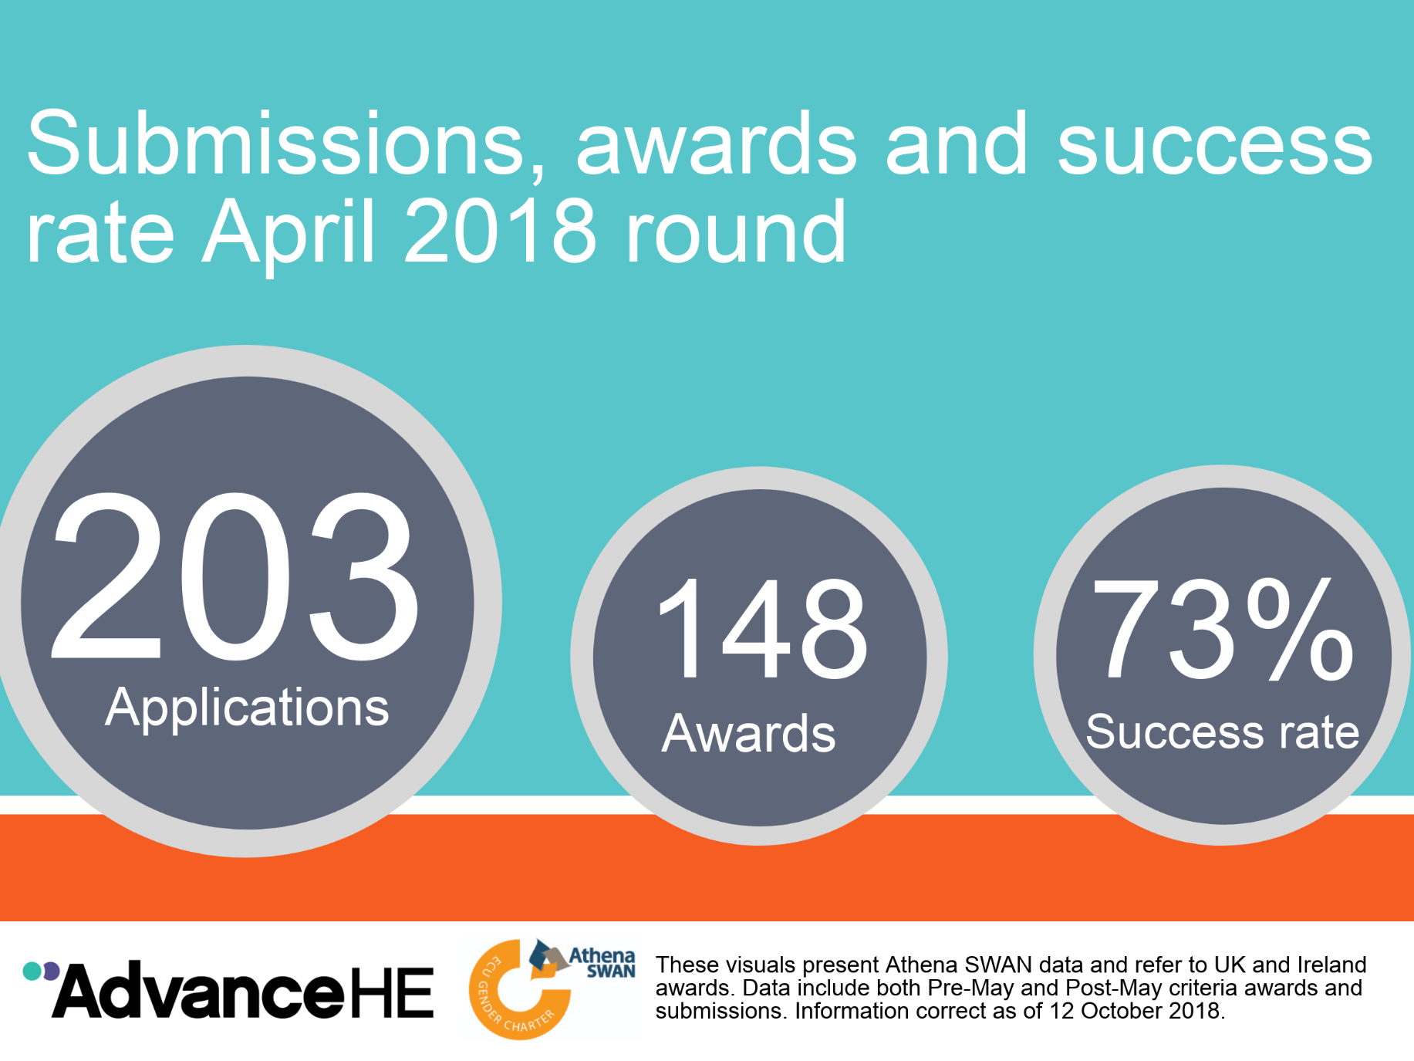
Success Rates

Slide 31
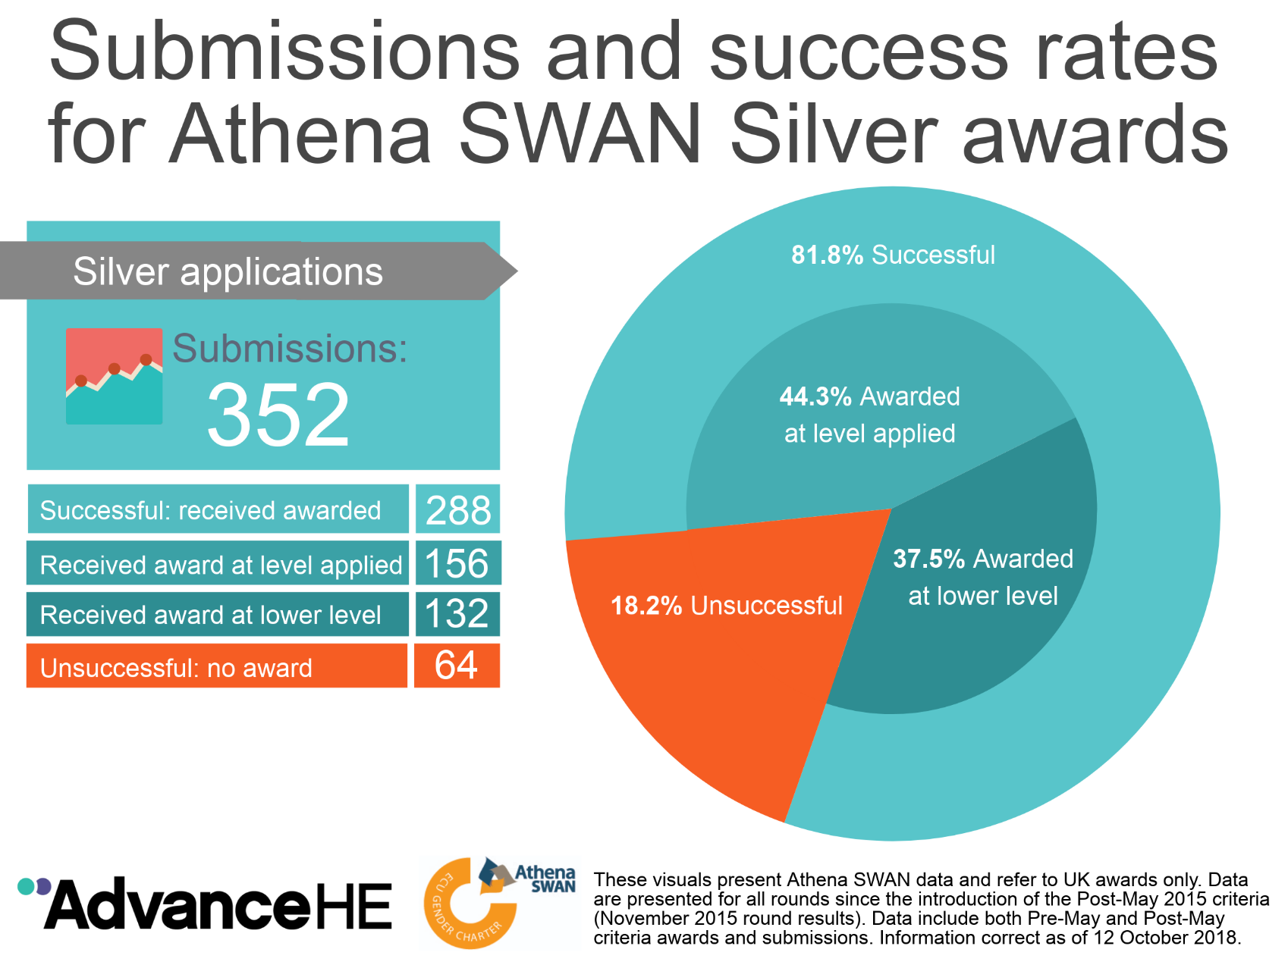
Success Rates

Slide 32

Pros and Cons of Athena SWAN
Advantages
Requirement for data analysis drives action
Emphasis on policies and process ensures that actions continue when people change
Disadvantages
Formal aspects of submission involve a lot of work
Disheartening when an application is unsuccessful
Trial & error - most effective way to drive change?

Slide 33
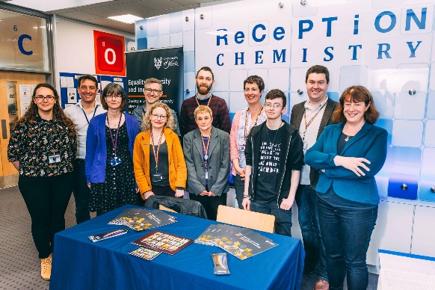
Acknowledgments
Dr Leonie Jones, Dr Helen Coombs,
Chemistry Dept. Equality and Diversity Group (EDG) at York
Thank you!

