Slide 1
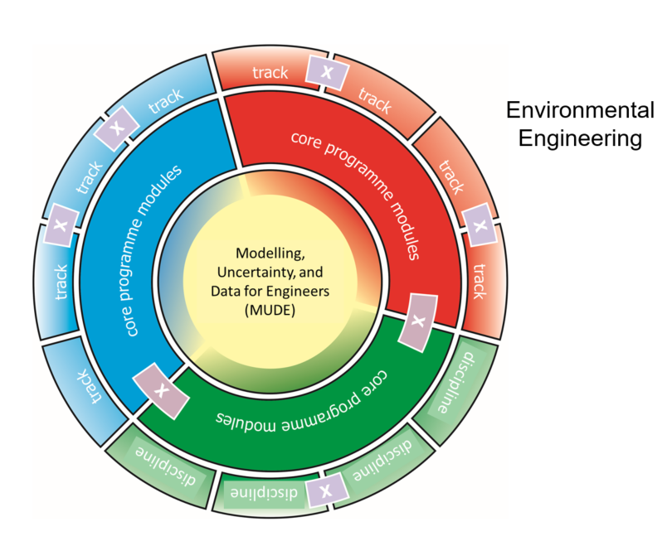
MSc Environmental Engineering Information for third-year bachelor students Room D

Slide 2
Overview programme MSc EnvEng

Slide 4
Water and Resource Engineering (WRE)
Core track module
Environmental Water Quality & Biochemical processes
Environmental Water Quantity & Hydrological processes
Water Resources Engineering system design
Project: Data quality and data analysis; Evidence based advice

Slide 6
Possibilities and choices in programme MSc MSc EnvEng
Choices between tracks and modules within those tracks
Choices of project topics within the modules
Q5: Broadening: JIP, MDP, Internship, study abroad
Specialisation: in depth free electives
Q6 Cross over modules
Q7-8 thesis topic

Slide 7
Preparations for MSc MSc EnvEng

Slide 8
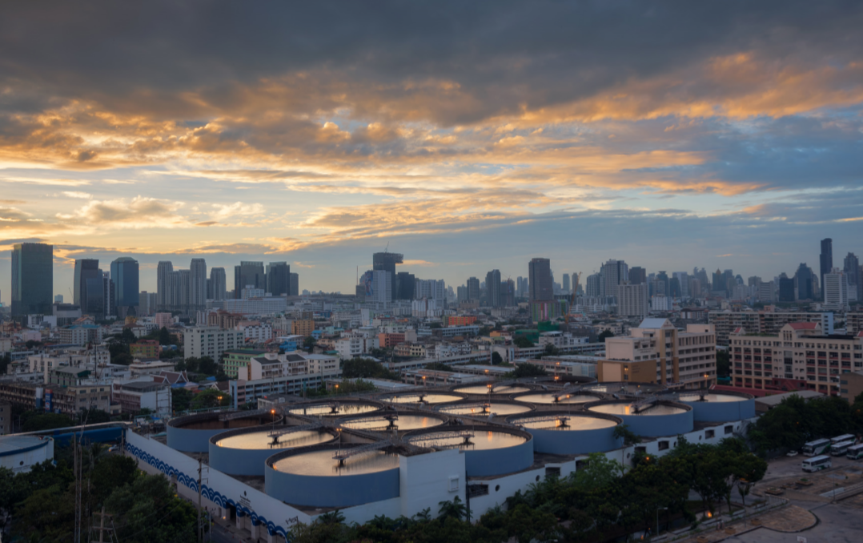
Questions? Live and in the chat
More info
Merle de Kreuk
CITG, room 4.61
T: (015 27)85274
E: environmental-engineering@tudelft.nl
Study Advisors:
Studyadvisors-CEG@tudelft.nl
https://dispuutwaterandenvironment.com/
www.tudelft.nl/onderwijs/opleidingen/masters
Student portal: FAQ

