Slide 1
MSc programmes CEG Core Faculty Module Modelling, Uncertainty and Data Information for third-year bachelor students
29 September 2021
Room A

Slide 2
General introduction, MUDE and Cross-overs: Before we start…
The general introduction about all three new MSc programmes at CEG is presented in room A. This is also streamed to rooms B, C and D.
You can ask your questions after the presentation.
Students watching from home can ask their questions in the Teams chat (Teams link in invitation). Please turn off your camera and microphone in this Teams meeting.
All sessions are recorded. Recordings will be made available on portal and Brightspace.

Slide 3
Time | Activity | Lecture hall
12.45-13.00 | General introduction new MSc programmes, MUDE and Cross-overs | A
13.05-13.30 | MUDE and Cross-overs Overview programme and content Possibilities and choices in programme Preparation Questions | A
13.05-13.30 | Environmental Engineering Overview programme and content Possibilities and choices in programme Preparation Questions | D
13.05-13.30 | Civil Engineering Overview programme and content Possibilities and choices in programme Preparation Questions | B
13.05-13.30 | Applied Earth Sciences Overview programme and content Possibilities and choices in programme Preparation Questions | C

Slide 4
General introduction
Why redesigned and new programmes?
To educate students to become and remain world class engineers
Future-proof programmes
Multidisciplinary with ‘real life’ and current challenges
Explicit focus on research and design cycle, methodology, writing and presentation skills
Structure master programmes Common elements:
MUDE, CO, Q5, thesis preparation and thesis
Admission
Admission to programme (not track)

Slide 5
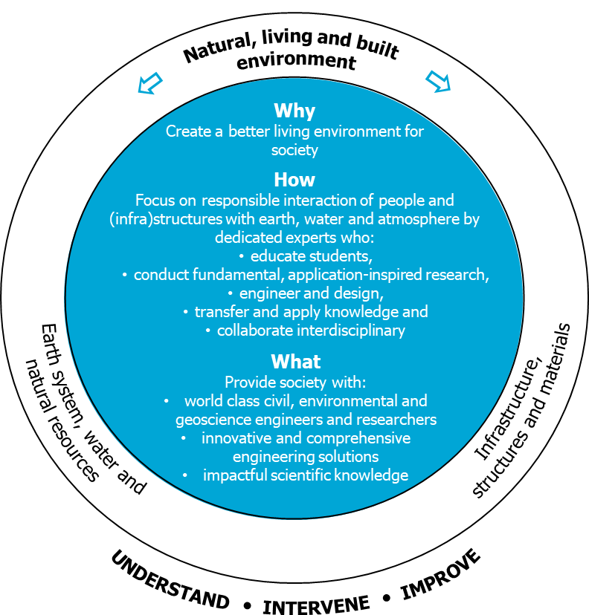
Faculty CEG strategic framework
OCT 2018
FEB 2019

Slide 6
Coherence new MSc programmes
Environmental Engineering
Civil Engineering
Applied Earth Sciences

Slide 7
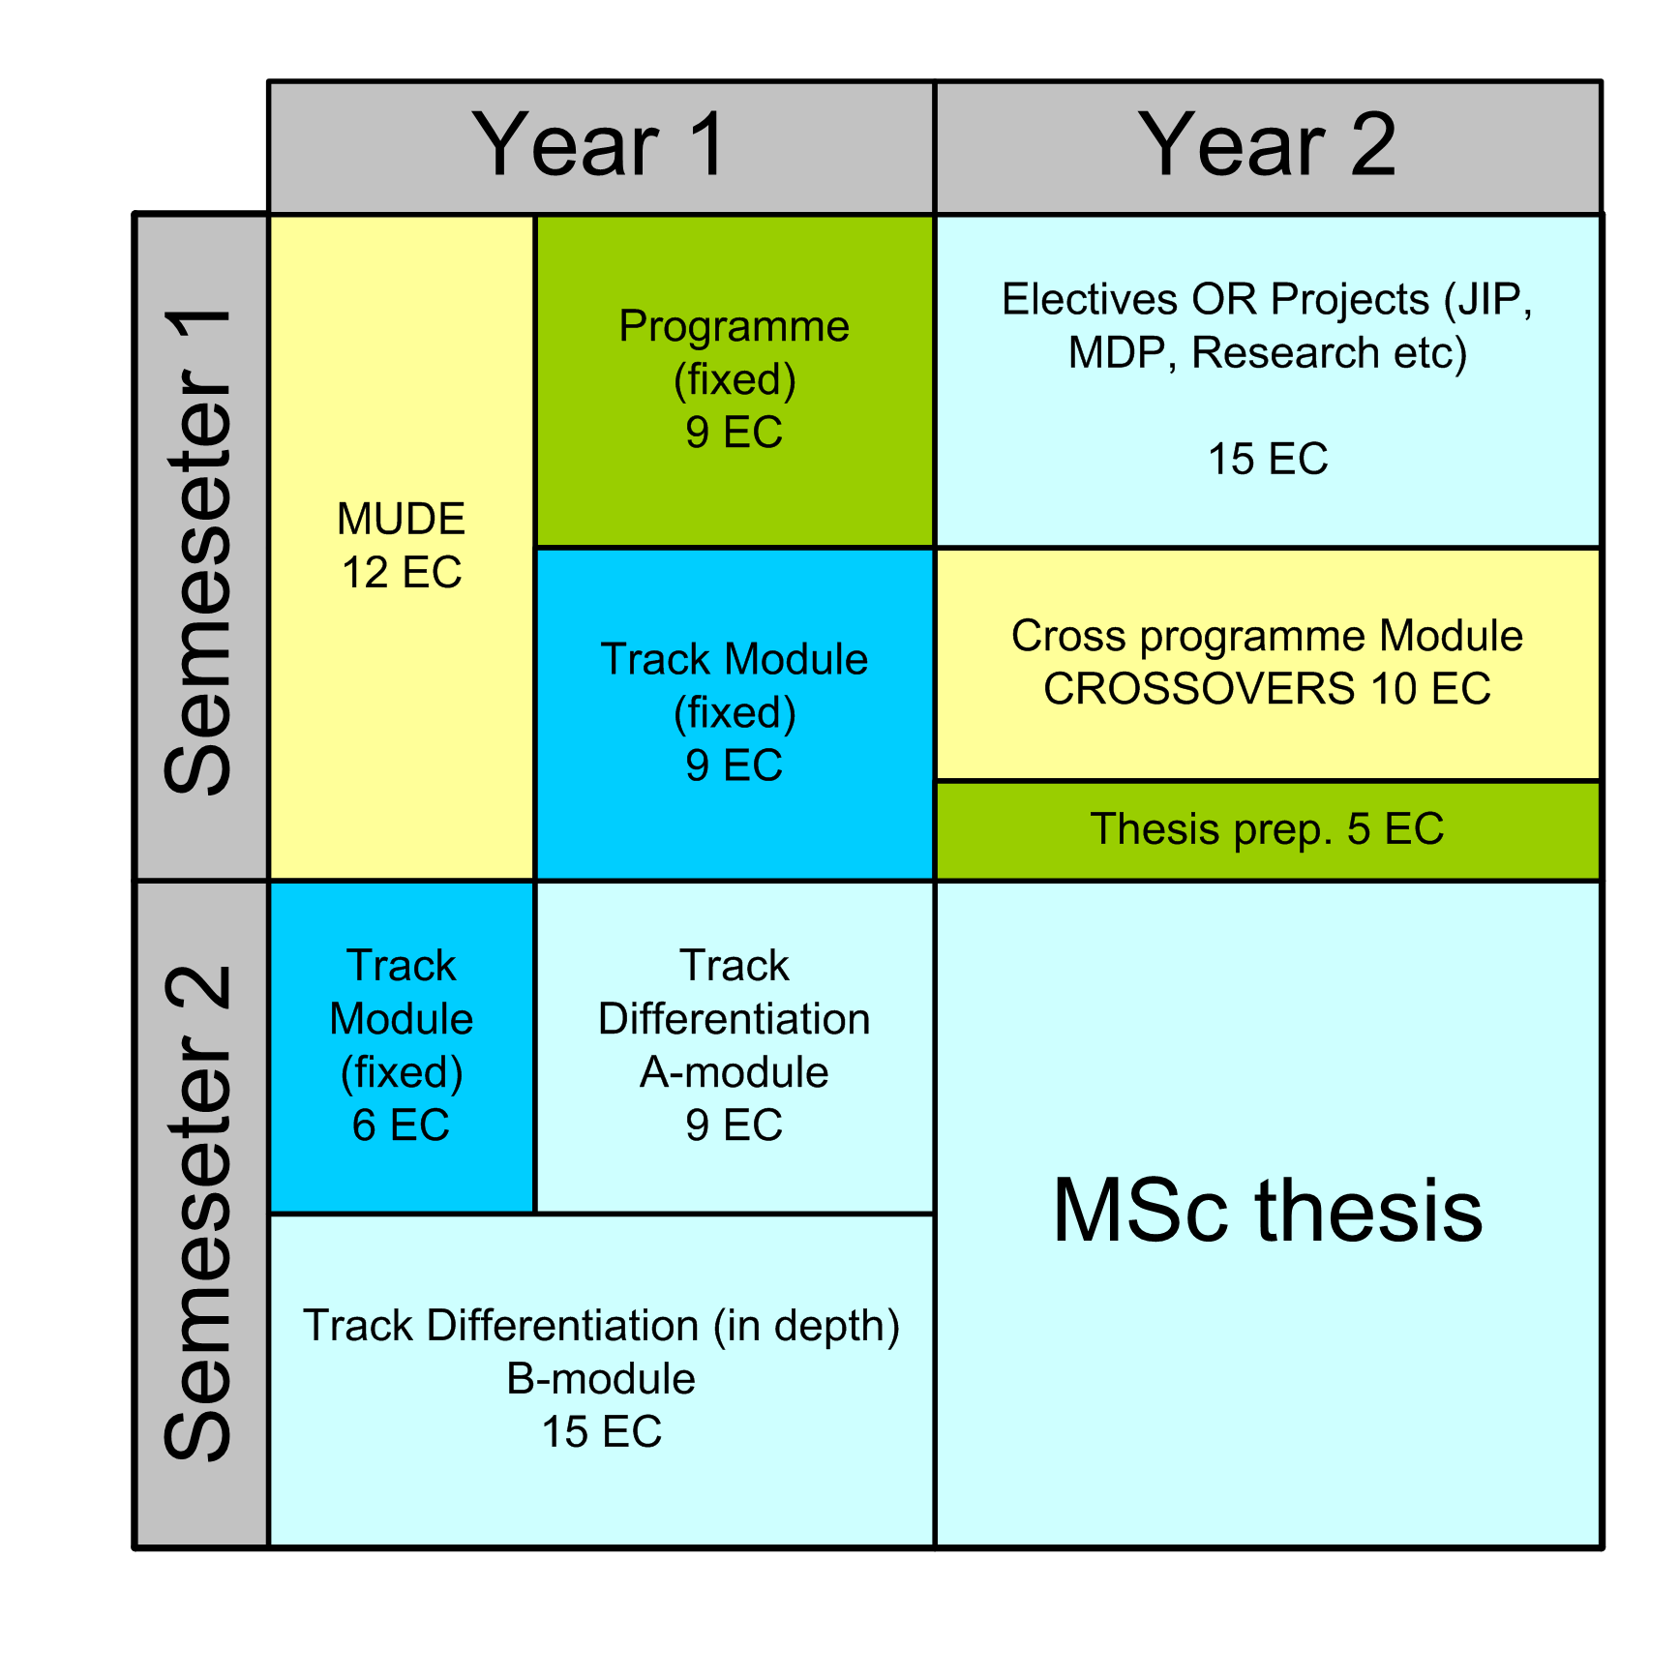
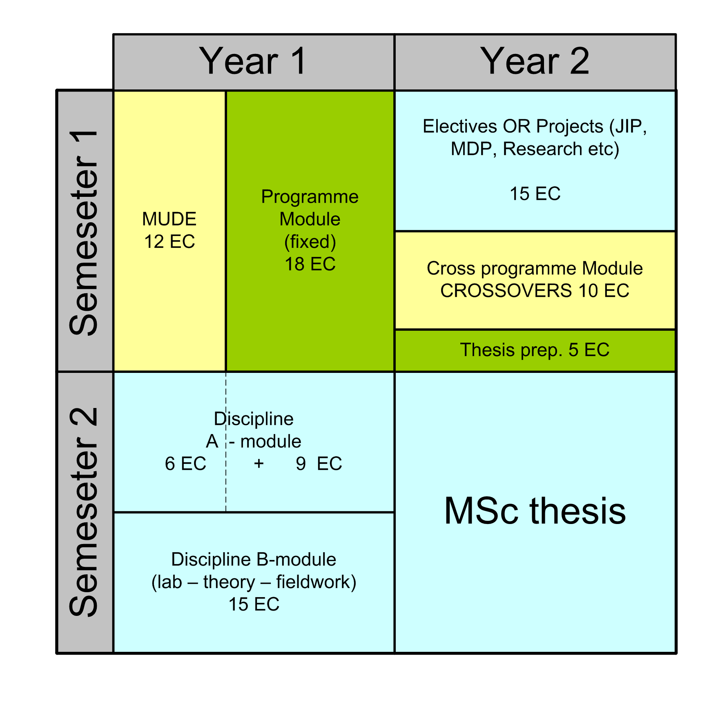
Structure new programmes
(Modular concept function/theme, coherence, in-depth, multiple options, track or discipline linked with electives and multidisciplinary elements, individual study plan)
Civil Engineering & Environmental Engineering
Applied Earth Sciences

Slide 8
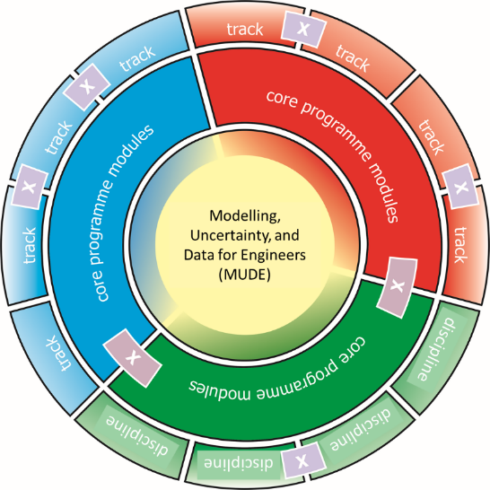
Modelling, Uncertainty and Data for Engineers (MUDE) Information for third-year bachelor students
29 September 2021
Room A

Slide 9
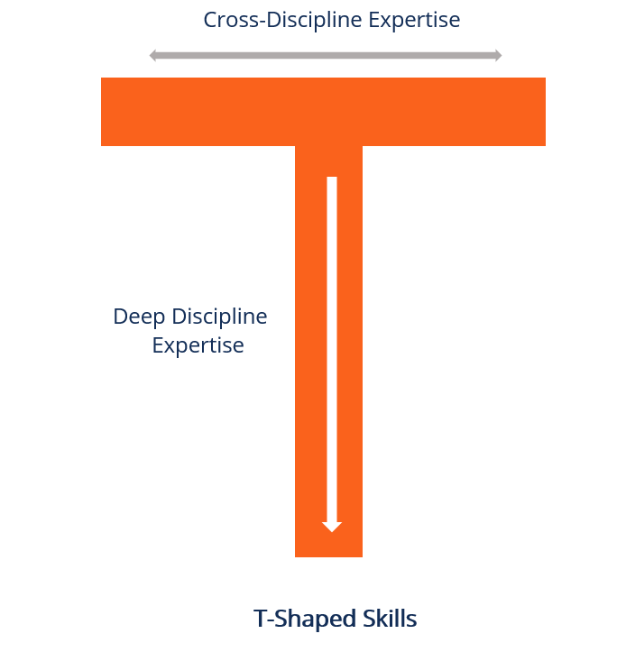
Modelling, Uncertainty and Data for Engineers (MUDE)
Landing zone
Engineering fundamentals
Skills / Compentences

Slide 10
Modelling, Uncertainty and Data for Engineers (MUDE)
Q1
Q2
Theory & Application
Theory & Application
Coding
Coding
Challenges & Project
Challenges & Project

Slide 11
MUDE: Applications and challenges
rainfall variability
merging traffic
drought indicators
steel gate design
railway structures
cracks in structures
cloud formation
drinking water treatment
crowd density
soil behaviour
subsurface activity
subsidence monitoring and modelling
… and many more

Slide 12
Cross-over Modules Information for third-year bachelor students
29 September 2021
Room A

Slide 13
Principles & Framework
10 EC in Q6 (September 2023)
Principles for CO Modules
Methodological (More on techniques)
Topical (More on topic)
Not mutually exclusive
Framework (Guidelines)
Multidisciplinary: at least interesting for 2 programs
Aligned with programs iLOs
Units thematically connected (coherent module)
Flexible: take into account needs of each CO

Slide 14
Learning Objectives
11 LOs aligned with intended Learning Outcomes of ENVE, AES & CIE
Not expected to cover all of them
Strong project-based component
Teaching teams from different programmes/tracks/faculties

Slide 15
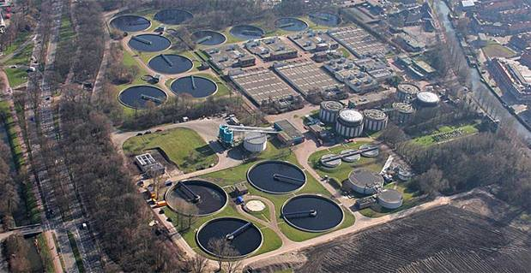
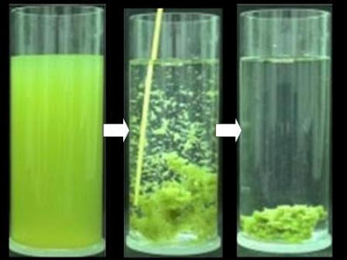
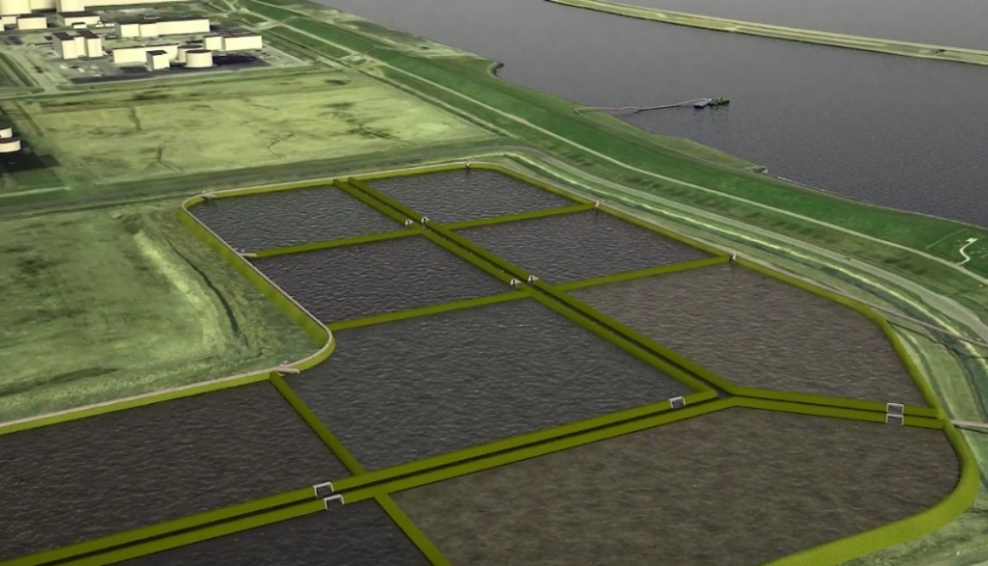
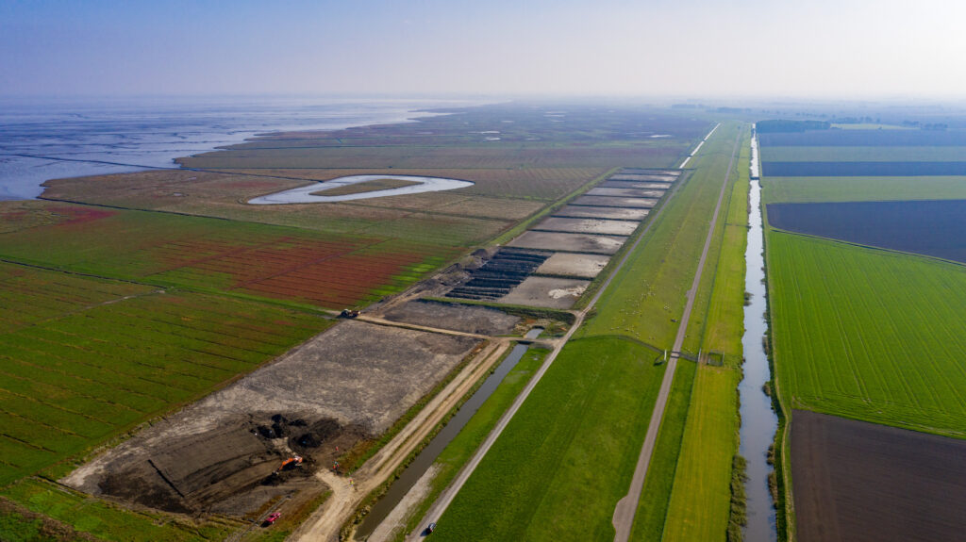
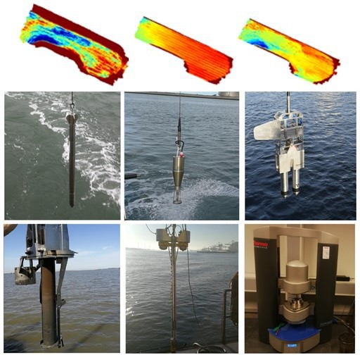
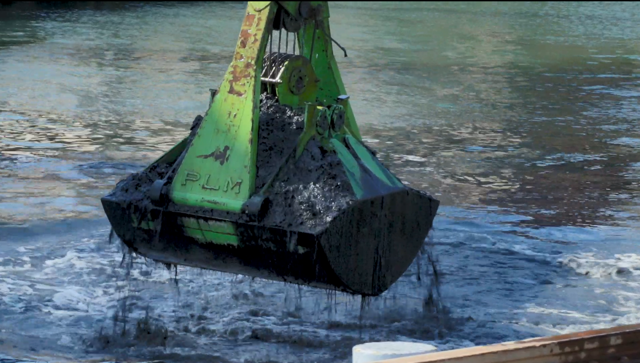
Sewage treatment (Utrecht)
Understanding MUD
Kleirijperij
(The Netherlands)
From suspended clay to soil
Trial dike from dried mud (Waterschap Hunze en Aa’s)
Dredging (Port of Rotterdam)

Slide 16
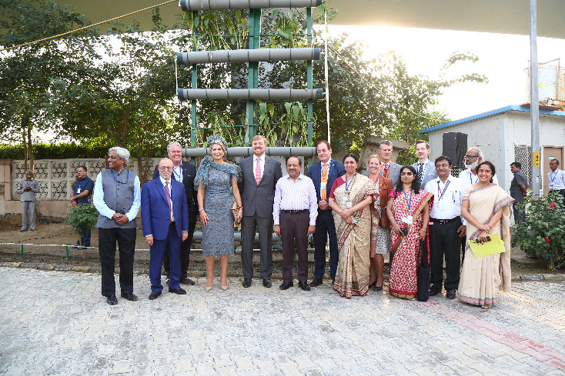
Engineering for Global Development

Slide 17
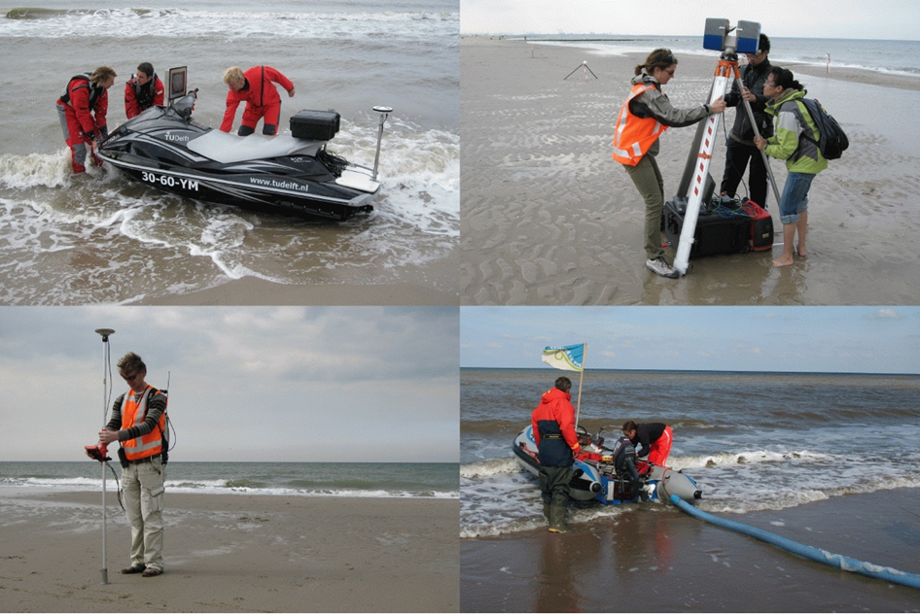
Coastal Remote Sensing & Fieldwork

Slide 18
Data Science and Artificial Intelligence for Engineers (DSAIE)
Data Science & Machine Learning
Responsible Instructor: I. Rocha
Topics:
Intro / connection to MUDE
Data types / data handling
Supervised/Unsupervised/…
Deterministic vs Probabilistic
Model selection and validation
Kernel methods
Clustering, PCA, …
Tree-based methods & ensembles
Deep Learning & Interpretable Machine Learning
Responsible Instructor: H. Wang
Topics:
Artificial Neural Networks
Convolutional NN
Recurrent NN
Transfer Learning
Interpretable, explainable and physics-based machine learning
Model diagnostics
Applications
Responsible Instructor: TBD
Examples:
AI-based detection of floating plastic in urban waterways
Unsupervised learning for rail health condition classification
Deep image matching for photogrammetry.
…
PTYHON CODING SKILLS: programming, data processing, and data visualization

Slide 19
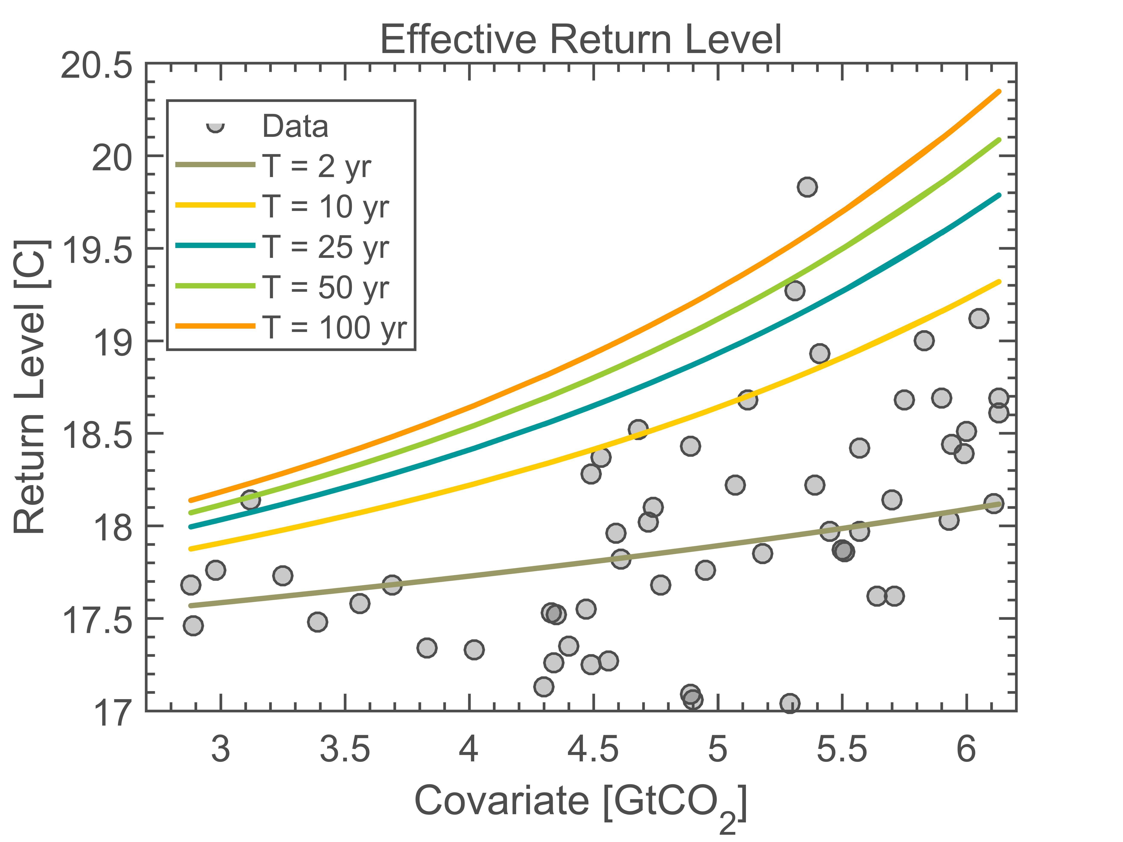
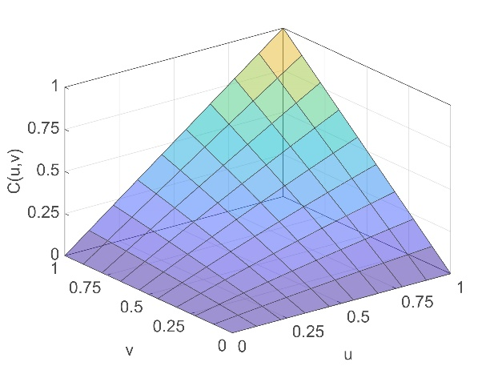
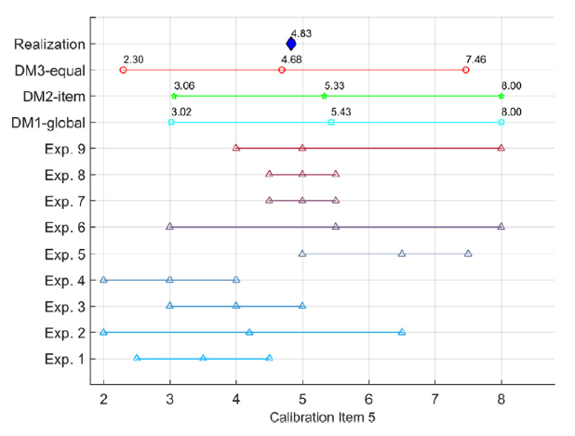
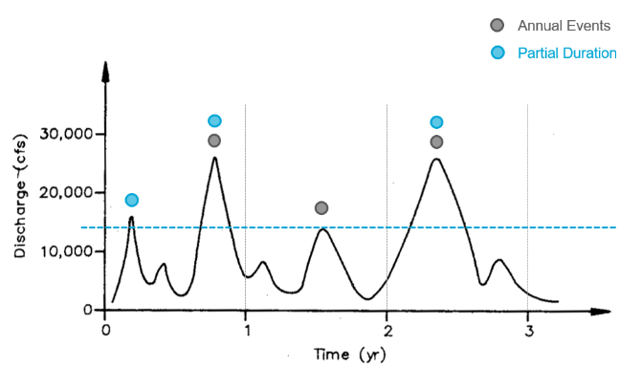
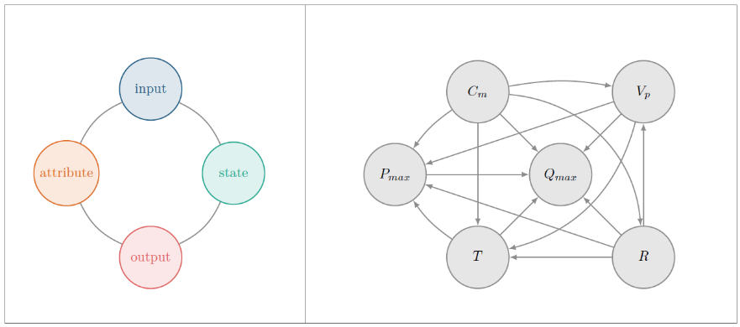
ATPSE – Methodological type module
 | Week 1 | Week 2 | Week 3 | Week 4 | Week 5 | Week 6 | Week 7/8
6 ECTs Knowledge transfer and practical applications | Review and Extreme Value theory | Bivariate copulas | Bayesian Networks | Vine Copulas | Expert Judgments | Additional Topics Such as Data Assimilation and Stochastic processes
 | data analyses of (extreme) observations for inferring, e.g., design values. | modelling correlation between pollutant and health | Stochastic modelling of vehicle loads in bridges, | modelling dependent environmental variables for, infrastructure loads | Elicitation of future hydro-meteorological variables due to climate change | probabilistic seismic hazard assessment
4 ECTs Group project |  |  |  |  | Project concept | Project concept approved including timeline | Review and project preparation dedicated Q&A session
Advanced Topics in Probability and Statistics

Slide 20
Subsurface storage Energy and Climate
Subsurface storage technology
Why?
What?
How to assess?
Heat, solute and compressible fluid transport
How the fluids used in storage behave
Simulation tools and exercises
Storage design and evaluation project
Energy scenario through technology assessment
Assessment using appropriate numerical tools
Critical insight into the results
Communication of results

Slide 21
Deltas
Physics of the coupled delta system
Climate change and scenarios
Adaptation pathways for deltas

Slide 22
Monitoring of structural health and geohazards
1: Introduction to SHM and Applications
2: Learning from data
3: Case studies: Advanced monitoring of structural health and geohazards

Slide 23
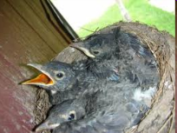
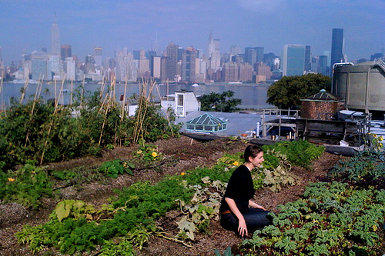
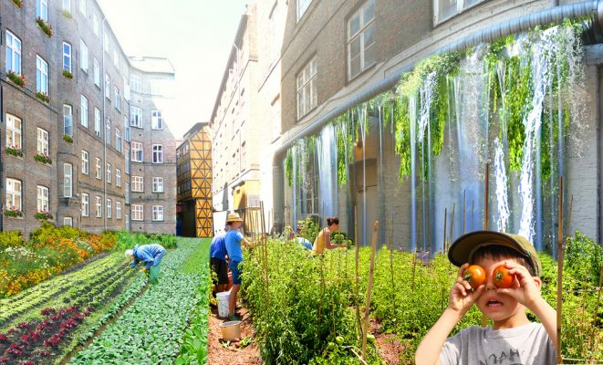
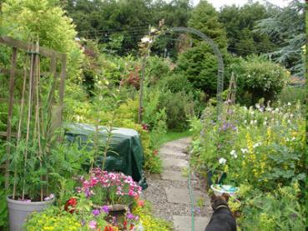
Sustainable Cities
Ecoengineering solutions for climate resilient and healthy cities
Societal needs (particularly in cities):
Clean (healthy) air, water, soil
Climate-mitigating built environment (CO₂ reduction)
Climate adaptive built environment (e.g. heat stress)
Circular material use (non-finite materials)
Desirable living conditions (well-being)

