Slide 1
Efficient Estimation of Vibrational Thermodynamics from First-Principles Calculations
Darko Simonovic
Department of Materials Science & Engineering
Delft University of Technology

Slide 2
Outline
First-Principles (ab-initio) calculations
Conventional phonon methods
Improved vibrational (free) energy methods
Results
Conclusion
Notes:
Thermodynamics

Slide 3
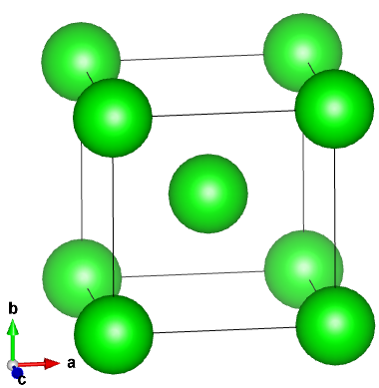
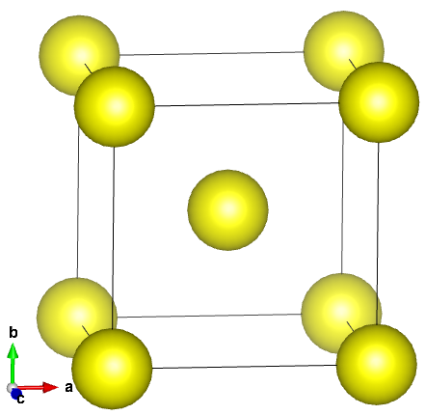
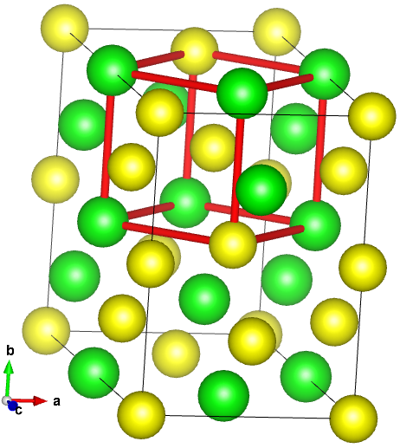
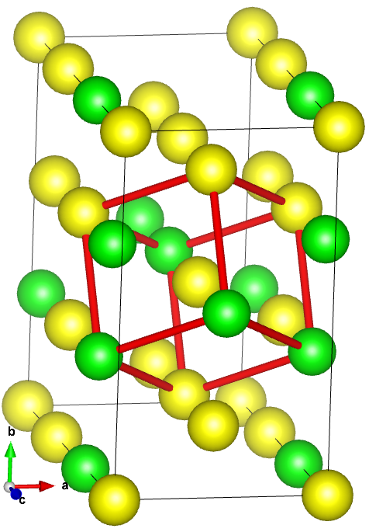
First-Principles (ab-initio) calculations
        No experimentally fitted parameters
        Supply a structure → get energy, forces
        Complexity: ～100 atoms structure
        Frozen in time (temperature 0K)
        Excitations → temperature
        Stability of structures (phases)
Notes:
look at atoms -> go to material properties
how computational (num atoms)

Slide 4
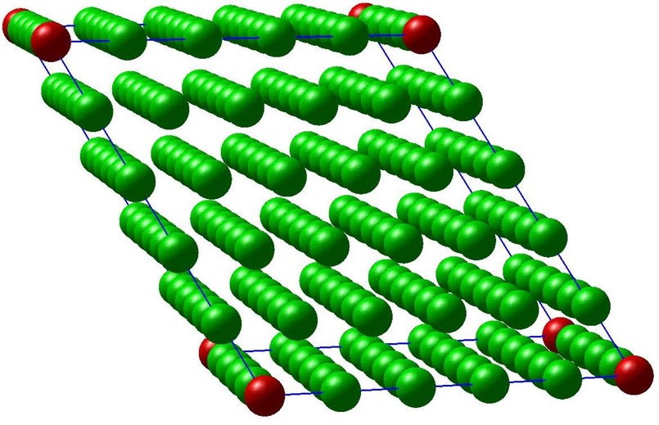
Vibrational excitations
X₁₂₅
Harmonic model
Expand energy near minimum
  force constant matrix
Direct method
  displace and measure
4
Notes:
why it is important

Slide 5
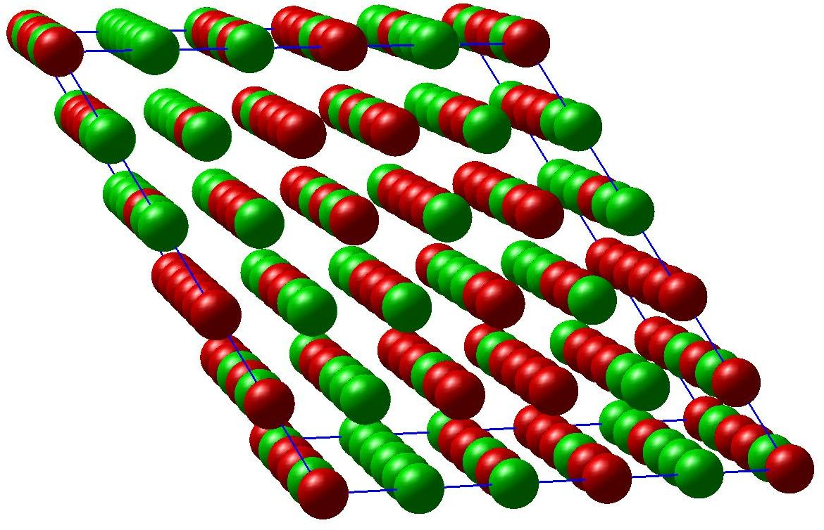
Reduction of measurements
Example: no symmetry, local interaction
Compressive sensing
    random mixing
  ∆f_{i} = K_{ij} ∆r_{j}
  = X
Notes:
what is old what is new
symbolic representation of squares is not clear
build it logicaly

Slide 6
Reconstruction strategies: ∆f= K ∆r
Finite cut-off radius
Regularize and finite cut-off radius
Distance dependent regularization

Slide 7
Cut-off radius
High Entropy Alloy (MoNbTaW)
  No crystal symmetries (except translational and rotational)
Notes:
remove deshed line

Slide 8
Regularization

Slide 9
Distance dependant regularization

Slide 10
Free energy
Notes:
plotting zero line

Slide 11
Conclusion
Novel method for phonon calculation
  Fast (10 times faster)
  Accurate (within ab-initio accuracy)
  Flexible
Notes:
Uncertainty in the range of input data

Slide 12
Thank you

