Slide 1
Dynamic multilevel multiscale simulation of flow in porous media
DCSE kick-off event
23rd May 2017
M. Cusini, M. Tene, S. Bosma, M. HosseiniMehr, H. Hajibeygi

Slide 2
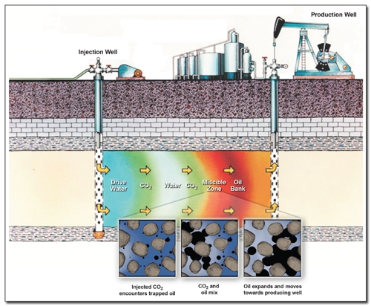
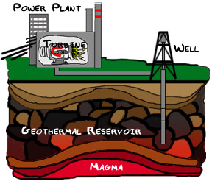
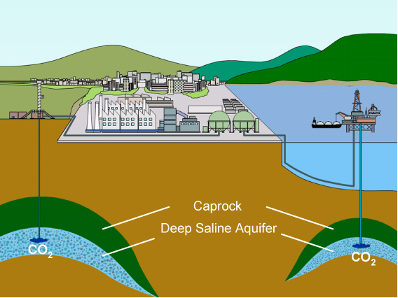
Growing demand for…
Accurate simulations of flow in porous media
Hydrocarbon production
Geothermal energy production
CO ₂ sequestration
https://energy.gov
https://c03.apogee.net
https://www.rite.or.jp/

Slide 3
Flow in porous media
Governing equations…

Slide 4
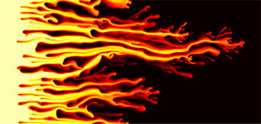
Flow in porous media
It’s a challenging problem because of
Heterogeneities
Complex fluid physics
SPE 10 Test Case, M. A. Christie & M. J. Blunt, SPE 66599
news.mit.edu/

Slide 5
Why multilevel multiscale methods?
Fine-scale discrete system
Expensive to solve!

Slide 6
Why multilevel multiscale methods?
Fine-scale discrete system
What would we like to have?
Expensive to solve!
1. Solve smaller system
2. Prolong to approximate fine-scale solution

Slide 7
Why multilevel multiscale methods?
Upscaling rock/fluid parameters
No scale separation
Loss of fine-scale information

Slide 8
Why multilevel multiscale methods?
Upscaling rock/fluid parameters
No scale separation
Loss of fine-scale information

Slide 9
Why multilevel multiscale methods?
Upscaling rock/fluid parameters
No scale separation
Loss of fine scale information
Multiscale methods
2 levels
Only pressure equation
Consistent mapping of equations
Efficient solving
MSFE/V: Hou & Wu, 97, Efendiev 00, Jenny et al. 03,...
i-MSFV: Hajibeygi et al. 08, Wang et al. 14, Tene et al. 15

Slide 10
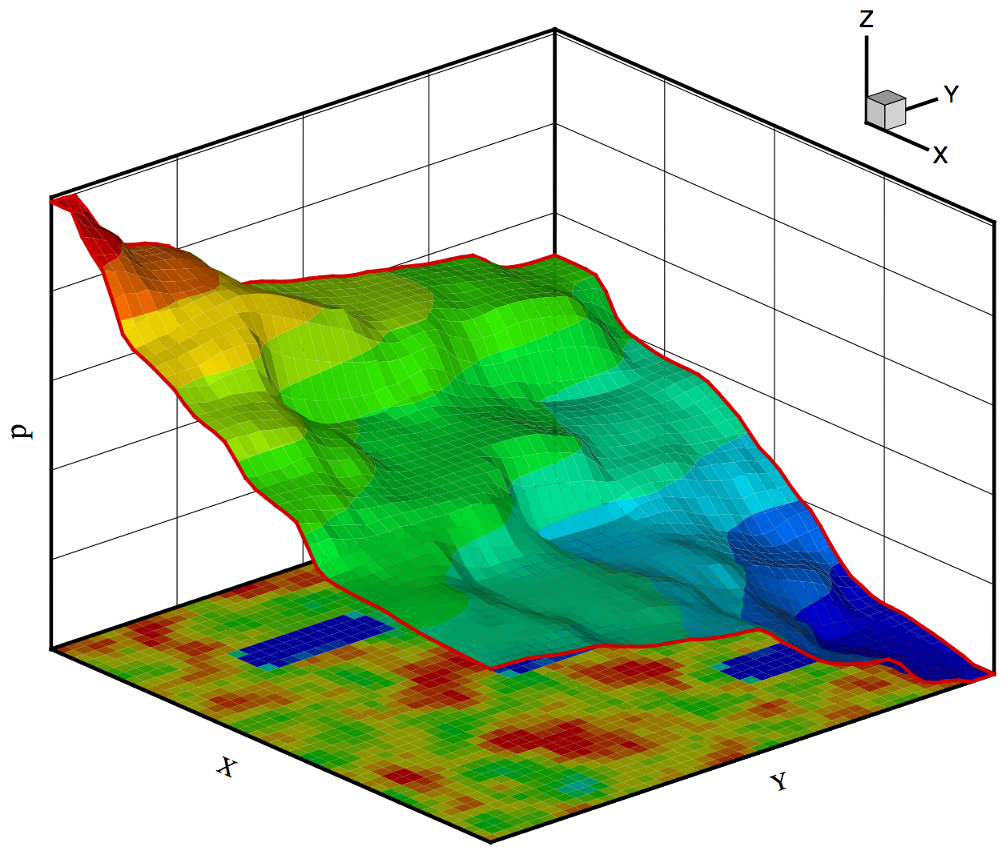
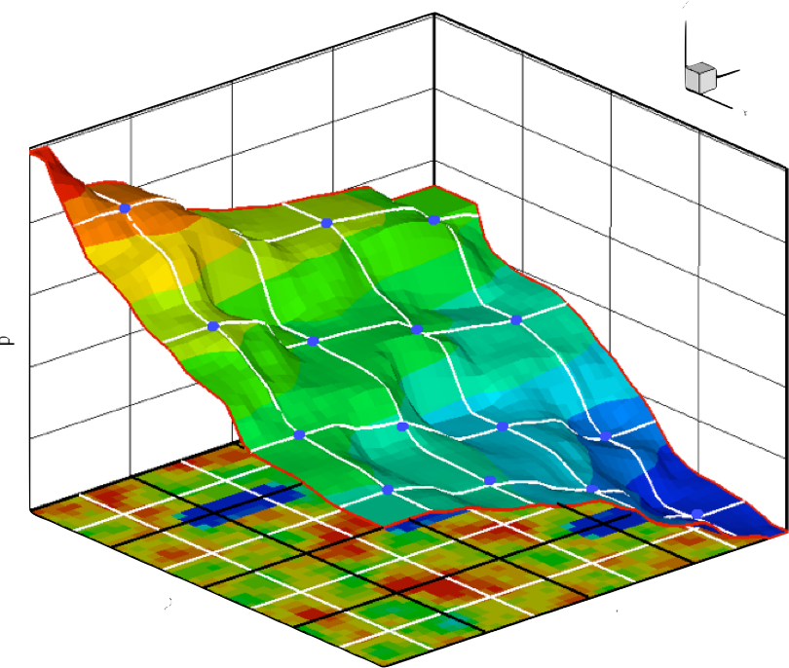
Multiscale in a nutshell
Fine grid: 44x44
Coarse grid: 4x4
Fine-scale numerical solution ( )
MSFV solution ( )

Slide 11
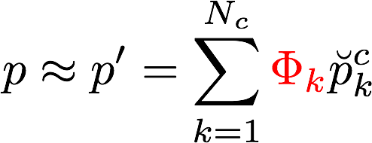
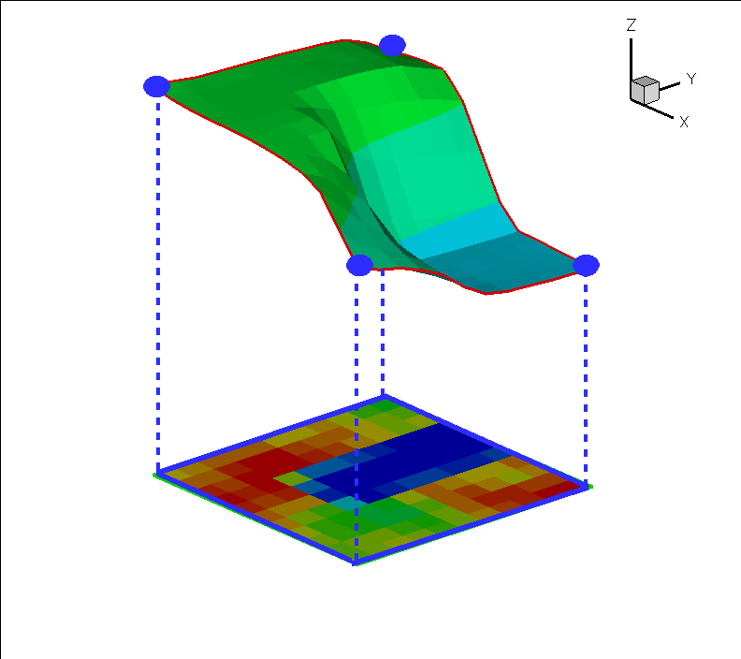
Multiscale in a nutshell
Basis functions:
(Hou and Wu, JCP 97: MSFE)
(Jenny, Lee, Tchelepi, JCP 2003: MSFV)
Coarse grid: 4x4
MSFV solution ( )

Slide 12
Let’s push MS further
Algebraic Dynamic Multilevel (ADM) method
Cusini et al., JCP, 2016

Slide 13
Let’s push MS further
Algebraic Dynamic Multilevel (ADM) method
n levels
Cusini et al., JCP, 2016

Slide 14
Let’s push MS further
Algebraic Dynamic Multilevel (ADM) method
n levels
All unknowns (i.e., p, S, x, …)
Cusini et al., JCP, 2016

Slide 15
Key features of ADM
Needed: Space-time-physics dynamic multiscale multilevel method
Accurate: consistent mapping between levels for all unknowns
Robust: all couplings, physics
Smart: integrable, advanced architectures (parallel, ..., cloud,...)

Slide 16
Key features of ADM
Needed: Space-time-physics dynamic multiscale multilevel method
Accurate: consistent mapping between levels for all unknowns
Robust: all couplings, physics
Smart: integrable, advanced architectures (parallel, ..., cloud,...)

Slide 17
Key features of ADM
Needed: Space-time-physics dynamic multiscale multilevel method
Accurate: consistent mapping between levels for all unknowns
Robust: all couplings, physics
Smart: integrable, advanced architectures (parallel, ..., cloud,...)

Slide 18
Things can get even nastier…

Slide 19
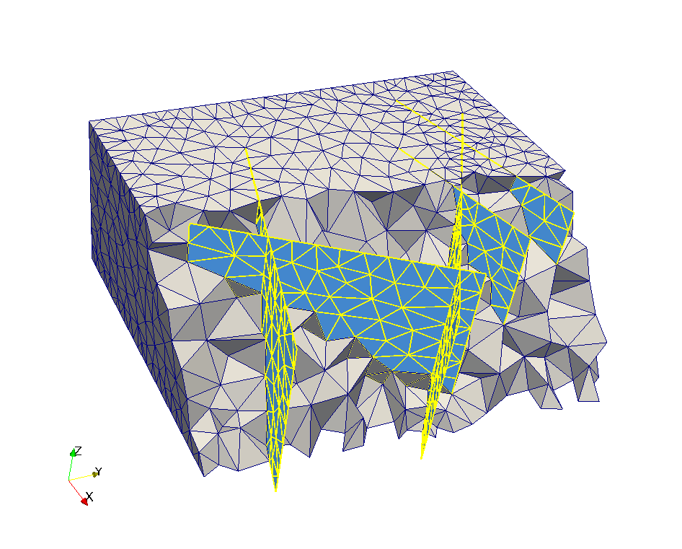
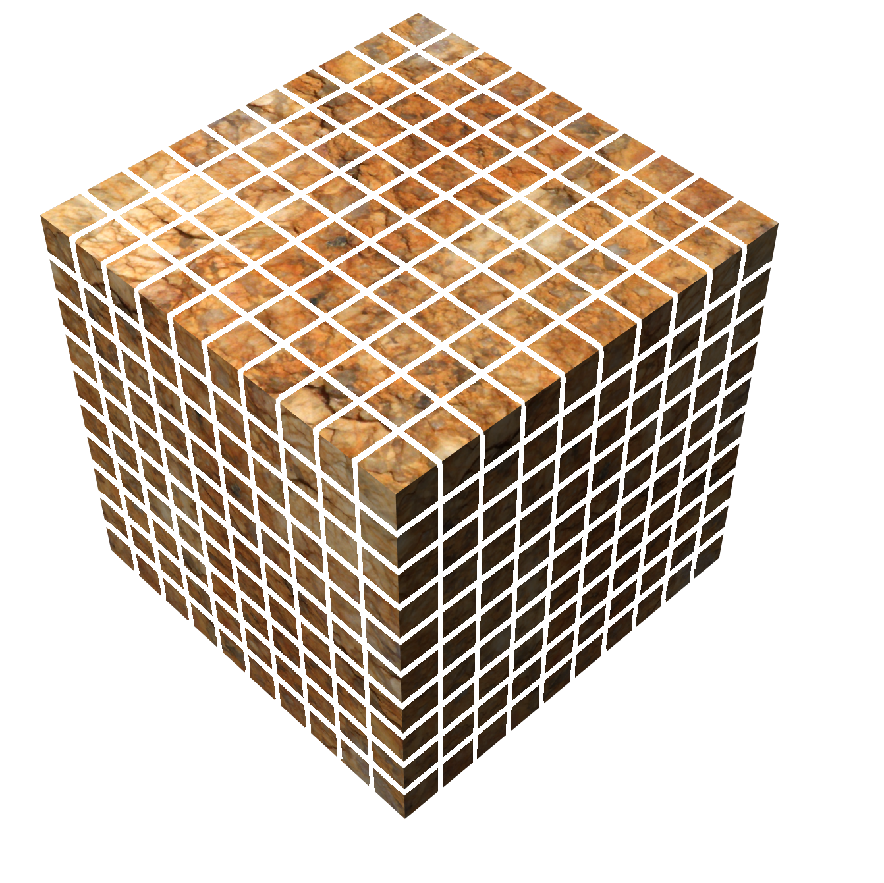
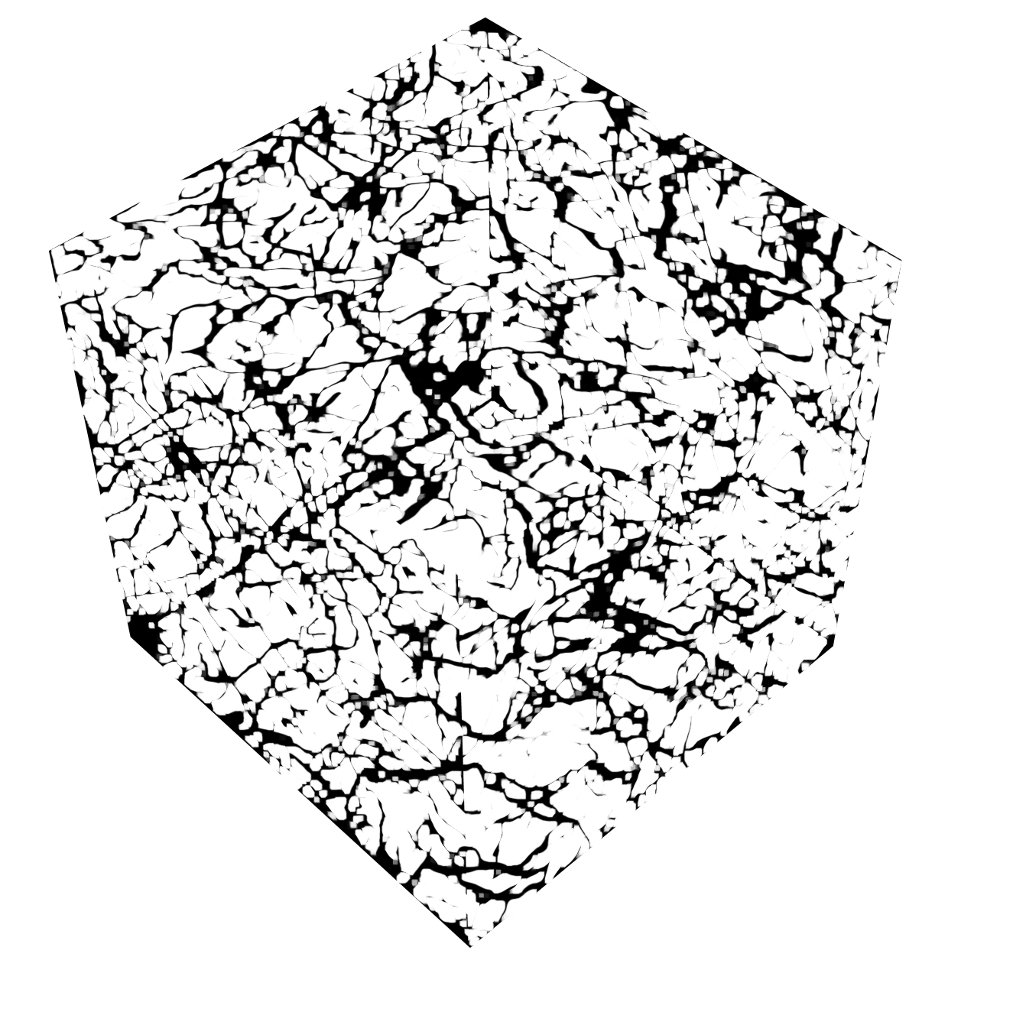
Multiscale methods for fractured media
EDFM
DFM
Tene et al., JCP, 2016

Slide 20
Grazie per l’attenzione!
Thank you for your attention!

