Slide 1
Implicit Bias
Hans van Dijk

Slide 2
DEWIS 2010
The boy and the doctor…

Slide 3
Definitions
Stereotype = the automatic associations people have in their minds about groups of people
Implicit bias = attitudes towards people based on stereotypes
→ Leads to prejudiced judgment and social behavior

Slide 4

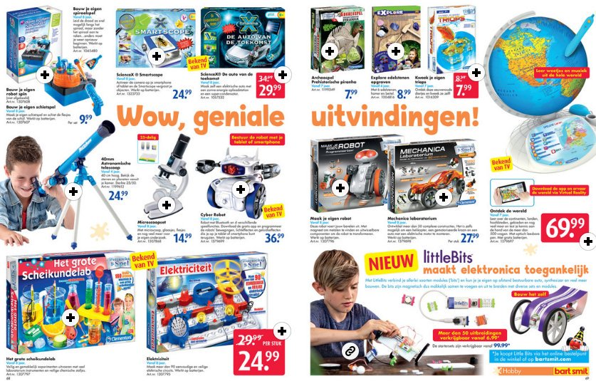
Implicit bias is culturally learned and shared

Slide 5
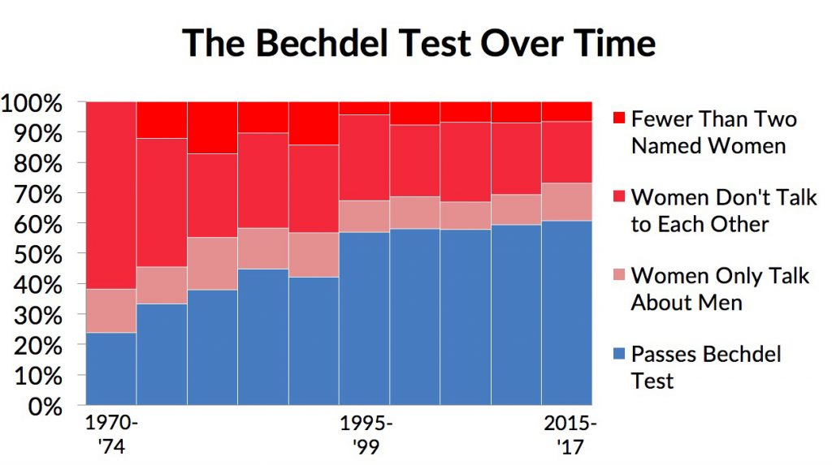
Implicit bias is culturally learned and shared

Slide 6
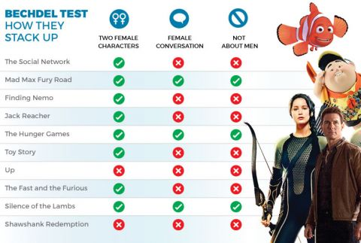
Implicit bias is culturally learned and shared

Slide 7
Implicit bias is self-reinforcing
Role congruity theory (Eagly & Karau, 2002) / lack of fit model (Heilman, 1983; 2012)
Social role theory (Eagly, 1987) / status construction theory (Ridgeway, 1991)
Implicit bias
Job/task allocation

Slide 8
Implicit bias is self-reinforcing
Expectation states theory (Berger et al., 1974; Correll & Ridgeway, 2003)
BIAS map (Cuddy et al., 2007)
Implicit bias
Job/task allocation
Behavior of perceivers
van Dijk, Meyer & van Engen, 2018

Slide 9
Implicit bias is self-reinforcing
Socialization (social role theory; Eagly, 1987)
Stereotype threat (Schmader et al., 2008)
Fear of backlash (Rudman & Fairchild, 2004)
Implicit bias
Job/task allocation
Behavior of perceivers
Behavior of targets
Exclusion
Performance
van Dijk, Meyer, van Engen, Loyd, 2017
van Dijk & van Engen, in progress

Slide 10
How to overcome implicit bias
Changing associations
  Sheryl Sandberg
  You!
Changing control
  → Oranges exercise

Slide 11
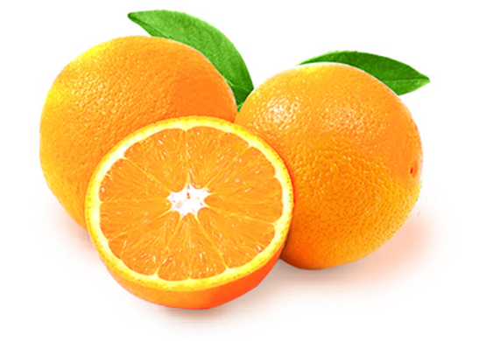
Oranges exercise

Slide 12
Questions? Suggestions?
J.vanDijk1@uvt.nl

Slide 13
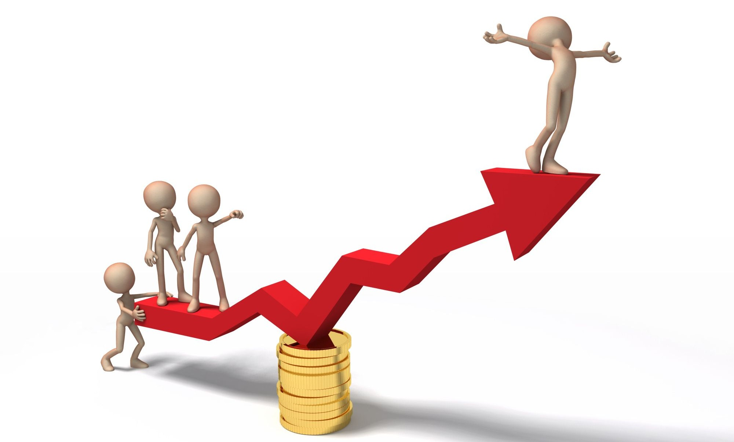
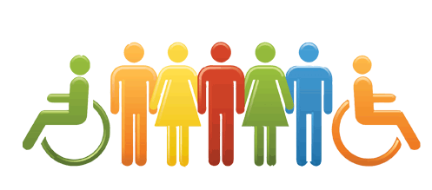
Two perspectives on why diversity
Business Case Perspective
Utilitarianism
Equality Perspective
Deontology
Van Dijk, H., van Engen, M. L., & Paauwe, J. (2012). Reframing the business case for diversity: A values and virtues perspective.
Journal of Business Ethics, 111, 73-84.

Slide 14
Business Case Perspective
Reasons for diversity
Talent shortage
Be like customers
Performance
→ 1 & 2 are accepted, 3 demands research
Kochan et al. (2003). The effects of diversity on business performance: Report of the diversity research network.
Human Resource Management, 42, 3-21.

Slide 15
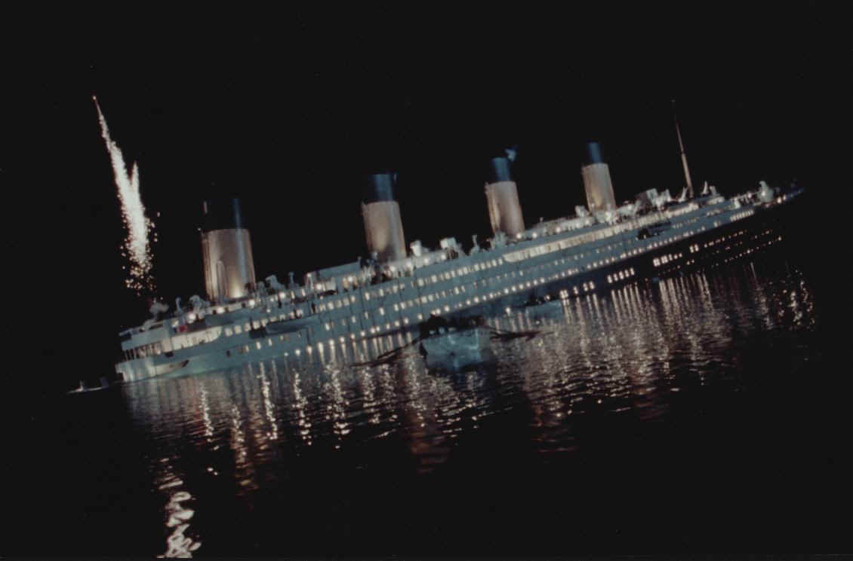
Merging The Two Perspectives

Slide 16
Merging The Two Perspectives
Three people
A retired captain
A sailor
A grandmother
Two tasks
Rowing
Steering

Slide 17
Merging The Two Perspectives
Status differences between group members tend to emerge automatically when
(a) when different team members are categorized differently, and
(b) when those different categories (are expected to) relate to different (informational) resources
van Dijk, H., van Engen, M. L. (2013). A status perspective on the consequences of work group diversity.
Journal of Occupational and Organizational Psychology, 86, 223-241.
Notes:
17

Slide 18
Merging The Two Perspectives
What if:
* the grandmother is only 40 years old and a former Olympic rowing champion
* the sailor has a whiplash
* the retired captain is blind
Notes:
18

Slide 19
Forming phase
Stereotype content model (Fiske, Cuddy, Glick, & Xu, 2002)

Slide 20
Forming phase
BIAS map (Cuddy, Fiske, & Glick, 2009)

Slide 21
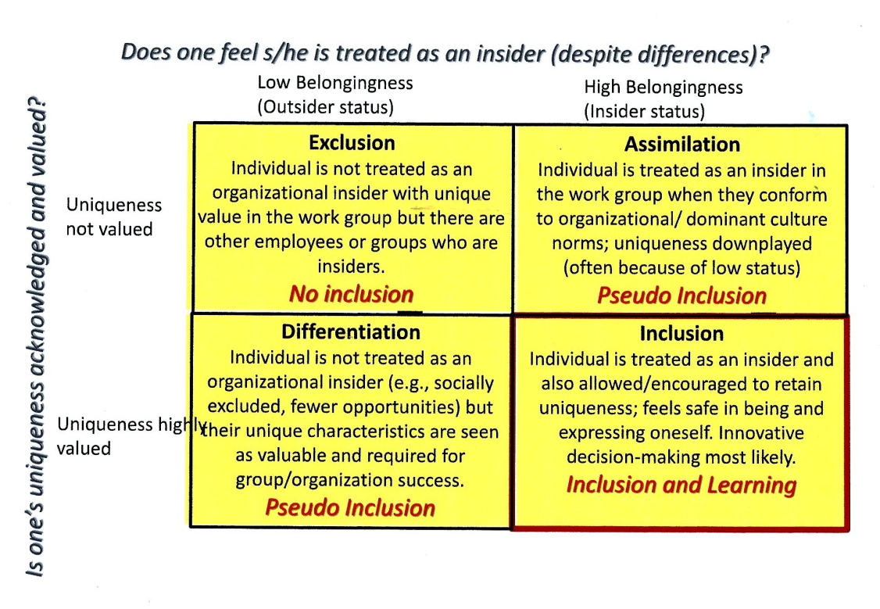
Inclusion

