Slide 1
The myth of gender equality in the Netherlands
Henriëtte Prast, TiSEM, Tilburg University
Delft, July 12, 2019

Slide 3
Women Full Professors (%, 2018, NL)
Law 28
Social Sciences 31
Language and Culture 30
Nature 14
Technical 13
Economics 11

Slide 4
Women Full Professors/Women Students (2018, NL)
Technical 1 : 2.0
Economics 1 : 3.2

Slide 5
“Explanations” and “solutions”
Women have less ambition
Women have other preferences
Women should negotiate better
Women should work more hours

Slide 6
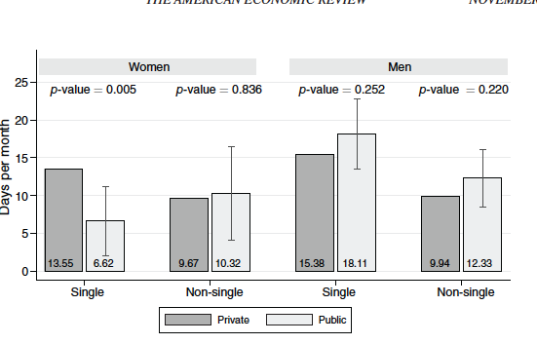
Would you be willing to travel for work?

Slide 8
Some key terms
Implicit bias
Stereotyping
Stereotype threat

Slide 10
Spending and gender, Netherlands

Slide 11
Exam questions

Slide 12
Why is this a problem
Stereotyping influences career choices and chances
Gender bias in interpretation of cv s, funding requests
Little economic research into root causes of gender differences in income distribution, labor market participation

Slide 14
Job Market Forum by/about economists
Top 12 words in posts about female colleagues
hotter pregnant plow marry
hot marrying pregnancy attractive
beautiful breast dumped kissed

Slide 15
Job Market Forum by/about economists
Top 12 words in posts about male colleagues
homo testosterone chapters satisfaction
feckers macroeconomics cuny thrust
UK macro finance founding

Slide 16
Policy suggestions
Gender quota to replace mediocre men by top women (talent pool)
Screening of education material for gender bias
Screen teachers for gender bias (Harvard iat)
Introduce gender and economics in curriculum
Treat gender (50%) issue different from diversity issue

