Slide 1
The techie and the fuzzy: the case for a more open academic education
Frits van Oostrom
emeritus Distinguished University Professor
Utrecht University,
President emeritus KNAW

Slide 3
INTRODUCTION TO THE CORE CURRICULUM The purpose of this guide is to inform members of the Freshman class about Harvard’s Core Curriculum. It explains the aims and design of the program, offers some practical advice on how to meet the requirement, and lists the Core requirement for each field of concentration. I The Core Curriculum for undergraduate education at Harvard is both a requirement and a philosophy. The requirement can be simply stated. Undergraduates must devote almost a quarter of their studies to courses in the following areas of the program: Foreign Cultures, Historical Study, Literature and Arts, Moral Reasoning, Quantitative Reasoning, Science, and Social Analysis. The philosophy of the Core rests on the conviction that every Harvard graduate should be broadly educated, as well as trained in a particular academic specialty. It assumes that students need some guidance in achieving this goal, and that the faculty has an obligation to direct them toward the knowledge, intellectual skills, and habits of thought that are the distinguishing traits of educated men and women. But the Core differs from other programs of general education. It does not define intellectual breadth as the mastery of a set of Great Books, or the digestion of a specific quantum of information, or the surveying of current knowledge in certain fields. Rather, the program seeks to introduce students to the major approaches to knowledge in areas that the faculty considers indispensable to undergraduate education. It aims to show what kinds of knowledge and what forms of inquiry exist 1 in these areas, how different means of analysis are acquired, how they are used, and what their value is.

Slide 4
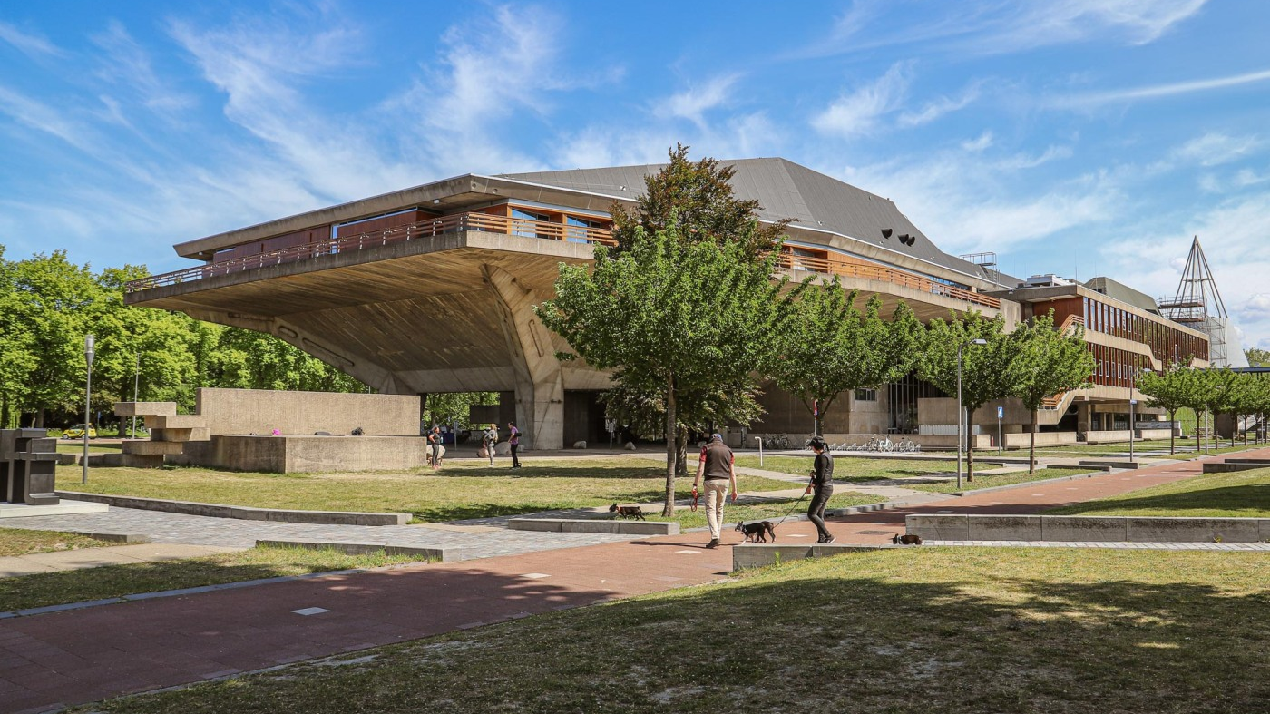

Slide 5
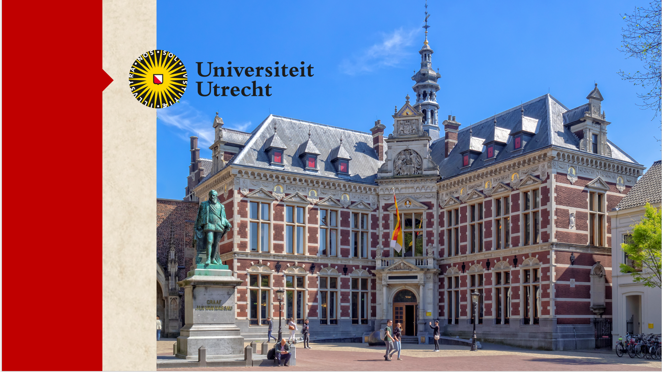

Slide 6
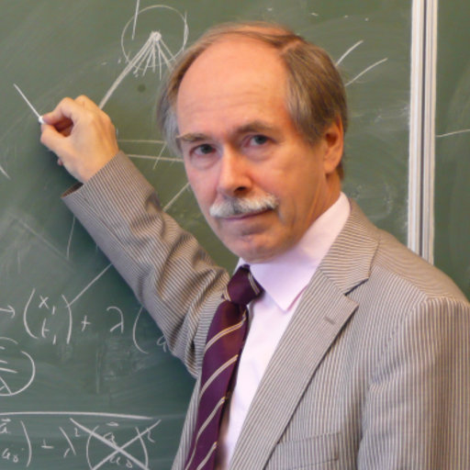

Slide 9
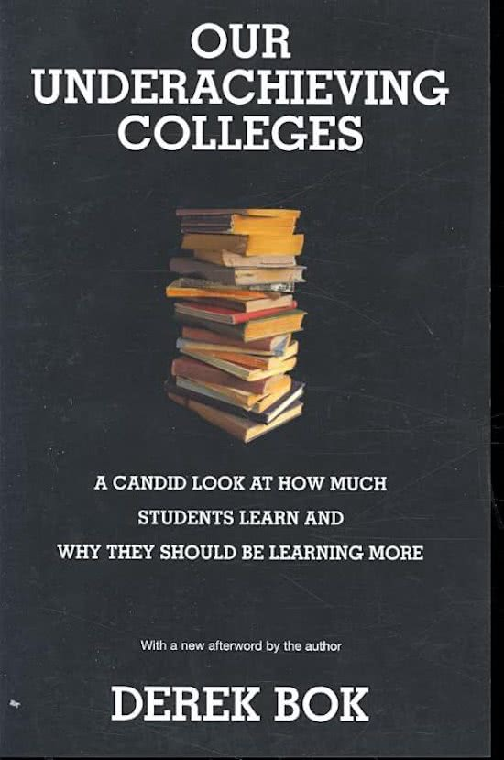
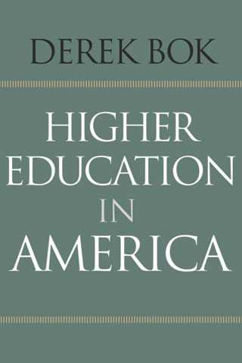
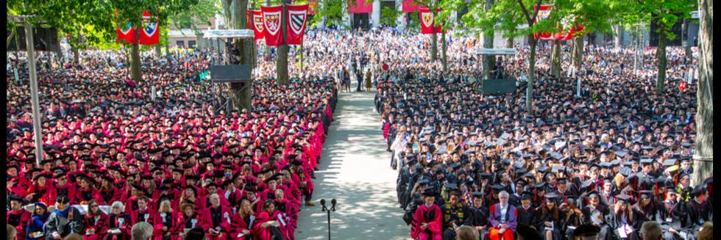

Slide 10
Derek Bok: The new advances in sciences offer the possibility of prolonging human life, destroying human life, transforming human life artificially in ways that challenge the very meaning of what it is to be human.
In the face of such prospects, the traditional focus of the humanities on questions of value, of meaning, of ethics, are more important than ever before.

Slide 11
Such questions are extremely difficult. They do not lend themselves to testable theories or to empirically verified results.
But they are no less essential if we are to make sense of the changes that science thrusts upon us and create a society in which we all can live fulfilling lives.
Humanists can help us build a world in which our scientific advances do not overwhelm us, but are made to serve humane purposes.

Slide 12
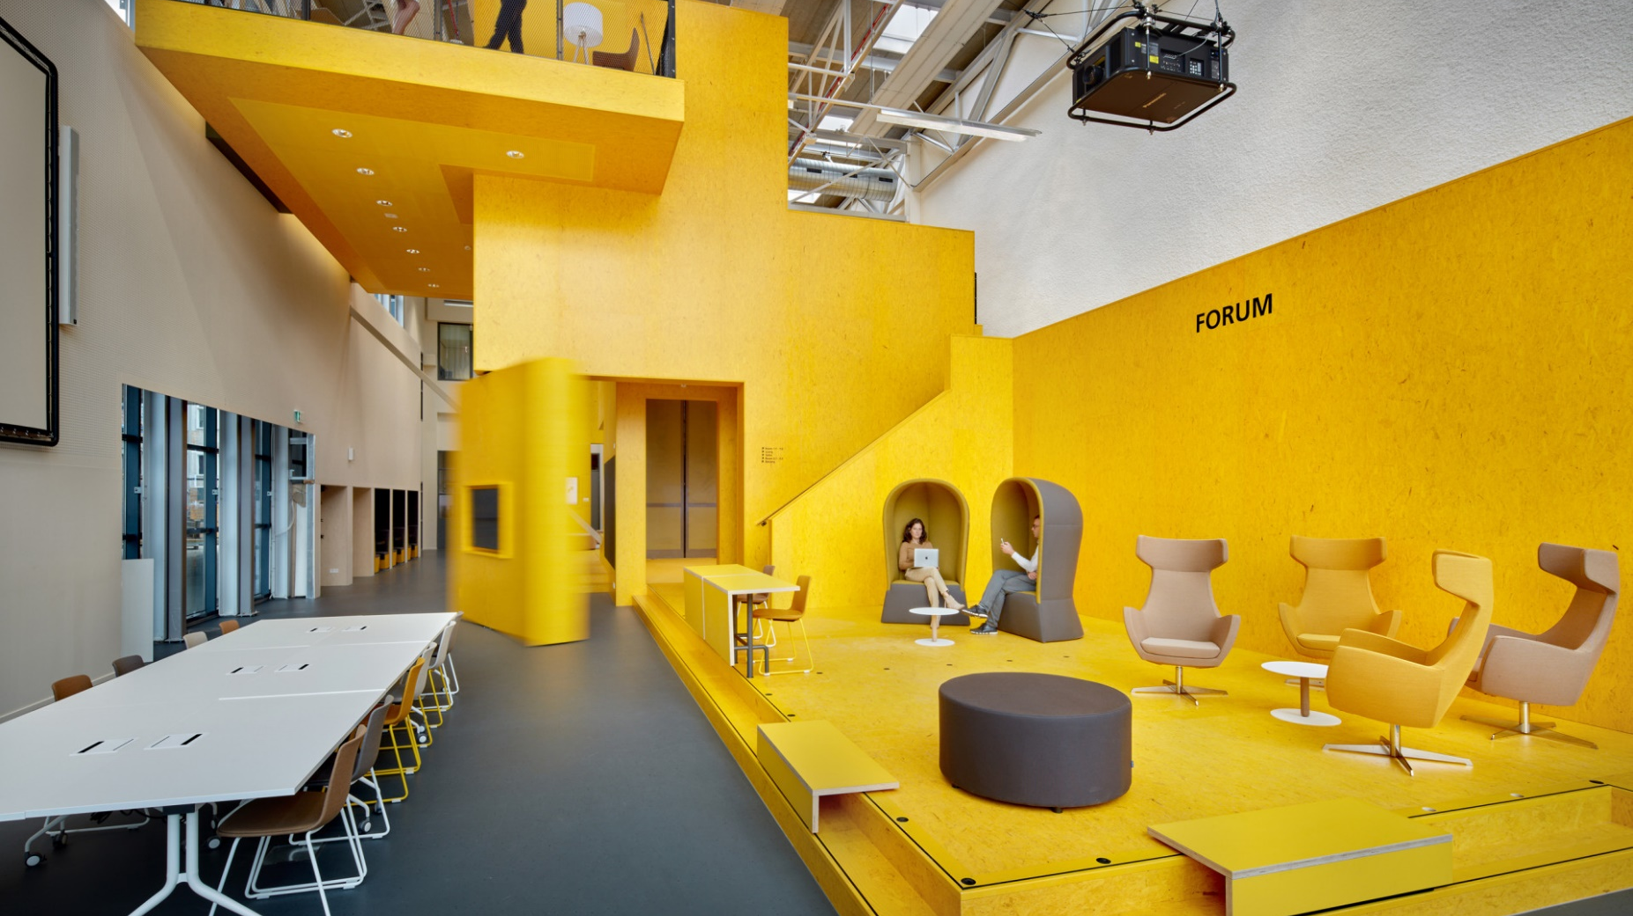
Scholar(s) in residence

Slide 13
Wisdom in the age of information

Slide 14
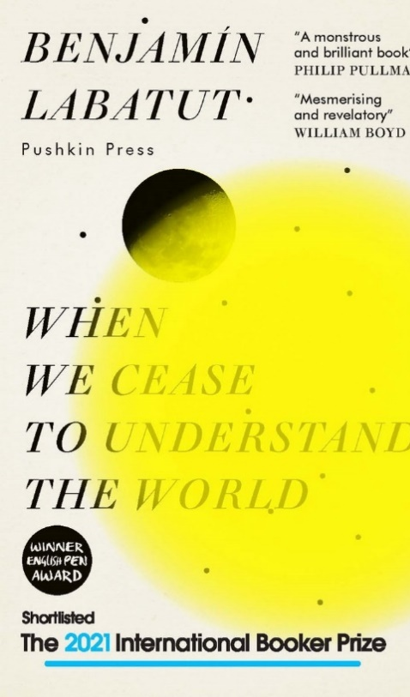
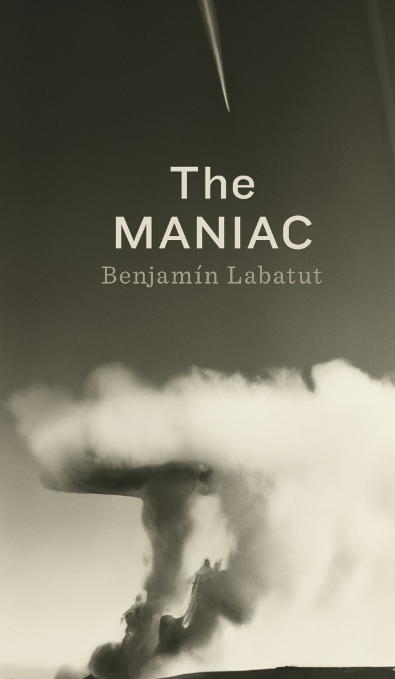

Slide 15
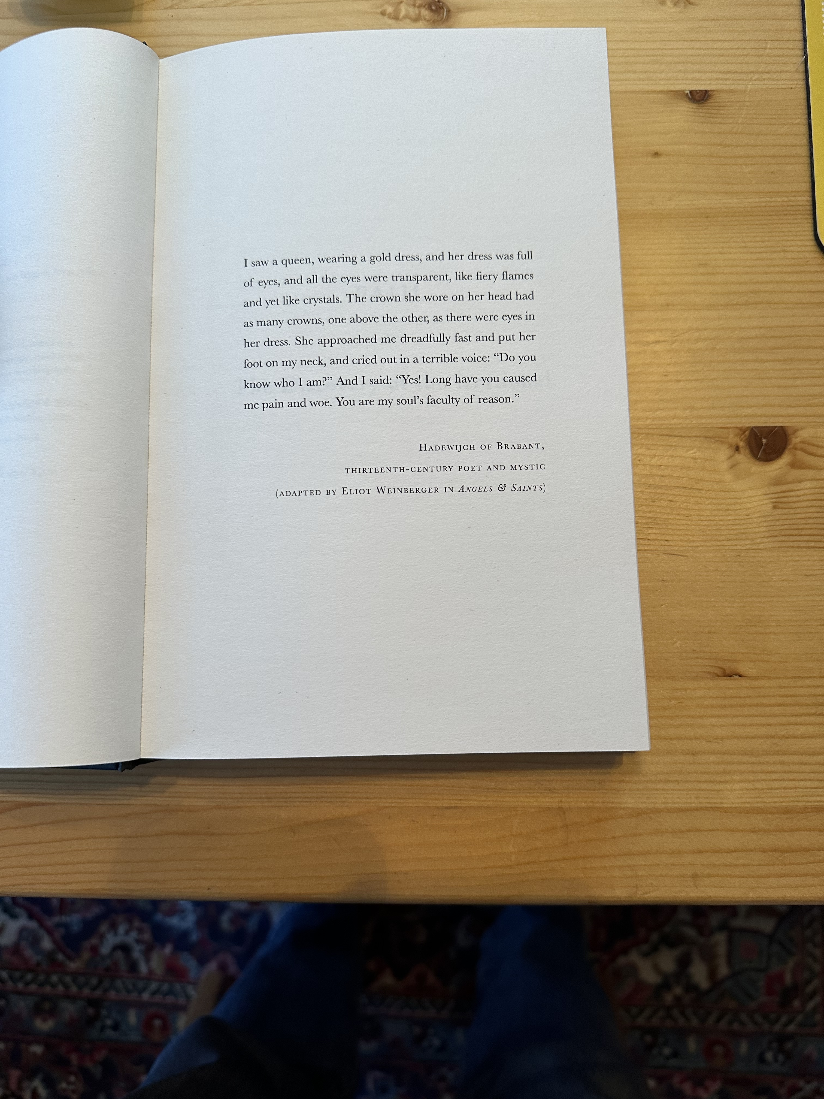

Slide 16
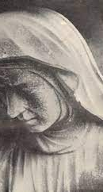
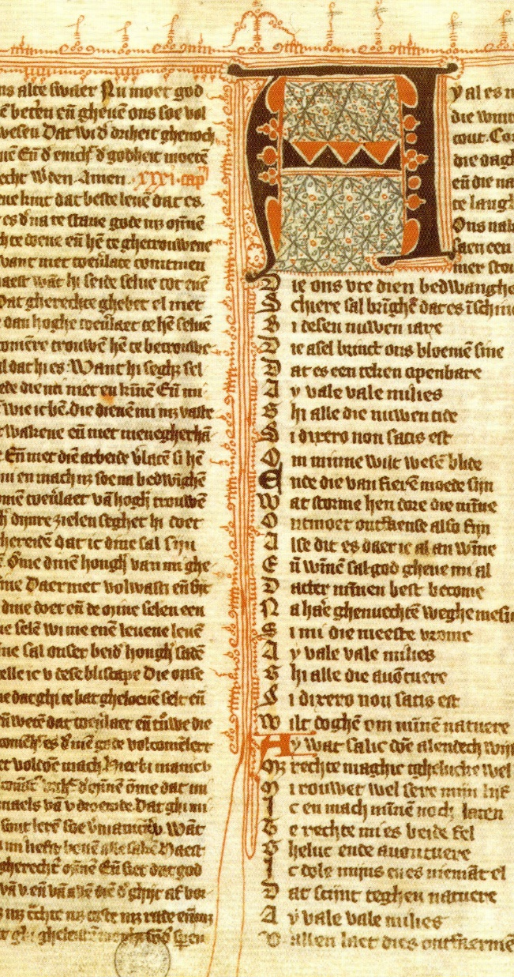
Ic sach in den geeste dat quam ene coninghinne ghecleedt met enen guldenen clede. Ende dat cleet was al vol oghen, ende al die oghen waren alle doresiende alse viereghe vlammen, ende nochtan ghelijc cristalle. Ende die crone diese opt hoeft hadde, die hadde also vele cronen, denen boven dandere, alse oghen waren ane dat cleet. [...]
Die coninghinne quam te mi sterkeleke snel ende sette haren voet op mine kele ende riep met eenre vreseleker stemmen ende seide: “Weetstu wie ic ben?” Ende ic seide: “Ja ic wel, ghi hebt mi so langhe leet ende wee ghedaen – ende sidi die redene miere zielen.”

Slide 17
Thank you
www.fritsvanoostrom.nl

