Slide 1
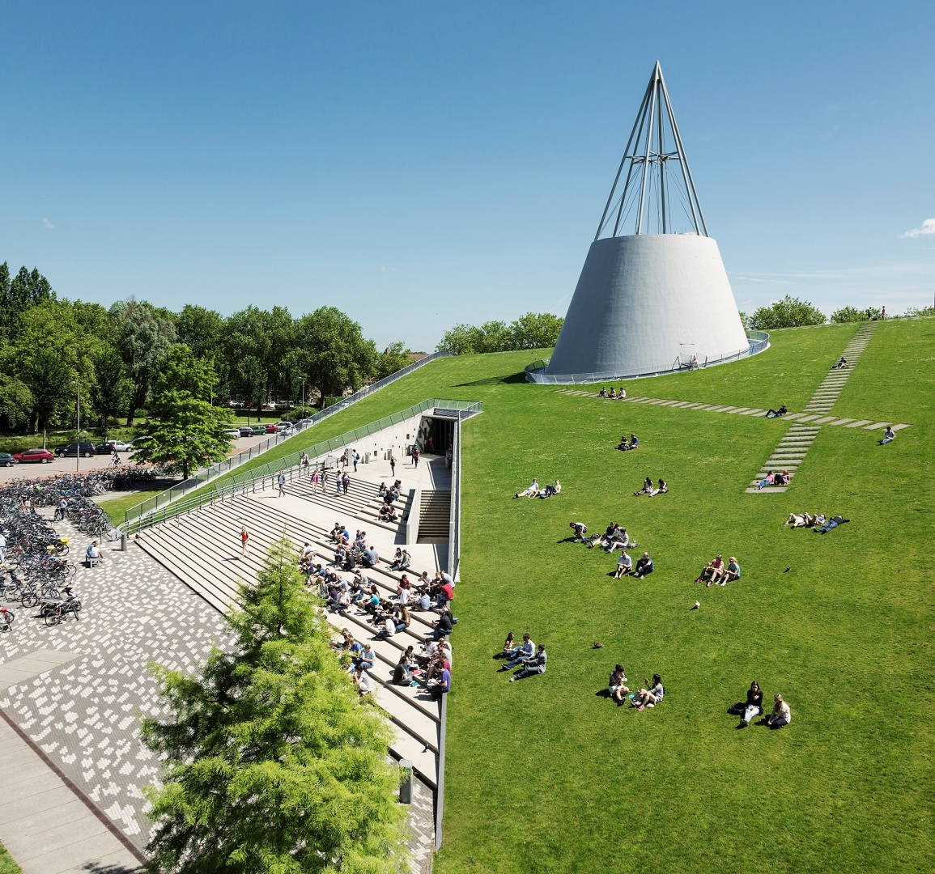
Digital Competence Centre
Information Event
DCC Call Autumn 2023
21 September 2023

Slide 2
Agenda
15:00 Introduction Digital Competence Centre
15:10 Call details
15:20 Q&A session
16:00 End

Slide 3
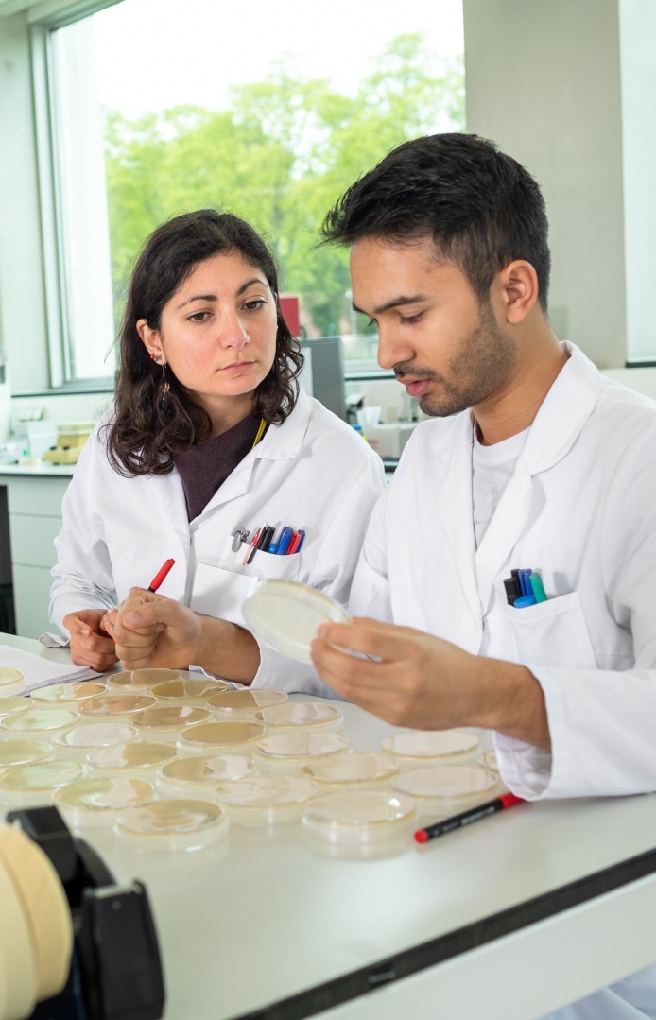
TU Delft DCC
The DCC is a central team of Data Managers and Research Software Engineers organized by the Library and ICT. The DCC is an initiative of the Open Science Program.
Our mission
To help researchers produce FAIR* data, improve research software, and apply suitable computing practices to increase the efficiency of the research process.
*Findable, Accesible, Interoperable and Reusable

Slide 4
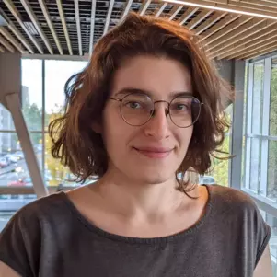
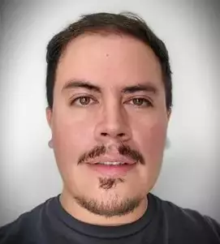
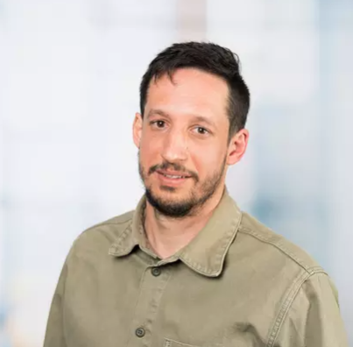
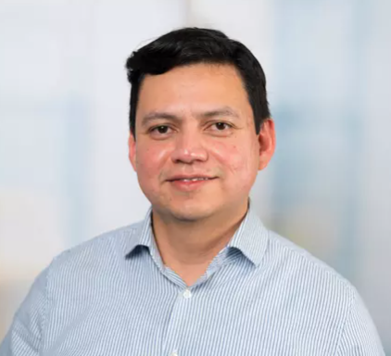
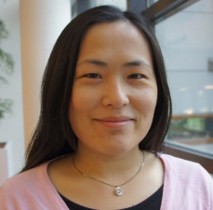
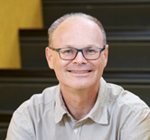
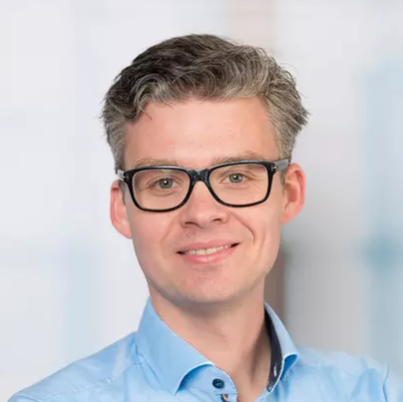
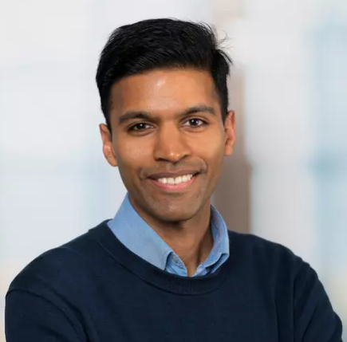
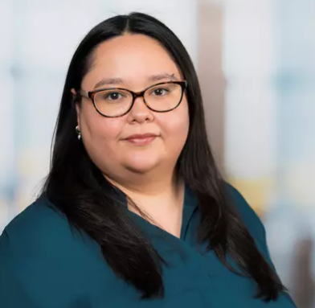
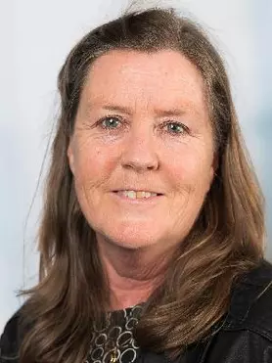
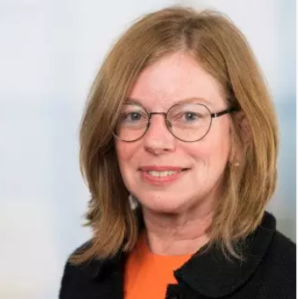
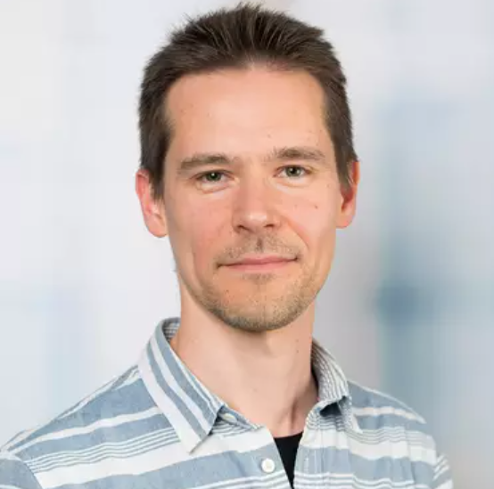
The DCC team
Library Research Data and Software
Data Managers
Research Software Engineers
ICT Innovation
Q4
Q4
Project Manager
Coordinator
DCC
Delft HPC
Q4

Slide 5
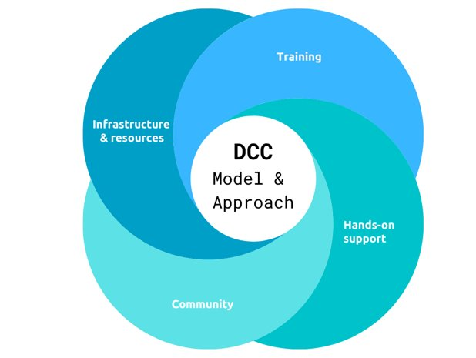
Our main services
Supporting research projects with hands-on co-development of solutions (e.g., this call)
Training on practical digital skills via Data and Software Carpentries, Code Refinery and custom workshops
Consulting on (FAIR) data management and software development

Slide 6
Call for projects Autumn 2023
Call for research projects involving data management and/or software development
The DCC offers hands-on support for up to 10 months
Open to all TU Delft research staff (including PhD candidates)
Support can include
development time
technical consultation
workshops and training materials

Slide 7
How we provide support
1 or 2 DCC staff members will join your research project (part-time) for up to 10 months
Support tasks and deliverables are agreed upon during the initial week(s) of the support
Solutions are developed through co-creation
at least one researcher is available as co-developer
solutions will need to be maintained by the researchers
aim to transfer knowledge
We encourage researchers to follow FAIR and Open Science guidelines
We collaborate with TU Delft experts (e.g., Data Stewards, DHPC, 4TU.ResearchData) and can join projects supported by external parties (SURF, eScience Center)

Slide 8
Examples of previous projects
Design and set up a data repository where researchers can store and share data
Code optimization and GPU acceleration
Develop a C++ plugin for Python
Develop a testbed for robust development
Create an interactive dashboard for live data visualization
Implementation and knowledge transfer
Develop a GUI to make software available for MSc course
Containerize software for sharing across different operating systems
Update software for sharing with contributors
Setting up a database server with web application
Introduce a collaborative workflow for software development

Slide 9
Application procedure
Timeline​
Application Open​ | 4 September – 9 October​
Intake Meetings​ | 23 October – 10 November​
Final Decision​ | 15 November​
Support period​ | December 2023 – October 2024​
Fill out the application form
Submit the application form with additional relevant documents through https://tudelft.nl/dcc/call
Eligibility check
Project review
Intake meetings for shortlisted projects
Award support

Slide 10
Q&A session
For further questions, please contact us at dcc@tudelft.nl

