Slide 1
Acceptance of the energy transition and related technologies
Nikki Kluskens
PhD Candidate Eindhoven University of Technology
n.t.t.m.kluskens@tue.nl
GA meeting Flexinet 4-4-2023

Slide 2
AGENDA
Theoretical insights acceptance concept
Factors important for acceptance
Acceptance in relation to Flexinet
Workshop

Slide 3
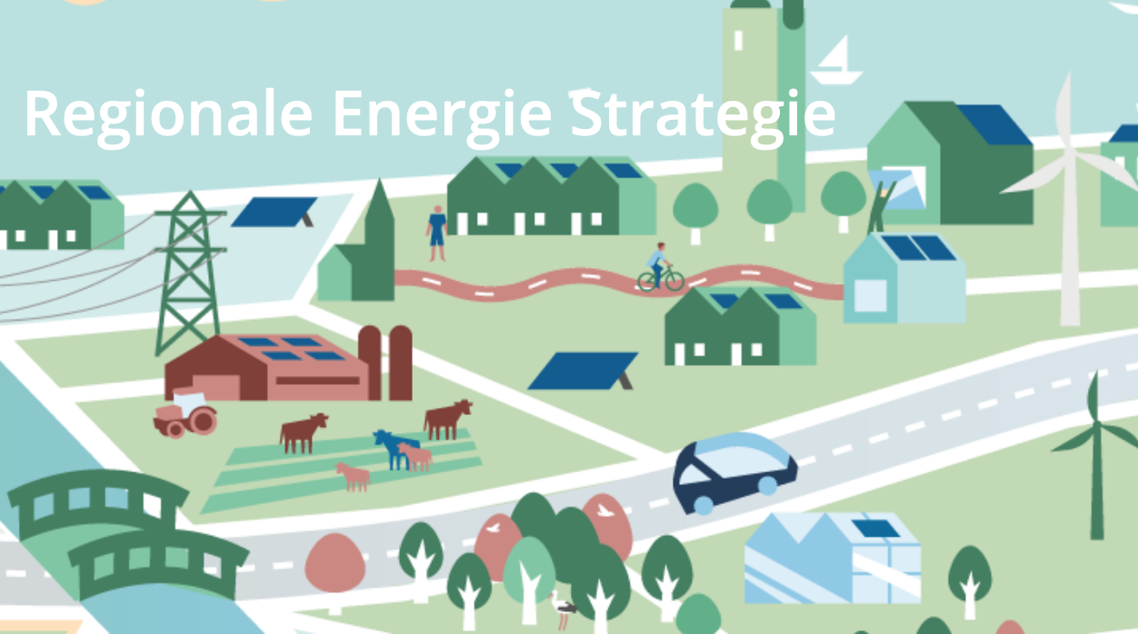
Importance of acceptance
Call for urgent system change
Acceptance getting specific policy attention
Research showing examples of delay or cancellations (Aitken et al. 2008; Devine-Wright 2011)
Risk of severe environmental costs (Soma and Haggett 2015)
→ We ‘only’ need social acceptance!

Slide 4
Complexities of acceptance: a concept with multiple dimensions
Actors
(who)
Roles
Responses
(how)
Objects
(what)

Slide 5
Actors and roles ‘who’ are accepting
First and second dimension of acceptance

Slide 6
Socio-political acceptance
Public
Key-stakeholders
Policymakers
Local authorities
Local residents
Local stakeholders
Consumers
Investors
Firms
Community acceptance
Market acceptance
Figure adjusted from Wüstenhagen et al. 2007;complemted with insights from Landeta-Manzano et al. 2018)

Slide 7
Actors shaping acceptance processes
All these actors are embedded in social interaction and have different roles in different parts of society (Wolsink 2010).
Depending on role they have (or is allocated to them) they shape, to a greater of lesser extend, acceptance processes of the energy transition and related technologies (Van Rijnsoever et al. 2015)
→ Through different forms of engagement and social interaction in energy transition processes.
Passively or actively (doing nothing vs. support or using a technology)
Moreover, actors can have explicit formal or informal roles (authorities vs. citizens)
Actors and roles important to look at when talking about acceptance

Slide 8
Responses ‘how’ are actors accepting
Third dimension of acceptance

Slide 9
Various acceptance responses
Complications because of related connotations: support, acceptability, tolerance.
Allows for silence being considered an acceptance response as well in the context of RE technologies and policies.
‘Support is more favorable position towards something (project), acceptance is more passive form of response’ (tolerance)
Batel et al., 2013
‘Acceptance is not a single outcome, but range of possible approval responses, from passive to active’
Bertsch et al., 2016

Slide 10
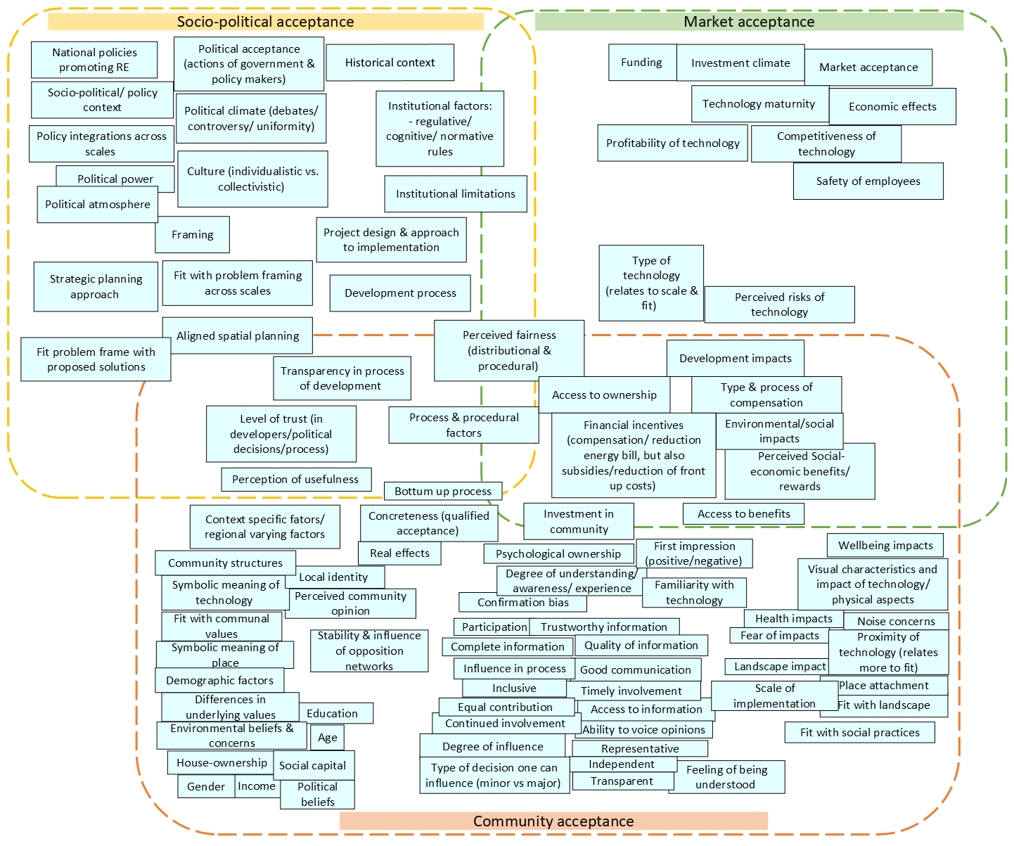
Factors hindering/ facilitating acceptance responses
Many factor can hinder/ facilitate acceptance responses of these actors
Does not say anything about the steerability.
Not a ‘checking the box’ list.
Based on literature review: see last slide

Slide 11
Objects ‘What’ are actors accepting
Fourth dimension of acceptance

Slide 12
Various objects of acceptance
System change towards a sustainable energy system requires alteration → on several levels.
Many decision involved in energy transition. (Wolsink, 2012)
For example, wind energy (as a source in the grid, technology as such), but also applies for Flexibility technologies.
Distribution of decision-making (from international to local) often leads to more concrete decision on local level → has consequences for ‘what’ is being accepted. (Perlaviciute and Squintani 2020).
Difference between aspects that are subject to acceptance (socio-political vs. community acceptance)
On local level this often comes down to; decision on concrete projects, location of RET, types of innovation, process, distribution of benefits.

Slide 13
Over time

Slide 14
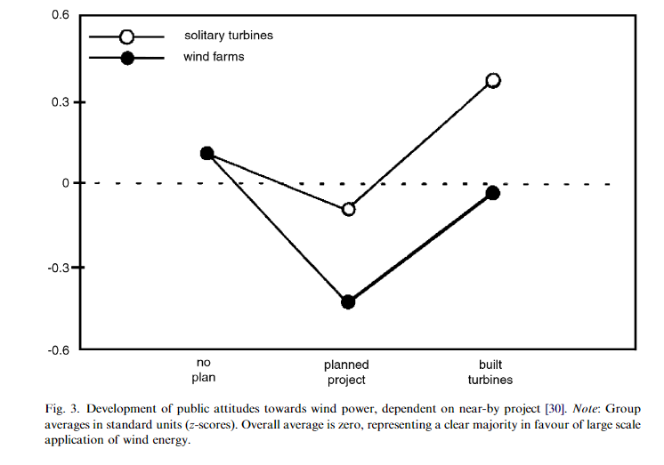
Acceptance being multidimensional and not static
Looking at all these different dimension acceptance can hardly be understood as one-dimensional & one time decision.
Acceptance inherently related to the dimension time
U-turn effect (Wolsink, 2007)
Attitudes are dynamic and can change over time: depending on changing circumstances.
Source: Wolsink, 2007

Slide 15
Results research: in the context of wind a solar projects in The Netherlands

Slide 16
acceptance consisting of multiple dimensions
Responses differ within actor groups.
Responses do not change that much over time, but rather relate to liking one aspect of an implementation process over another.
For example liking RET, but not location OR not liking RET, but liking distribution of benefits.
What stood out: technology is just one of many aspects that people consider when developing their acceptance responses.
Actors like different aspects of a project. Objects differ across scales, but also within scales.
Technology just being one of the many aspects respondents consider important for acceptance
Participation: not everyone wants to participate in same way and should be inclusive in the way it can meet different needs.

Slide 17
Factors influencing acceptance

Slide 18
Literature review
Based on a categorization from relevant (1) to maybe relevant (2) to not relevant (3), 88 articles were selected for a in depth review on social acceptance.
Out of these 88 articles only 24 articles talked about factors influencing acceptance.
This selection was used to create an overview (following dia) of relevant factor for social acceptance in the context of the energy transition and green design.

Slide 19
Based on literature review: see last slide

Slide 20
Problem with only looking at factors
They do not say anything about steerability
Most cases are based on
Opposition (so we know what can hinder acceptance)
Hypothetical (= more general = socio-political acceptance)
This is what they call gap between socio-political acceptance & community acceptance
Concreteness thus plays a role→ people can respond different over time when innovations are concretely implemented/play out.
How to do research what people find important when things are not concrete yet: difficult to oversee all implications
Therefore VSD + information provision needed

Slide 21
VSD approach (relation acceptance research with Flexinet)
With the VSD we try to understand what is important for people and what that would mean for design criteria for the technologies being developed in Flexinet.
Interviews:
Current state of knowledge
What are important values that need to be met in order to accept something

Slide 22
Current state of knowledge
Codes | Explanations from interviews
Changing energy resources | ‘A conversation about passing from fossil to renewable energies’ ‘Changing the use of fewer fossil fuels to renewable energy like solar or hydrogen’ ‘The way we produce energy and how we store that and share that among everyone’ ‘It is more difficult and less available compared to the past’
Diversification of energy sources | ‘I think it is diversification of the energy mix, suppliers and everything also change to alternative carbon sources’.
Changing energy use | ‘Another way of using energy’ ‘It has a lot to do with behaviors, because in the past nobody cared about where their energy is coming from’
Positivity | ‘I see it as something positive and I see the need for it’
Changing energy suppliers | ‘In my country it is very centralized, we need to decentralize’.
Change in perception | ‘Change in how we look at energy and our use of it. It is mainly awareness about that energy is not finite.. and that we have to think about how we divide that equally among everyone’

Slide 23
Values important for accepting the energy transition and related technologies (without information provision)
Values important in energy transition (daily life/in general) | Values important for acceptance
Availability of energy | Affordability
Sustainable sources of energy | Viability of proposed solution
Affordability (economically) | Sustainability of technology (in terms of environment/ within the system)
Accessibility | Practicality
Gradualism in change | Fair
Control | Exclusion of negative feedback loops
Comfortability | Simplicity
Fulfillment of basic needs | Engaging
 | Clear cost-benefit

Slide 24
Results workshop Green Village
Providing information + asking them again what factors / values are important for them after knowing more about the innovations of Flexinet
We did this step to see whether other factors were going to be mentioned as soon as people know more about an innovation.
Interestingly, things that came up: autonomy, fairness, comfort.
So, this does not differ that much from the factors that came up without the provided information.
What stood out: Finding a common language between residents and partners was difficult. Addresses the need for understandable information provision.
‘This is the first time in my life that I had to explain the difference between AC and DC grid’

Slide 25
Workshop
Developing a common understandable language
Understanding of what factors are important to all actors
What are you developing?
Why? What problem is it going to solve?
What are its current implications?
Noise, space, costs etc..
What factors are most relevant for you as designers/partners within the Flexinet project?
What factors are least relevant for you as designers/partners within the Flexinet project?
Which factors are met the most?
For which factors do you foresee problems

Slide 26
References
Aitken M (2010) Why we still don’t understand the social aspects of wind power: A critique of key assumptions within the literature. Energy Policy 38:1834–1841. https://doi.org/10.1016/j.enpol.2009.11.060
Batel S, Devine-Wright P, Tangeland T (2013) Social acceptance of low carbon energy and associated infrastructures: A critical discussion. Energy Policy 58:1–5. https://doi.org/10.1016/J.ENPOL.2013.03.018
Bertsch V, Hall M, Weinhardt C, Fichtner W (2016) Public acceptance and preferences related to renewable energy and grid expansion policy: Empirical insights for Germany. Energy 114:465–477. https://doi.org/10.1016/j.energy.2016.08.022
Devine-Wright P (2011) Public engagement with large-scale renewable energy technologies: breaking the cycle of NIMBYism. Wiley Interdiscip Rev Clim Chang 2:19–26. https://doi.org/10.1002/WCC.89
Landeta-Manzano B, Arana-Landín G, Calvo PM, Heras-Saizarbitoria I (2018) Wind energy and local communities: A manufacturer’s efforts to gain acceptance. Energy Policy 121:314–324. https://doi.org/10.1016/j.enpol.2018.05.034
Perlaviciute G, Squintani L (2020) Public Participation in Climate Policy Making: Toward Reconciling Public Preferences and Legal Frameworks. One Earth 2:341–348
Van Rijnsoever FJ, Van Mossel A, Broecks KPF (2015) Public acceptance of energy technologies: The effects of labeling, time, and heterogeneity in a discrete choice experiment. Renew Sustain Energy Rev 45:817–829. https://doi.org/10.1016/J.RSER.2015.02.040
Wolsink M (2007a) Wind power implementation: The nature of public attitudes: Equity and fairness instead of “backyard motives.” Renew. Sustain. Energy Rev. 11:1188–1207
Wolsink M (2007b) Planning of renewables schemes: Deliberative and fair decision-making on landscape issues instead of reproachful accusations of non-cooperation. Energy Policy 35:2692–2704. https://doi.org/10.1016/J.ENPOL.2006.12.002
Wolsink M (2010) Contested environmental policy infrastructure: Socio-political acceptance of renewable energy, water, and waste facilities. Environ Impact Assess Rev 30:302–311. https://doi.org/10.1016/j.eiar.2010.01.001
Wolsink M (2012) Wind power: Basic challenge concerning social acceptance. Encycl. Sustain. Sci. Technol.
Wüstenhagen R, Wolsink M, Bürer MJ (2007) Social acceptance of renewable energy innovation: An introduction to the concept. Energy Policy 35:2683–2691. https://doi.org/10.1016/j.enpol.2006.12.001

Slide 27
References model
This model is based on literature review of the following articles: (Upreti and Van Der Horst 2004; Devine-Wright 2007, 2011, 2017; Jones and Eiser 2009; Huijts et al. 2012; Bidwell 2013; Petrova 2013; Aas et al. 2014; Wiersma and Devine-Wright 2014; Soma and Haggett 2015; Stenekes et al. 2016; Larson and Krannich 2016; Sütterlin and Siegrist 2017; Perlaviciute et al. 2018; Landeta-Manzano et al. 2018; Kokkinos et al. 2018; Mjahed Hammami et al. 2018; Whitmarsh et al. 2019; Suškevičs et al. 2019; Liu et al. 2019; Leer Jørgensen et al. 2020; Bevk and Golobič 2020; Segreto et al. 2020)

Slide 28
THANK YOU
Nikki Kluskens
n.t.t.m.kluskens@tue.nl
Eindhoven University of Technology
Department of Industrial Engineering and Innovation Sciences

