Slide 1
Role of soil and subsurface for decentral authorities
Environmental planning strategies and a bottom up strategic research agenda
DIMI on TOUR
Integrated design in… Urban infrastructures
Subsurface
2018
Maaike Blauw, Linda Maring Deltares
Henk van den Berg VNG

Slide 2
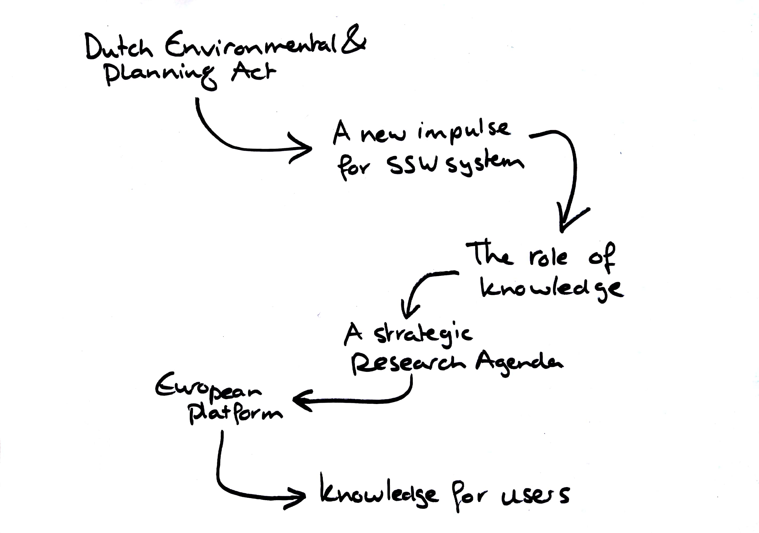

Slide 4
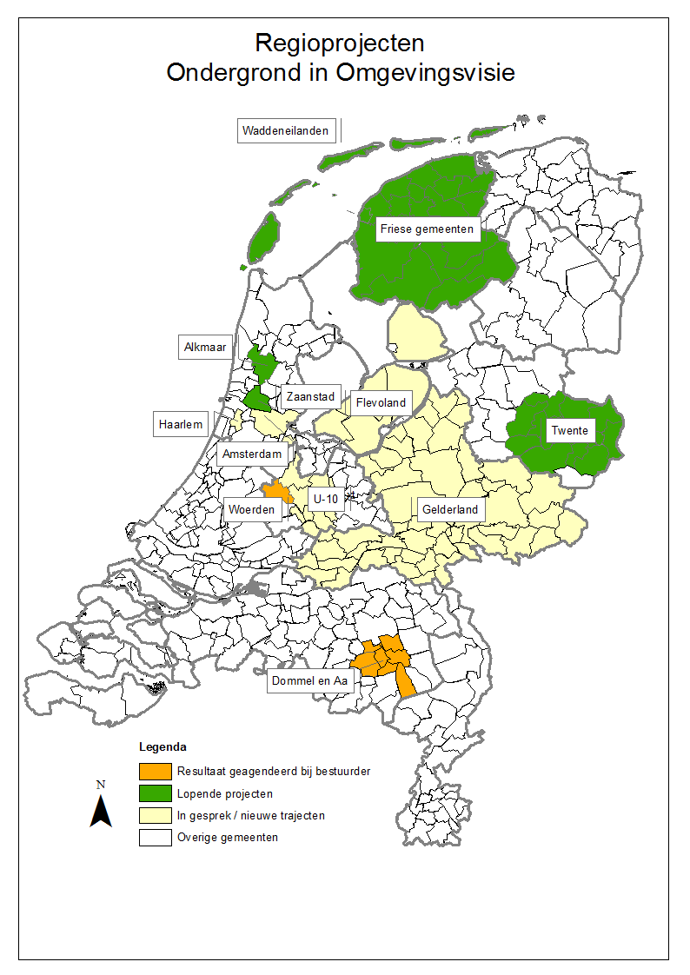

Environment and Planning Act
Through the Environment and Planning Act (Omgevingswet) the government wants to combine and simplify the regulations for spatial projects. The aim is to make it easier to start up projects.
https://www.government.nl/topics/spatial-planning-and-infrastructure/revision-of-environment-planning-laws
The Organisation of Dutch Municipalities has the ambition that in 2021 all municipalities have described the role of soil and subsurface in dealing with societal challenges. The moment to do this is during the development of the environmental planning strategies, while implementing the Environment and Planning Act
Oplegnotitie VNG-Commissie Milieu, Energie en Mobiliteit, werkgroep Bodem, 7 juli 2016

Slide 5
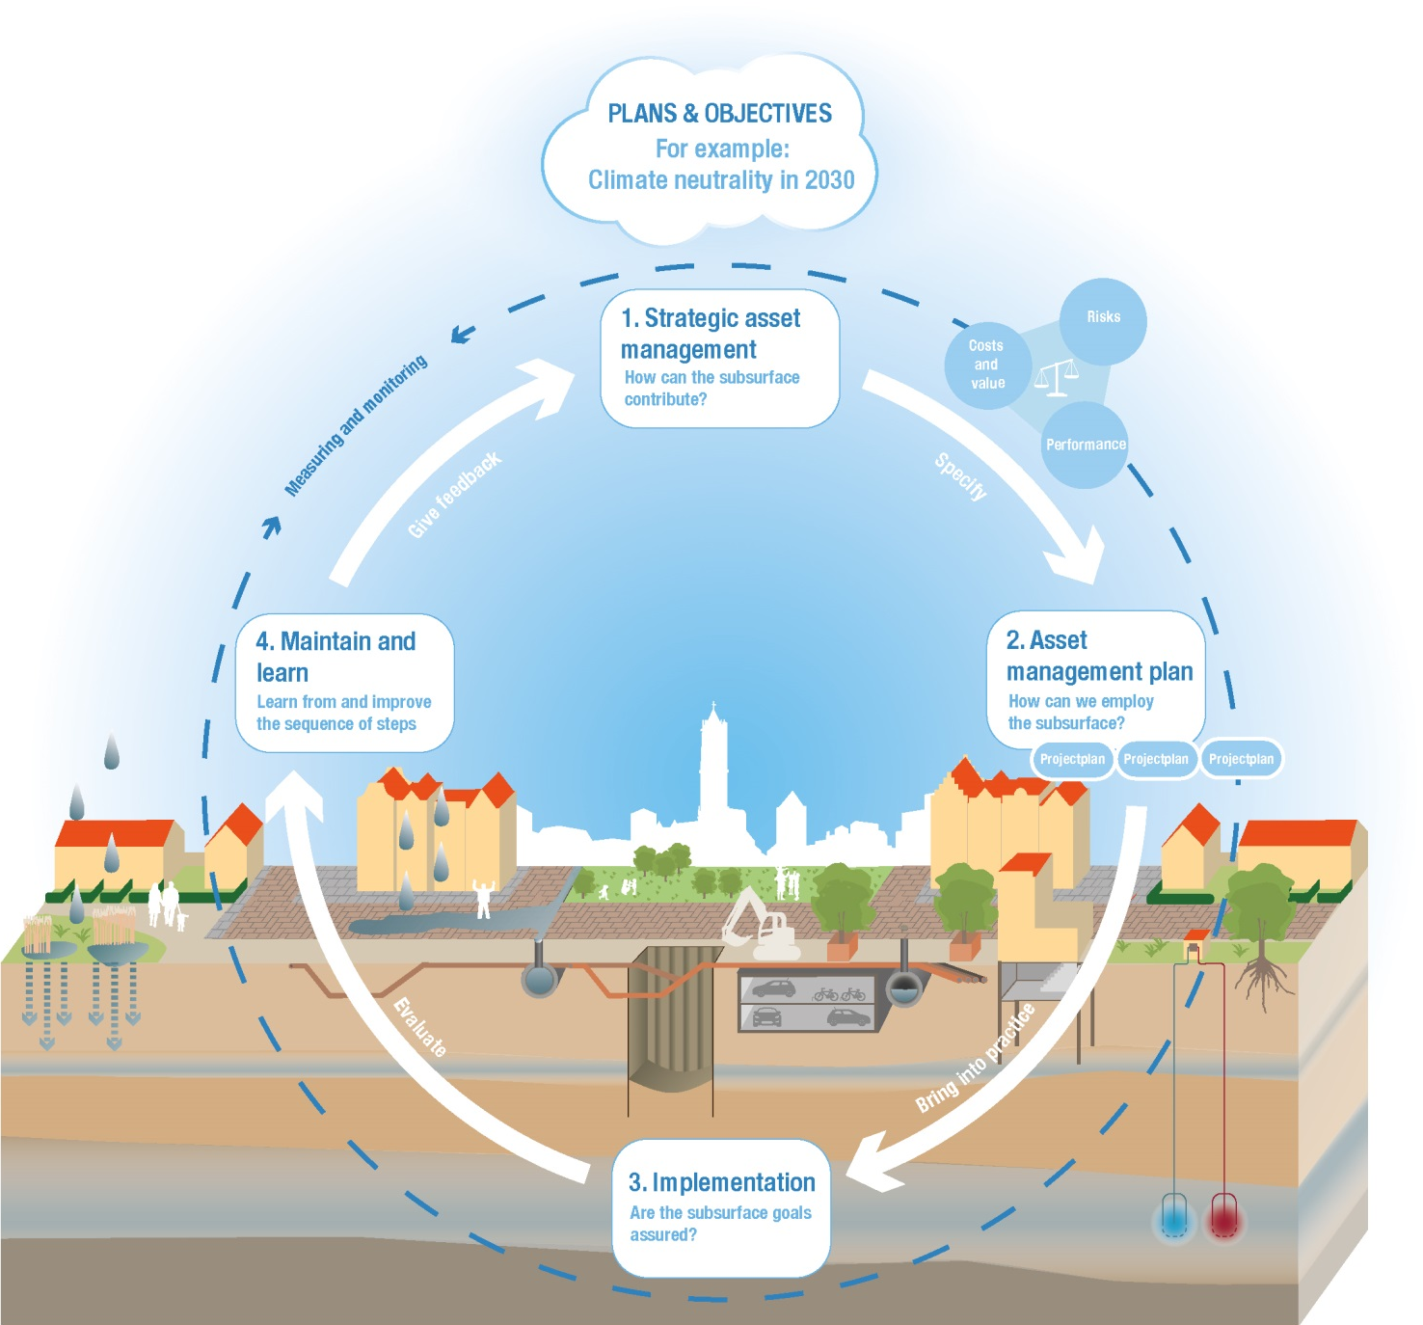
Subsurface in environmental planning policies
Environmental planning strategy
How can the subsurface contribute?
risks
Costs and value
Perfor-
mance
Maintain and learn
Learn from and improve the sequence of steps
Environmental plan
How can we employ the subsurface?
Implementation
Are the subsurface goals assured?

Slide 6
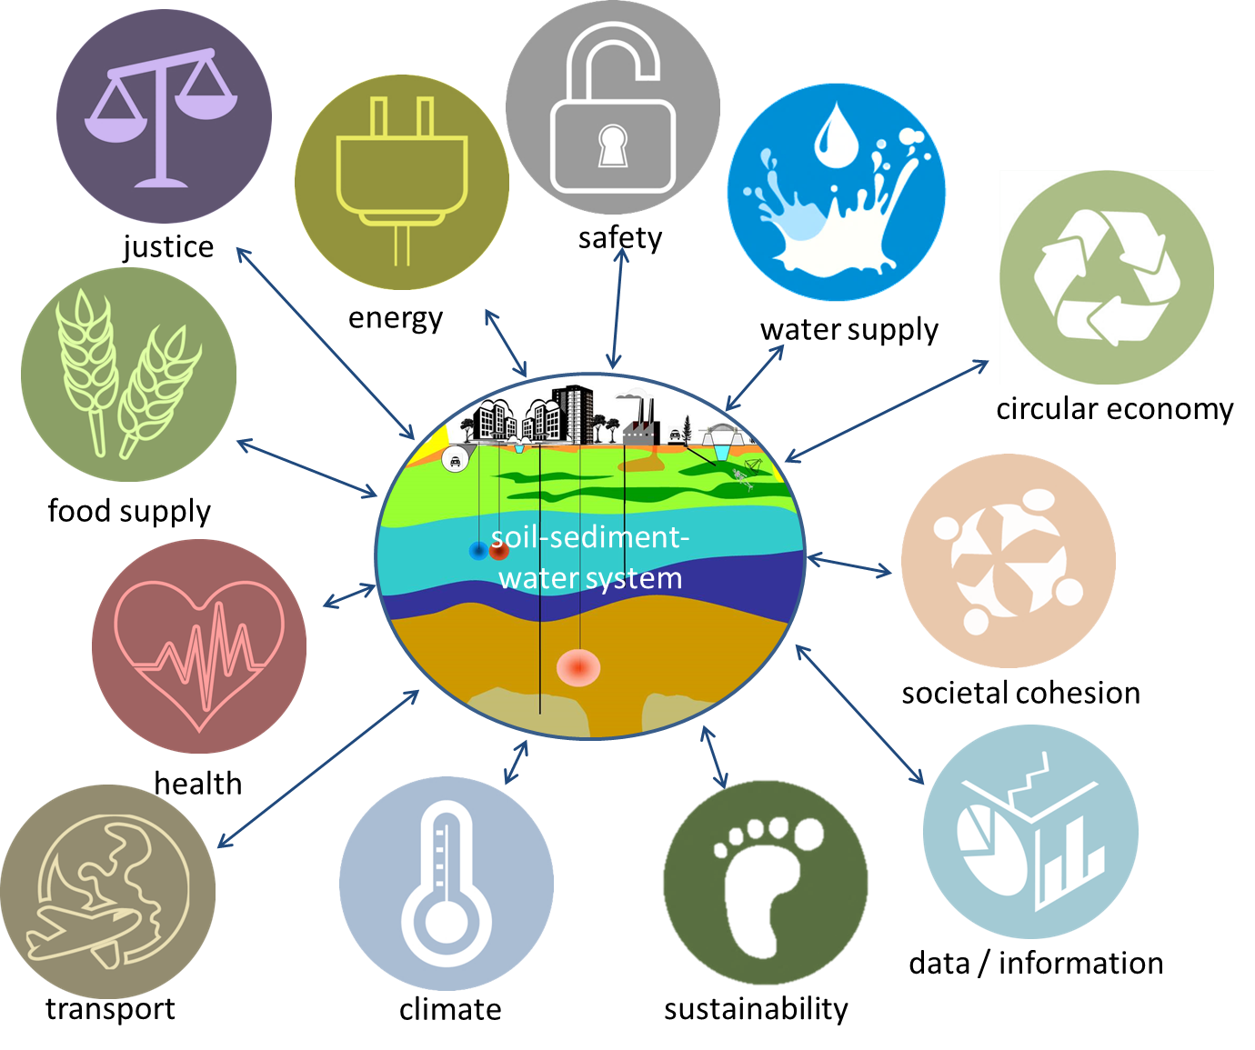
Opportunity for redefining role SSW system

Slide 7
Road trip along municipalities
System Exploration Environment & Subsurface:
Societal challenges and subsurface
surfacing choices and challenges
Insight in role subsurface,
can be used in environmental planning strategies
Involvement of experts, policy maker and decision maker

Slide 8

Examples
Dilemmas and choices to make

Slide 9

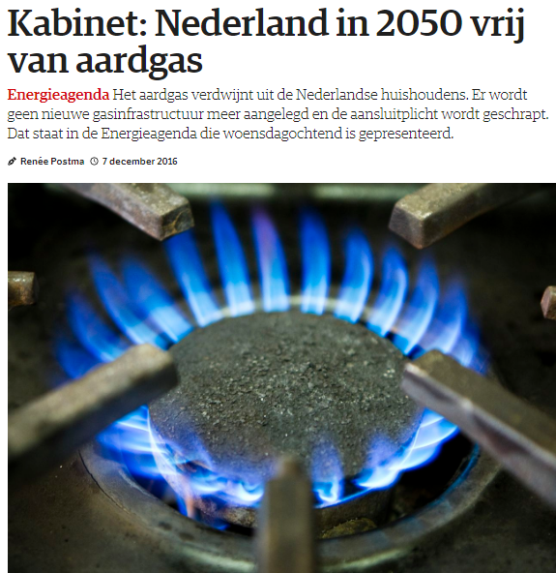
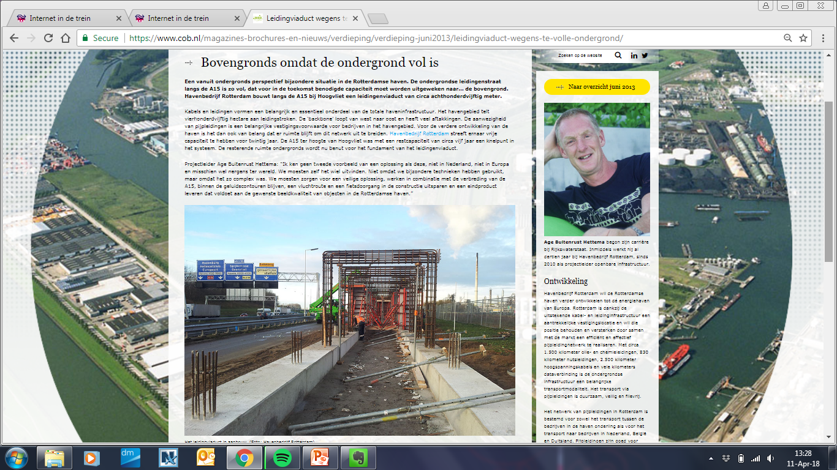
Example 1: energy transition
Feasibility transition
Subsurface needed
Use of space -> choices needed
Enormous spatial planning challenge
Cables and pipes: new remediation operation?
Asset Management subsurface (risks costs performance)
No use of natural gas in 2050
“subsurface is fully occupied”

Slide 10



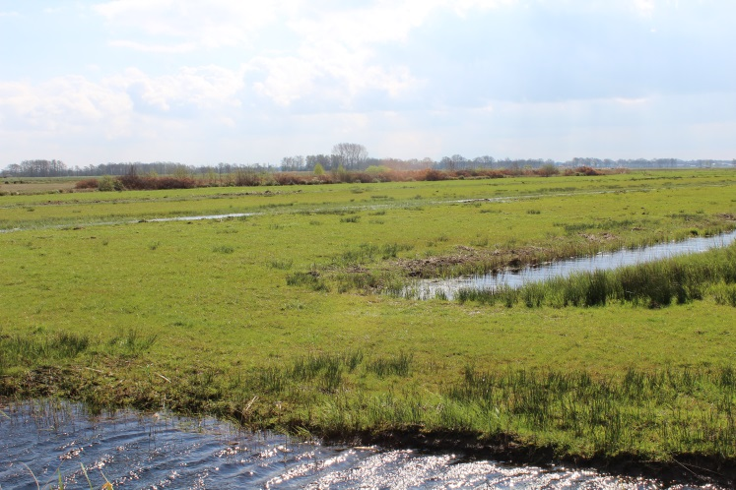
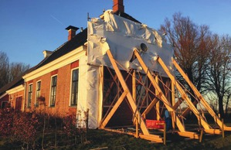
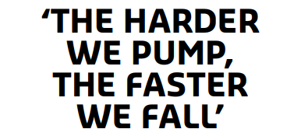
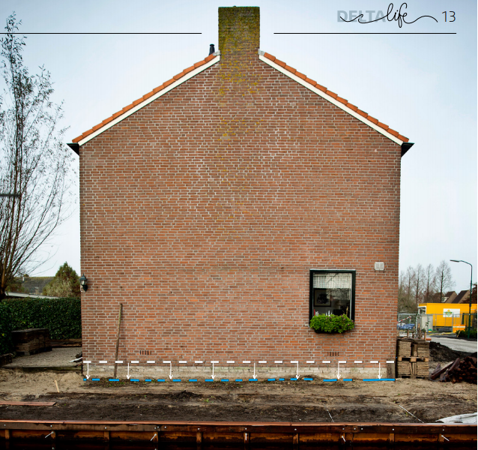
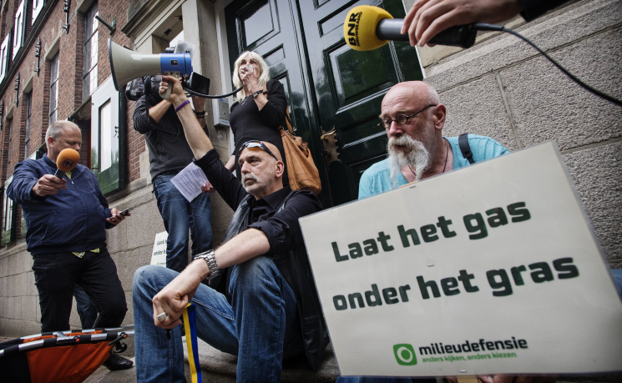
Example 2: subsidence
Land & water management in peat areas
Due to natural gas extraction
Acceptance of citizens

Slide 11

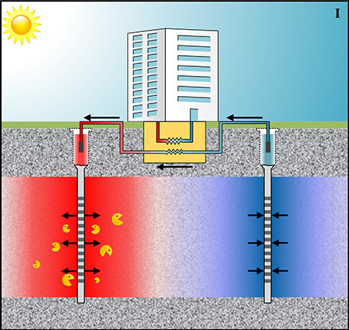
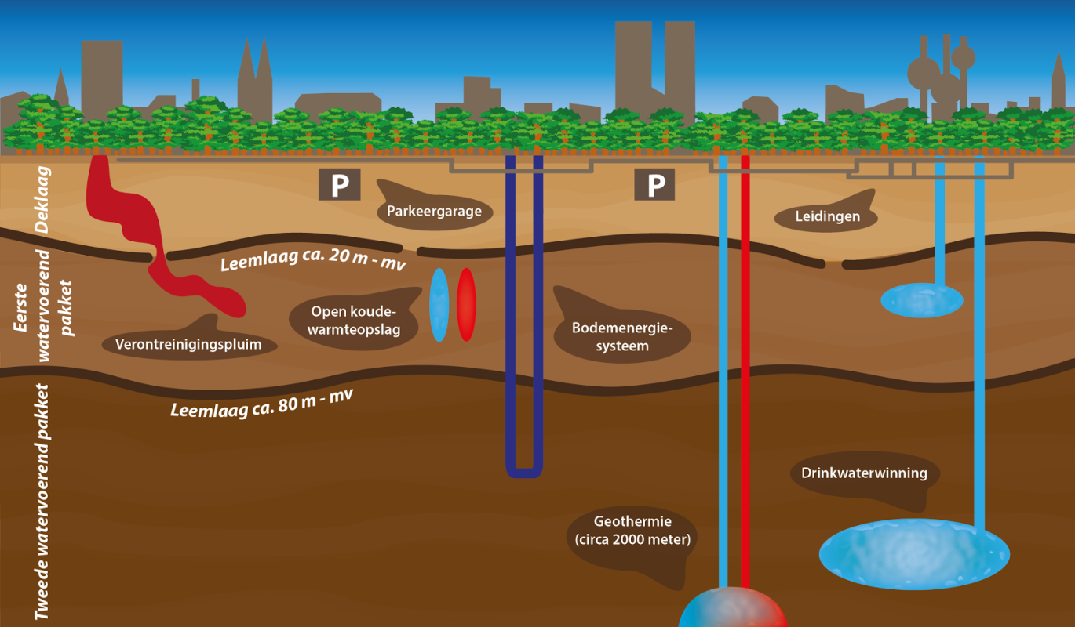
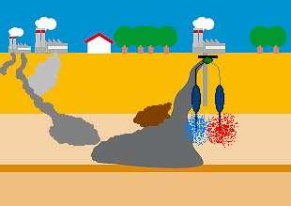
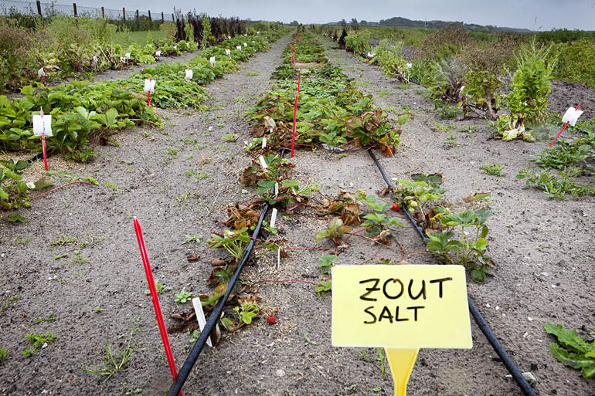
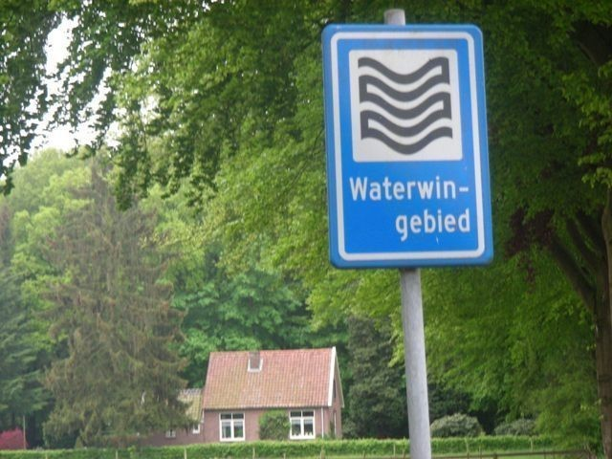
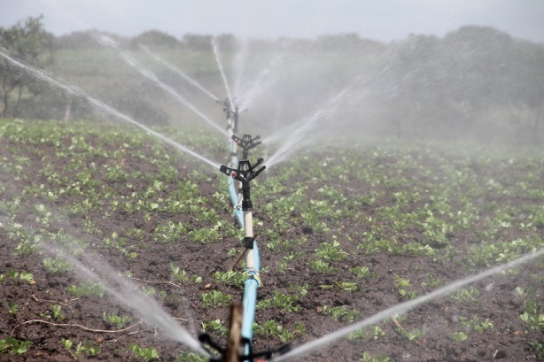
Example 3: groundwater uses
Aquifer thermal energy storage
Groundwater contamination
Salinization
Water extraction for drinking or process water
Water for irrigation

Slide 12

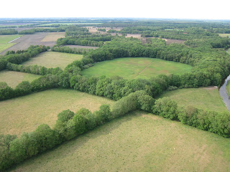
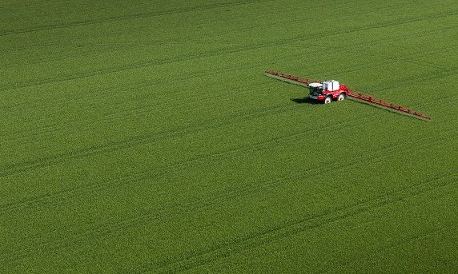
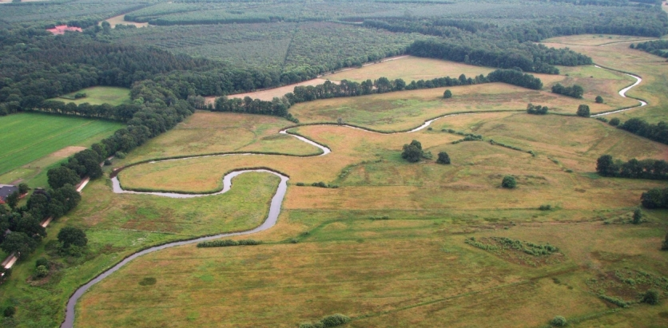
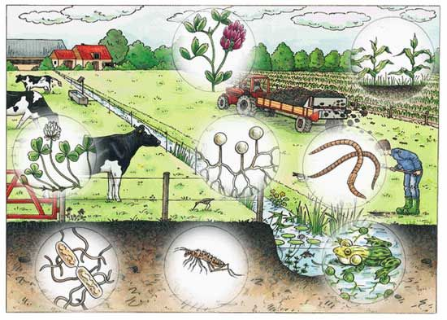
Example 4: agriculture vs landscapes
intensive up-scaled agriculture
landscapes
(soil)biodiversity

Slide 13




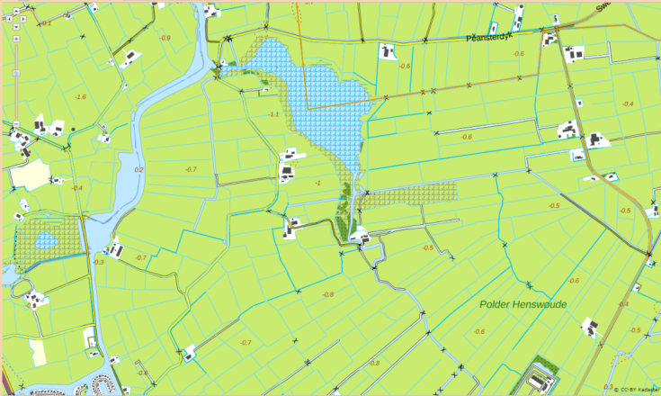


We need knowledge about subsurface when making environmental planning policies

Slide 14
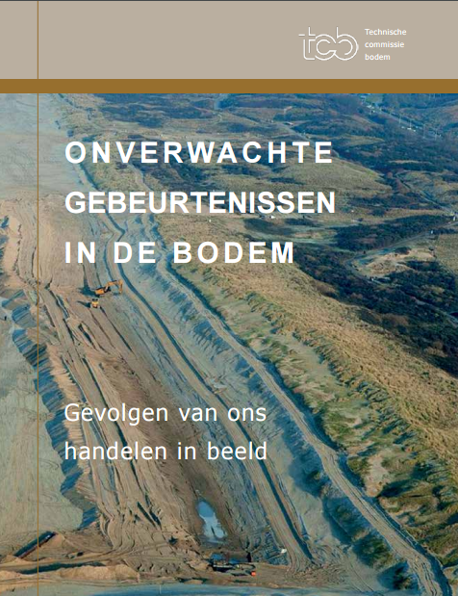
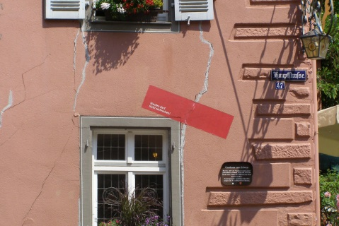
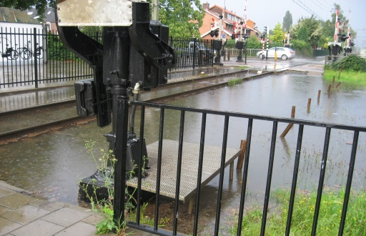
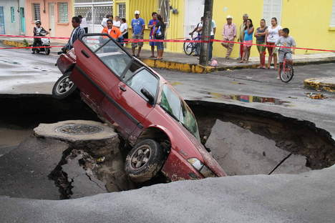
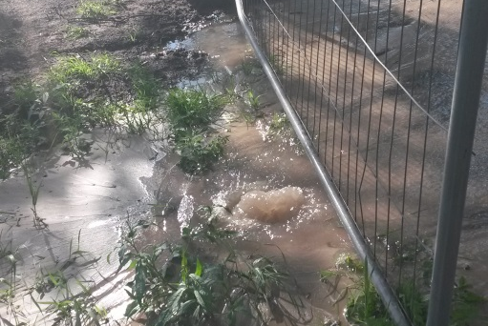
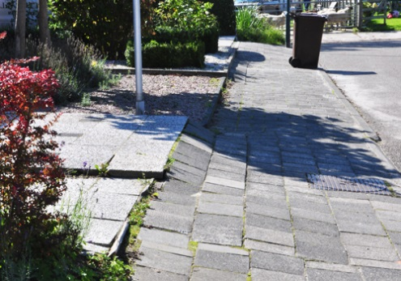
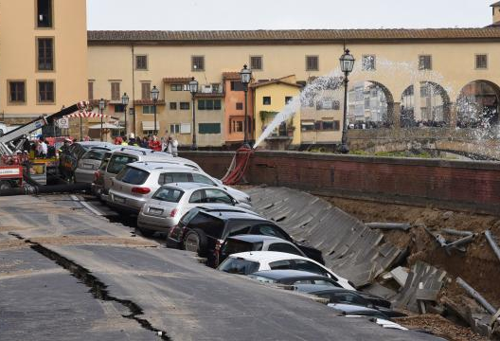
Role of knowledge of the SSW system
Unexpected and unnecessary events in the subsurface
https://www.tcbodem.nl/publicaties/alle-publicaties/761-r23-2014-rapport-onverwachte-gebeurtenissen-in-de-bodem-gevolgen-van-ons-handelen-in-beeld-4

Slide 16
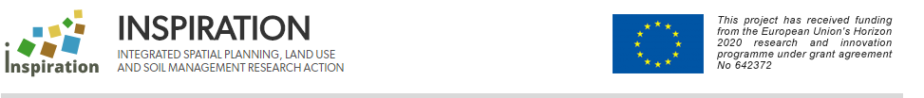
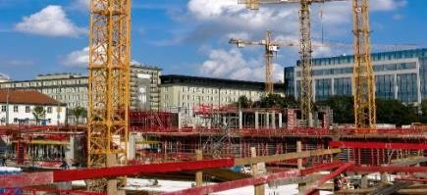
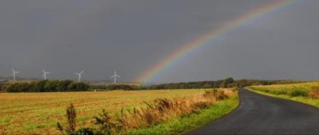
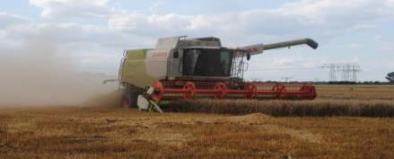
Structuring research on soil, land-use and land management in Europe
Establish & promote a Strategic Research Agenda (SRA)
17+ countries
Bottom up
Consider current & future societal challenges
Involve funders and create a network
Spatial Planning
Land Use
Soil Management
http://www.inspiration-h2020.eu/
http://www.inspiration-agenda.eu/

Slide 17
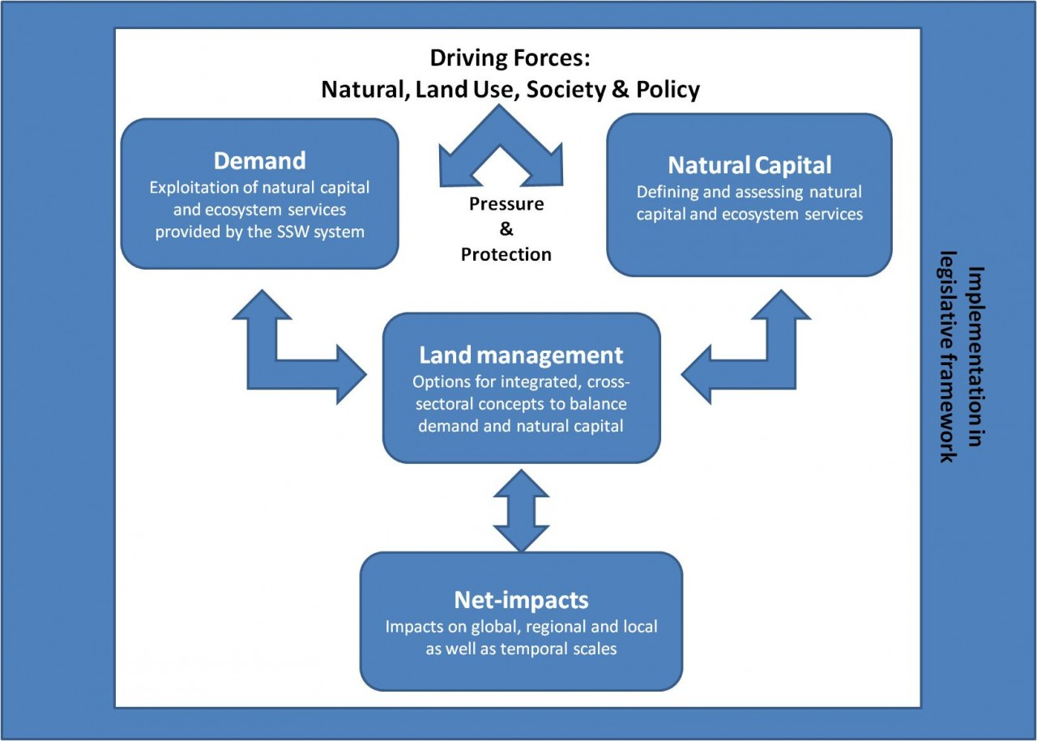
Conceptual model INSPIRATION

Slide 18
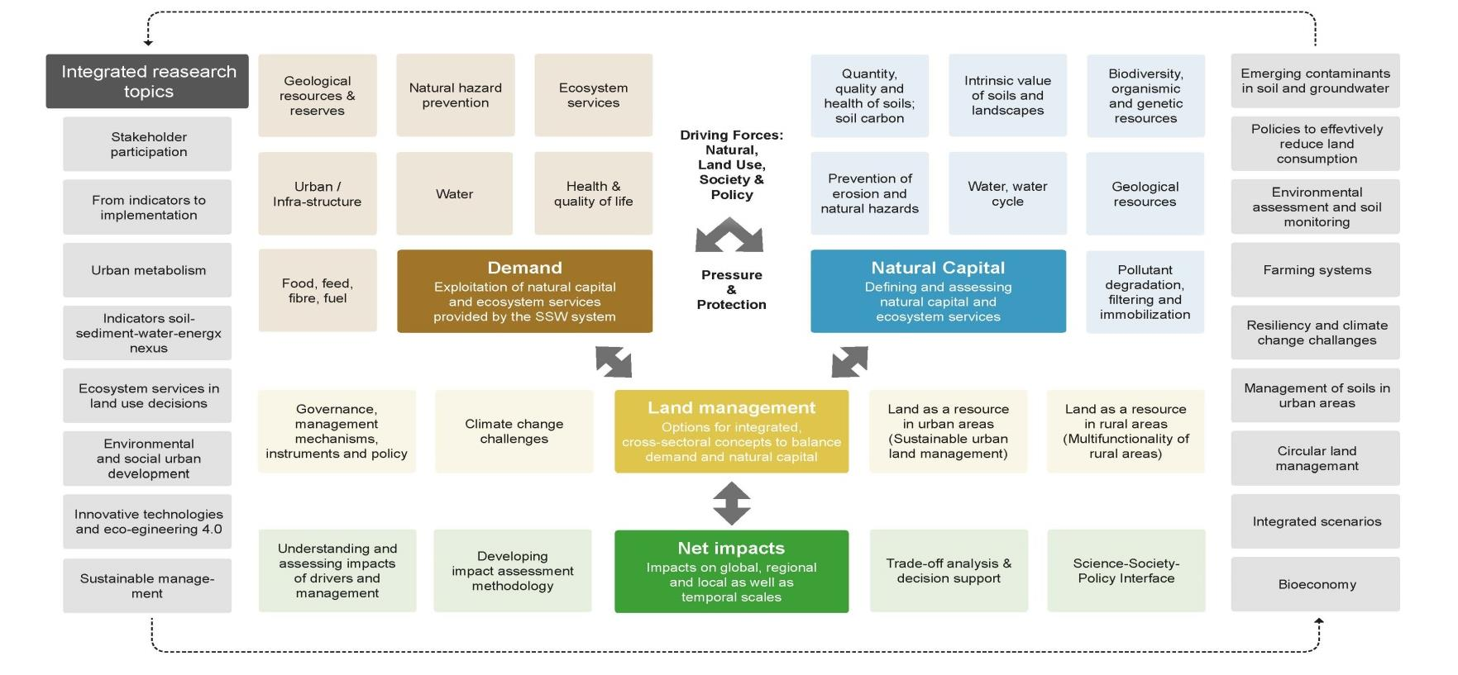

INSPIRATION Research Agenda

Slide 19
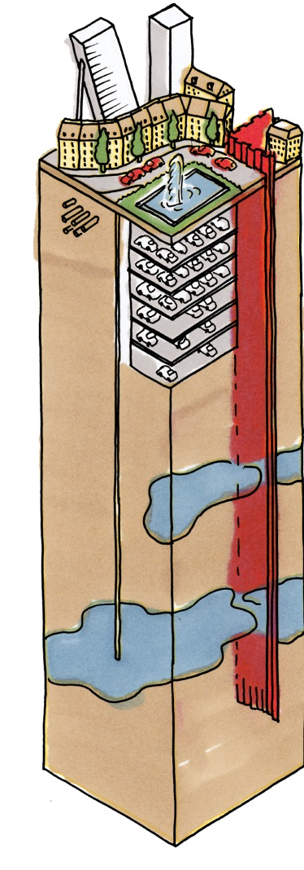
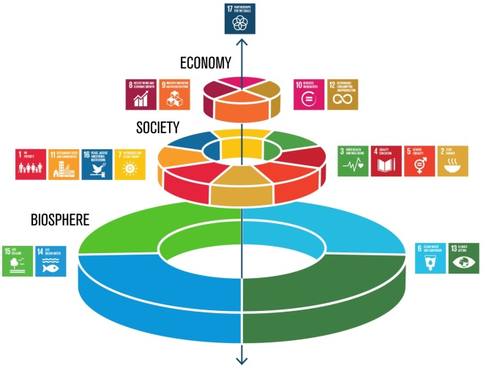
Soil and Land Research Funding Platform
strongly believing in the need for
integrated soil and land research in Europe.
seeing added value through
coordinating, co-funding and disseminating cross-border research.
seeking to establish
a new self-financed platform of funders to implement integrated, trans-/multidisciplinary research
Current and future societal challenges need research to close knowledge gaps
  Prerequisite for informed land use and evidence based policies
  Smarter use of the services provided by land and the Soil Sediment Water (SSW) system

Slide 21

We need knowledge about the SSW system when making environmental planning policies
Current and future societal challenges need research to close knowledge gaps
Prerequisite for informed land use and evidence based policies
Smarter use of the services provided by land and the Soil Sediment Water (SSW) system

Slide 22
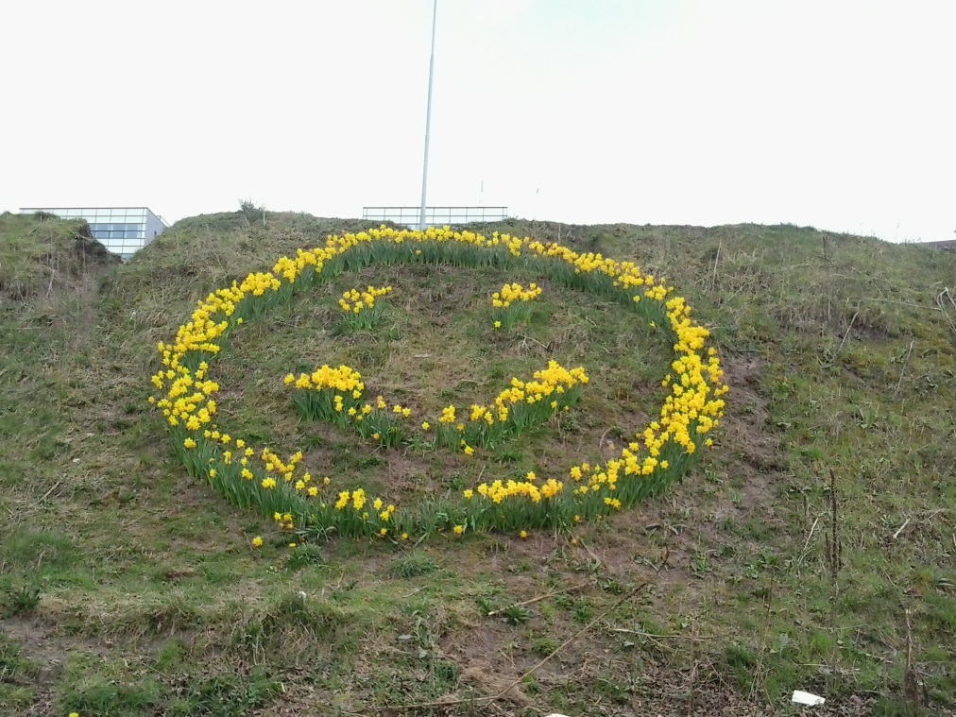
Thank you
Linda.maring@deltares.nl
http://www.inspiration-h2020.eu/
http://www.inspiration-agenda.eu/

