Slide 1
Justice in Climate and Mobility
Dick Ettema (Utrecht University)
Masterclass “Justice in Climate and Mobility”,
Ministry of I&W, 12 September 2023

Slide 2
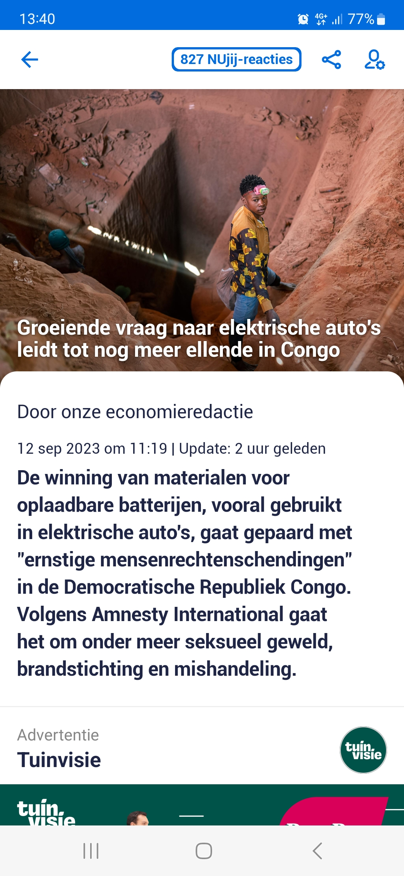
Zero-Emission Transport
What is zero-emission (person) transport?
‘Klimaatakkoord’
    Cleaner, smarter
    Shift to PT and (e)bicycle, tele-activities
‘Real’ zero-emission transport
    More ambitious/less CO2 emissions
    Switch to SHARED car use (with less use of raw materials), ransoning mobility (driving rights)
Different ambitions will have different implications for equity and fairness

Slide 3
How to get to zero-emission transport?
Ways to influence travel behaviour/decisions: money, power, words
Can we achieve ZE transport with only words?
‘Power’ and ‘money’ may work out differently for different people by income, geography, adaptability
- carrot
- stick
Gärling & Fujii, 2009

Slide 4
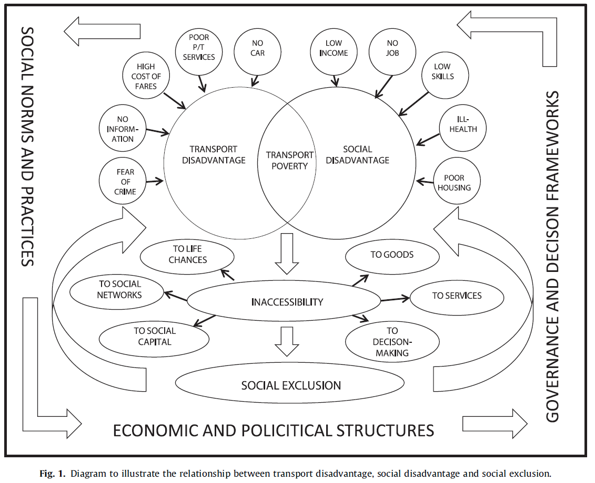
Effects of ZET policies: transport and exclusion
Factors driving transport poverty (Lucas, 2012)

Slide 5
Effects of ZE policies: transport and exclusion
Definition of transport poverty by Lucas et al. (2016):
  There is no transport option available that is suited to the individual’s physical condition and capabilities.
  The existing transport options do not reach destinations where the individual can fulfil his/her daily activity needs. in order to maintain a reasonable quality of life.
  The necessary weekly amount spent on transport leaves the household with a residual income below the official poverty line.
  The individual needs to spend an excessive amount of time travelling, leading to time poverty or social isolation.
  The prevailing travel conditions are dangerous, unsafe or unhealthy for the individual.

Slide 6
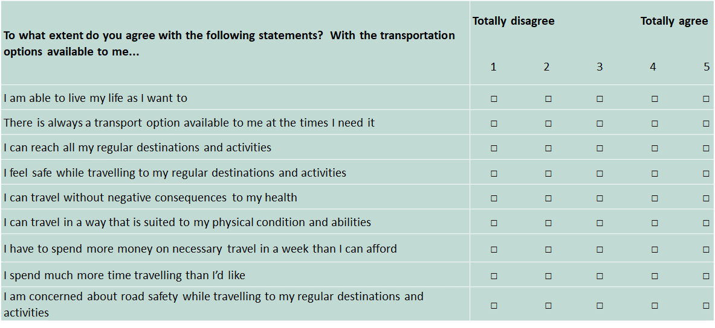
An example: differences in transport adequacy (MOBIMON)

Slide 7
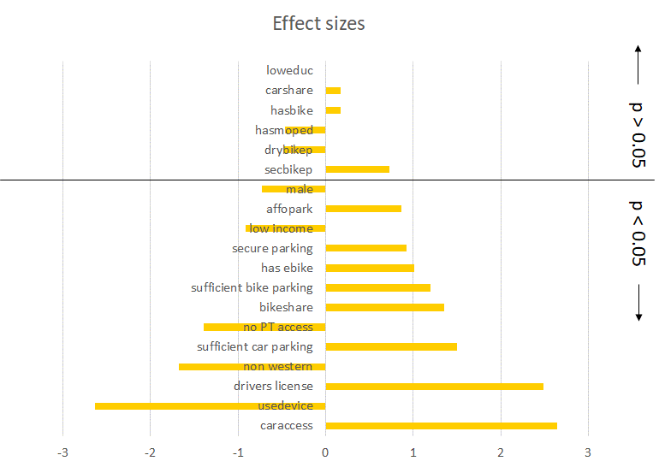
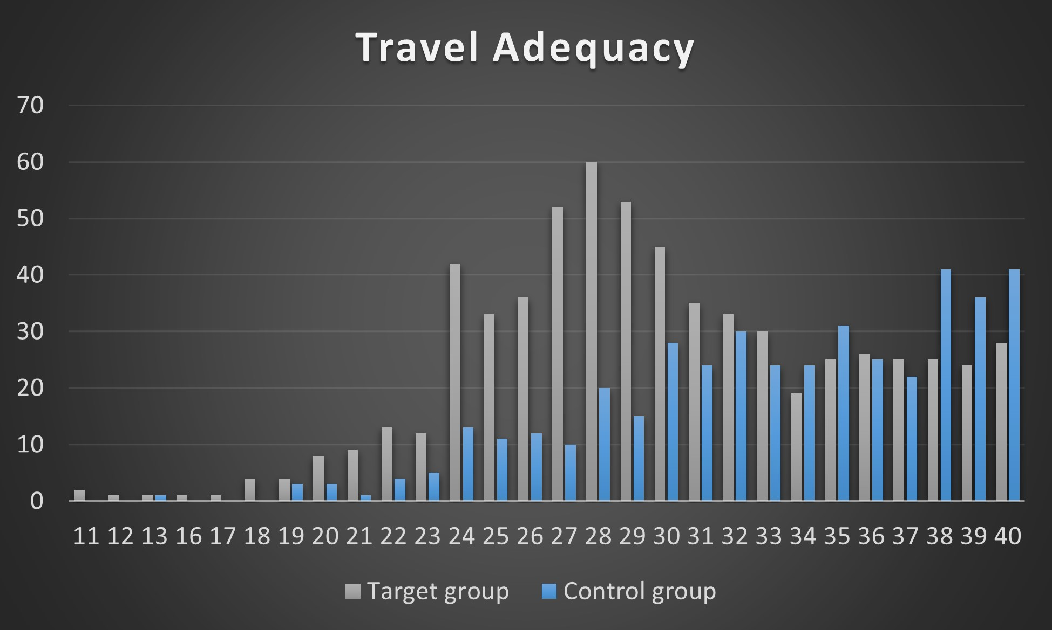
An example: differences in transport adequacy (MOBIMON)
Ettema et al., 2023
Access to a household car is the major driver of transport adequacy!

Slide 8
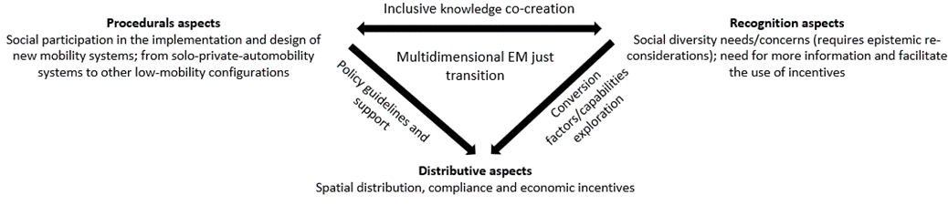
Justice outcomes of a transition toward zero-emission transport
(Verlinghieri & Schwanen, 2020; Israel et al., 2023)
Distributive justice: how are outcomes distributed?
    Outcomes: access to travel options (transport adequacy), health, livability, safety
    Distributed along: income, geography, capabilities, causative/injured parties
Procedural justice: decision making, governance, participation
Recognition justice: acknowledgment of and respect for the needs, values, understandings, capabilities and practices of groups
Israel et al., 2023

Slide 9
How to value distributive outcomes?
Utilitarianism: maximizing the sum of all profits (even if some experience negative effects) > Cost Benefit Analysis
Egalitarianism: “equalising the relative level of accessibility between different social groups” (Lucas et al., 2014) > focus on those less well off first
Sufficientarianism: everyone should enjoy a minimum level of accessibility
Limitarianism (Robeyns): no one should consume/own more than what they need to flourish (Timmer, 2021)

Slide 10
Boundaries of your system?
Geographical: city, Netherlands, World?
Outcomes balanced against GHG emissions: travel/accessibility, health (of travelers and others), livability, safety, environmental pollution elsewhere?
Time: current, future generations?

Slide 11
Example: inclusive transition toward electric mobility (ITEM project): interviews
ITEM (Utrecht, Oxford, Oslo, Poznan) investigates in- and exclusion effects of the transition toward electric mobility
Interviews with households to discuss implications of EV policies
Utrecht region, n=25
11 low, 9 middle, 5 high income
12 male, 13 female
15 ICEV, 10 EV owners

Slide 12
Example: inclusive transition toward electric mobility (ITEM project): interviews
High and low income respondents feel that EV subsidies are inadequate for people with low incomes > high income groups (who maybe do not need the subsidy in the first place) reap the benefits
“I was able to take advantage of the subsidy [SEPP] easily . This has partly made it possible for me to drive an EV at all. And even if I could [ done it [adopt an already, I would have just got some extra money (Participant 7 EV owner)”
Second hand EVs are still considered to be too costly and high risk, and only few affordable models
“By the time second hand cars are affordable to buy, those cars are already so old that their batteries have to be replaced. The initial low initial purchase price will not matter as much because there will be a very expensive battery replacement on top of that. (Participant 13, ICEV owner)”

Slide 13
Example: inclusive transition toward electric mobility (ITEM project): interviews
High income groups are able to adopt EVs earlier, and profit from subsidies for a longer period
High income groups profit from the ease of charging at home (based on parking lot) and from charging with solar panels
People in lower income areas perceive lower availability of public charging facilities, and reduced parking space for ICEVs
“ There are a lot of charging stations, I do like that. A lot of big earners live here [...][...], that does contribute, of course. I think most of the people here drive electric cars. (Participant 21, ICEV owner)”
ICEV owners in Utrecht fear inaccessibility of city center due to planned Zero Emission zone

Slide 14
Example: inclusive transition toward electric mobility (ITEM project): interviews
Some indicate a lack of information about subsidy options, and understandability of this > depending on capabilities

Slide 15
Example: inclusive transition toward electric mobility (ITEM project): interviews
To summarize:
Various examples of distributive injustice (by income, residential location)
These are based on lack of recognition justice (geared toward higher income, early adopters; inadequate information)
Procedural injustice?

Slide 16
Other pillars of decarbonization (mode shift, car free city initiatives) > some distributive equity effects
(Nieuwenhuijsen et al., 2019; Wågsæther et al., 2022; Israel et al., 2023; )
Pricing of car use hurts lower income groups more
Concern about low income car dependent groups > due to locations of home and work places
Shared mobility projects: distributive fairness depends on locational distribution and fee structures. While privileged groups use them more, vulnerable segment can also benefit.
Cycling policies: increased cycling densities and speed differences may lead to lower perceived accessibility for specific groups (e.g. elderly)

Slide 17
Other pillars of decarbonization (mode shift, car free city initiatives) > some distributive equity effects
Parking restrictions: public/private parking users will face different consequences, parking paid by employer
Accumulated investment in public transport in urban areas and compact city development may lead to green gentrification (e.g. Merwede Kanaal Zone)

Slide 18
Toward a classification scheme of policies?
 | JUSTICE |  |  |  | CLIMATE
 | Distributive-local (by income, geography, agency) | Distributive-global | Procedural | Recognition | GHG reduction
EV subsidy | Accessibility - Cost - Vehicle access - Health 0 Livability 0 Safety 0 | Resources - Local communities - | - Ways to involve community - | - | +
Cycling | Accessibility + Cost 0 Vehicle access + Health + Livability + Safety +/- | Resources 0 Local communities 0 | - Ways to involve community + | 0 | 0
...

Slide 19
Discussion
ZET policies need to balance justice against effectiveness
A limitarianism/sufficientarianism perspective is needed to get public support for ZET policies
Increasing public involvement is necessary to increase procedural and recognition justice
Electrification should not be the only/main pillar of ZET policies, car reduction measures will also be needed (more stick, less carrot)
Assess equity/justice of ZET policies on a broad set of outcomes (accessibility, health, livability, safety…)
ZET policies may have inconsistent outcomes for equity (e.g. cycling helping some at the cost of others)

