Slide 1
Equity, Justice and FAIRNESS in CLIMATE & MOBILITY
Dr. Diana Reckien
Associate Professor Climate Change and Urban Inequality,
University of Twente, The Netherlands;
Coordinating Lead Author WGII Ch.17: Decision-making options for managing risks

Slide 2
Growing interest in justice issues
Various EU policies focusing on justice/ referring to justice issues, e.g.:
Energy Union and Climate Action Regulation requires EU States to monitor and report ... mitigation and adaptation policies to pursue “a socially acceptable and just transition” (EU, 2018, p. 4)
Covenant of Mayors refers to fairness in the climate transition process: Signatories commit to share a vision of “a transition that is fair, inclusive and respectful of [the] citizens”(Covenant of Mayors - European Office, 2021, p. 1).
The Council of the EU published recommendations on ensuring a fair transition towards climate neutrality (EC, 2022a, part of the European Green Deal), emphasizing inclusivity of climate resilience.
Mission on “Adaptation to Climate Change” (EC, 2022b), also makes frequent references to the just resilience principle.

Slide 3
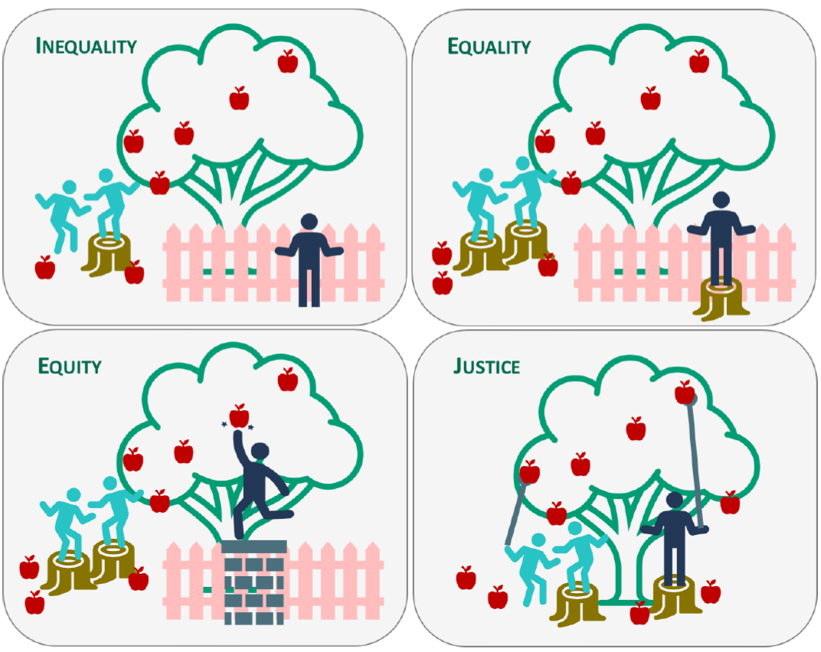
What do we understand under equity, justice, and fairness?
Equity, justice, and fairness often used interchangeably, but differences exist (Reckien et al. 2018)
What exactly qualifies as “fair” or “just” depends on personal or cultural judgment.
→ It is therefore important to consider who decides what is equitable, fair, and just.
Lager et al. (2023)

Slide 4

Why is it important to look at equity, justice, and fairness?
Societies/ cities:: Great diversity of socioeconomic groups
  → Stratification based on, e.g., class, caste, gender, profession, race, ethnicity, age, ability
  → Discrimination based on group membership
  → Affect the ability of individuals/ groups to endure stresses and minimize risk.
Some equity/ fairness/ justice aspects are rarely disputed → normative power (Kallbekken et al., 2014)
Increase → Quality of social life & Characteristics a good society
→ Some constraints on the actions of self-interest are believed to be favorable for all in the long run.
https://spsp.org/about/diversity-and-inclusion

Slide 5
How does equity, justice, and fairness relate to social vulnerability?
Certain social groups particularly vulnerable to stressors
These groups include:
  The young,
  the elderly,
  women,
  poor or low-income households,
  people in poor health,
  people with poor social networks,
  immigrants and
  ethnic minorities…. Particularly intersecting vulnerability markers
Proven relationship between social vulnerability & poverty/ other SV markers
Often lack of power and access to resources, adequate urban services, and functioning infrastructure
Increases susceptibility to climate impacts and reduces capacity to adapt

Slide 6
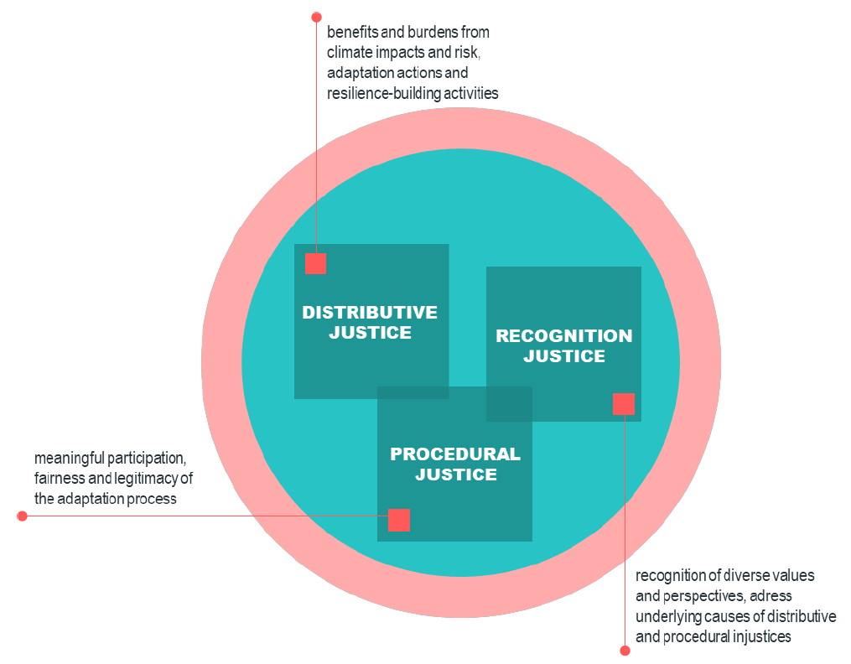
What dimensions of equity/justice are distinguished?
Restorative/ retributive justice
Intergenerational justice
Lager et al. (2023)

Slide 7
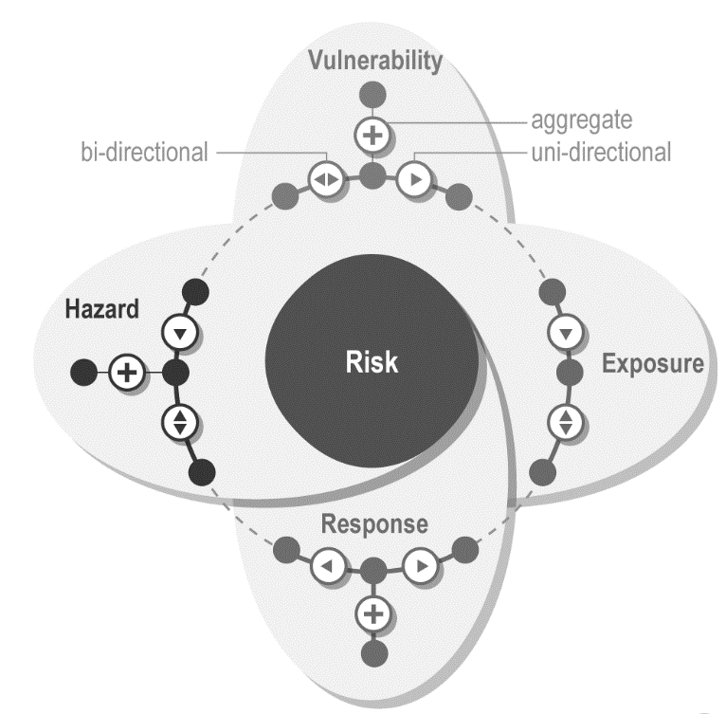
What dimensions of justice are distinguished?
Distributive justice:
How are climate change impacts/ risks distributed in society and space?
Recognitional justice:
How are social groups and places considered in impact assessments?
Impacts
Mitigation
Adaptation
Distributive justice:
How are benefits/ burdens of mitigation/ adaptation distributed?
Recognitional justice:
How are cultures/ perspectives considered in mitigation / adaptation?
Procedural justice:
Who takes part and decides about mitigation / adaptation?
Restorative justice:
How can adaptation/ mitigation be used to restore past injustices?

Slide 8
Summary I
  Equity and justice fosters quality of social life, i.e. human well-being, social capital, and sustainable social and economic urban development
  → all of which increase a person’s/ city’s/ country’s capacity to respond to climate change.
  Current science distinguishes between distributive, procedural, recognitional and restorative justice

Slide 9
Distributive justice & CC & mobility
Distributive justice:
How are climate change impacts/ risks distributed in society and space?
Impacts:
Interruptions of transport before, during and after extreme events mostly affect vulnerable groups (women, children and the elderly and low-income groups), in remote and scarcely connected areas, as they are dependent on transport
Impacts of heat, flooding, sea level rise on transport & T-Infrastructure well documented
Less information about impact of drought on transport & equity
Impact of heat on health of transport workers outside
Adaptation EU countries:
1/3 of EU countries note justice in national reporting on adaptation, particularly distributive justice
Most countries assess physiological inequalities to heat (elderly, children, people in poor health)

Slide 10
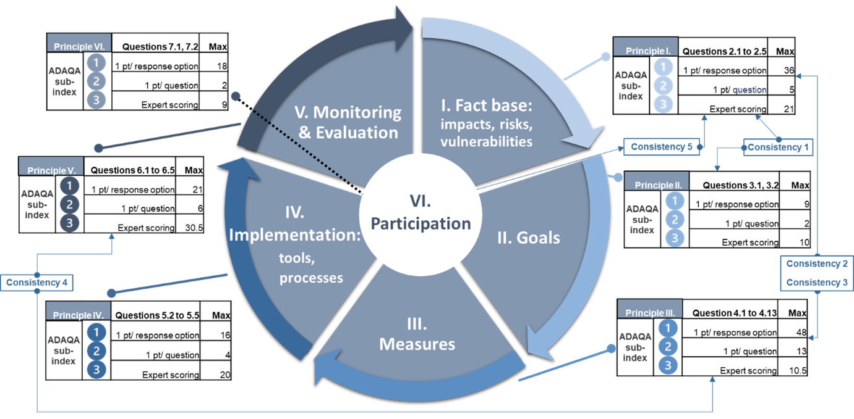
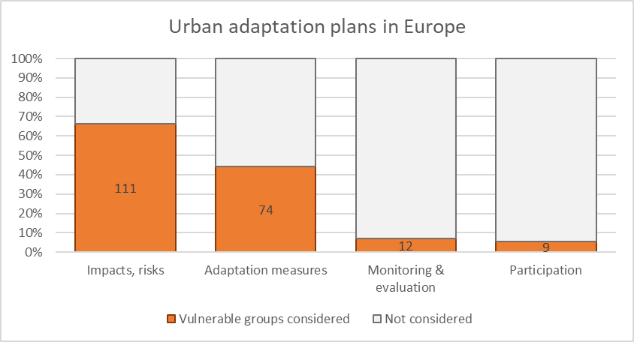
Distributive justice & CC & mobility
Distributive justice:
How are benefits/ burdens of mitigation/ adaptation distributed?
Quality of adaptation planning in urban areas in Europe:
→ 2/3 of plans look at risk of vulnerable groups; ½ of plans include measures for vulnerable groups
Our recent paper in Nature Urban Sustainability: https://doi.org/10.1038/s42949-023-00085-1

Slide 11
Distributive justice & CC & mobility
Distributive justice:
How are benefits/ burdens of mitigation/ adaptation distributed?
Adaptation in urban areas in Europe:
→ Consideration of vulnerable groups got lower over time
Our recent paper in Nature Urban Sustainability: https://doi.org/10.1038/s42949-023-00085-1

Slide 12
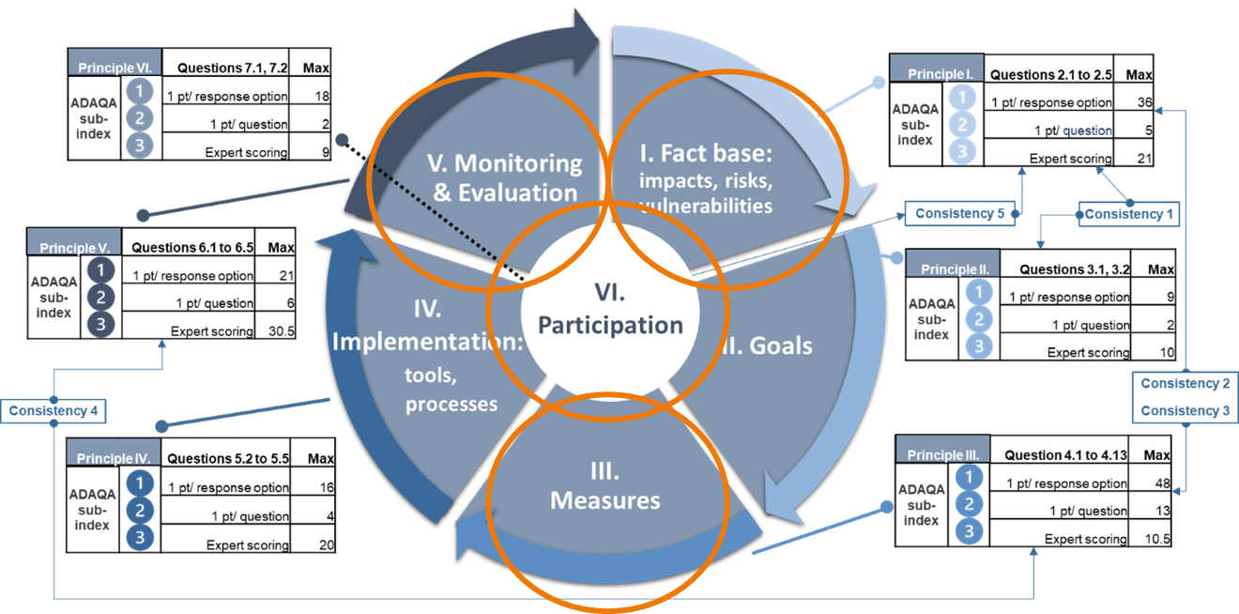
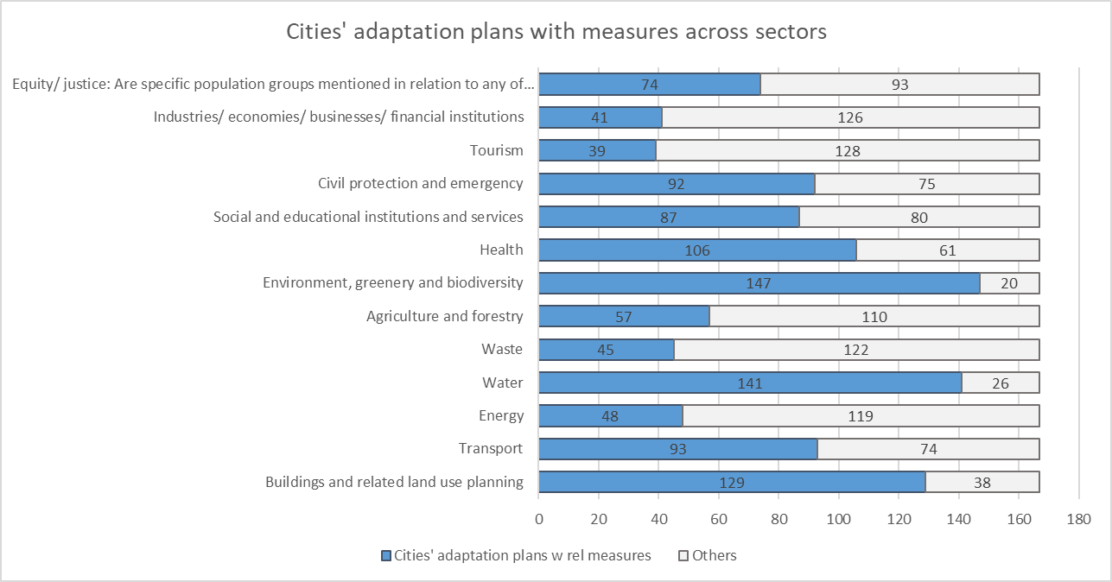
Distributive justice & CC & mobility
Distributive justice:
How are benefits/ burdens of mitigation/ adaptation distributed?
Adaptation in urban areas in Europe:
5th largest sector
of planning for adaptation

Slide 13
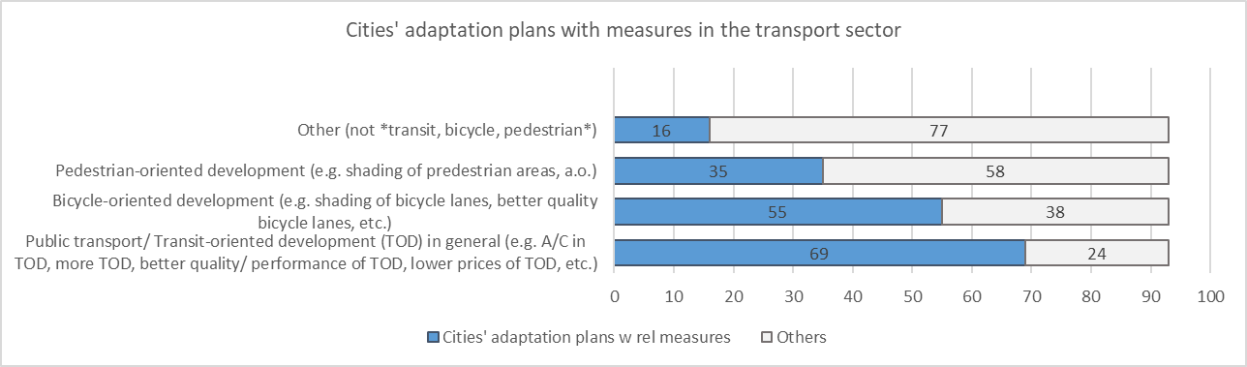
Distributive justice & CC & mobility
Distributive justice:
How are benefits/ burdens of mitigation/ adaptation distributed?
Adaptation in urban areas in Europe:

Slide 14
Distributive justice & CC & mobility
Distributive justice:
How are benefits/ burdens of mitigation/ adaptation distributed?
Mitigation:
Public transport: Mitigation policies raise justice concerns → may affect low-income households via rising energy prices & transport cost,
Private transport: Fuel taxes affect mostly middle-income households
Electrification of mobility systems on-going in high- and low-income countries

Slide 15
Procedural justice & CC & mobility
Procedural justice:
Who takes part and decides about mitigation / adaptation?
Adaptation EU level:
In general procedural justice is not yet widely considered across EU countries
Limited number of EU members, e.g. France, Spain, Sweden, Greece and Finland consider procedural justice.
Studies suggest that a higher level of participation leads to more transformative adaptation (Cattino & Reckien, 2018)
→ Procedural justice is important to cultivate social trust, enhance legitimacy and widen support for policy outcomes and transformative changes

Slide 16
Procedural justice & CC & mobility
Procedural justice:
Who takes part and decides about mitigation / adaptation?
Adaptation in urban areas in Europe:
→ About 5% of urban adaptation plans have dedicated participation strategy
Our recent paper in Nature Urban Sustainability: https://doi.org/10.1038/s42949-023-00085-1

Slide 17
Procedural justice & CC & mobility
Procedural justice:
Who takes part and decides about mitigation / adaptation?
Adaptation in urban areas in Europe:
→ Measures planed for vulnerable groups are not monitored by them
Our recent paper in Nature Urban Sustainability: https://doi.org/10.1038/s42949-023-00085-1

Slide 18
Procedural justice & CC & mobility
Procedural justice:
Who takes part and decides about mitigation / adaptation?
Mitigation:
Little information about how vulnerable groups take part in deciding about climate change mitigation policies
Studies show that a higher level of participation leads to more ambitious mitigation (Cattino & Reckien, 2018)
Concern: Decision-making in national energy policy and small-scale pilot programs is usually of closed nature → excludes willing participants
Concern: Strong power of lobbies (Sovacool et al. 2019).
Procedural justice is important to cultivate social trust, enhance legitimacy and widen support for policy outcomes and transformative changes

Slide 19
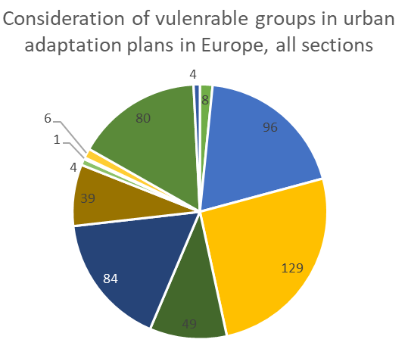
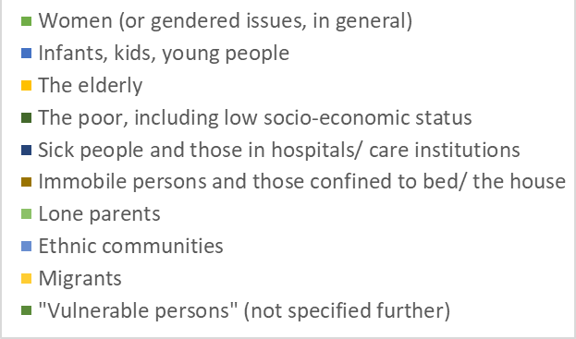
Recognitional justice & CC & mobility
Recognitional justice:
How are social groups and places considered in impact assessments?
Adaptation EU countries:
50% of EU countries recognize the importance to engage vulnerable
20% consider different values patterns, including the specific recognition of future generations, women, or cultural minority groups.
Adaptation in urban areas in Europe:
→ Hardly consideration of low-income and gender aspects.
Recognitional justice:
How are cultures/ perspectives considered in mitigation / adaptation?

Slide 20
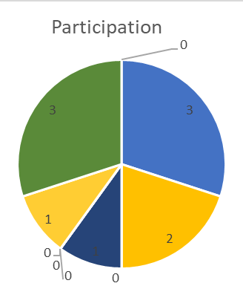
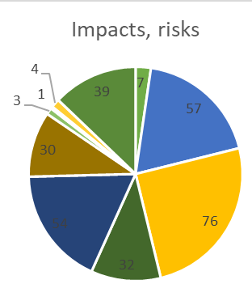
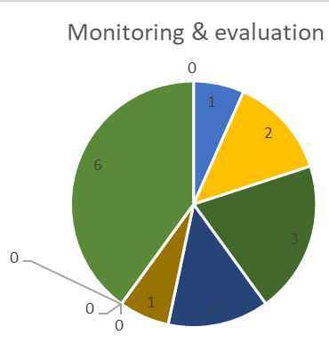
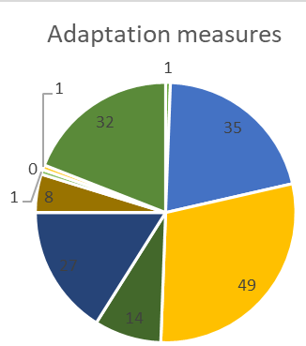
Recognitional justice & CC & mobility
Recognitional justice:
How are social groups and places considered in impact assessments?
Adaptation in urban areas in Europe:
Recognitional justice:
How are cultures/ perspectives considered in mitigation / adaptation?

Slide 21
Recognitional justice & CC & mobility
Recognitional justice:
How are social groups and places considered in impact assessments?
Mitigation:
Negligible information
Closely linked to procedural justice: lobby groups; close-door national decision making may be an issue
Recognitional justice:
How are cultures/ perspectives considered in mitigation / adaptation?

Slide 22
Summary II
  Distributive justice most often considered, less often procedural, recognitional, restorative justice
  Distributive: A: declining; M: widening energy prices biggest issue
  Procedural: low in A/M, particularly in M&E; lobbies are an issue
  Recognitional: A: the elderly & kids largest groups considered, rarely the poorer strata
  → Procedural justice most important aspects to build social trust, enhance legitimacy and widen support for policy outcomes and transformative changes
  → Achieving justice requires deliberate action to ensure that vulnerable populations are not disproportionately burdened and can fully participate in and benefit from initiatives

Slide 23
How to improve justice in CC response?
Distributive justice:
How are climate change impacts/ risks distributed in society and space?
Recognitional justice:
How are social groups and places considered in impact assessments?
Impacts
Mitigation
Adaptation
Distributive justice:
How are benefits/ burdens of mitigation/ adaptation distributed?
Recognitional justice:
How are cultures/ perspectives considered in mitigation / adaptation?
Procedural justice:
Who takes part and decides about mitigation / adaptation?
Restorative justice:
How can mitigation be used to restore past injustices?

Slide 24
How to improve justice in CC response?
Respect, plan for & consider outcomes of mobility/ transport measures on vulnerable groups
Monitoring and Evaluation (M&E) particularly important
→ Vulnerable groups should be included in M&E and assess the outcome of actions on them, both on national and local level.
M&E needs fair indicators and progress measurements.
Transport/ mobility: Indicators should measure the share of income spent on transport.

Slide 25
How to improve justice in CC response?
Distributive justice:
How are climate change impacts/ risks distributed in society and space?
Recognitional justice:
How are social groups and places considered in impact assessments?
Impacts
Monitor uneven burden due to climate change – who is more vulnerable, in order to set up goals for policy making for just adaptation.
Monitor how social and cultural values are included in impact assessment.
Mitigation
Adaptation
Distributive justice:
How are benefits/ burdens of mitigation/ adaptation distributed?
Recognitional justice:
How are cultures/ perspectives considered in mitigation / adaptation?
Procedural justice:
Who takes part and decides about mitigation / adaptation?
Restorative justice:
How can mitigation be used to restore past injustices?
Monitor the (un)equal distribution of costs/ benefits from A/M between groups, and specifically the most vulnerable
Monitor how social/ cultural values are included in development and implementation of A/M
Monitor more equal involvement & engagement of stakeholder, incl. vulnerable people.
Monitor compensation and restoration of unintended harm

Slide 26
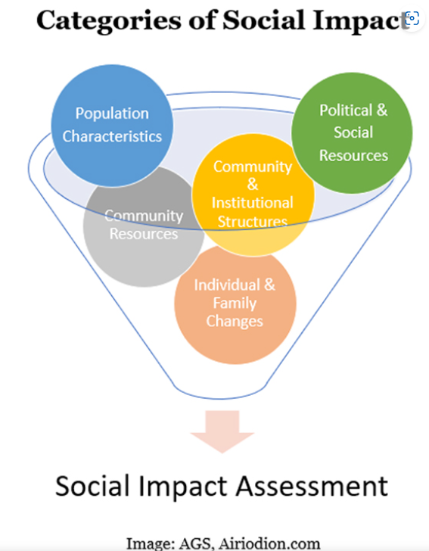
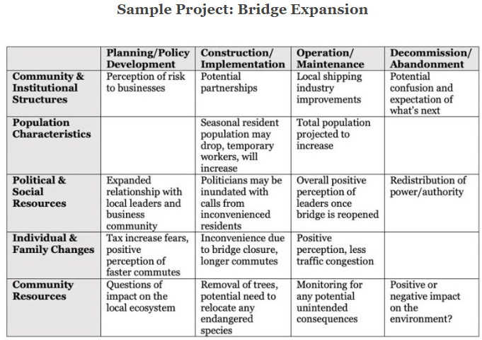
How to improve distributive justice in CC response?
Social Impact Assessments important
the processes of analysing, monitoring and managing the intended & unintended social consequences of planned interventions and the social changes invoked by those interventions.
https://www.ocmsolution.com/social-impacts-assessment/

Slide 27
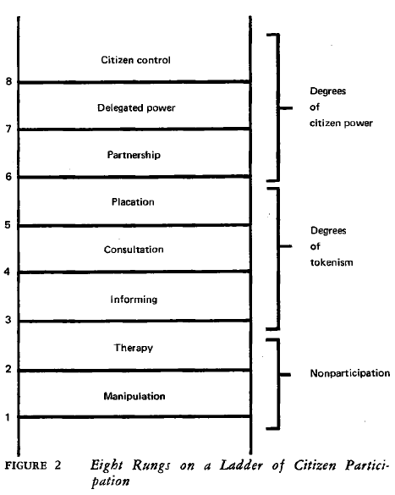
How to improve procedural justice in CC response?
Four conditions for public participation (Cattino & Reckien, 2018):
  Recognition of all actors,
  Their clear and meaningful engagement in all decision-making stages,
  Full decision-making power of the involved public, and
  The support of a logic of welfare.
Strive for a higher level of participation (Arnstein, 1969)
Arnstein, 1969

Slide 28
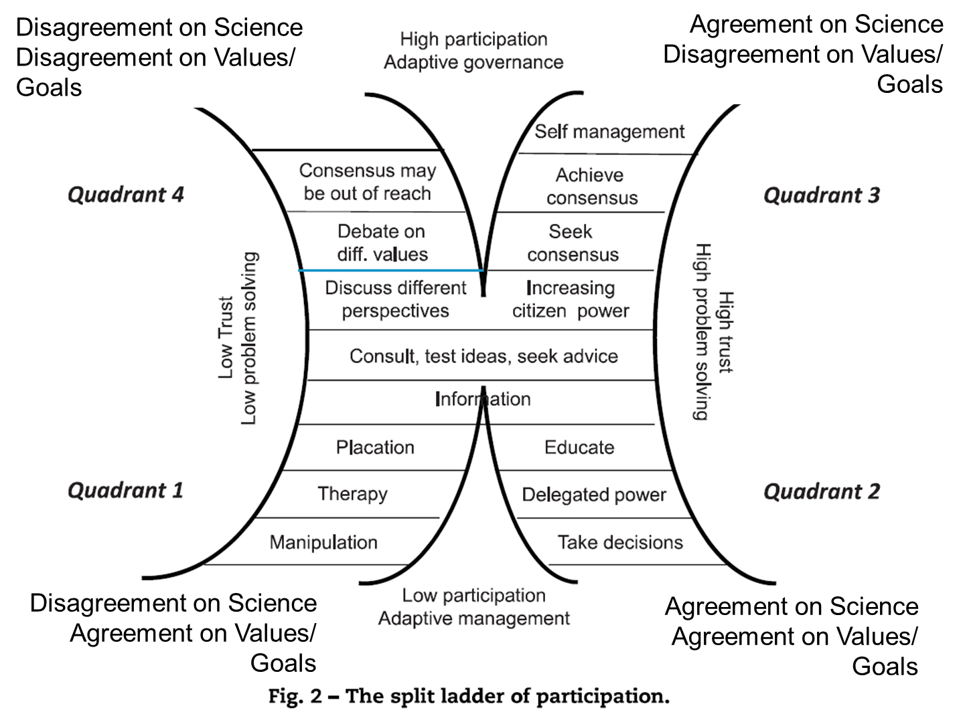
How to improve procedural justice in CC response?
Hurlbert & Gupta (2018); Wood (2018)

Slide 29
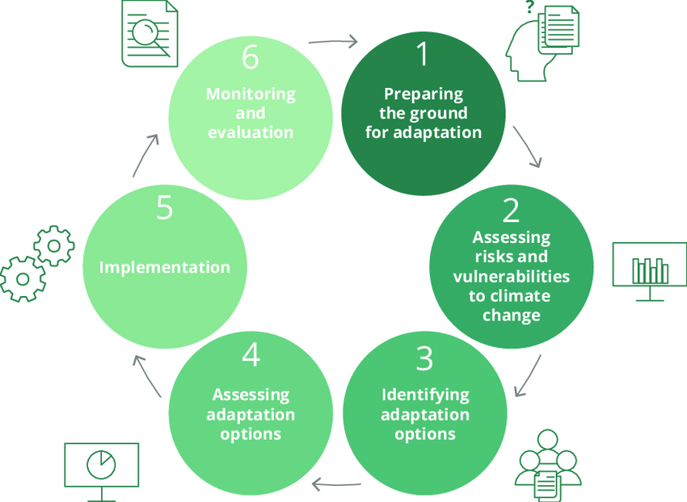
At what point improve justice in general CC response?
Procedural justice 1 - 6:
Monitor more equal involvement and engagement of stakeholders, including the vulnerable people.
Restorative justice 5 – 6:
Monitor the compensation and restoration of unintended harm
Recognition justice 1 - 5:
Monitor how social and cultural values are included in impact assessment and development and implementation of adaptation measures.
Distributive/ recognitional 2: Monitor which social groups experience an uneven burden due to climate change – who is more vulnerable, in order to set up goals for policy making for just adaptation.
Distributive justice 3 – 4 – 5:
Monitor the (un)equal distribution of costs and benefits from A/M actions between different groups, and specifically the most vulnerable

Slide 30
Summary III
  Large need for improving justice considerations in climate action on mobility/ transport
  Includes distributive, procedural, recognitional, and restorative justice
  Requires deliberate action to ensure that vulnerable populations are not disproportionately burdened and can fully participate in and benefit from initiatives
  Procedural justice very important
    i.e. Recognition of all actors,
    Their clear and meaningful engagement in all decision-making stages,
    Full/high decision-making power of the involved public, and
    The support of a logic of welfare.
  M&E of various stages in climate responses is key,
  Along with Social Impact Assessments of interventions, particularly
  Consideration of poor households in all decision stages (!!)

Slide 31
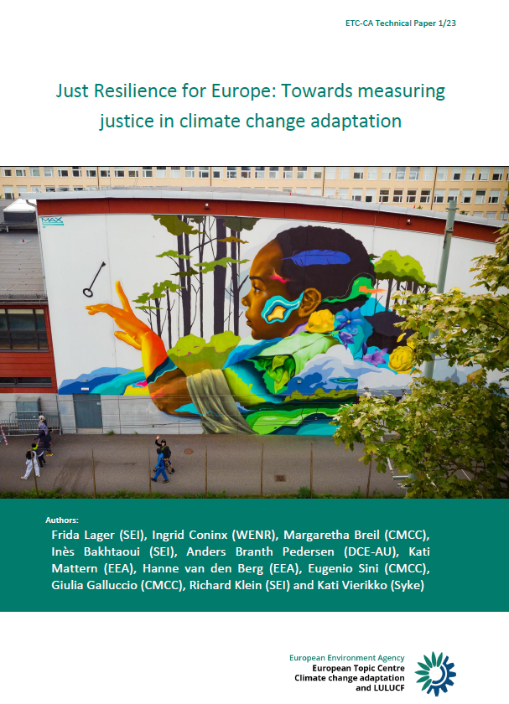
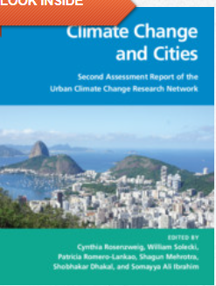
References
Lager, F., Coninx, I., Breil, M., Bakhtaoui, I., Branth Pedersen, A., Mattern, K., van den Berg, H., Sini, E., Gallucio, G., Klein, R., & Vierikko, K. (2023). Just Resilience for Europe: Towards measuring justice in climate change adaptation. ETC CA. https://doi.org/10.25424/CMCC-BATP-3M95.
Reckien, D., Lwasa, S., Satterthwaite, D., McEvoy, D., Creutzig, F., Montgomery, M., Schensul, D., Balk, D., and Khan, I. (2018). Equity, environmental justice, and urban climate change. In Rosenzweig, C., W. Solecki, P. Romero-Lankao, S. Mehrotra, S. Dhakal, and S. Ali Ibrahim (eds.), Climate Change and Cities: Second Assessment Report of the Urban Climate Change Research Network. Cambridge. University Press. New York. 173–224
Cattino, Reckien, 2018: https://doi.org/10.1016/j.cosust.2021.03.013

Slide 32
THANK YOU VERY MUCH !
Dr. Diana Reckien
University of Twente
d.reckien@utwente.nl

Slide 33
Does public participation lead to more ambitious and transformative local climate change planning?
Review of the scientific literature on participation in planning, assessing:
  Re adaptation: Is the level of participation associated with transformative potential of adaptation?
  Re mitigation: Is public participation significantly related to local greenhouse gas reduction targets?
Cattino & Reckien, 2018: https://doi.org/10.1016/j.cosust.2021.03.013

Slide 34
Does public participation lead to more ambitious and transformative local climate change planning?
Findings#1: Positive outcomes re transformative adaptation and ambitious mitigation are related to more meaningful participation, i.e. higher ladder of participation (Arnstein, 1969).
5 Thematic codes/ themes | Ladder of participation for Adaptation, average |  | Ladder of participation Code for Mitigation, avg.
Diversity of citizens’ role in local climate planning | 4,2 | Consultation | 4,3
Benefits of community empowerment and engagement | 4,6 | Placation | 4,7
Lack of clear and meaningful public participation leading to ineffective or detrimental local climate planning | 3,3 | Informing | 3
Positive examples of participation in regards to transformative adaptation/ ambitious mitigation | 5,8 | Partnership | 5,5
Negative examples of participation in regards to transformative adaptation/ ambitious mitigation | 4 | Consultation | 4
Cattino & Reckien, 2018: https://doi.org/10.1016/j.cosust.2021.03.013

Slide 35
Does public participation lead to more ambitious and transformative local climate change planning?
Findings#2: Adaptation:
Public participation highly significantly associated with more transformative local adaptation planning.
  (log regression highly significant, x2(1) = 11.440, p < .001; R2 (Nagelkerke): 45.0% variance explained)
Local adaptation planning processes including a higher level of interaction in participation are 4.02 times more likely to exhibit a transformative outcome.
Findings #3: Mitigation:
Significant positive relation between public participation and mitigation ambition.
  (F (1, 250) = 9.605, p < .002, R2 = .033).
Public participation increases the mitigation ambition of local climate plans by 0.192, i.e. 1/5.
Cattino & Reckien, 2018: https://doi.org/10.1016/j.cosust.2021.03.013

Slide 36
Does public participation lead to more ambitious and transformative local climate change planning?
Summary:
Public participation has a positive impact on both, the transformative potential of adaptation and the ambition for mitigation.
  The influence of participation on adaptation is stronger than the influence on mitigation.
  We highlight four conditions under which public participation can lead to potentially transformative action and greater local climate ambition:
    Recognition of all actors,
    Their clear and meaningful engagement in all decision making stages,
    Full decision-making power of the involved public, and
    The support of a logic of welfare.
Cattino & Reckien, 2018: https://doi.org/10.1016/j.cosust.2021.03.013

Slide 37
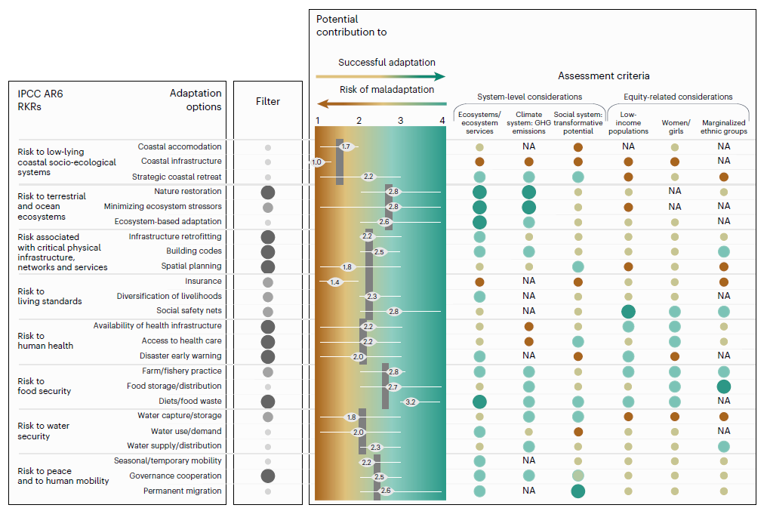
Example: Outcomes of adaptation on vulnerable groups globally
Our new study in Nature Climate Change:
https://doi.org/10.1038/s41558-023-01774-6

Slide 38
Example: Outcomes of adaptation on vulnerable groups globally
Our new study in Nature Climate Change:
https://doi.org/10.1038/s41558-023-01774-6

Slide 39
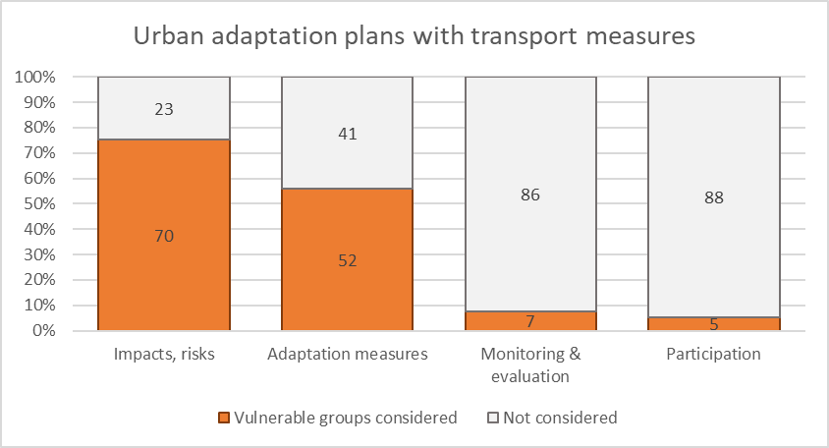
Distributive justice & mobility
Distributive justice:
How are benefits/ burdens of mitigation/ adaptation distributed?
Adaptation in urban areas in Europe:

