Slide 1

Equations of State for CO₂ and CO₂-Rich Mixtures
What is Relevant for Non-Ideal Compressible-Fluid Dynamics?
R. Span
3rd Int. Seminar on Non-Ideal Compressible-Fluid Dynamics for Propulsion & Power

Slide 2

Overview
Why do we use Helmholtz equations of state?
What is special about thermodynamic properties of carbon dioxide?
Why do properties in the (extended) critical region require special attention?
Do we utilize the potential of Helmholtz equations of state properly?
Equations of state for carbon dioxide rich mixtures
How do impurities affect the properties of carbon dioxide?
Can we use mixtures to improve processes?

Slide 3

Why do we use Helmholtz equations of state?
Hypothesis: The second law of thermodynamics yields a complete description of equilibrium states
A complete description of equilibrium states should be possible in terms of the independent variables introduced by the second law of thermodynamics
This approach results in …
closed systems:
flow processes:
Entropy cannot be measured directly, has an arbitrary reference state
Nobody wants an equation of state that uses entropy as variable
$$Tds=du+pdv ⇒ du=Tds−pdv ⇒ u=u(s,v)$$
$$Tds=dh−vdp ⇒ dh=Tds+vdp ⇒ h=h(s,p)$$

Slide 4





Why do we use Helmholtz equations of state?
Legendre transformation allows for a loss free change of variables
Closed systems:
with the Helmholtz (free) energy
Flow processes:
with the Gibbs (free) enthalpy
In engineering calculations typical combinations of independent variables are
T,p ⇨ direct calc. from g(T,p), one dim. iteration from a(T,ρ)
p,h ⇨ one dim. iteration from g(T,p), two dim. iteration from a(T,ρ)
p,s ⇨ one dim. iteration from g(T,p), two dim. iteration from a(T,ρ)
g(T,p) seems to be the right choice for engineering applications!
$$u=u(s,v) ⇒ a=a(T,ρ)$$
$$a(T,v)=u−Ts$$
$$h=h(s,p) ⇒ g=g(T,p)$$
$$g(T,p)=h−Ts$$

Slide 5



Why do we use Helmholtz equations of state?
For consistent calculations across phase boundaries, the fluid surface needs to be described by a single mathematical expression
$$g=g(T,p)$$
saturated liquid
supercritical
liquid
$$a=a(T,ρ)$$
p_{s} curve
Pressure
saturated liquid
Density
two phase
region
supercritical
discontinuous plot
of most properties
continuous plot
becomes possible
saturated vapour
saturated vapour
Temperature
Temperature
Gibbs energy allows for fast calculations but does not allow for a
closed description of the whole fluid surface

Slide 6

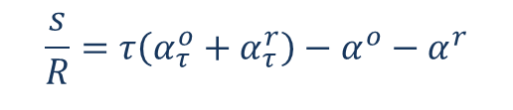
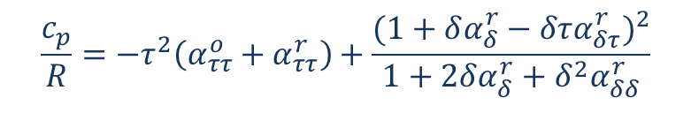
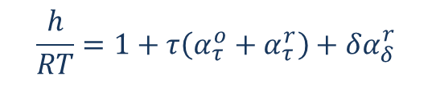
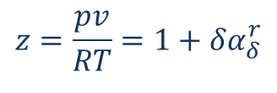
Why do we use Helmholtz equations of state?
Fundamental equations of state allow for a consistent calculation of all thermodynamic properties by combining derivatives
For the reduced Helmholtz energy we write:
$α\left(δ,τ\right)=\frac{a(T,ρ)}{RT}=α^{o}\left(δ,τ\right)+α^{r}\left(δ,τ\right)$ $\text{with} δ=\frac{v_{c}}{v}=\frac{ρ}{ρ_{c}} \text{and} τ=\frac{T_{c}}{T}$
$$z=\frac{pv}{RT}=1+δα_{δ}^{r}$$
$$\frac{h}{RT}=1+τ\left(α_{τ}^{o}+α_{τ}^{r}\right)+δα_{δ}^{r}$$
$$\frac{c_{p}}{R}=−τ^{2}\left(α_{ττ}^{o}+α_{ττ}^{r}\right)+\frac{(1+δα_{δ}^{r}−δτα_{δτ}^{r})^{2}}{1+2δα_{δ}^{r}+δ^{2}α_{δδ}^{r}}$$
$$\frac{s}{R}=τ\left(α_{τ}^{o}+α_{τ}^{r}\right)−α^{o}−α^{r}$$

Slide 7
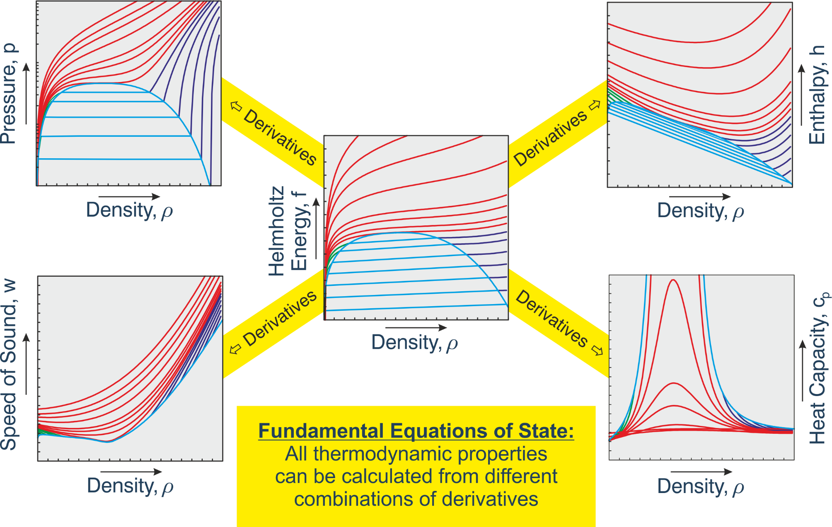
Why do we use Helmholtz equations of state?

Slide 8
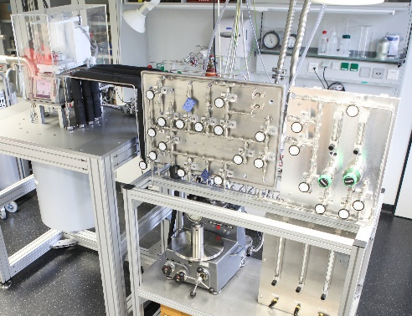
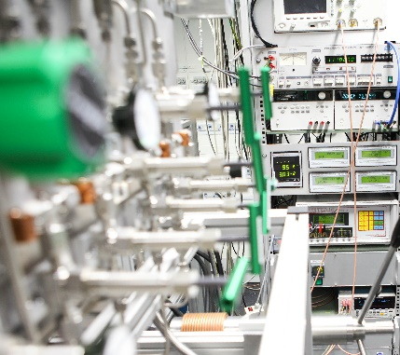
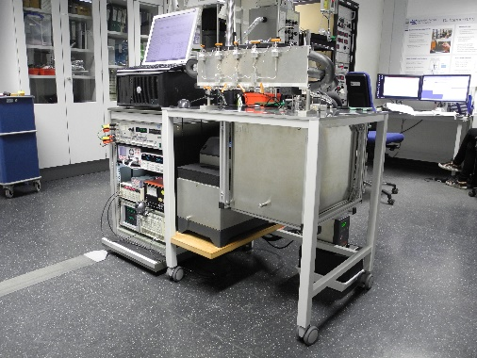
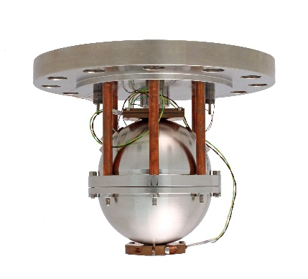
Why do we use Helmholtz equations of state?

Slide 9
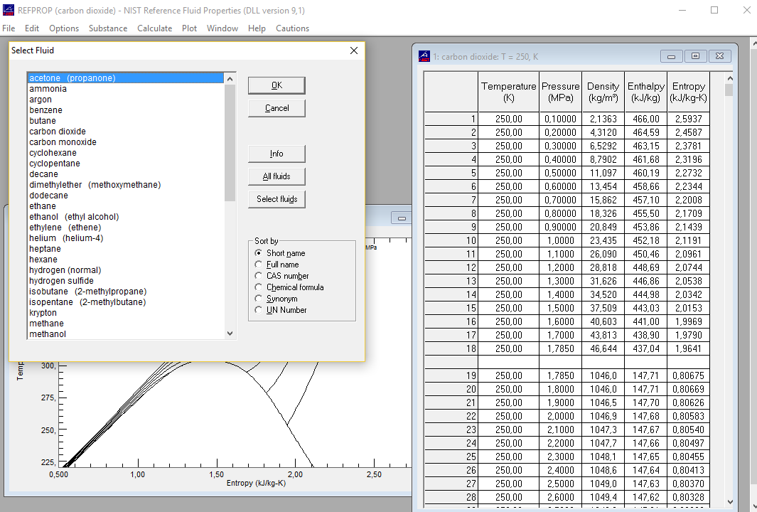
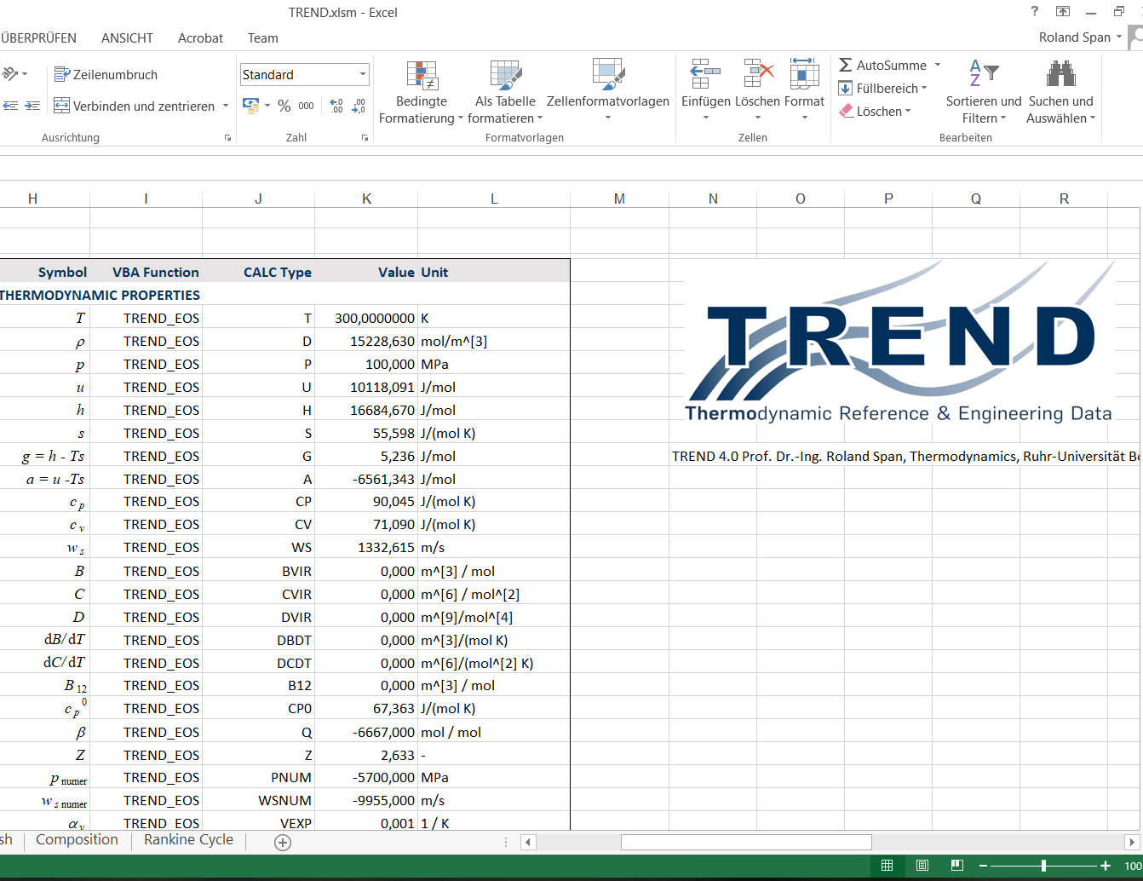
Why do we use Helmholtz equations of state?

Slide 10
What is special about thermodynamic properties of carbon dioxide?
Carbon Dioxide
Nitrogen
R134a

Slide 11
What is special about thermodynamic properties of carbon dioxide?
Carbon Dioxide
Critical temperature T_{c} = 304.1282 K (30.98° C)
Critical pressure p_{c} = 7.3773 MPa
Critical density ρ_{c} = 467.6 kg/m³
Triple point temperature T_{tr} = 216.592 K (-56.56° C)
Triple point pressure p_{tr} = 0.51795 MPa
The critical region of CO₂ is experimentally well accessible
CO₂ was considered the reference fluid for critical phenomena in the 1980s / 1990s
A reference eq. of state that does not show nonanalytical behavior at the critical point would not have been accepted

Slide 12
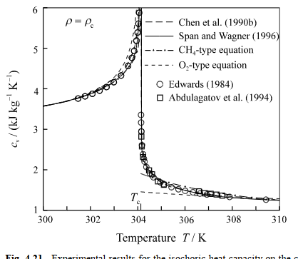
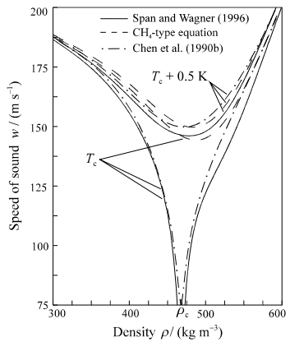
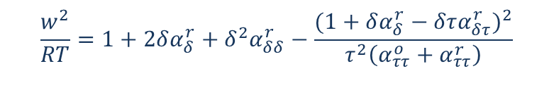

Why do properties in the critical region require special attention?
Theory tells that at the critical point…
the isochoric heat capacity c_{v} gets infinite
the speed of sound w gets zero
Nonanalytical terms required in multiparameter equations of state
$$\frac{c_{v}}{R}=−τ^{2}\left(α_{ττ}^{o}+α_{ττ}^{r}\right)$$
$$\frac{w^{2}}{RT}=1+2δα_{δ}^{r}+δ^{2}α_{δδ}^{r}−\frac{(1+δα_{δ}^{r}−δτα_{δτ}^{r})^{2}}{τ^{2}\left(α_{ττ}^{o}+α_{ττ}^{r}\right)}$$

Slide 13

Why do properties in the critical region require special attention?
Theory tells that at the critical point…
the isochoric heat capacity c_{v} gets infinite
the speed of sound w gets zero
Nonanalytical terms required in multiparameter equations of state
$c_{v}$infinite
$α_{ττ}^{r}$ infinite
nonanalytical
$$\frac{c_{v}}{R}=−τ^{2}\left(α_{ττ}^{o}+α_{ττ}^{r}\right)$$
$$\frac{w^{2}}{RT}=1+2δα_{δ}^{r}+δ^{2}α_{δδ}^{r}−\frac{(1+δα_{δ}^{r}−δτα_{δτ}^{r})^{2}}{τ^{2}\left(α_{ττ}^{o}+α_{ττ}^{r}\right)}$$

Slide 14
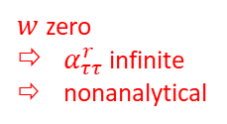


Why do properties in the critical region require special attention?
Theory tells that at the critical point…
the isochoric heat capacity c_{v} gets infinite
the speed of sound w gets zero
Nonanalytical terms required in multiparameter equations of state
$c_{v}$infinite
$α_{ττ}^{r}$ infinite
nonanalytical
$w$zero
$α_{ττ}^{r}$ infinite
nonanalytical
$$\sim {\left(\frac{∂p}{∂T}\right)}_{ρ}→finite$$
$$\frac{c_{v}}{R}=−τ^{2}\left(α_{ττ}^{o}+α_{ττ}^{r}\right)$$
$$\frac{w^{2}}{RT}=1+2δα_{δ}^{r}+δ^{2}α_{δδ}^{r}−\frac{(1+δα_{δ}^{r}−δτα_{δτ}^{r})^{2}}{τ^{2}\left(α_{ττ}^{o}+α_{ττ}^{r}\right)}$$
$$\sim {\left(\frac{∂p}{∂ρ}\right)}_{T}→0$$

Slide 15


Why do properties in the critical region require special attention?
Nonanalytical terms in the Span & Wagner EOS (1996)
Theory tells that at the critical point…
the isochoric heat capacity c_{v} gets infinite
the speed of sound w gets zero
Nonanalytical terms required in multiparameter equations of state
$c_{v}$infinite
$α_{ττ}^{r}$ infinite
nonanalytical
$w$zero
$α_{ττ}^{r}$ infinite
nonanalytical
$$\sim {\left(\frac{∂p}{∂T}\right)}_{ρ}→finite$$
$$\frac{c_{v}}{R}=−τ^{2}\left(α_{ττ}^{o}+α_{ττ}^{r}\right)$$
$$\frac{w^{2}}{RT}=1+2δα_{δ}^{r}+δ^{2}α_{δδ}^{r}−\frac{(1+δα_{δ}^{r}−δτα_{δτ}^{r})^{2}}{τ^{2}\left(α_{ττ}^{o}+α_{ττ}^{r}\right)}$$
$$\sim {\left(\frac{∂p}{∂ρ}\right)}_{T}→0$$

Slide 16
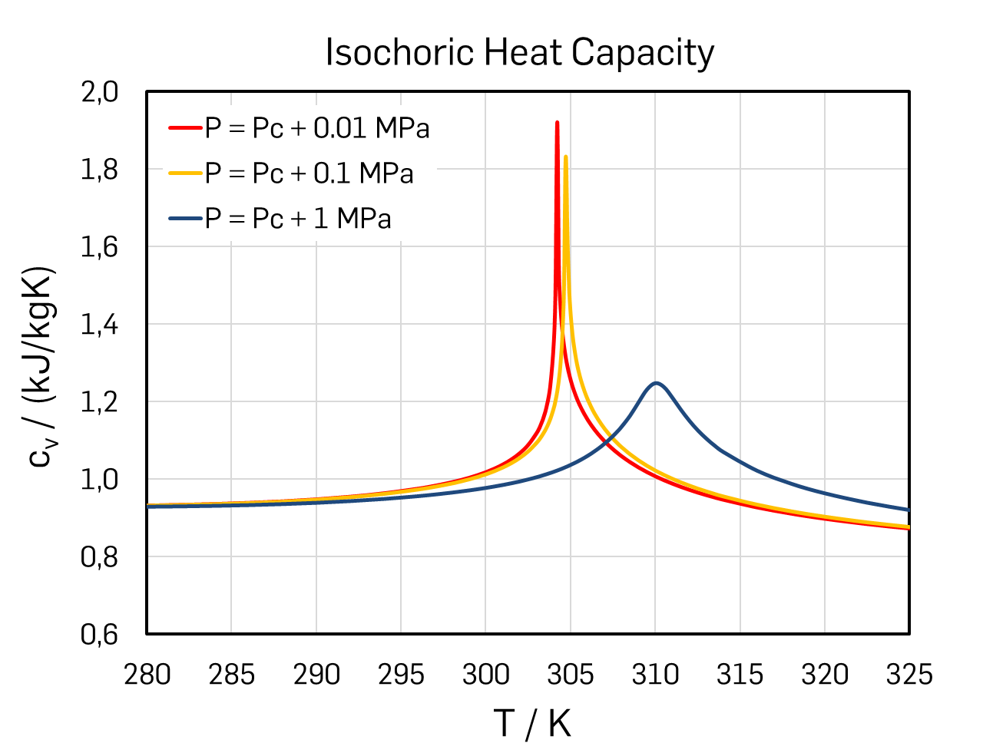
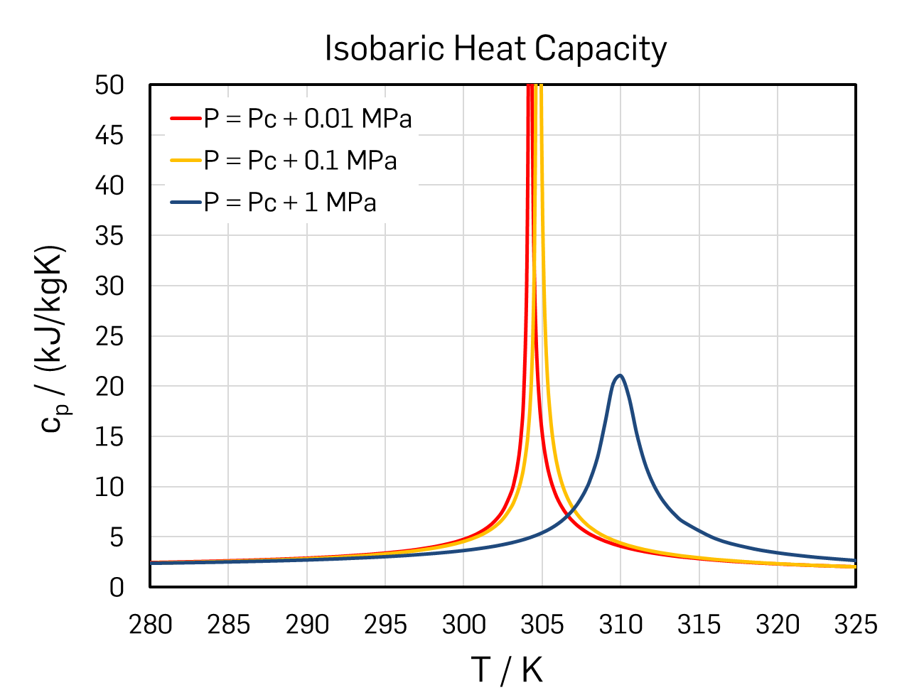
Why do properties in the critical region require special attention?
Is nonanalytical behavior actually relevant for NICFD?

Slide 17
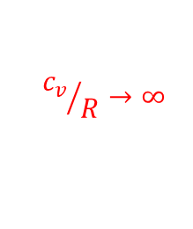
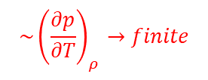

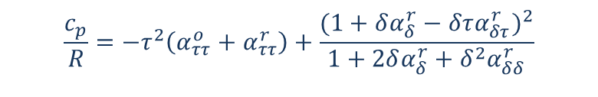
Why do properties in the critical region require special attention?
Is nonanalytical behavior actually relevant for NICFD?
$$\sim {\left(\frac{∂p}{∂T}\right)}_{ρ}→finite$$
$$\frac{c_{p}}{R}=−τ^{2}\left(α_{ττ}^{o}+α_{ττ}^{r}\right)+\frac{(1+δα_{δ}^{r}−δτα_{δτ}^{r})^{2}}{1+2δα_{δ}^{r}+δ^{2}α_{δδ}^{r}}$$
$${c_{v}}/R→∞$$
$$\sim {\left(\frac{∂p}{∂ρ}\right)}_{T}→0$$
The contribution of derivatives of the
pvT surface is dominant in the critical region
Make sure equations of state describe
p(ρ,T) very well!

Slide 18
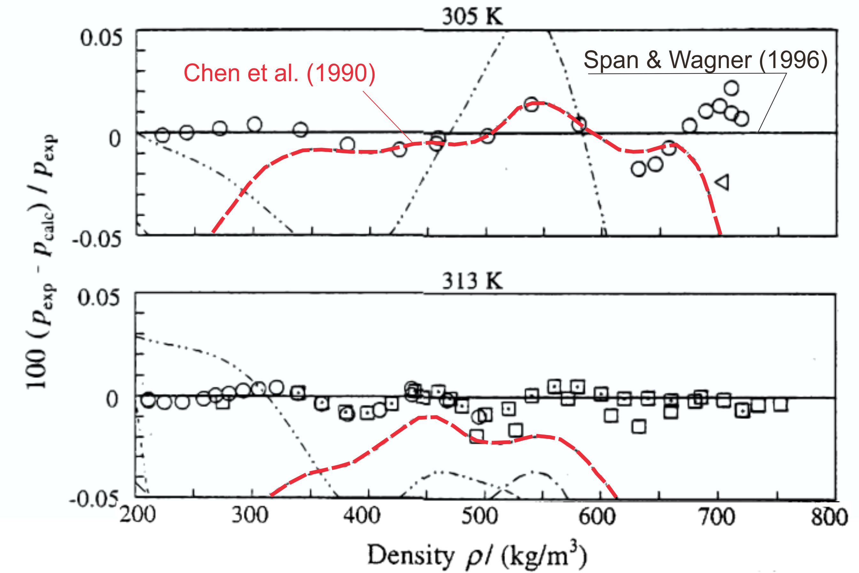
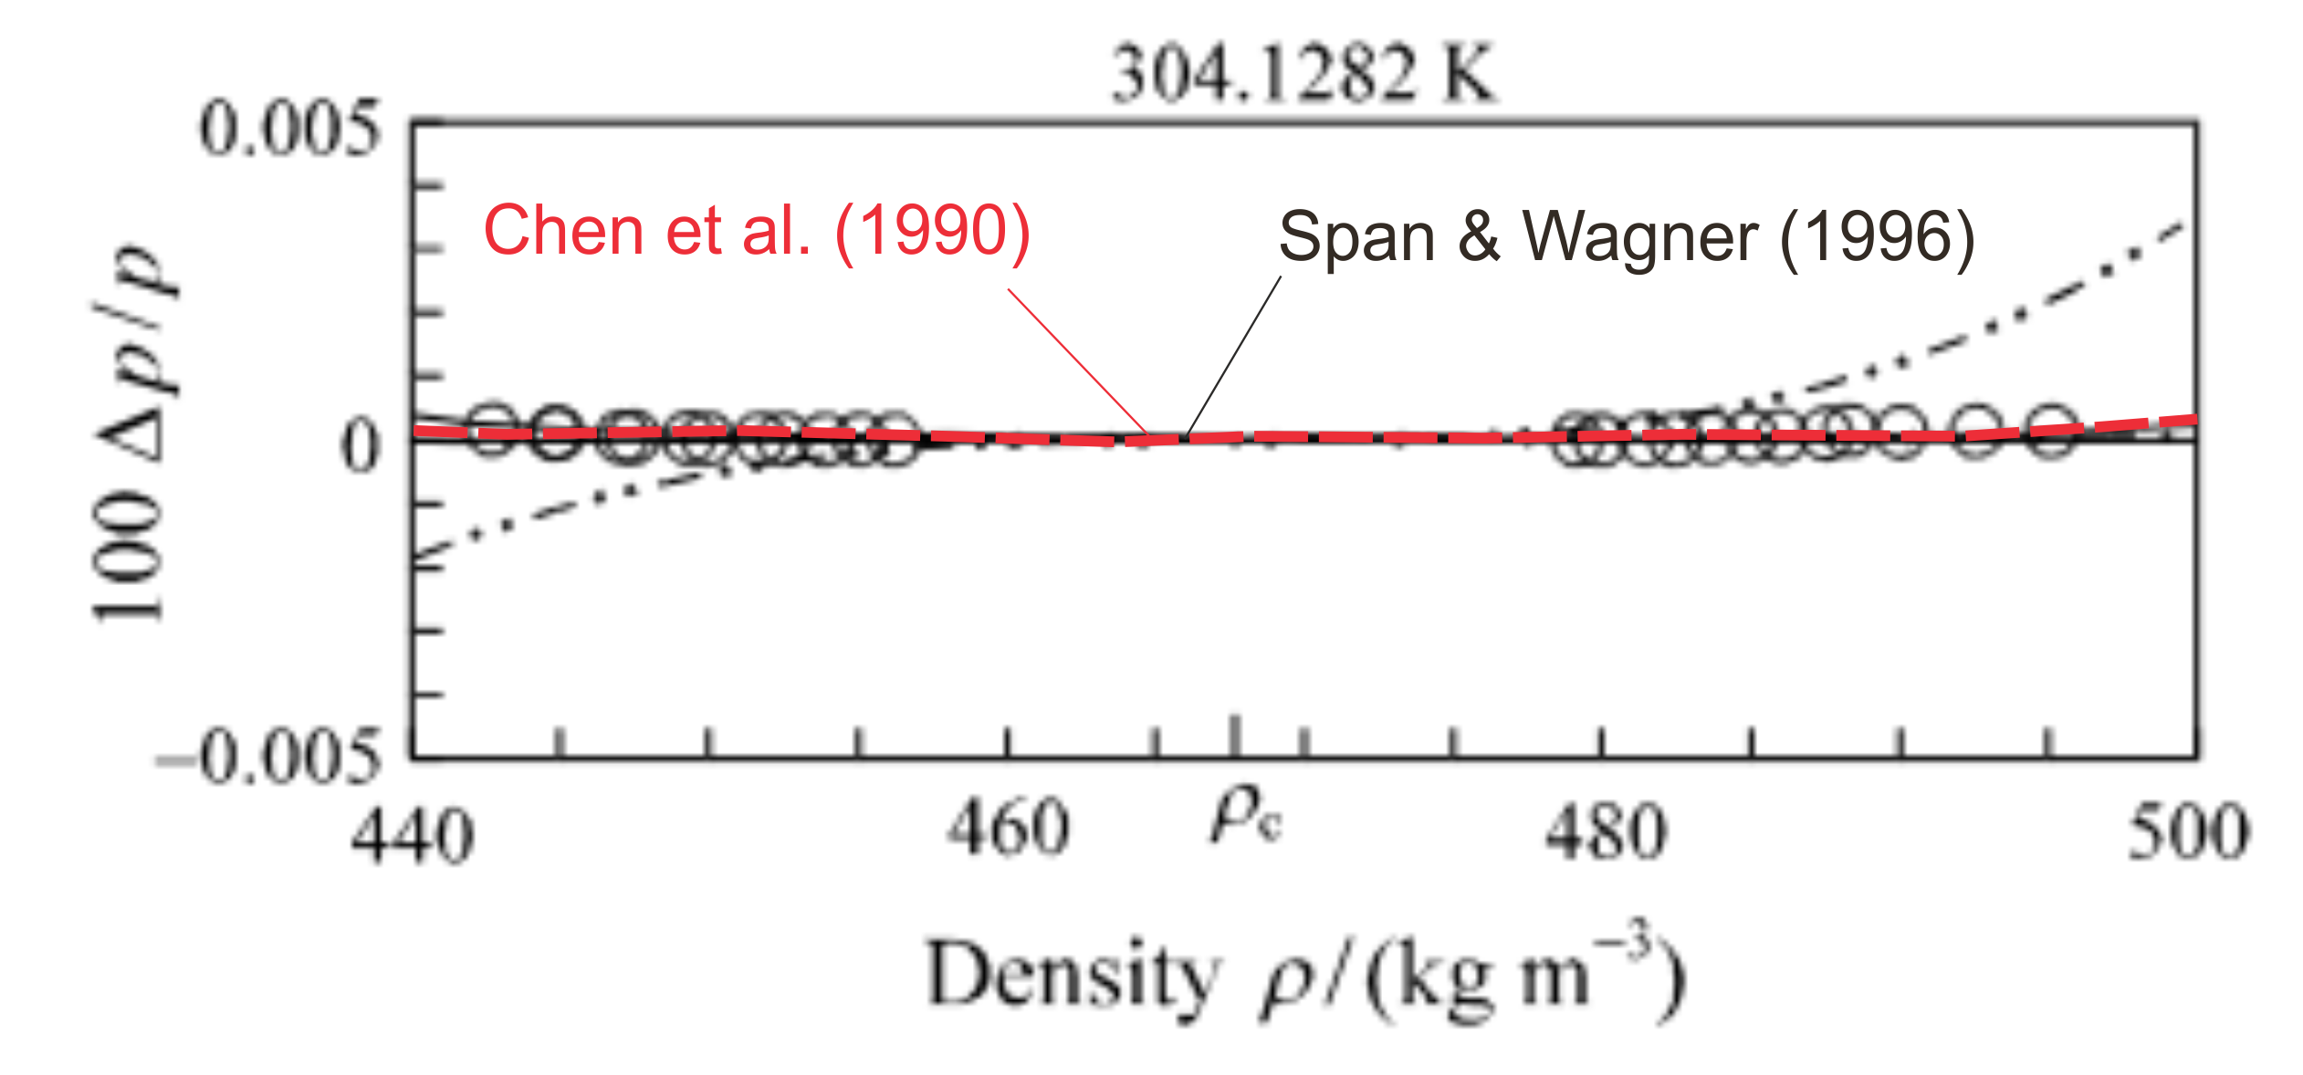
Why do properties in the critical region require special attention?
Carbon Dioxide
Empirical multiparameter equations of state describe the pvT surface in the (extended) critical region more accurately then scaled equations of state

Slide 19
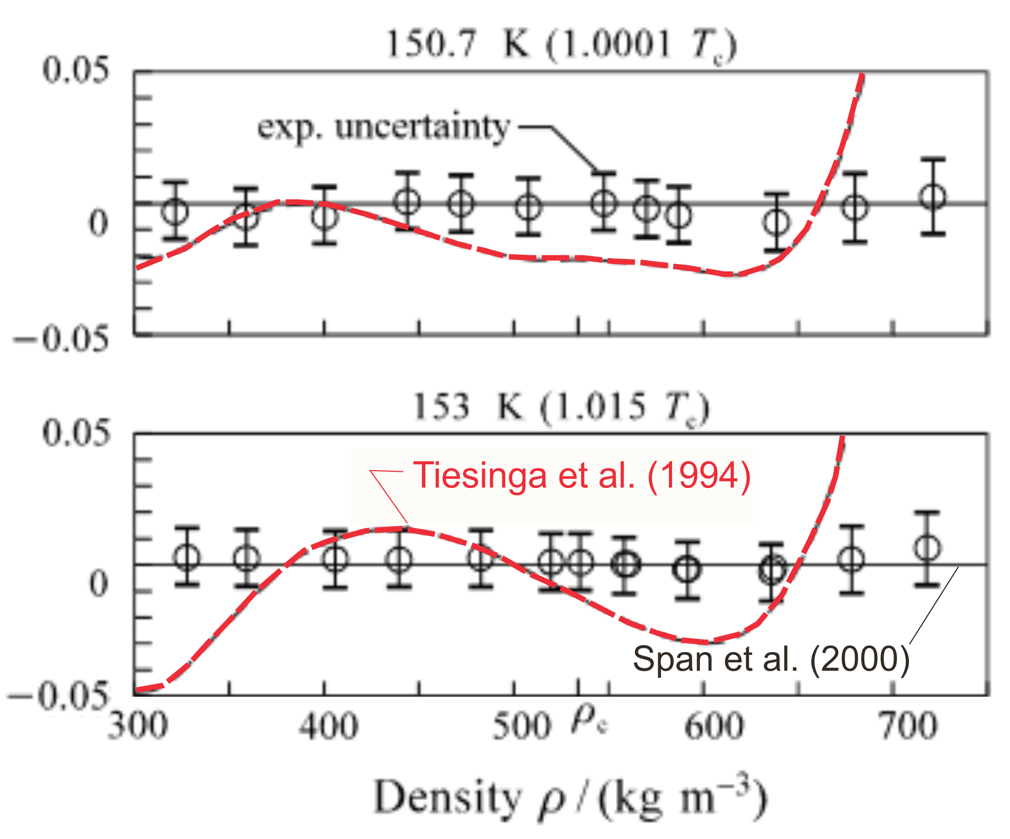
Why do properties in the critical region require special attention?
Nitrogen
Empirical multiparameter equations of state describe the pvT surface in the (extended) critical region more accurately then scaled equations of state

Slide 20





Do we utilize the potential of Helmholtz equations of state properly?
Of course, this depends on your algorithms / your code!
Just one example on how to mess things up …
$$p_{1}∙v_{1}^{k}=p_{2}∙v_{2}^{k}=const.$$
⇨
${\left(\frac{∂p}{∂v}\right)}_{s}=−const.∙{k∙v}_{}^{−k−1}$= $−k∙\frac{p}{v}$
$${k=\left(\frac{∂p}{∂v}\right)}_{s}\frac{v}{p}$$
$$k^{o}=\frac{c_{p}^{o}}{c_{v}^{o}}$$
⇨
⇨
ideal gas
$$k=\frac{ρ{∙w}^{2}}{p}≠ \frac{c_{p}}{c_{v}}$$
⇨
real fluid
Some well known definitions have been derived for ideal gas, do not hold in combination with real fluids

Slide 21
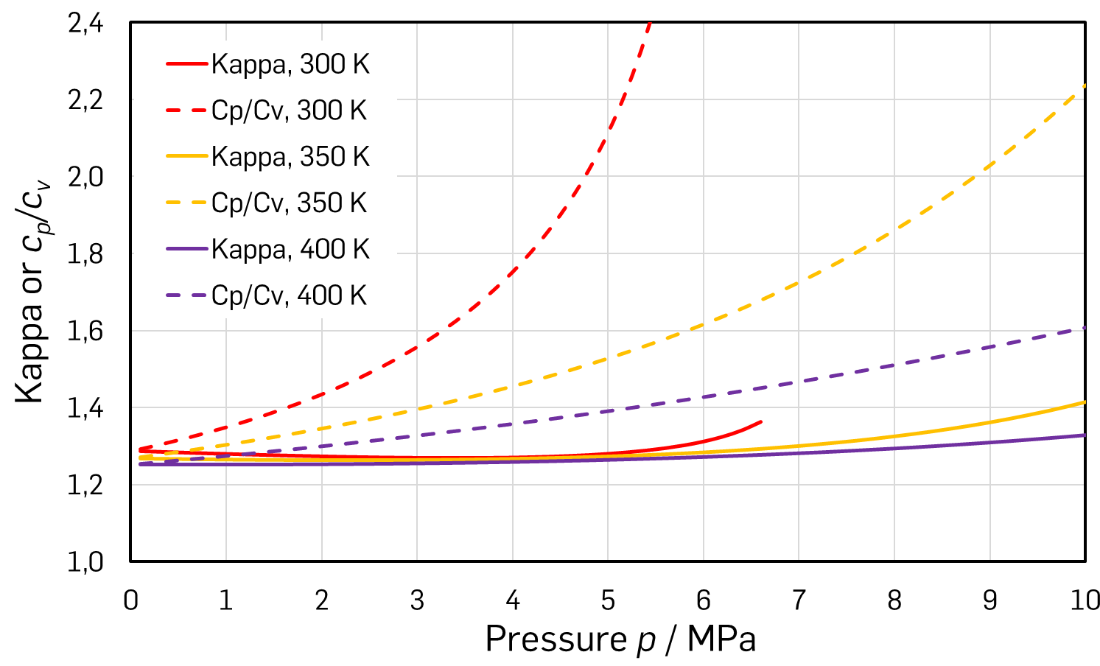
Do we utilize the potential of Helmholtz equations of state properly?
CO₂
Some well known definitions have been derived for ideal gas, do not hold in combination with real fluids
To derive the temperature from κ we need the ideal gas assumption

Slide 22
Do we utilize the potential of Helmholtz equations of state properly?
Do we need the isentropic exponent κ at all?
The enthalpy h₂s = h(p₂,s₁) can be calculated directly
from Helmholtz equations of state
So can T₂s = T(p₂,s₁) or T₂ = T(p₂,h₂)
Algorithms should be checked for obsolete routines!
Using enthalpy and entropy directly avoids problems
with averaging of properties that change drastically
for strongly non-ideal fluids (like c_{p} or w)

Slide 23

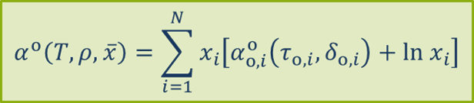
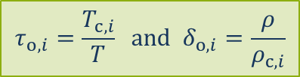
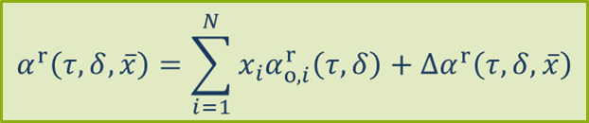
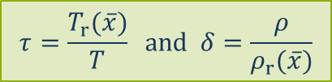
Equations of state for carbon dioxide rich mixtures
Helmholtz energy for mixtures
Approach by Lemmon and Tillner-Roth (1999)
(as discribed by Thol et al., 2019)
Ideal gas contribution
Reducing parameters correspond to critical parameters of pure fluids
Residual fluid contribution
Reducing parameters as functions of composition
Pure fluid contribution at corresponding states
Departure term

Slide 24
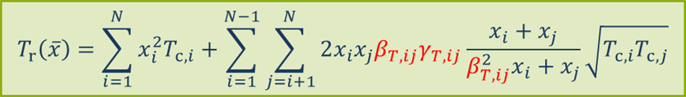
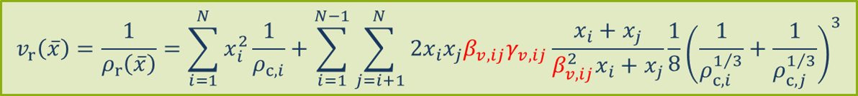
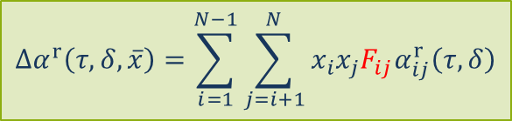
Equations of state for carbon dioxide rich mixtures
Reducing parameters
Departure term
Adjustable parameters: coefficients, temperature and density exponents, exponential parameters, number of terms
Combination of polynomial, exponential and special exponential terms

Slide 25
Equations of state for carbon dioxide rich mixtures
No experimental data available:
Application of predictive combination rules such as the Lorentz-Berthelot or linear
mixing rules
Few experimental data or only a single thermodynamic property type available:
Adjustment of one or more binary interaction parameters
Experimental data for similar binary mixtures with adequate quality and quantity available:
Development of generalized departure function and adjustment of weighting factor
Comprehensive database including many state points with known experimental uncertainty and different thermodynamic properties available:
Development of binary-specific departure function

Slide 26
Equations of state for carbon dioxide rich mixtures
⇦ (d) highest accuracy
⇦ (c) high accuracy
⇦ (b) limited accuracy
} ⇦ (a) low accuracy
Herrig et al. (2018)
Herrig et al. (2018)

Slide 27
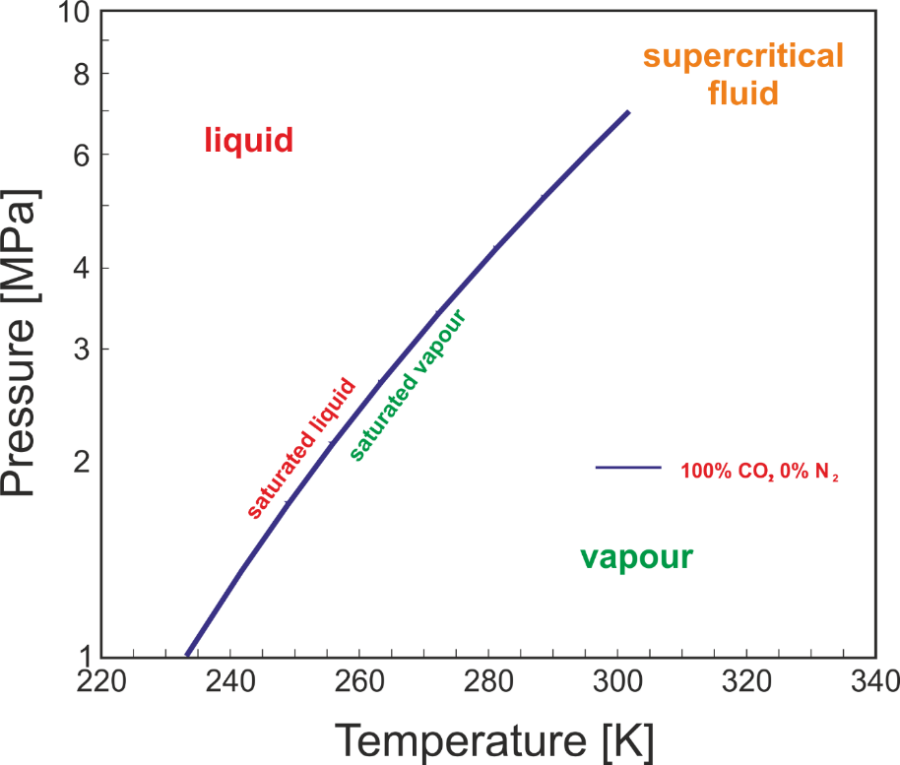
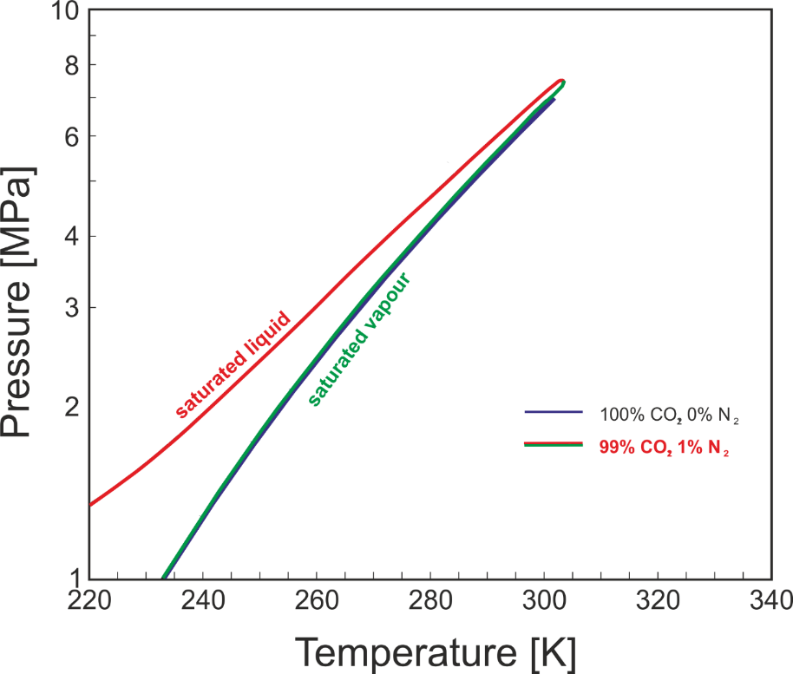
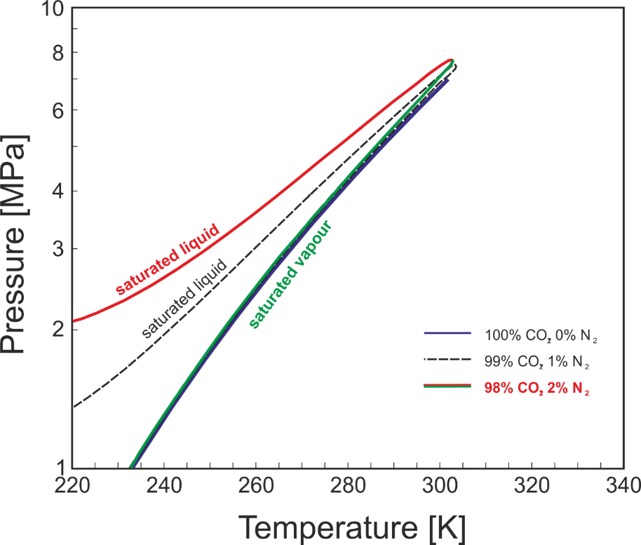
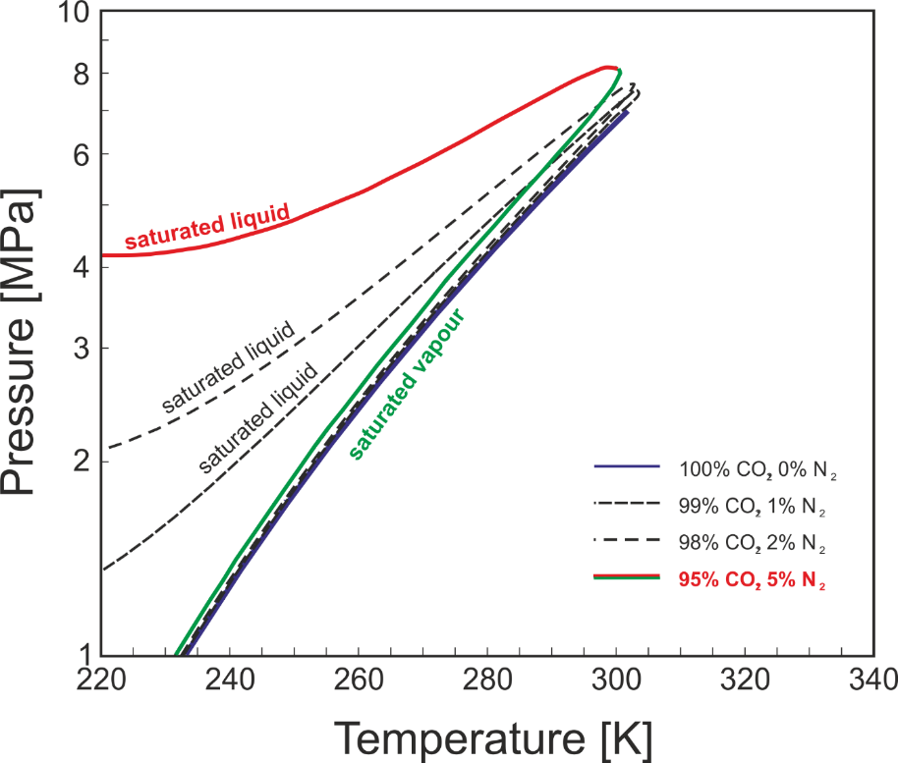
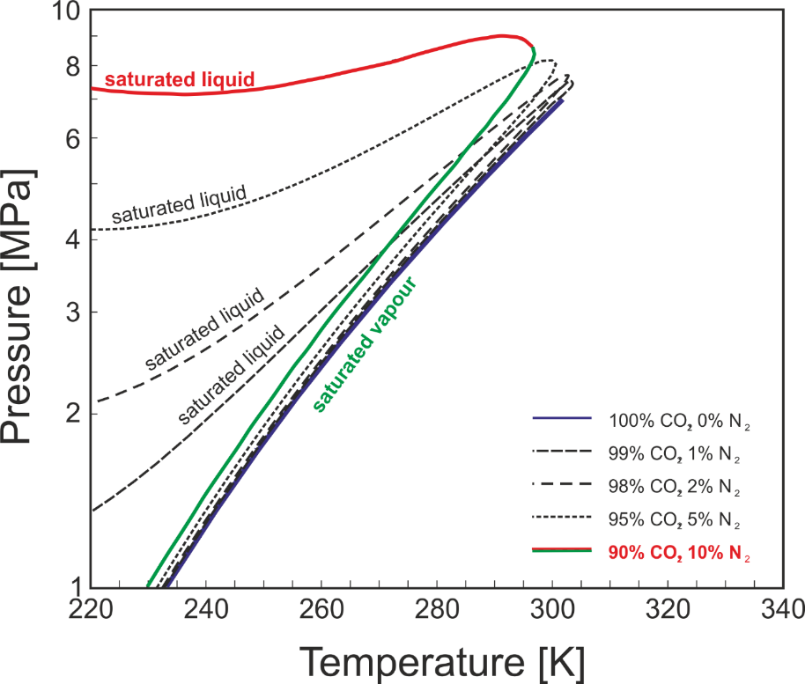
How do impurities affect the properties of carbon dioxide?
Helmholtz models for mixtures
allow for the same calculations as for pure fluids
Impurities have a strong impact in
particular on the phase boundary
Properties in the (extended) critical
region are strongly influenced as well

Slide 28
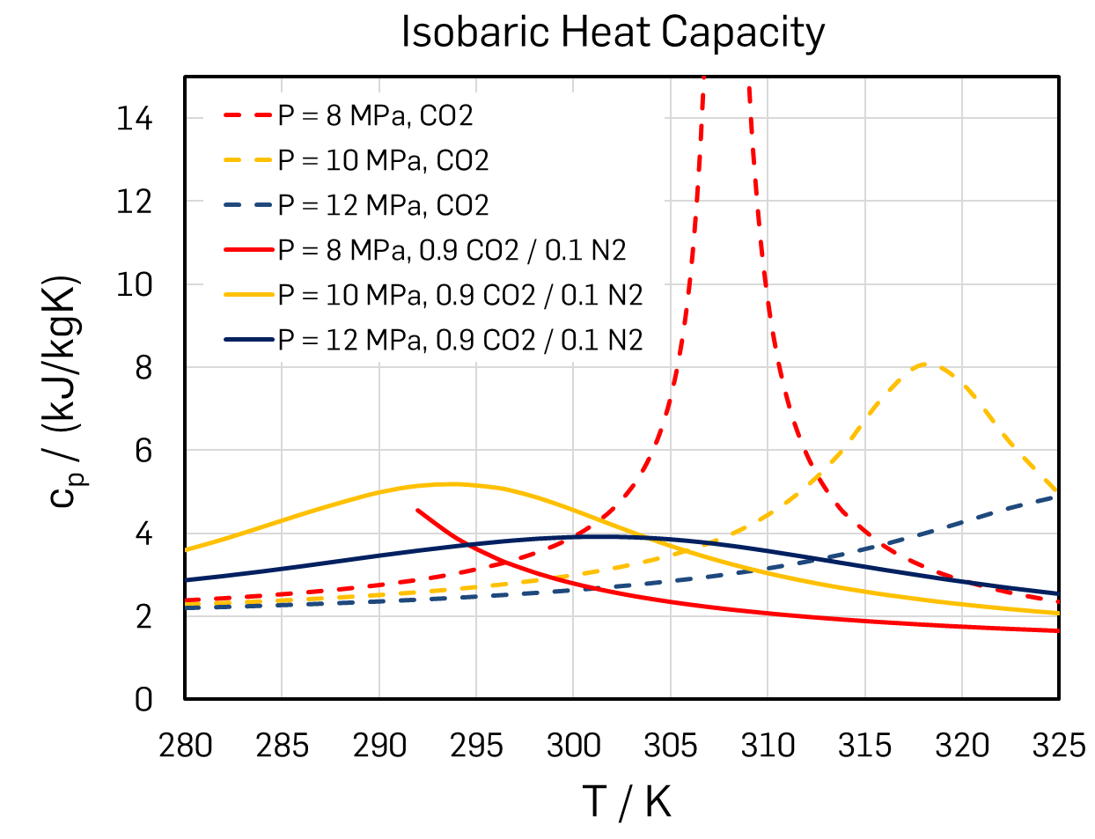
How do impurities affect the properties of carbon dioxide?
Helmholtz models for mixtures
allow for the same calculations as for pure fluids
Impurities have a strong impact in
particular on the phase boundary
Properties in the (extended) critical
region are strongly influenced as well

Slide 29
Can we use mixtures to improve processes?
To calculate properties for mixtures is numerically more demanding than for pure fluids
Table look-up routines get more complicated, because the number of independent variables increases (composition vector)
However: Except for phase equilibrium calculations the composition remains constant; mixtures can be treated like pure fluids in table look-up
Optimization of processes for mixtures is a viable option!
Advantages may be expected for heat transfer processes due to a better fit of temperature curves (although supercritical heat supply is already pretty good …)

Slide 30
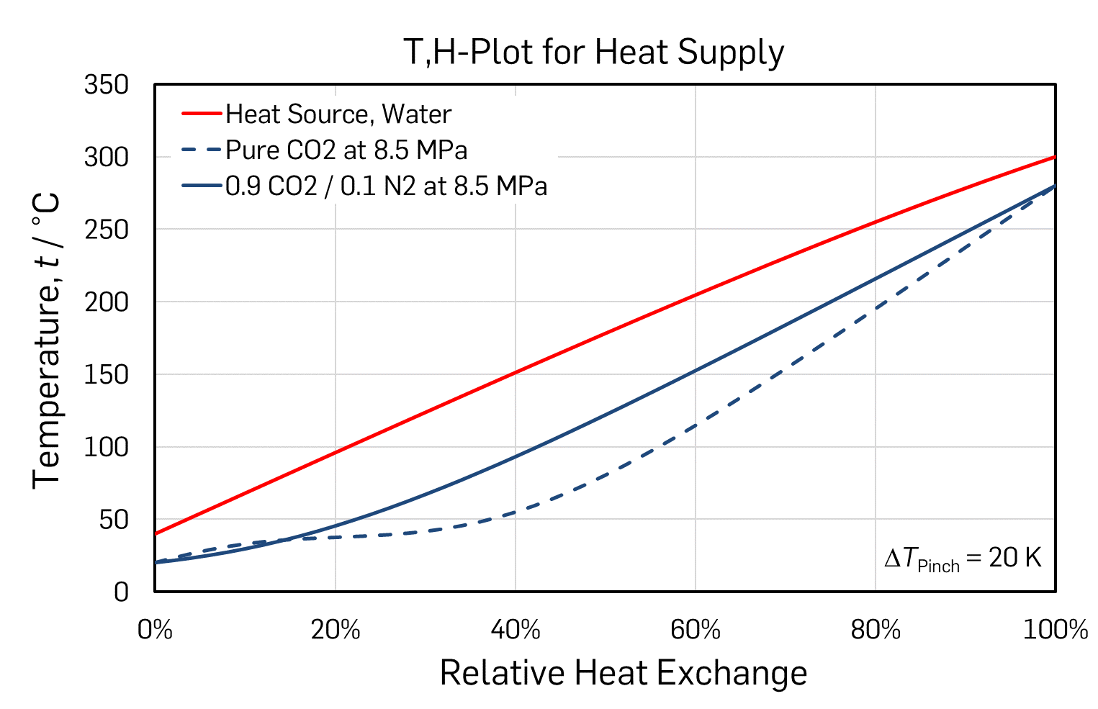
Can we use mixtures to improve processes?

Slide 31


Thank You For Your Patience – Do You Have Questions?
Why do we use Helmholtz equations of state?
What is special about thermodynamic properties of carbon dioxide?
Why do properties in the (extended) critical region require special attention?
Do we utilize the potential of Helmholtz equations of state properly?
Equations of state for carbon dioxide rich mixtures
How do impurities affect the properties of carbon dioxide?
Can we use mixtures to improve processes?

