Slide 1


Analysis of External Influences on an OTEC cycle
Vilborg Guðjónsdóttir
Challenge the future

Slide 2
The Project
What are the effects of temperature fluctuations on the OTEC cycle?
  Based on previous optimization of the OTEC cycle
  Model created
  Experiments performed to validate the model
  Three working fluid researched
    Ammonia
    Ammonia water
    R32 – R134a

Slide 3
The model
Steady state off design model
Implemented in MATLAB
Thermodynamic properties from the REFPROP database
Experiments performed with pure ammonia to validate the model

Slide 4
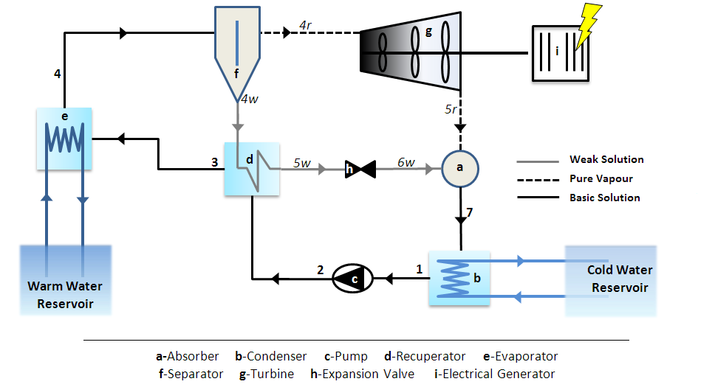
The Thermodynamic cycle

Slide 5
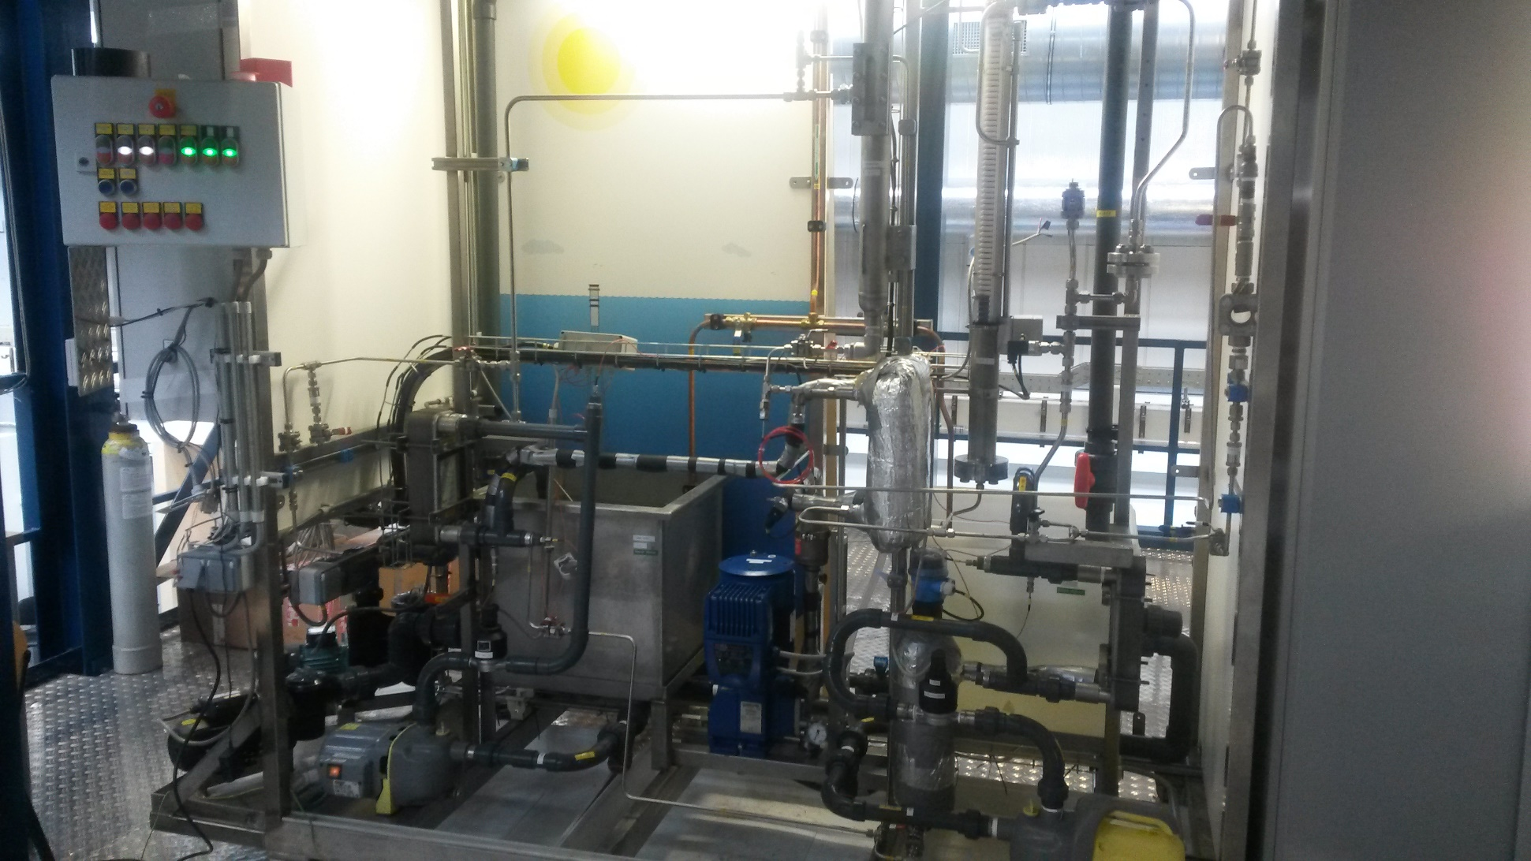
The OTEC Demo

Slide 6
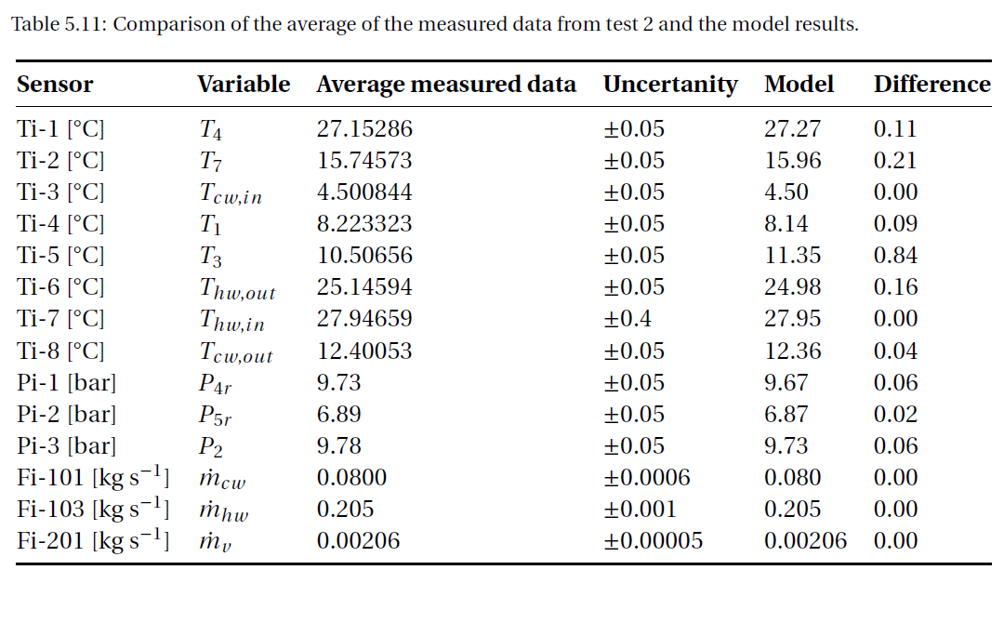
Validation

Slide 7
Results

Slide 8
Results

Slide 9
Conclusions
Decrease in power and efficiency is proportional to the decrease in temperature difference
  Warm and cold seawater temperature fluctuations have similar effects
  Each degree difference has high impact
Mass flow of the working fluid can be varied to improve the performance slightly

Slide 10
Recommendations
Combine the off design model with optimizing model
Perform more experiments with more sensors
  Confirm pressure drop correlations
  Confirm heat transfer correlations for ammonia water

Slide 11
1st Ocean Energy colloquium
Questions ?
June 2015
Challenge the future

