Slide 1
Energy transition, distribution grids and network tariffs
Fairness of dynamic network tariffs as solution for network congestion
Machiel Mulder
Professor of Regulation of Energy Markets
Faculty of Economics and Business
University of Groningen
PowerWeb Institutute, TU Delft
15 November 2019

Slide 2
Outline
Energy transition and the electricity networks
Network tariffs
Fairness of dynamic network tariffs

Slide 3
Energy transition in the electricity market
grid operator faces two challenges: balancing and congestions
EU Emissions Trading Scheme
Electricity user
Factory
Bilateral trade, Over-the-Counter, (OTC)
Wind turbines
Electricity producer
Gas-fired power
plant
Network (grid)
Coal-fired power
plant
Balancing market
Electricity producer
Solar panels
Electricity user
Green certificates market
Power exchange
House
Heat pump,
E-car
Retailer

Slide 4
For balancing: grid operator gives incentives to help wholesale market transactions are linked to balancing
E-programme (net-in- or outflow) to be submitted to system operator (TSO)
Real time (15 min)
(balancing market)
Day before real time
Portfolio of contracts (in MWh)
Day-ahead
Monthly ahead
Quarterly ahead
Year-ahead contracts
Actual inflow/outflow should match
E-programme
(otherwise: imbalance)
If new information:
adaptation of commitments in intra-day market (between day-ahead market closure and real-time)

Slide 5
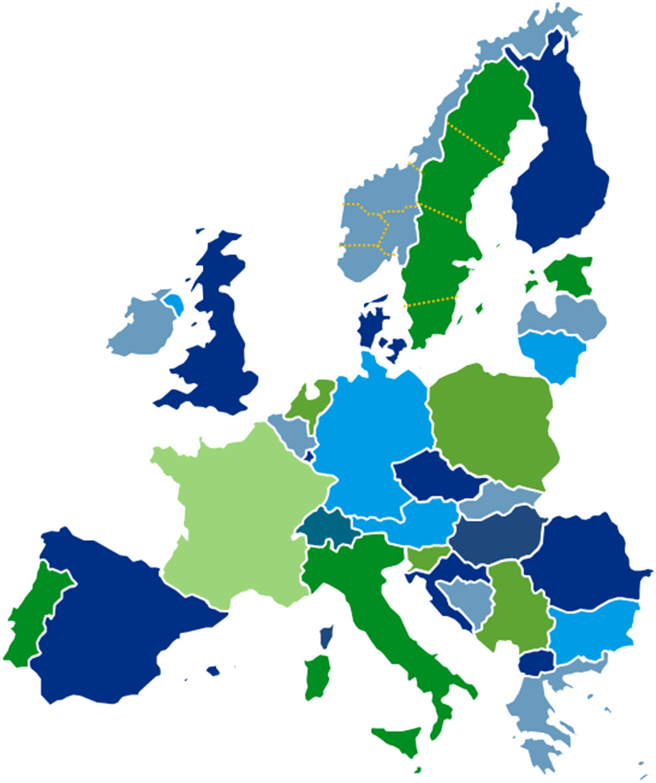
For grid capacity: hardly incentives to help to prevent congestion
Copper plate
for traders, no network constraints within zones (“zonal markets”)
Europe is divided in zonal markets
Within zone
congestions are solved through redispatch
Between zones
limited transport capacity, which is allocated
in different ways, including auctions

Slide 6
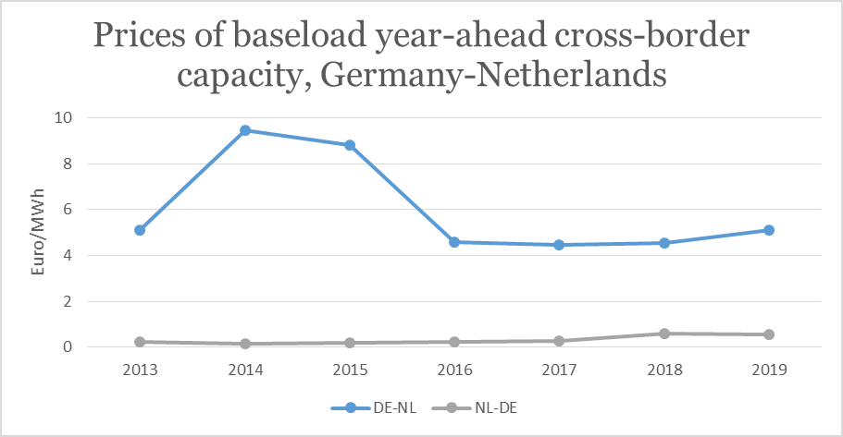
Allocation of capacity on Dutch-German border
Short-term: implicit auction (market coupling)
Long-term: explicit auctions
Source: http://www.jao.eu/marketdata/yearlyauctions

Slide 7
Within market zone, no allocation of capacity
network tariffs are not related to capacity / bottlenecks
network tariffs are only meant to reimburse costs of network operator, including the costs to solve congestion (i.e. costs of redispatch)
tariffs consist of
fixed fee per year (independent of actual use)
variable fee (related to size of annual transport use) (not for households anymore)
hence
level of tariffs may increase if network operators have to make many costs for solving congestion,
but the tariffs are not related to occurrence/size of congestion

Slide 8
What is problem?
impact of renewable energy on congestion
In principle, network operators should prevent that market parties experience network constraints
by making forecasts of future load and generation and invest in capacity timely
Currently, renewable energy is strongly stimulated in regions where network capacity is not sufficient / cannot quickly expand
What can they do?
Give incentives to network users to adapt their behaviour to network situation
investments: “do not invest in region where network capacity is scarce”
operation: “do not generate/consume at times when network capacity is scarce”
Hence, this would result in location-and-time differentiated tariffs

Slide 9
Economically, dynamic tariffs are more efficient
Principle of peak-load pricing
- product must be non-storable
- capacity must be in place for a period of time
Optimal incentives:
network users:
users in peak periods pay for variable plus fixed costs
users in offpeak periods pay only for variable costs
Network operator:
only invest if expected revenues from peak prices > investment costs
Supply curve
(short-run MC)
P^{peak}
Peak
demand
P^{offpeak}
Offpeak
demand
capacity

Slide 10
How fair are dynamic grid tariffs?
3 perspectives
Behavioural economics
Ethics
Economics
This part is based on
Neuteleers, S., Mulder, M., & Hindriks, F. (2017). Assessing fairness of dynamic grid tariffs.
Energy Policy, 108, 111-120

Slide 11
What can we learn from behavioral economics on fairness of peak prices?
Example 1: Selling snow shovels
(Frey & Pommerehne 1993)
'A hardware store has been selling snow shovels for $15. The morning after a large snow storm, the store raises the price to $20? Please rate this action as: completely fair/acceptable/unfair/very unfair'
83% “unfair” or “very unfair
69% “very unfair”
result has been confirmed in studies in several countries

Slide 12
What can we learn from behavioral economics on fairness of peak prices?
Example 2: Travelling by train in snow storm
(Raux et al. 2009)
‘Three TGVs are scheduled in the evening, but because of a snow storm only one travels between Paris and Lyon. What is a fair allocation?’
a) Available seats are given to people willing to pay an exceptional
supplement of 30 Euros (peak pricing)
Fair?: 10%
b) Passengers are allowed to board the train until all seats are taken
(queuing; first-comes, first-served)
Fair?: 37%
c) Priority is given to elderly persons, pregnant women and people with
young children (moral rule)
Fair?: 90%

Slide 13
Lessons from behavioural economics
Why is peak pricing seen as unfair?
Not cost-based
if one is (not) confronted with higher costs, the producer does (not) deserve a higher price
Market exploitation
excess demand, people’s price elasticity and higher ability to pay
are not seen as a good reason for deserving more profit
excess demand, low price elasticity and low ability to pay (part of WTP)
might be indicators of needs (dependency)
Unpredictable
unpredictable events allow for little alternatives (dependency)

Slide 14
Perception of unfairness can be reduced by specific measures
REASON Peak pricing is perceived as unfair if it is … | INTERPRETATION The explanation that people see peak pricing as unfair is that … | MEDIATION Possible ways of moderating unfairness perception:
not cost-based | if one is not confronted with higher costs, the producer does not deserve a higher price | ▪ relate price to costs ▪ clarify relation with costs
based on market exploitation (using market features just to increase profit) | excess demand, people’s price elasticity and higher ability to pay (part of WTP) are not seen as a good reason for deserving more profit excess demand, low price elasticity and low ability to pay (part of WTP) might be indicators of needs (dependency) | ▪ use revenues to address problems at stake (e.g. additional supply) ▪ increase trust in agency (e.g. by consultation and participation) ▪ consider compensatory measures ▪ guarantee minimal provision
unpredictable | unpredictable events allow for little alternatives (dependency) | ▪ apply to reoccurring situation rather than to exceptional ones ▪ provide more information about when and how

Slide 15
Lessons from ethics
Which principles?
General, widely supported, found in justice literature
Ethical criteria:
Equal:
formal equal treatment
Ability to pay
meeting basic needs (affordability)
no increase current inequality
Costs
cost causation
Benefits
related to net benefits

Slide 16
Assessing alternative network tariff designs
Tariff design | Definition
Capacity charge | The grid tariff is based on the size of the connection (capacity). In this case, the size of the connection determines how much power one can use on one moment and thus to which extent one can load the grid.
Transport charge | The grid tariff is based on the total consumption within one year, households using more electricity consequently pay a higher contribution for the use of the network.
Flat rate | Every household pays the same grid tariff, independently of income and consumption.
Socialised flat rate | The grid tariff is equal for all households but the costs are partly paid through general tax revenues. Everyone is thus contributing to the extent he/she is paying taxes.
Ramsey prices | Companies pay a lower grid tariff than households because companies are more sensitive for price changes on the electricity market.
Peak pricing | The grid tariff is higher during the moments the grid is intensely loaded, during non-peak moments one pays a lower grid tariff.

Slide 17
Ethical assessment of network tariffs
 |  | Tariff-design options
Ideal type of principles for fair distribution | Distributive principle | Flat rate (possibly partly socialised) | Transport & capacity charge | Ramsey pricing | Peak pricing
1. Equality | Formal equal treatment | + | + | − (price elasticity is morally arbitrary criterion) | +
2. Ability to pay | (a) Meeting basic needs | − / + (+ if socialised through progressive taxes) | − / + (requires study on relation use levels and income levels) | − (low-use probably low elasticity and thus high prices) | − (peak use probably less accessible to less well-off)
 | (b) According to ability to pay | − / + (+ if socialised through progressive taxes) | − / + (requires study on relation use levels and income levels) | − (low-use probably low elasticity and thus high prices) | − / + (requires study on relation peak use and income levels)
3. Costs | Cost causation | − (no relation with costs) | + (kWh & kW are proxies for cost for network) | − (no relation with costs) | + (higher price if network faces congestion costs)
4. Benefits | Equalise net benefits | − (everyone pays the same, independent of benefits) | + (those who use/benefit more, contribute more) | ? (because of mix preference intensity and ability to pay are benefits unclear) | + (− / +) (those benefitting from peak use contribute more)

Slide 18
Integrated assessment of network tariffs
 |  |  | Tariff-design option
Perspective |  | Evaluative criterion | Flat rate (socialised) | Transport & capacity charge | Ramsey pricing | Peak pricing
Economic |  | Allocative efficiency | − | − / + | + | +
Behavioural-economic |  | Cost-based | − | + | − | − / +
 |  | Non-exploitation | + | + | − | −
 |  | Predictability | + | + | + | −
Ethical |  | Formal equal treatment | + | + | − | +
 |  | Meeting basic needs | − / + | − / + | − | −
 |  | According to ability to pay | − / + | − / + | − | − / +
 |  | Cost causation | − | + | − | +
 |  | Equalise net benefits | − | + | ? | + (− / +)

Slide 19
Results of survey among Dutch consumers on fairness
perceptions of grid-tariff designs (N=1541)
 | very fair | fair | neutral | unfair | very unfair | no opinion | fairness score
1. Capacity charge | 9.7 | 43.8 | 24.4 | 14.4 | 2.8 | 4.9 | 36.4
2. Transport charge | 17.7 | 53.4 | 12.2 | 10.8 | 3.9 | 2.0 | 56.3
3. Flat rate | 10.9 | 25.2 | 18.5 | 30.3 | 12.8 | 2.3 | -7.0
4. Socialised flat rate | 4.9 | 31.1 | 24.7 | 25.5 | 9.9 | 4.0 | 0.6
5. Ramsey (proxy) | 1.2 | 5.6 | 16.5 | 44.8 | 27.7 | 4.2 | -65.6
6. Peak pricing | 6.2 | 32.7 | 23.6 | 25.4 | 8.6 | 3.6 | 4.8
6bis. Framed peak pricing | 7.0 | 42.7 | 18.3 | 23.2 | 7.9 | 1.0 | 18.5

Slide 20
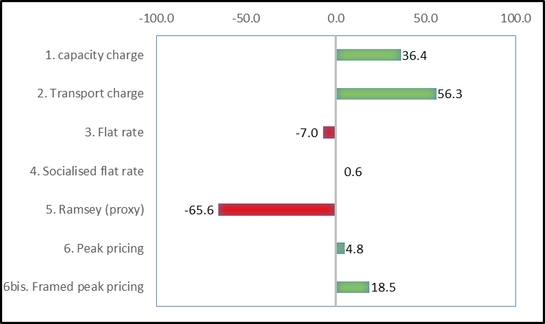
Fairness score of different grid-tariff designs
Fairness score = % (very) fair - % (very) unfair

Slide 21
Conclusion
From ethical perspective, dynamic prices are not necessarily unfair
Dynamic network tariffs are perceived as unfair if not based on a change in underlying costs based on excess demand, price elasticity or willingness-to-pay (market exploitation) if it is unpredictable Unfairness perception of peak pricing is reduced if: it concerns reoccurring, predictable situations revenues are used to address problems at stake by e.g. additional supply there is more trust in the pricing agency

Slide 22
Contact details:
Prof. Machiel Mulder
Centre of Energy Economics Research (CEER)
Faculty of Economics and Business
University of Groningen
Homepage:
http://www.rug.nl/staff/machiel.mulder

