Slide 1
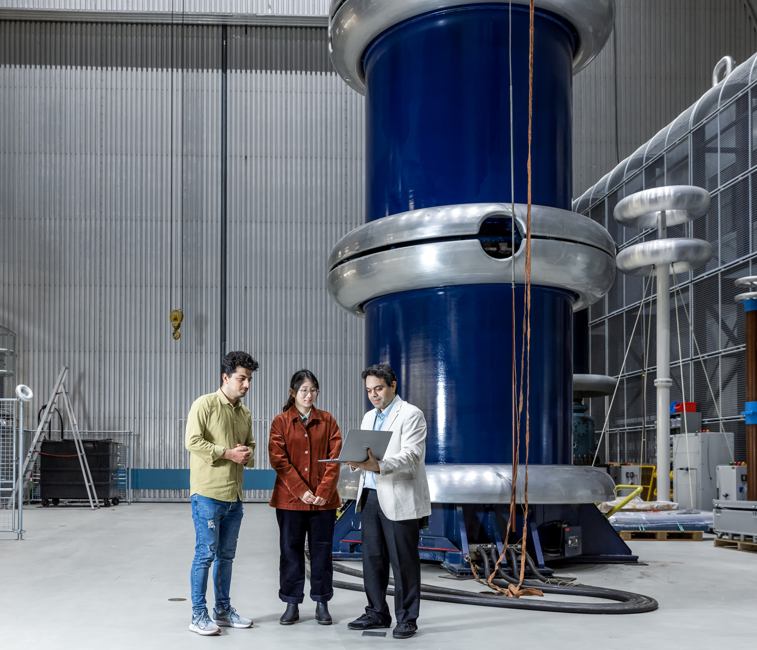
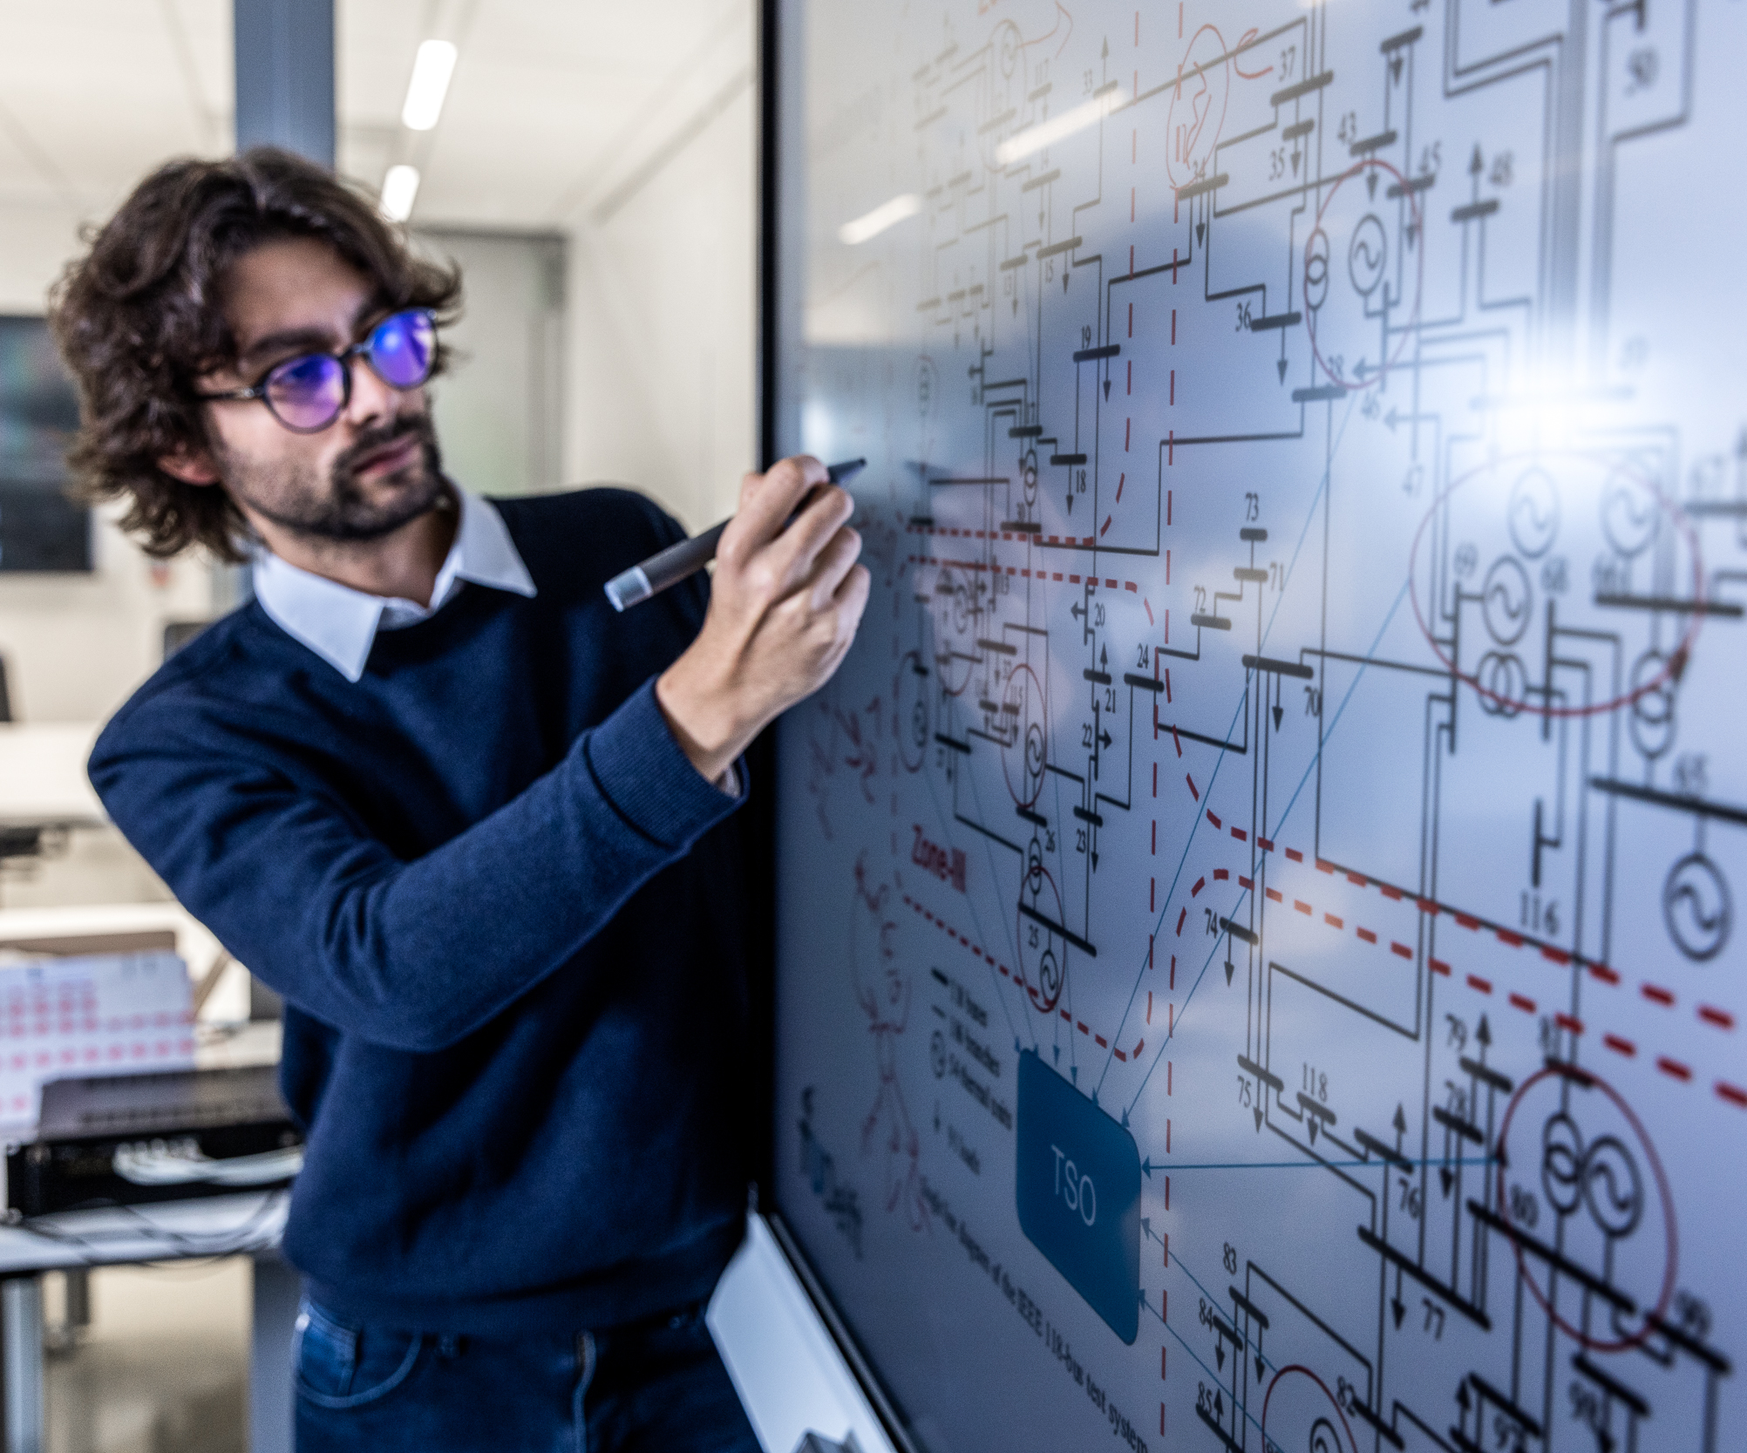
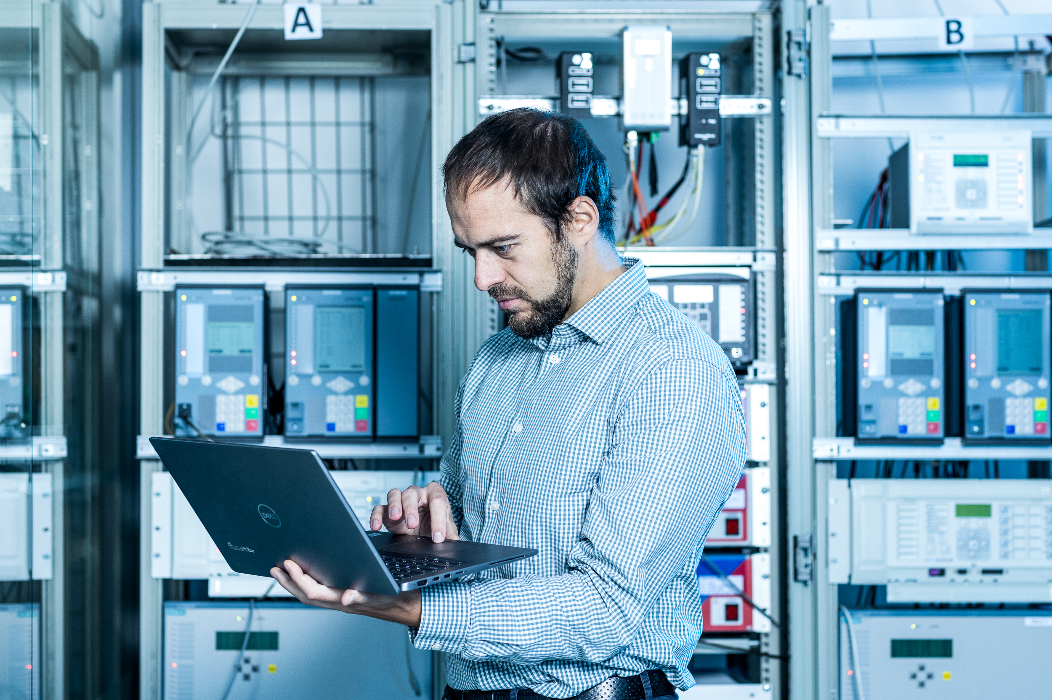
AI & ENERGY: get involved!
Cooperation in research & innovation Cooperate in Research & innovation: Find your research partner in AI4Energy (contact c.g.duterloo@tudelft.nl) Joint research & innovation grant applications Fully funded: ranging from 1 PhD to ICAI lab (min. 5 positions) Make use of our research facilities: ESP lab Delft AI Energy Lab ICAI AI for Energy Grids Lab Delft High Performance Computing Centre EnergySHR Digital Energy Studio (in development) TU Delft Campus Digital Twin Lab (in development) Examples / success stories / patents: Innovation projects: Innovation Projects (tudelft.nl) TU Delft Patents: TU Delft patent portfolio | Ecosystem Join our communities and come to events and talks: Mondai – House of AI Powerweb Institute Urban Energy Institute Fieldlabs: Green Village - dataplatform; AMS Institute – urban energy; FRAIM (Robotics & AI for Future of Work) Online platform: TU Delft Pioneering Tech Let your employees enjoy our education: Executive Education Extension school for Continuing Education
Young talent Get students to work with you: As part of the curriculum: Computer Science Bachelor Software Project (2 months, 4-5 students software development) Joint Interdisciplinary Projects (Master): Joint Project | TU Delft | University Course Work experience internships: Internship offices and Career Centre (tudelft.nl) Delft Career Days (tudelft.nl) Within a joined traineeship program for graduates: X!Lead | Entrepreneurship Entrepreneurship: TU Delft Impact studio Entrepreneurship: Yes!Delft TU Delft Patents: TU Delft patent portfolio

