Slide 1
EU policy for energy efficiency and seismic resilience
The need for social fairness
Rutger Broer – 08.02.2022
Notes:
Add your logo

Slide 2
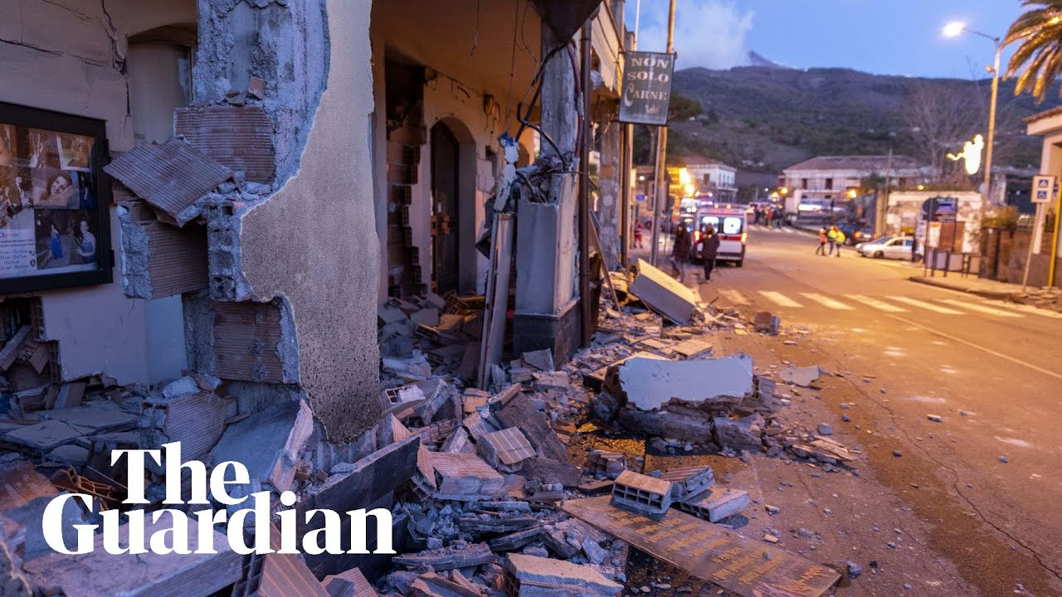
Policy context
Urgent need to decarbonise the building stock
The EU is revising key building policies to achieve more ambitious climate targets
Broaden the scope beyond energy
- Focus in this presentation
Which EU policies are relevant for social fairness
What are the main energy efficiency & seismic resilience policies
How is social fairness reflected in these policies
How is that relevant for e-SAFE and social innovation

Slide 3
Ensuring a fair transition towards climate neutrality
European Comission presents guidelines*
Putting people at the hart of the green transition
“it is essential to use all available tools and put the right accompanying policies in place at EU, Member States, regional and local levels.
Conversely, in the absence of well-designed accompanying employment and social policies, there are socio-economic risks. ”
Social fairness and innovation are essential to ensure a just energy transition. Which EU policies are relevant for this?
*https://ec.europa.eu/commission/presscorner/detail/en/ip_21_6795

Slide 4
Key EU policies addressing social fairness
EU Green Deal (2019) and the fit for 55 package (2020)
- Detailed vision to make Europe the first climate-neutral continent by 2050, safeguard biodiversity and establish a circular economy
- Fit for 55: Reduce EU emissions with 55% by 2030
Revision of relevant climate and energy legislation
The Energy Efficiency Directive (EED)
The Energy Taxation Directive
The EU Emission Trading System Directive
EU Social Climate Fund
The Energy Performance of Buildings Directive (EPBD)
How is social fairness integrated in the GD and F455?

Slide 5
Interlinkages between legislations and topics
Social fairness and decarbonisation in buildings
Policymaking?
DG Env
EED
DG Grow
DG EnergyD
EPBD
EED

Slide 6
(Building) policy has a social impact
Social fairness in the Green Deal and Fit for 55
Green Deal & Fit for 55: “social fairness at its heart” – ‘’Leaving no one behind”
Just Transition Mechanism
Just Transition Fund
InvestEU – ‘Just Transition Scheme’
Public Sector Loan Facility
Social Climate Fund – linked to emission trading system
References to prioritising vulnerable in EED and EPBD
New European Bauhaus: core value of inclusion, focus on co-design of the movement, and prioritising people who need it most in delivery
How is this reflected in EU policies like ETS2, EED and EPBD?
* https://ec.europa.eu/commission/presscorner/detail/en/QANDA_21_6823

Slide 7
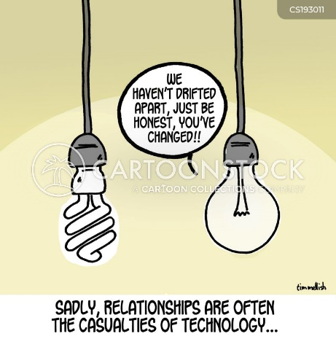
Prioritising the vulnerable
Social fairness in the
Energy Efficiency Directive
Key elements Energy Efficiency Directive (EED)
Energy efficiency targets for primary (39%) and final (36%) energy consumption
Stronger focus on energy poverty – obliges MS to prioritise efficiency measures for energy poor households (Art 22).
Definition Energy poverty (Art.2)
Energy saving obligations ( Art 8 & 9) – MS must reach energy saving targets among vulnerable households.
Some countries have implemented schemes for utilities
Important role to play for providers of social and affordable housing
Links to Emission Trading System and Social Climate Fund …
https://ec.europa.eu/energy/sites/default/files/proposal-recast-energy-performance-buildings-directive.pdf

Slide 8
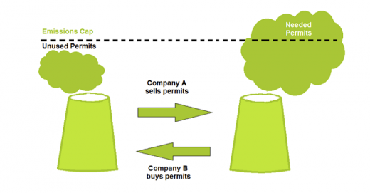
Importance to include vulnerable groups
Social fairness in the Emission Trading System & Social Climate Fund
Key elements Emission Trading System (ETS) and Social Climate Fund
New ETS for buildings and mobility – for buildings: emission rights for heating fuel suppliers
Social Climate Fund to be filled with the revenues from the emission auction
‘The aim of the fund is to mitigate price impact and should support Member States to implement policies addressing the social impact of emission trading on vulnerable households, enterprises, and transport users’*
Critical aspects ETS2
Additional costs > negative consequences for energy poor
Lower income groups cannot invest in EE or fuel switch to avoid increasing prices
Fuel switch does not automatically improve the quality of life (leaky stays leaky)
Critical aspects SCF
Timing: Funding only available for 2025 – 2032.
Beneficiaries: reference to the definition of EP from the EED should define eligible households
Eligible measures should lead to (one-stage) deep renovations of worst performing buildings
This illustrates why it is so important to integrate vulnerable groups in policy and solution design – by implementing socially innovative techniques
*https://ec.europa.eu/energy/sites/default/files/proposal-recast-energy-performance-buildings-directive.pdf

Slide 9
Improving energy performance in a social manner
Social Fairness in the Energy Performance of Buildings
Directive (EPBD)
Minimum energy performance standards (MEPS)
EU-wide Minimum Energy Performance Standards:
Publicly owned & non-res buildings must be at least F by 2027 & E by 2030
Residential buildings must be at least F by 2030 & E by 2033
With reform of EPC system, G = 15% worst performing buildings at national level
Member States must support compliance with financing, Technical Assistance, One-stop-shops
Monitoring & verification (e.g. on vulnerable groups) vaguely phrased
Deep renovations
Zero emission buildings after 2030 – receive more funding – larger potential to alleviate energy poverty
Financing and technical assistance (TA)
Requires MS to target vulnerable households as priority
Recognises importance of Technical Assistance, incl. One-Stop Shops
> The worst performing buildings must be renovated in the coming decade, with MS priority for vulnerable households

Slide 10
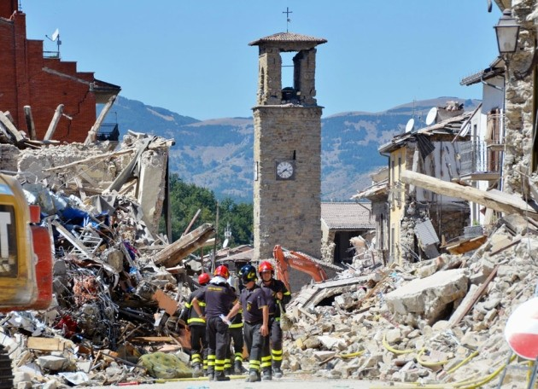
Why focussing on energy is not enough
Linking energy efficiency and seismic resilience in the
Energy Performance of Buildings Directive
Seismic resilience in the Energy Performance of Buildings Directive
Definition of deep renovation
Deep renovations are a prime opportunity to address “other aspects such as … resilience against disaster risks including seismic resilience”
Information provision – providing guidance and training
Next to energy efficiency – training may “also address risks related to intense seismic activity.’’
Although articles clearly steer towards social fairness, seismic resilience is not yet well-anchored in instruments.
No reference to seismic resilience in sections on information provision generally or information tools (Building Renovation Passports, One-stop-shops, training and guidance implementeres)
https://ec.europa.eu/energy/sites/default/files/proposal-recast-energy-performance-buildings-directive.pdf
Notes:
For BRP – health and comfort are mentioned – improved adaptive capacity – info about TA. But no

Slide 11
Conclusion
The European Commission has introduced articles focussing on social fairness and seismic resilience into the Fit for 55 / Green Deal policies
Priority financing for vulnerable households (EPBD, EED)
Emission Trading System – generates funds but also risk or rising costs for most vulnerable
Minimum energy performance standards aim to renovate worst performing buildings
Seismic resilience should be operationalised in policy instruments
Training experts to think holistically
Combine energy efficiency and seismic safety for the most vulnerable
Co-design and social innovation is essential to achieve the EU policy goals
e-SAFE is developing and validating methods in Catania

Slide 12
Questions?

Slide 13
Thank you!
Rutger.broer@bpie.eu

Slide 14
Why focussing on energy is not enough
Linking EE and seismic resilience in the
Energy Performance of Buildings Directive
Numbered recital 11
“Measures to improve further the energy performance of buildings should … not affect other requirements concerning buildings such as accessibility, fire safety and seismic safety.”
Numbered recital 33
“A deep renovation for energy performance purposes is a prime opportunity to address other aspects such as living conditions of vulnerable households … and resilience against disasters including seismic resilience.”
Existing buildings (Article 8)
“MS shall encourage, in relation to buildings undergoing major renovations, issues of IEQ, … and the risks related to intense seismic activity”
Information (Article 26)
“MS shall ensure that guidance is available for those implementing the directive... Such guidance may also address …. risks related to seismic activity,”
Annex II – Template for National Building Renovation Plans
Optional indicator for Overview of implemented and planned policies and measures includes “policies and measures with regard to .. The increase of resilience against disaster risks, including risks related to intense seismic activity”
https://ec.europa.eu/energy/sites/default/files/proposal-recast-energy-performance-buildings-directive.pdf

