Slide 1
How can deliberative mini-publics transform climate action?
Maija Setälä
University of Turku
maiset@utu.fi

Slide 2
Deliberative mini-publics
The term introduced by Archon Fung (2003)
Survey Article: Recipes for Public Spheres: Eight Institutional Design Choices and Their Consequences. The Journal of Political Philosophy 11(3): 338–367.
Citizens’ Juries and Planning Cells first formats (early 1970s)
Involving citizens in technically complex issues
More recent ones include Deliberative Polls (1990s), Citizens’ Assemblies (2000s)
Proliferation of mini-publics during recent years, especially to deal with climate issues

Slide 3
Key design features of deliberative mini-publics
Shared features
random selection of participants (often combined with stratification)
interaction with experts and witnesses
moderated (small-group) deliberations on a policy issue
Variation in
number of participants
duration of deliberation
outcomes of deliberation may be a written statements or vote results

Slide 4
The benefits and drawbacks of deliberative mini-publics
Several studies on the impact of mini-publics on participants (for a review, e.g. Setälä and Smith 2018)
Learning, correction of misperceptions, perspective-taking, empathy and so on
Open questions regarding the effects of mini-publics on a) policymaking b) public at large
Mixed scholarly evaluations of mini-publics’ impact on democracy
Ranging from enthusiasm to deep criticism

Slide 5
The role of deliberative mini-publics in representative systems
Mini-publics are usually initiated by governments on an ad hoc basis
Mini-publics may be used instrumentally to achieve policy goals or, more generally, to enhance governmentality (Woo & Kübler 2020)
Mini-publics have usually an advisory role
Entails a risk that policymakers ’cherry-pick’ the recommendations (or ignore them entirely) (Smith 2009)

Slide 6
The role of deliberative mini-publics in representative systems
Could mini-publics make binding decisions?
Mini-publics can be representative in a descriptive sense but they do not involve processes of authorization and accountability
The lack of electoral accountability
allows unconstrained deliberation
but could decisions made by mini-publics be legitimate?
Even some deliberative democrats think that deliberative minipublics should not shape policies (Lafont 2015)
So what should they do?

Slide 7
Standards for evaluation for effects
Deliberation as a standard of evaluation: mini-publics should enhance deliberation among policymakers and/or the public at large
’critical mini-publics’ (Böker and Elstub 2015)
What constitutes deliberation?
better communication or justification/more inclusive reason-giving/ deliberation within (e.g. perspective-taking)/ learning/ counteracting motivated reasoning

Slide 8
Standards for evaluation of effects
Effects of mini-publics on representative decision-making
bringing in new arguments, otherwise under-represented viewpoints (e.g. Hendriks 2017)
Mini-publics as trusted sources of information for the general public
more trusted among the public than partisan sources (e.g. governments)
can enhance learning (e.g. Warren and Gastil 2015) and perspective-taking (Setälä et al 2019) and mitigate the effects of motivated reasoning (Már and Gastil 2019)

Slide 9
Why are deliberative mini-publics used to shape climate policies?
1. Deliberative mini-publics help tackle complexity of climate policies
by providing opportunities for learning and thorough reflection on policy alternatives
2. Mini-publics help make judgments on the fairness of climate policies
by weighing losses and gains across different groups in the society
3. Mini-publics can increase the feasibility of climate policies
by pooling citizens’ experiential knowledge

Slide 10
The roles of mini-publics on climate
Mini-publics are expected improve the quality of deliberation on climate issues because they are not similarly constrained by voters as elected representatives
Epistemic benefits on climate policies (broadly speaking); better informed, more balanced, more fair
Expected to enhance the legitimacy of climate policies
Mini-publics are trusted as non-partisan actors

Slide 11
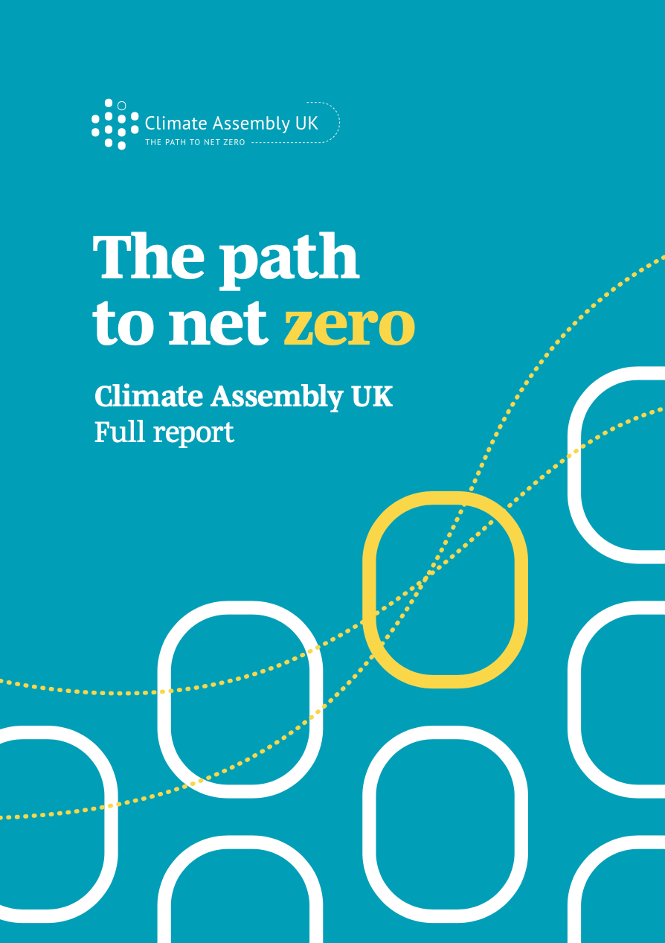
Deliberative mini-publics on climate policies
Plenty of examples of deliberative mini-publics on climate policies
Initiated by governments at different levels
Climate laws in Denmark and in Scotland
Nation-wide mini-publics e.g. in UK, France, Ireland, Finland, Denmark
The scale and the scope of climate mini-publics varies significantly
As shown by the following two examples

Slide 12
The Citizens’ Convention on Climate in France
The Citizens’ Convention on Climate
Initiated by President Macron (in response to the Yellow Vest movement)
150 citizens deliberated for 7 weekends (+1 unofficial weekend after the parliamentary proceedings) in 2020-21
Made a large number of suggestions (149) in the areas of traffic, consumption, work and food
President Macron had promised that the proposals would be dealt with ’unfiltered’
What does this mean? Governmental action, parliamentary procedure or a referendum?

Slide 13
The Citizens’ Convention on Climate in France
In the end, only handful of proposals were adopted (Courant 2021)
three proposals were rejected by the president
more than half of proposals (53%) were rejected by the parliament, 35 % were modified and 10% were adopted in the climate law
Frustration among participants but also mobilization among the wider public
a petition to ‘save the convention’ (over 500,000 signatures)

Slide 14
Citizens’ Jury on Climate Actions in Finland
Citizens’ Jury on measures of Medium-Term Climate Policy Plan
Commissioned by the Finnish Ministry of Environment and the Climate Policy Round Table in Spring 2021
Tasked to evaluate the fairness and efficacy of 14 measures in the areas of traffic, housing and food which are likely to affect consumers
Included 33 participants selected through random sampling and stratification (age, gender, place of living, level of education)
2,5 days of deliberation conducted online

Slide 15
Citizens’ Jury on Climate Actions

Slide 16
Citizens’ Jury on Climate Actions
The jury process was highly structured
91% of participants thought that the jury managed to deal with climate issues from the perspective of social justice; less confidence in the impact of the jury (57%); also the time for deliberation was regarded too short (54%)
The statement expressed concerns about social justice and negative impacts of climate policies on disadvantaged groups and peripheral areas; emphasis on positive incentives rather than taxation
The statement was taken into account when drafting the Medium-Term Climate Policy Plan

Slide 17
Summary of examples
Citizens’ Convention in France
Initiated by the president, motivated by public protests
Tasked to provide new policy proposals
A lengthy procedure; less structured than many counterparts
Wide public outreach and awarenesss
Recommendations dealt with in the parliament
Citizens’ Jury in Finland
Initiated by a ministry; motivated by public opposition (e.g. surveys)
Tasked to evaluate 14 policy proposals on the basis of social justice
Short and structured procedure
Relatively little public interest
Recommendations dealt with by civil servants

Slide 18
Challenges of minipublics on climate: the scope of the issue
How to address intergenerational and global character of climate change?
The global dimensions of climate change may be hard to tackle
Although minipublics are likely to be more future-regarding than e.g. parliamentary deliberation, they may not be sufficiently so
Specific exercises to think about the perspective of future generations (e.g. Future Design, cf. Hara et al 2020; Kulha et al 2021)
How to deal with issues of mitigation and adaptation?

Slide 19
Challenges of minipublics on climate: motivations and impact
Are mini-publics on climate issues used to avoid backlash caused by controversial climate policy measures? Or to pacify the civil society?
The impact of mini-publics often remains vague
‘Cherry-picking’ of recommendations
The impact on the general public remains marginal; the French as a positive example in terms of public visibility

Slide 20
Strengthening the role of mini-publics in climate policymaking
Coupling with policymaking (e.g. Hendriks 2017; Setälä 2017)
Key aspects
What is the output of deliberation?
How is the output of deliberation transmitted to policymakers? Is policymakers’ feedback required – and what kind of feedback? Are there opportunities for communication between policymakers and mini-publics?
Are policymakers directly involved in deliberation?

Slide 21
Strengthening the role of mini-publics in climate policymaking
Interaction with the general public is needed to triggger distributed processes of learning, reflection etc.
Minipublics can interact with the general public
During the process: public hearings, public submissions etc.
After the process: mini-publics’ arguments and recommendations are transmitted to the general public
How arguments are transmitted?: e.g. via media or directly to citizens; are there incentives for the public to deal with the arguments

Slide 22
Strengthening the role of mini-publics in climate policymaking
Institutionalization of mini-publics can help prevent instrumental use and create expectations of the role of deliberation
Institutionalization means defining the instances for use
Substantive conditions refer to issue type; e.g. the requirement of minipublics on climate issues
Procedural rules could allow other actors than governments to initiate mini-publics and give other than advisory roles
From mini-publics to more permanent deliberative bodies?

Slide 23
Concluding remarks
Mini-publics have a great potential in dealing with the complexities of climate policies
Yet this potential has not been fully achieved in current ways of using mini-publics
Issues intergenerational and global justice remain as challenges of mini-publics on climate
Coupling, interaction and institutionalization required to enhance impact

Slide 24
THANK YOU!

