Slide 1
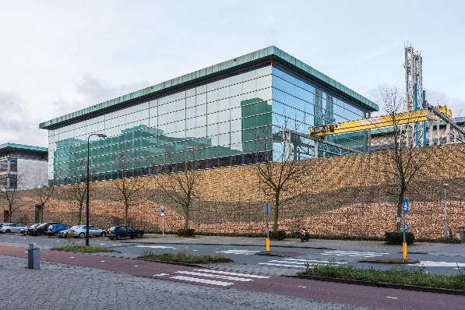
Shoot for the Moon, Land among the Stars
Frank van Bergen
TNO

Slide 2
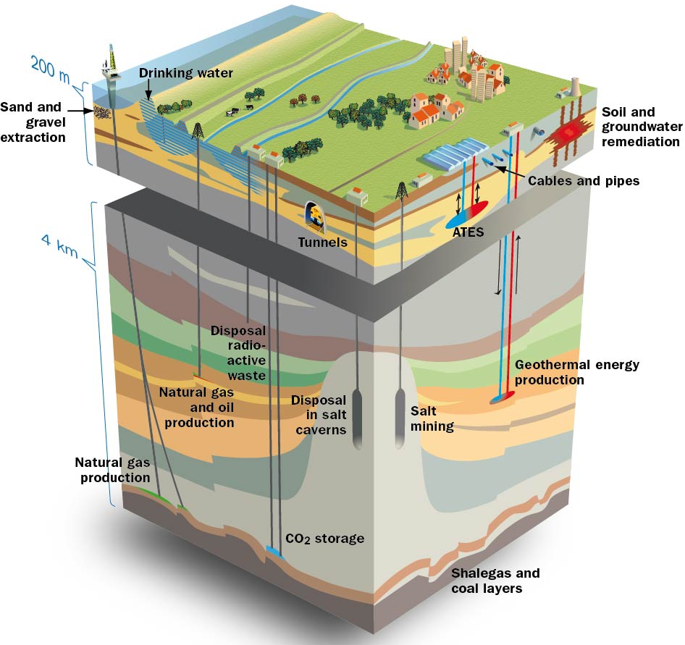
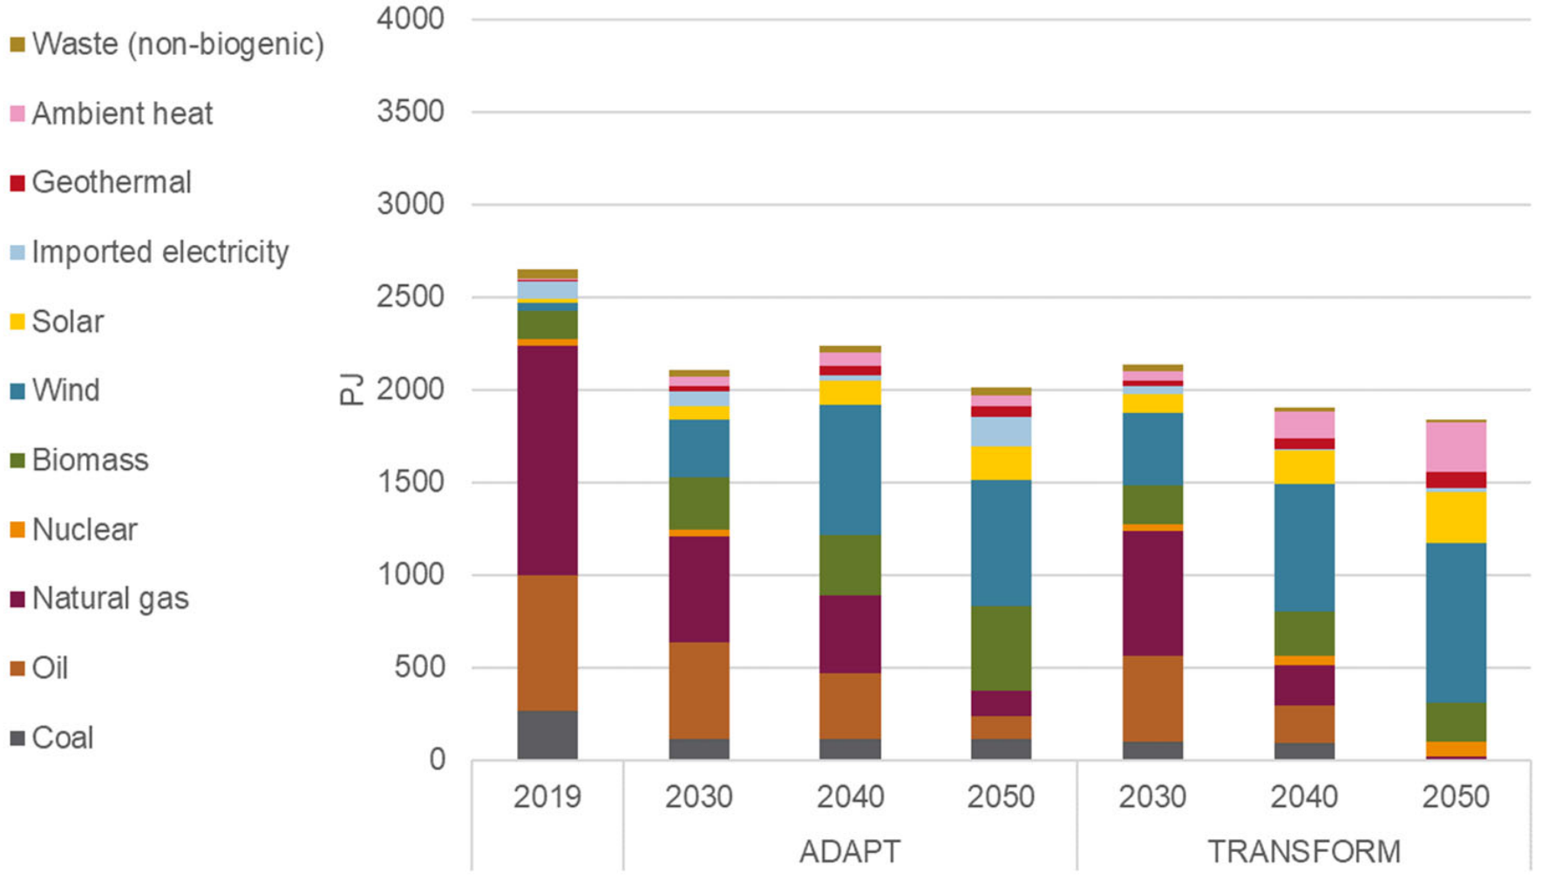
The role of subsurface in the energy transition
CO₂ storage
Geothermal
H₂ storage
Heat Storage
NL total final energy production in 2019 and in 2030 to 2050 (TNO 2022)
The subsurface plays a key role in the energy transition and
wells are essential to exploit the potential of the underground

Slide 3
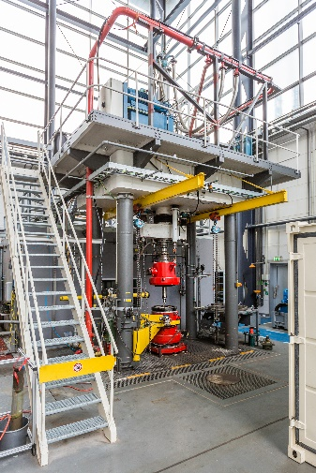
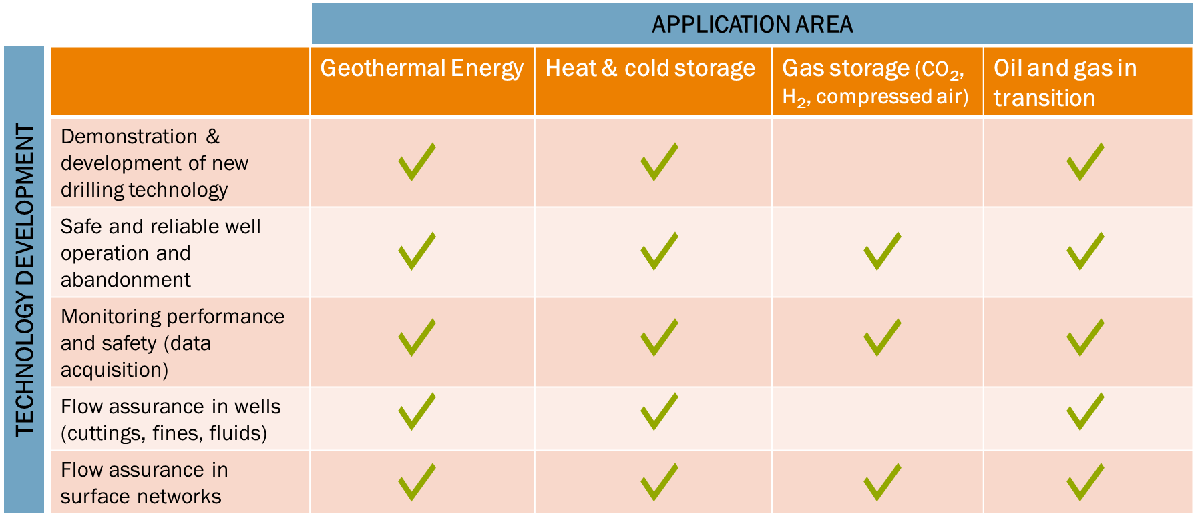
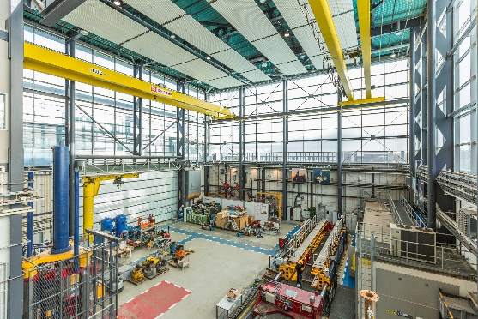
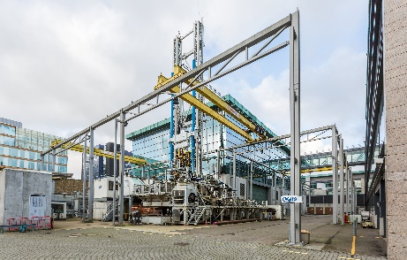
What is RCSG?
An open innovation centre of TNO for developing solutions to engineering challenges for the energy transition through large-scale experimental testing / research scale at downhole conditions.​
High-end laboratory facilities & experienced team of subsurface specialists and mechanical engineers​
Delivering innovations for safe, reliable and cost-effective well operations

Slide 4
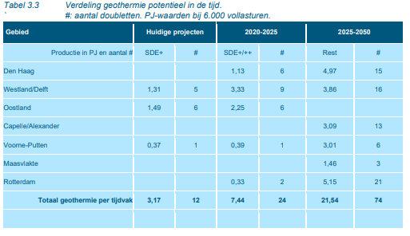
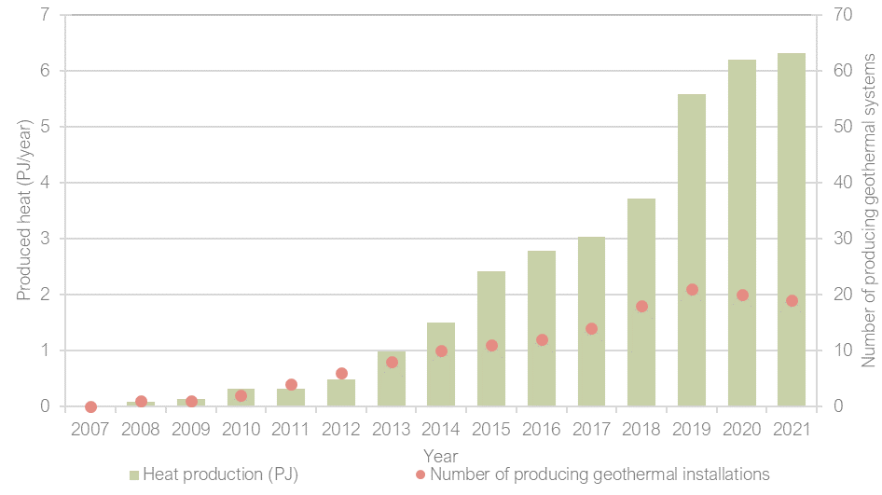
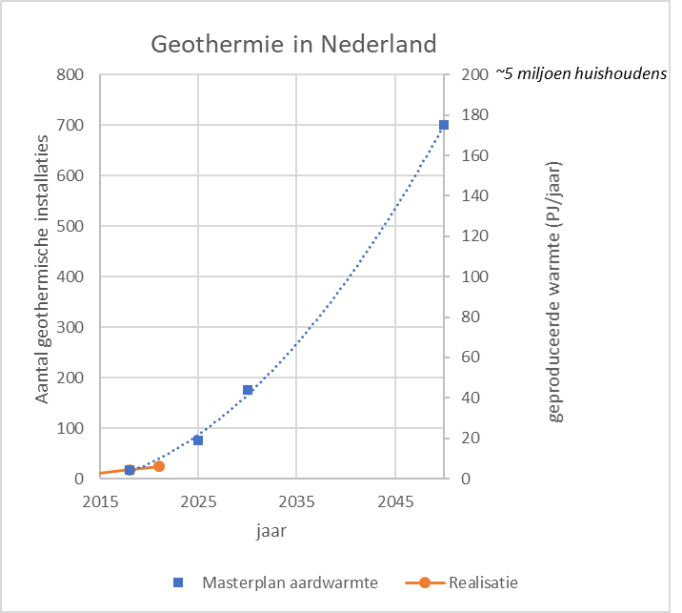
Why innovations?
Geothermal key part of (regional) energy transition plans …
But…development of geothermal is currently slowing down
from: Collectieve warmtevoorziening RES Rotterdam Den Haag (Royal-Haskoning DHV)
Annual production of geothermal energy (PJ/year) and number of operating geothermal installations.

Slide 5
Why innovations?
Several reasons for slow-down (permitting, heat network development. etc.), costs being one of them
Standardisation, Economy of scale
Costs, price
Costs of solar, wind
Innovations
subsidy
Price of energy
time
How do we drive and support innovations?

Slide 6
Shoot for the Moon, Land among the Stars

Slide 7
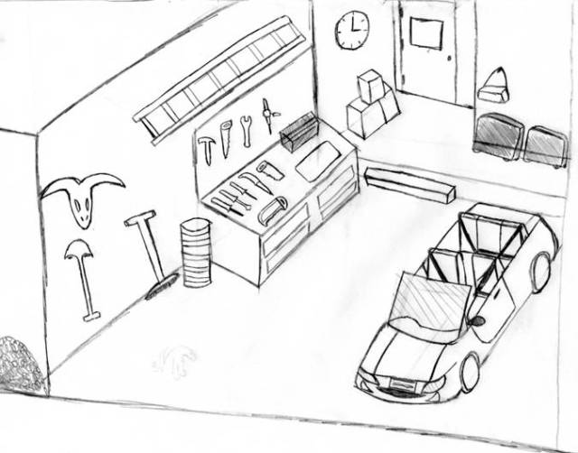
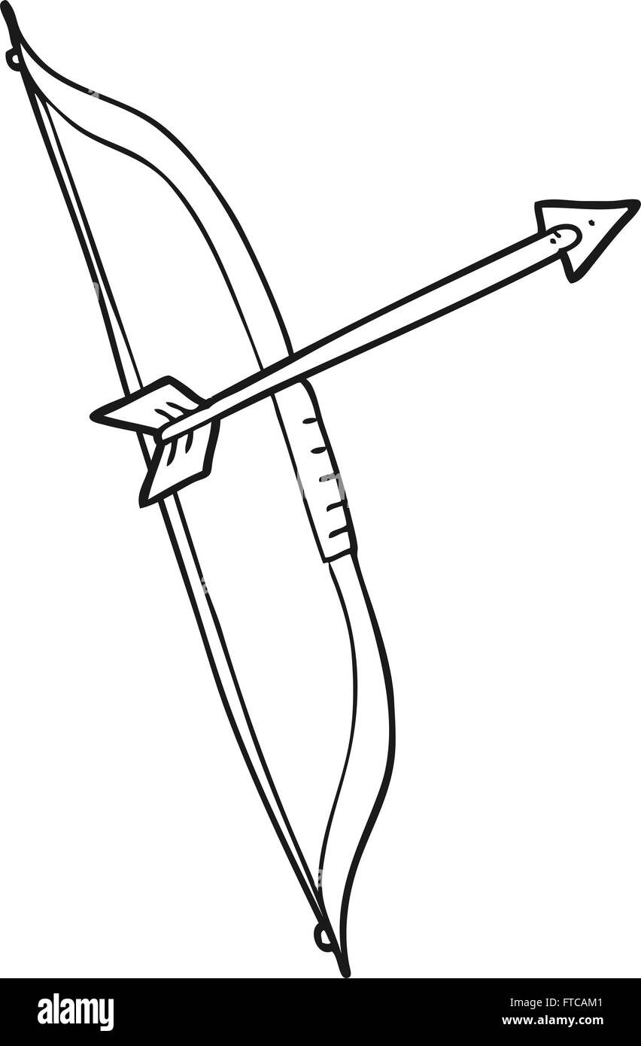
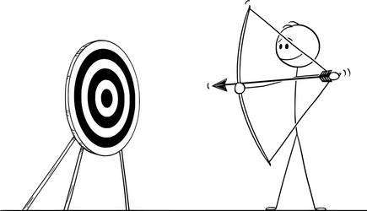

Slide 8
Project maturation
(TRL <4)
(TRL 4-6)
(TRL 7-8)
(TRL 9)
Market development
Discover
Develop
Demonstrate
Deploy

Slide 9
Shoot for the Moon, Land among the Stars

Slide 10
Project maturation
(TRL <4)
(TRL 4-6)
(TRL 7-8)
(TRL 9)
High gain, fast-tracking success
Market development
Discover
Develop
Demonstrate
Deploy

Slide 11
Shoot for the Moon, Land among the Stars

Slide 12
Project maturation
(TRL <4)
(TRL 4-6)
(TRL 7-8)
(TRL 9)
High gain in case of success, but also high risk of failure
Market development
Discover
Develop
Demonstrate
Deploy

Slide 13
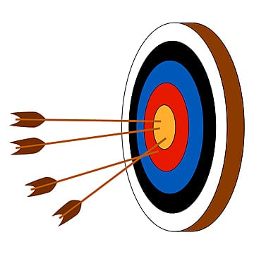
Shoot for the Moon, Land among the Stars

Slide 14
Shoot for the Moon, Land among the Stars

Slide 15
Shoot for the Moon, Land among the Stars

Slide 16
Shoot for the Moon, Land among the Stars

Slide 17
Project maturation
(TRL <4)
(TRL 4-6)
(TRL 7-8)
(TRL 9)
High risk of failure, high gain
Market development
Lower risk of failure, but longer time to market and higher upfront investments
Discover
Develop
Demonstrate
Deploy

Slide 18
Fast-track route
Fast-track route to market (high-gain, high risk) fits a low-capital industry with many innovative ideas
TRL<4
TRL 4-7
TRL 7-8
Discover
Develop
Demonstrate
success
failure
Apps, AI based technology, software, etc.

Slide 19
Lower-risk route
Lower risk route (longer time to market, higher upfront investments) fits high-capital (more mature?) industry
TRL<4
TRL 4-7
TRL 7-8
Discover
Develop
Demonstrate
success
failure
Hardware technology, etc.
failure
Subsurface solutions are largely in this domain!
19

Slide 20
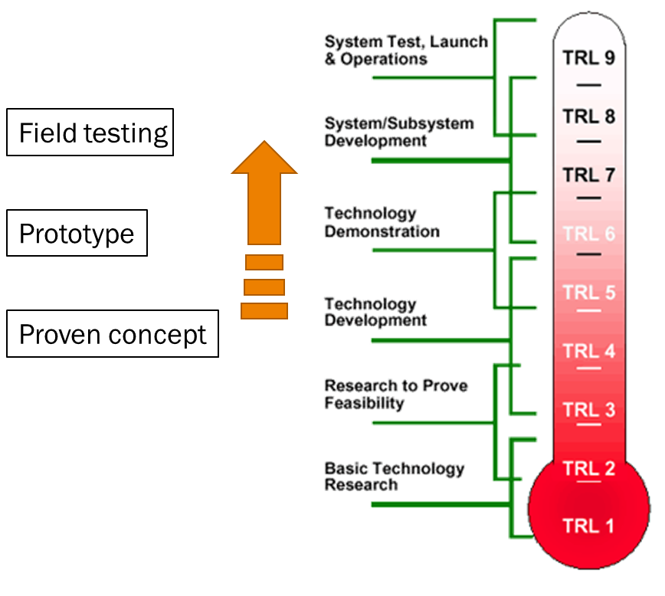
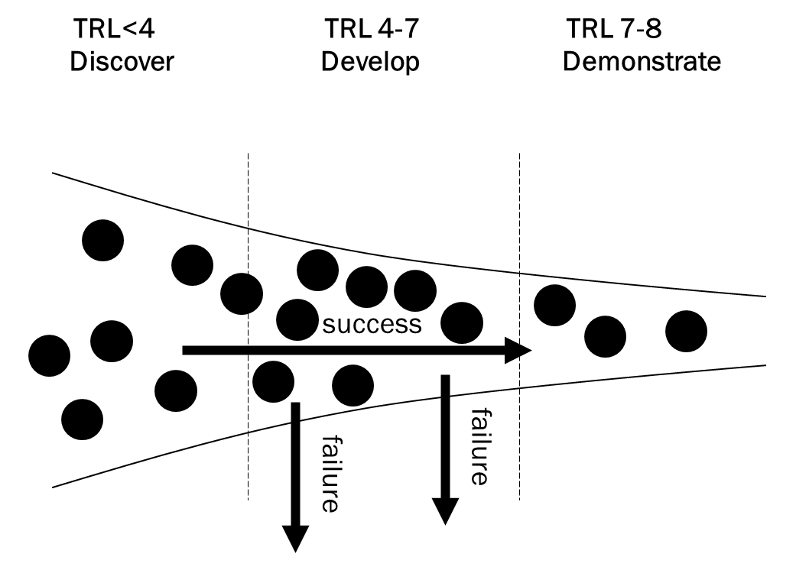
Technology maturation

Slide 21
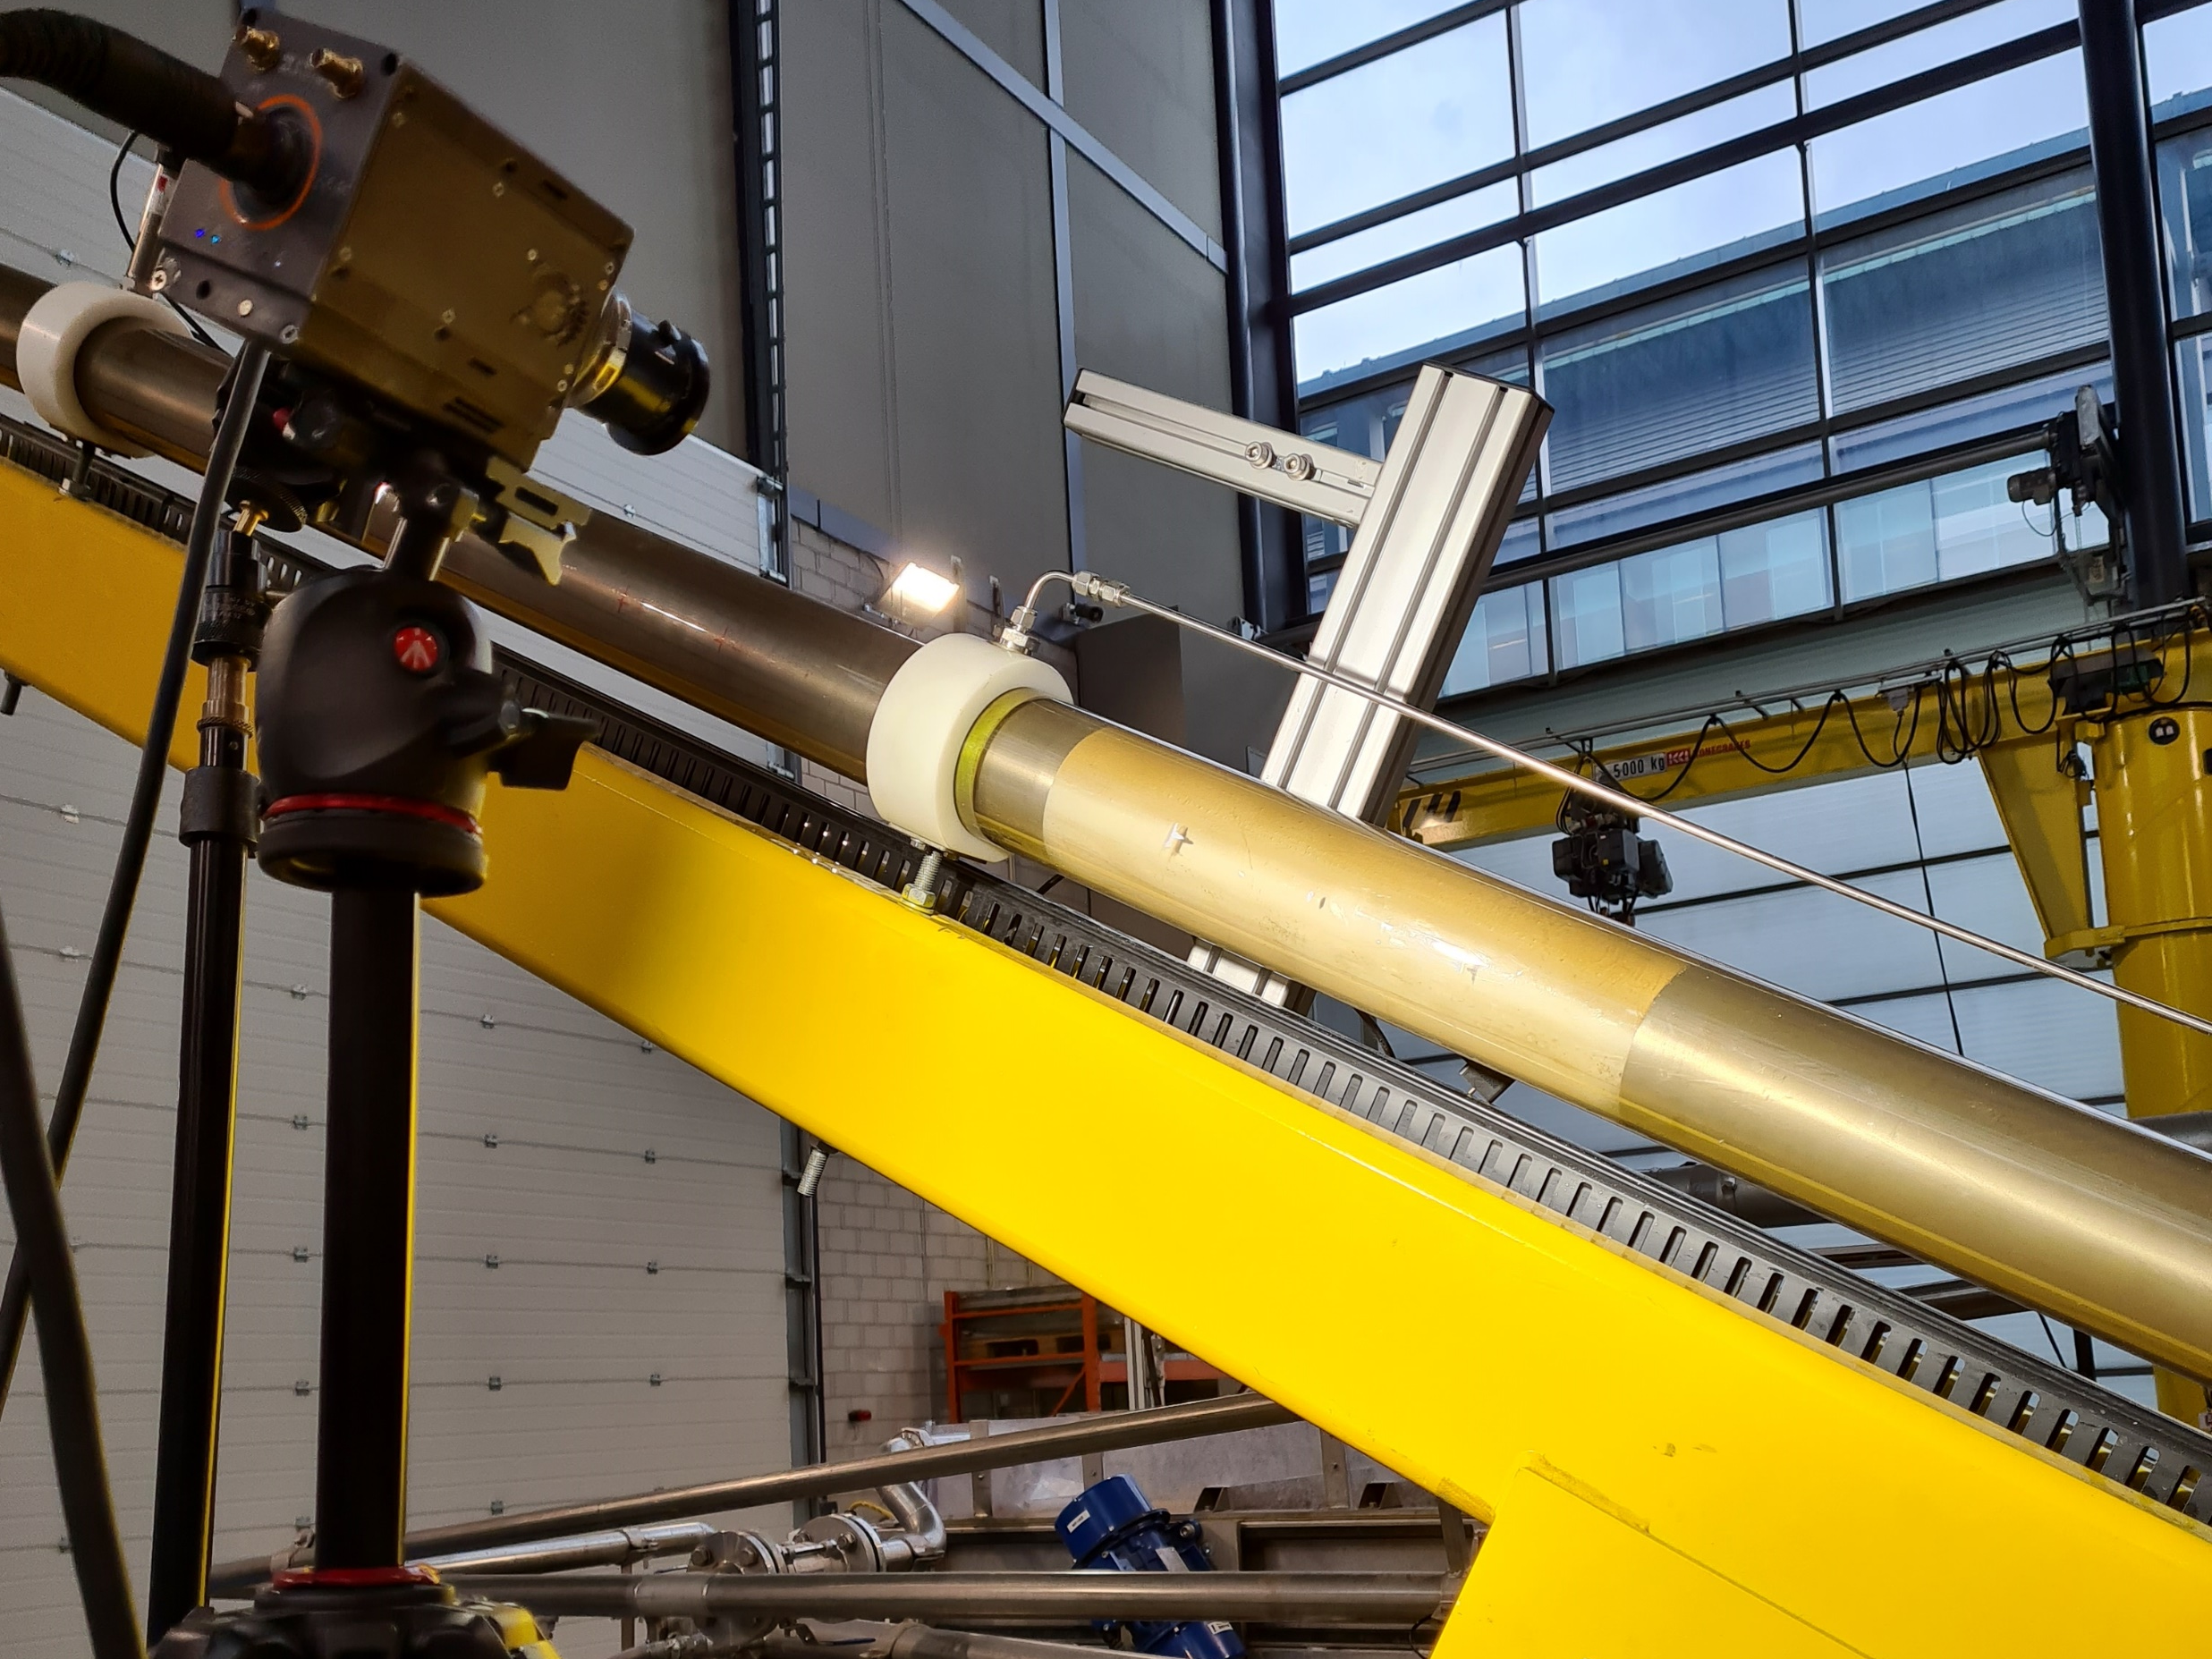
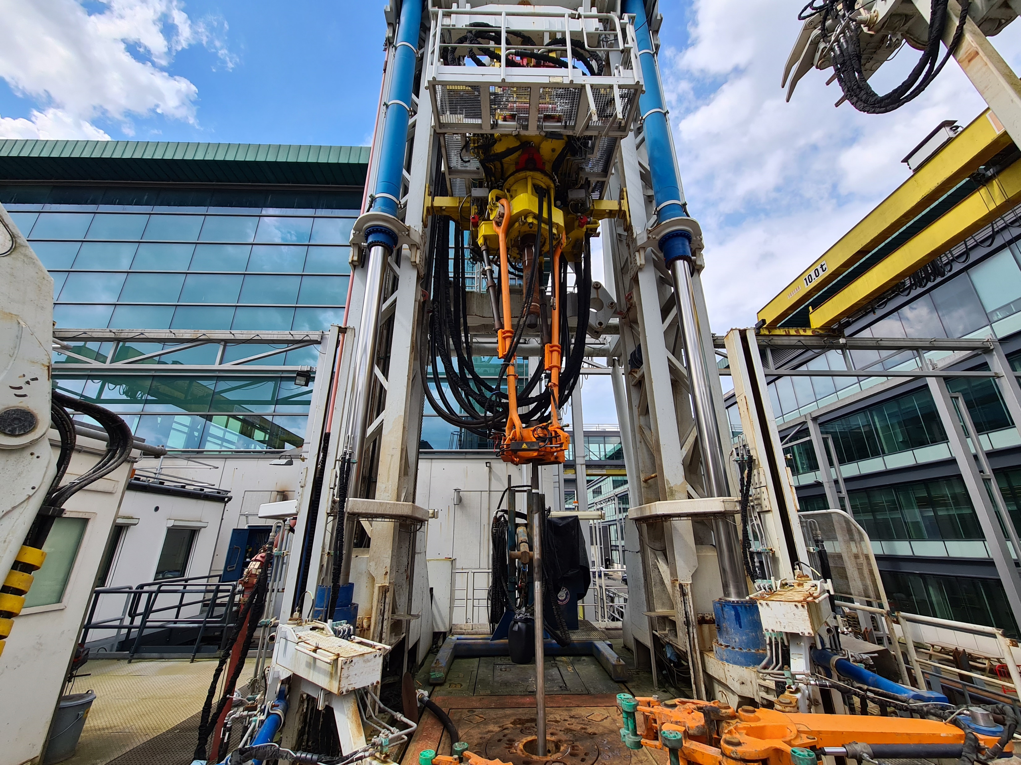
Driving technology maturation at RCSG
Engineering and development
Small to mid -scale experiments
Technology validated in the lab
Testing and optimization
Large-scale tests
Technology validated in relevant environment
Qualification
Factory acceptence testing at full scale
System complete and qualified
TRL 1
TRL 3
TRL 2
TRL 4
TRL 5
TRL 6
TRL 7
TRL 8
TRL 9

Slide 22
Strategy for innovations
Fill the funnel at every TRL by combining good ideas with the appropriate funding instruments to work on balanced project portfolio
Follow a program approach that targets the development of a technology through various follow-up projects
Develop expertise together with partners to accelerate the maturation
TRL<4
TRL 4-7
TRL 7-8
Idea collection
Market deployment
Seed/research funds
PPS
Discover
Develop
Demonstrate
JIP / B2B

Slide 23
Example technology maturation
(TRL <4)
(TRL 4-6)
(TRL 7-8)
(TRL 9)
RCSG
Seed/research funds
PPS
JIP / B2B
Market development
Discover
Develop
Demonstrate
Deploy

Slide 24
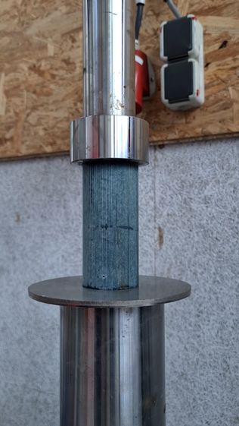
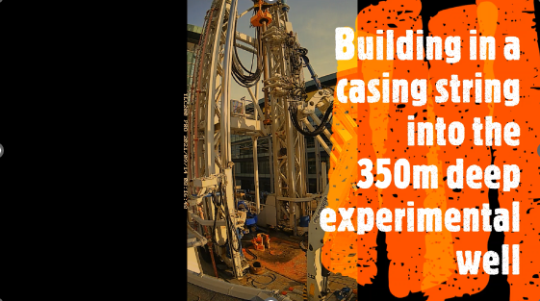
TKI Natural Sealing Large-Scale Evaluation
True scale testing of bentonite as natural material plug of a well
Small scale testing
Testing on rig
Field testing
Ilustration, not bentonite ☺

Slide 25
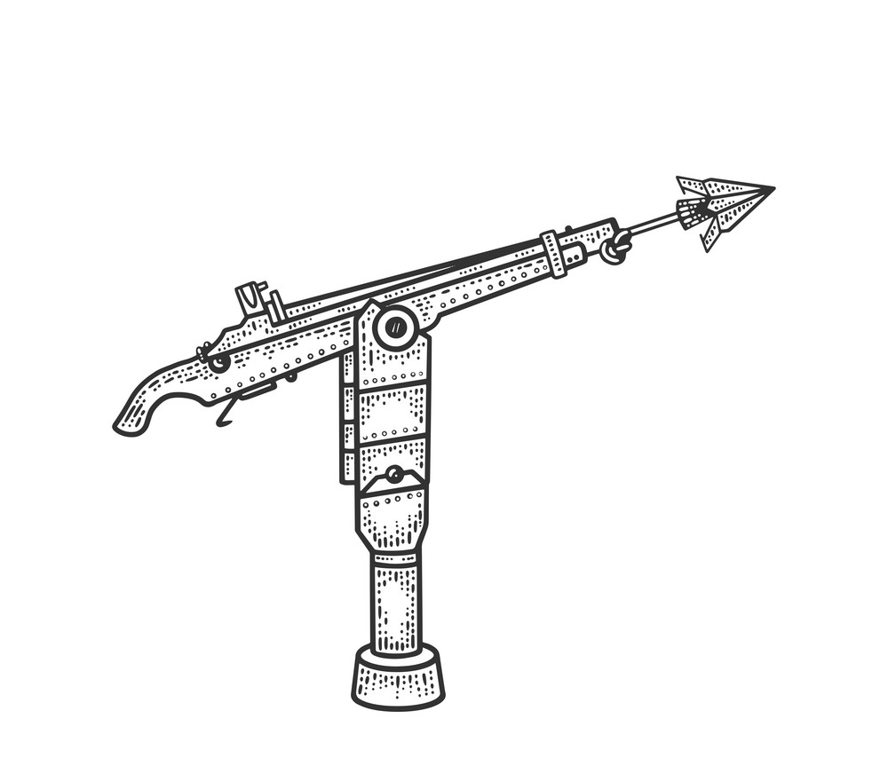
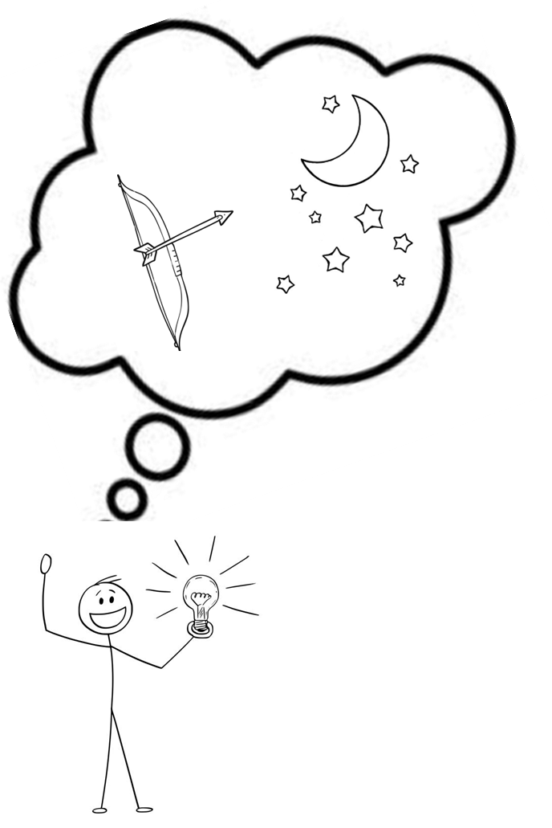
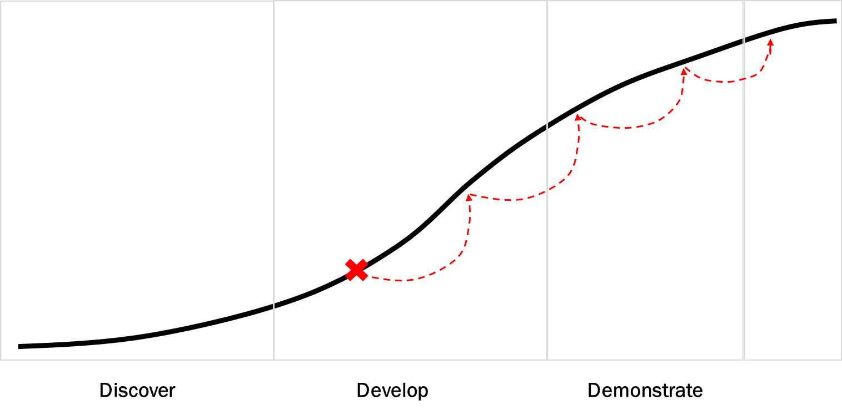
Shoot for the Moon, Land among the Stars

Slide 26
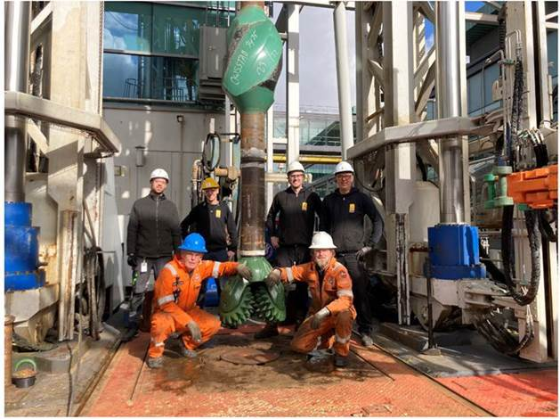
Thank you for your attention!

