Slide 1
Justice in the Urban Energy Transition
Udo Pesch
Future Horizons of the Urban Energy Transition
21 November 2023

Slide 2
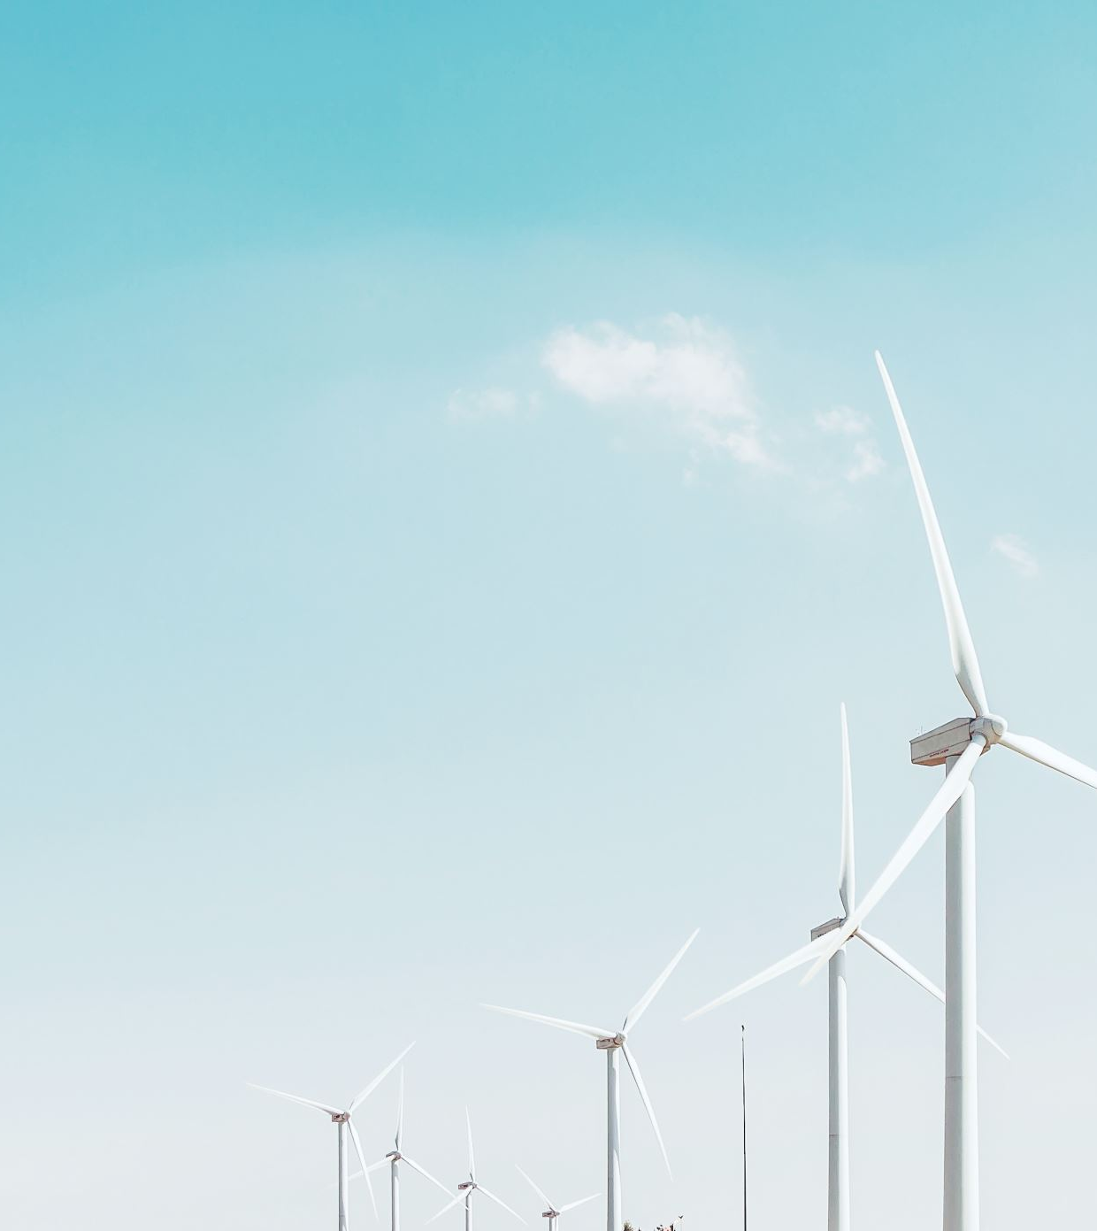
In the implementation of the measures to build a sustainable energy system, it becomes increasingly clear that this transition has many implications for justice.

Slide 3
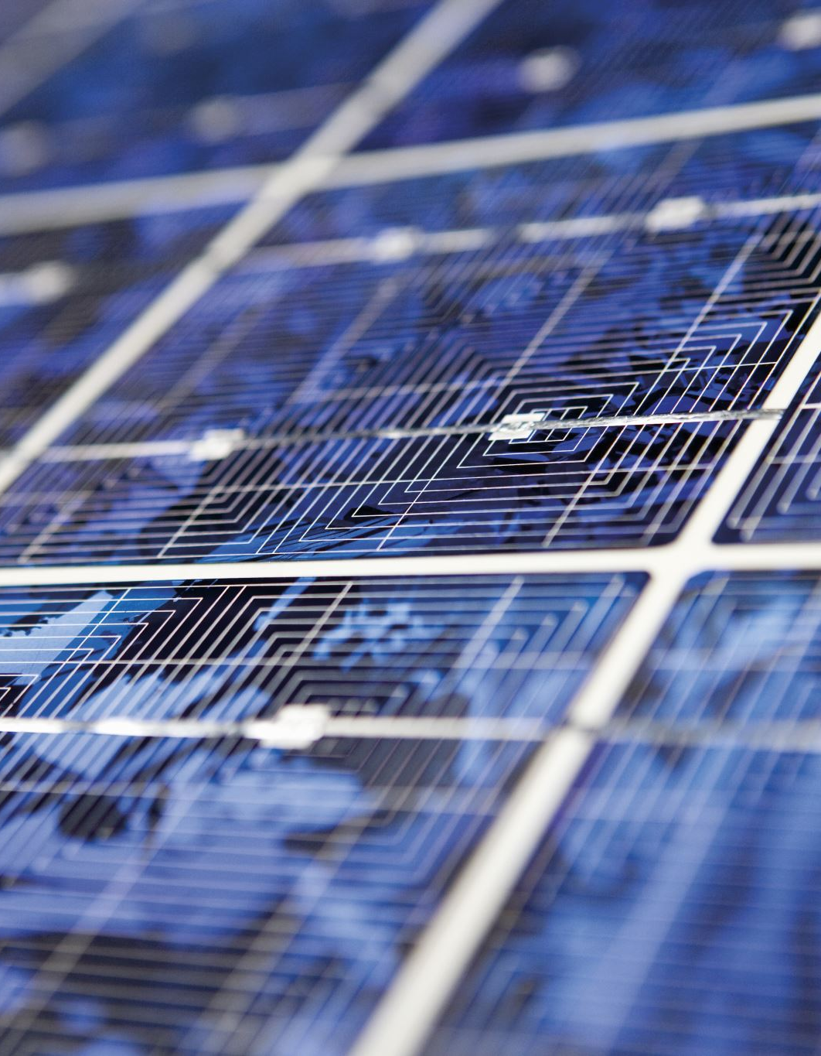
Subsidy schemes diffusion of sustainable technologies, but these subsidies imply that taxpayers who do not have the financial resources to afford solar panels or electric cars are funding those who can
Getting rid of these subsidy schemes means people who expected to be compensated buy something they could otherwise not afford

Slide 4
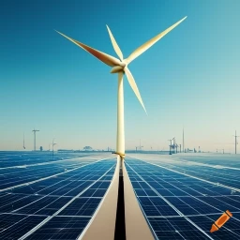
Wind turbines, solar parks, and other kinds of installations need space, which implies that residents in rural areas are disproportionally confronted by such technical systems, while the benefit of renewable energy is mostly enjoyed in urban areas

Slide 5
What is justice?

Slide 6
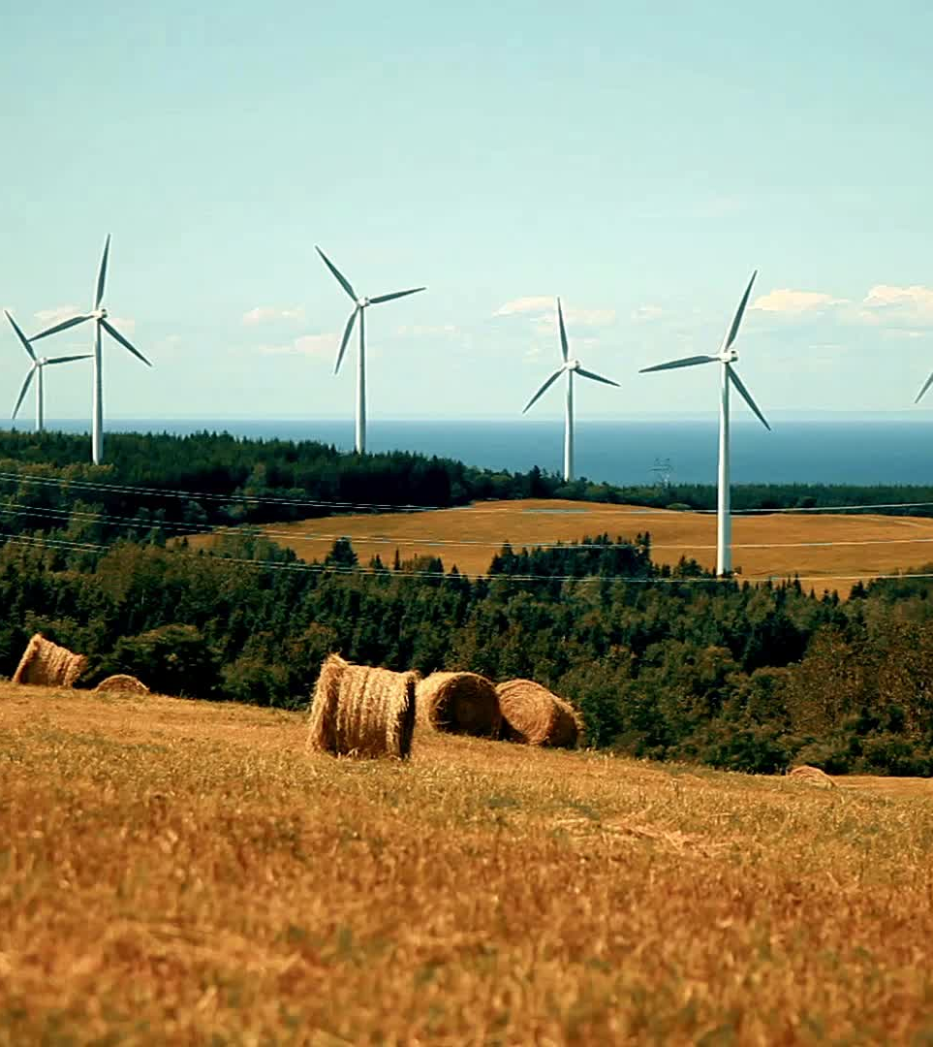
Institutions provide rules to distribute goods in a way that is accepted by society
For instance, the three traditional pillars of energy policy in The Netherlands:
Affordability
Security of Supply
Sustainability

Slide 7
In the energy transition such sustainability changes and the rules to distribute along with new technological systems and that will lead to a reshuffling of costs and benefits

Slide 8
The energy transition can be seen as an experiment in which we try to find out what the new rules of the game are

Slide 9
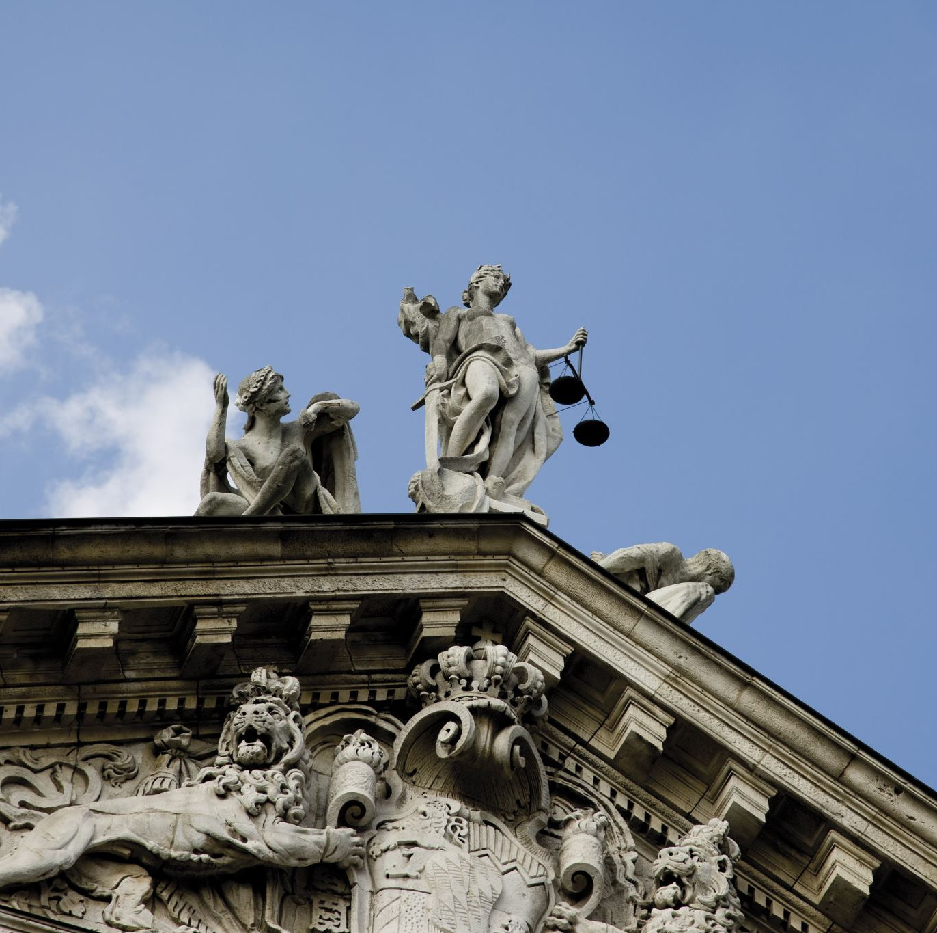
Extensions of justice
Inter- and intragenerational justice
Tenets of Energy Justice
Non-anthropocentric justice

Slide 10
Inter- and intragenerational justice
Carbon emissions need to be reduced so as not to threaten the quality of life for future generations
Energy measures should not threaten the quality of life of those people living now

Slide 11
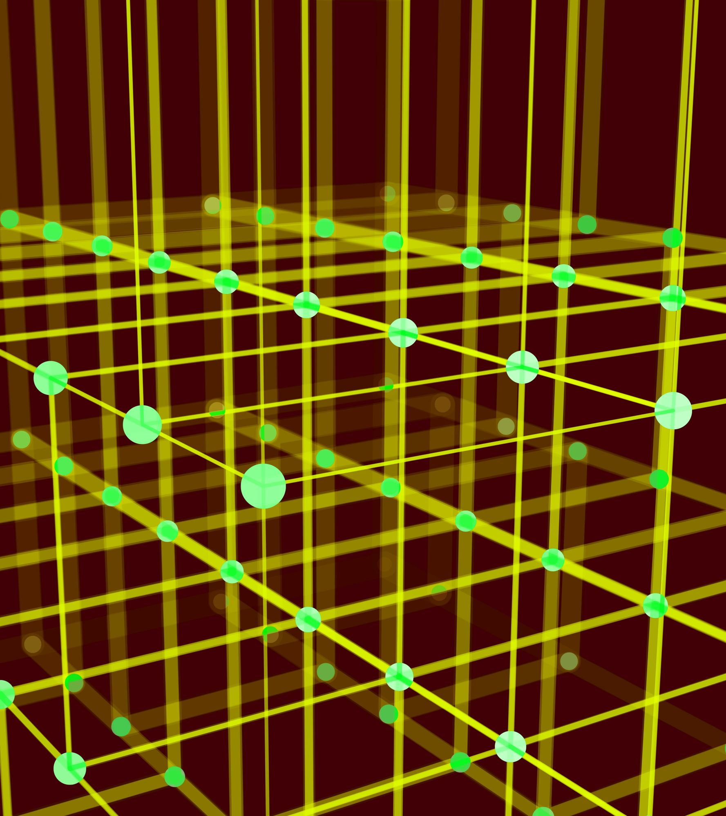
Three tenets of justice:
Distributional justice
Procedural justice
Recognition justice

Slide 12
Anthropocentric versus eco-centric justice

Slide 13
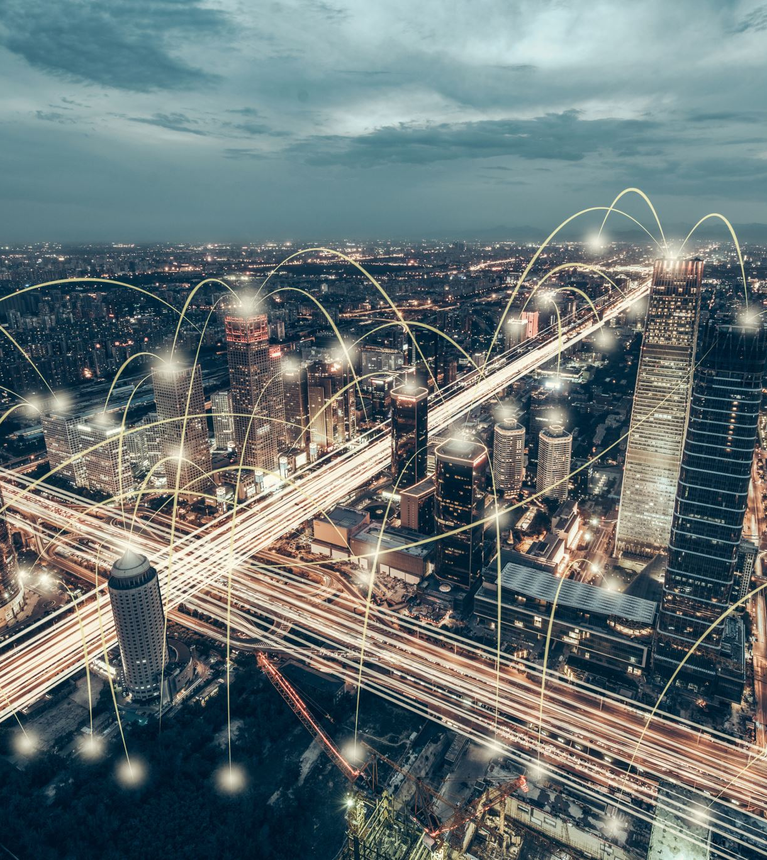
New energy policies and energy technologies for urban infrastructures can be tested by using these frameworks
What are their impacts on people living in the future?
What are their impacts on people living far away?

Slide 14
How does the distribution of goods change
What has been the opportunity for people to partake in decision-making
Has such participation been based on the recognition of individuals and groups as equals (knowledge, status, responsibilities)

Slide 15
What are the impacts on ecosystems, animals and plants?
Have these living beings been accounted for in decision-making arrangements?

Slide 16
The energy transition will hurt somewhere
It will not be considered just for everyone
We have to do our best to map out the possible impacts to really know what we are talking about

