Slide 1
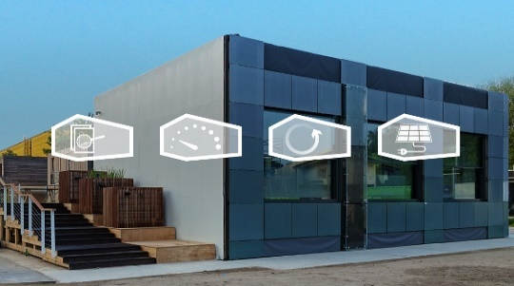
TU Delft Online Courses on Urban Decarbonisation and Energy Design for Buildings
Advanced Zero-Energy Design: Validate Your Building’s Energy Performance
How can buildings be made net zero energy, in different climates? Take this hands-on, interactive course to find out.
Learn to develop zero-energy designs and how to validate your design with energy performance calculations.
https://online-learning.tudelft.nl/courses/advanced-zero-energy-design/
Spatial Circularity Strategies for Sustainable Regional Development
Gain insights and learn to use appropriate tools to develop spatial strategies, plans and actions to support the transition towards circularity in your city or region.
https://online-learning.tudelft.nl/courses/spatial-circularity-strategies-for-sustainable-regional-development/
Buildings as Sustainable Energy Systems
How to realize energy-efficient and comfortable buildings? Find out with our online 4 step program. Learn all you need to design more sustainable buildings, whilst improving the thermal quality and comfort of their indoor environment.
https://online-learning.tudelft.nl/programs/buildings-as-sustainable-energy-systems/

