Slide 1
Safety @ P&E
May 2019

Slide 2
Why do we care about safety ?
We have ~ 40 experimental setups where:
We use gasses (flammable, toxic)
We use chemicals
Setups produce smoke (ventilation)
Liquids (water spill)
Electricity (high power)
(High) temperature/pressure
Steam
Lasers (in labs with interlock)
Construction work with crane/forklift

Slide 3
Incidents @ P&E:
Isopropanol in the eye
Cleaning lady injured on needle in trash can
Deep cut in finger from glass in the sink
Near fall from height because a chair was used as a raised working platform
Leaking exhaust in the frame
Smoke in lab due to ventilation failure
Loose connection of cooling water in chemistry lab
Starting fire in plastic tube connected to fuel cell
Remember:
At different places we have First
Aid people who can help you

Slide 4
How to protect ourselves?
Personal Protective Equipment
Alarms and evacuation
General safety measures for chemical lab and frame
Safe behaviours and Housekeeping

Slide 5
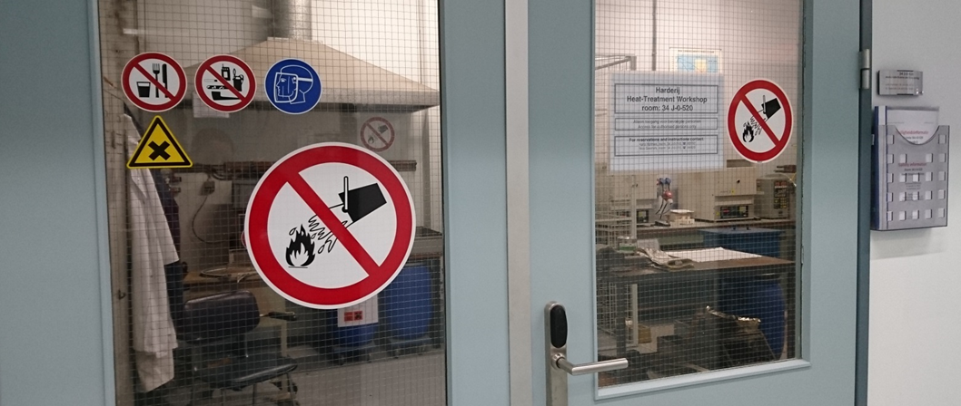
Personal Protective Equipment (PPE)

Slide 6
Personal Protective Equipment

Slide 7
Personal Protective Equipment

